Slide 1
Student name School Name Date
Cardiovascular Disease

Slide 2
Cardiovascular Disease
Introduction
Symptoms of Disease
Along with other diseases like cancer, cardiovascular disease or that which affects the human heart is one of the leading causes of premature death in the United States.
Although there are various medical conditions that cause cardiovascular disease, being a disease of the heart and the circulatory system in the human body, the most common symptoms include:
1. Chest pain in the area of the sternum and in the arms and neck;
2.Shortness of breath;
3.Pain and numbness in the legs and arms;
4.Feeling of fluttering in the area of the sternum;
5.Racing or slow heartbeat or pulse;
6. Lightheadedness; and
7.Dizziness.

Slide 3
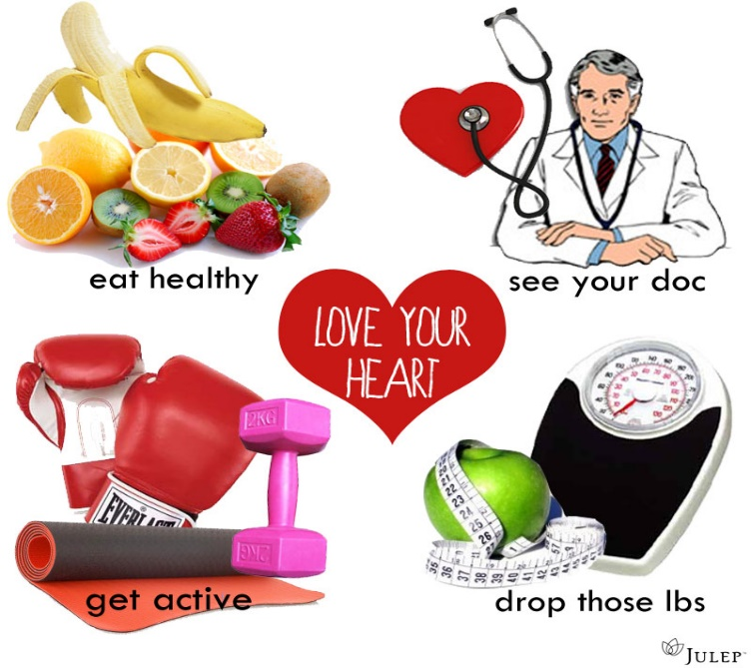
Causes & Prevention of Cardiovascular Disease
CAUSES OF CARDIOVASCULAR DISEASE
PREVENTING CARDIOVASCULAR DISEASE
Generally, cardiovascular disease is cause by a number of factors, such as a poor diet, a lack of exercise, smoking, etc.
Through a process known as atherosclerosis, cardiovascular disease develops "when a substance called plaque builds up in the walls of the arteries" which leads to a narrowing of the arteries, thus preventing blood from flowing properly
Cardiovascular disease can be avoided by following some very basic common sense advice.
Diet
Maintaining Healthy Weight
Exercise
Cessation of Smoking
Limiting Alcohol Intake

Slide 4
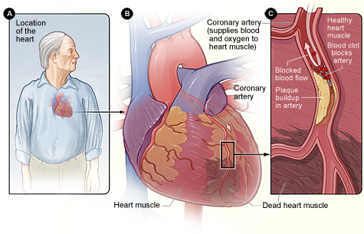
CARDIOVASCULAR DISEASE AND OTHER BODY ORGANS
The organ system that is most affected by cardiovascular disease is the circulatory system, composed of the heart, aorta, arteries, veins, and capillaries.
These parts of the circulatory system can be found in all areas of the human body, such as the head, arms, legs, torso, and feet.
Thus, when the heart is affected by a cardiovascular disorder, the rest of the circulatory system is adversely affected which can lead to other complications like stroke, blood clots, and varicose veins

Slide 5
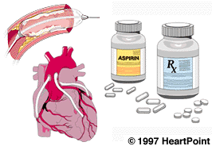
TREATMENT OPTIONS
Treatment is somewhat limited except in extreme cases where open-heart surgery is required in order to repair damaged heart valves and arteries in the heart.
But most of the time, one can take medications that help lower blood cholesterol levels and reduce the buildup of plaque in the arteries and veins.
The most common option for most people is called coronary angioplasty, a type of surgery in which a balloon is inserted into a blocked artery or vessel and then inflated which helps to remove the buildup of plaque.

Slide 6
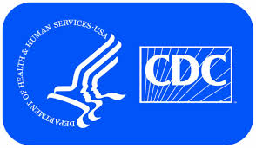
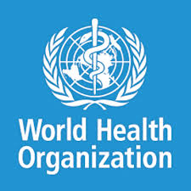
EDUCATION ON CARDIOVASCULAR DISEASE
The best way to help keep people informed and knowledgeable on cardiovascular disease is to create some type of national educational program through the U.S. federal government and state-based governments
American Heart Association, the Centers for Disease Control and Prevention, and the World Health Organization (WHO)
Therefore, the best way to educate people and the general public (especially older people and smokers) is to spread the information on heart disease so that they can live better and healthier lives and of course live longer.

Slide 7
Works Cited
Braunwald, Eugene. Essential Atlas of Heart Disease. New York: McGraw-Hill Education, Print 2001.
Disease and Condition: Heart Disease. 2014. Web. August 24, 2014.
Glanze, Walter D., Ed. Mosby's Medical, Nursing, and Allied Health Dictionary. St. Louis, MO: C.V. Mosby Company, Print, 1990.
Heart Disease. 2014. Web. August 24, 2014.
What Is Cardiovascular Disease? 2014. Web. August 24, 2014.
Pictures Provided By
American Heart Association. Retrieved from http://www.heart.org/HEARTORG/GettingHealthy/GettingHealthy_UCM_001078_SubHomePage.jsp
A Picture Guide To Coronary Artery Disease. (2014). Medicine Net. Retrieved from http://www.medicinenet.com/heart_disease_pictures_slideshow/article.htm
CDC. Retrieved from http://www.cdc.gov/
Causes of Heart Disease. (2013). Heart Symptoms. Retrieved from http://heart-symptoms.blogspot.com/2013/04/causes-of-heart-disease.html
Heart Disease. (2014). National Heart, Lung and Blood Institute. Retrieved from http://www.nhlbi.nih.gov/health/health-topics/topics/hdw/signs.html
NIH Medline Plus. Retrieved from http://www.nlm.nih.gov/medlineplus/magazine/issues/winter09/articles/winter09pg25-27.htm
l
Stoleman, Erica. (2012). Love Yourself: Love Your Heart. Julep. Retrieved from http://www.julep.com/blog/love-yourself-love-your-heart/
Therapeutic Angiogenesis. (1999). Brown University. Retrieved from
http://biomed.brown.edu/Courses/BI108/BI108_1999_Groups/Angiogenesis_Team/MainPage.html
World Health Organization. Retrieved from http://www.who.int/healthpromotion/conferences/7gchp/download/en/

