Slide 1
Cognitive dissonance
Name
Class
Professor
September 2014

Slide 2
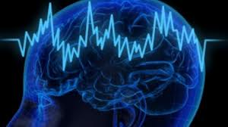
Meaning of cognitive dissonance
Cognitive dissonance refers to the experience that an individual faces when he or she is posed with a new idea that is in confliction with his or her own
This is applicable in education because many students struggle with new concepts because of pre-existing “knowledge”
It is important for teachers to address this dissonance to make it easier for students to learn

Slide 3
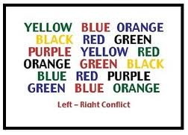
Examples from an educational context
Students get confused when they are told information that contradicts what they already believe
The aim of education should be to ensure that students are psychologically comfortable
It is acceptable to allow students to struggle while facing their incorrect knowledge provided that reinforcement is used to ensure they are able to cope with the new knowledge and practice it

Slide 4
Examples from an educational context part 2
The cognitive dissonance theory can be applied to motivation in learning
Technology and instructional software can be used to bridge the gap between dissonance and understanding or mastery of the topic
As neuroscience research continues to advance, we will be able to gain a greater understanding of cognitive dissonance

Slide 5
Application in the classroom
The degree to which cognitive dissonance is resolved depends upon how the class is taught. Useful methods to alleviate cognitive dissonance include:
Having discussions to determine prior beliefs before presenting the material
Repeatedly addressing the dissonance throughout the lesson
Using methods to reinforce the knowledge

Slide 6
references
Egan, L.C., Santos, L.R., & Bloom, P. (2007). The origins of cognitive dissonance: Evidence from children and monkeys. Psychological Science, 18(11): 978-983.
Festinger, L. (1962). Cognitive dissonance. Scientific American, 207(4): 93–107.
Harmon-Jones, E. (2002). A Cognitive Dissonance Theory Perspective on Persuasion, in The Persuasion Handbook: Developments in Theory and Practice, James Price Dillard, Michael Pfau, eds. Thousand Oaks, CA: Sage Publications.
Van Veen, V., Krug, M.K., Schooler, J.W., & Carter, C.S. (2009). Neural activity predicts attitude change in cognitive dissonance. Nature Neuroscience, 12(11): 1469–1474.

