Slide 1
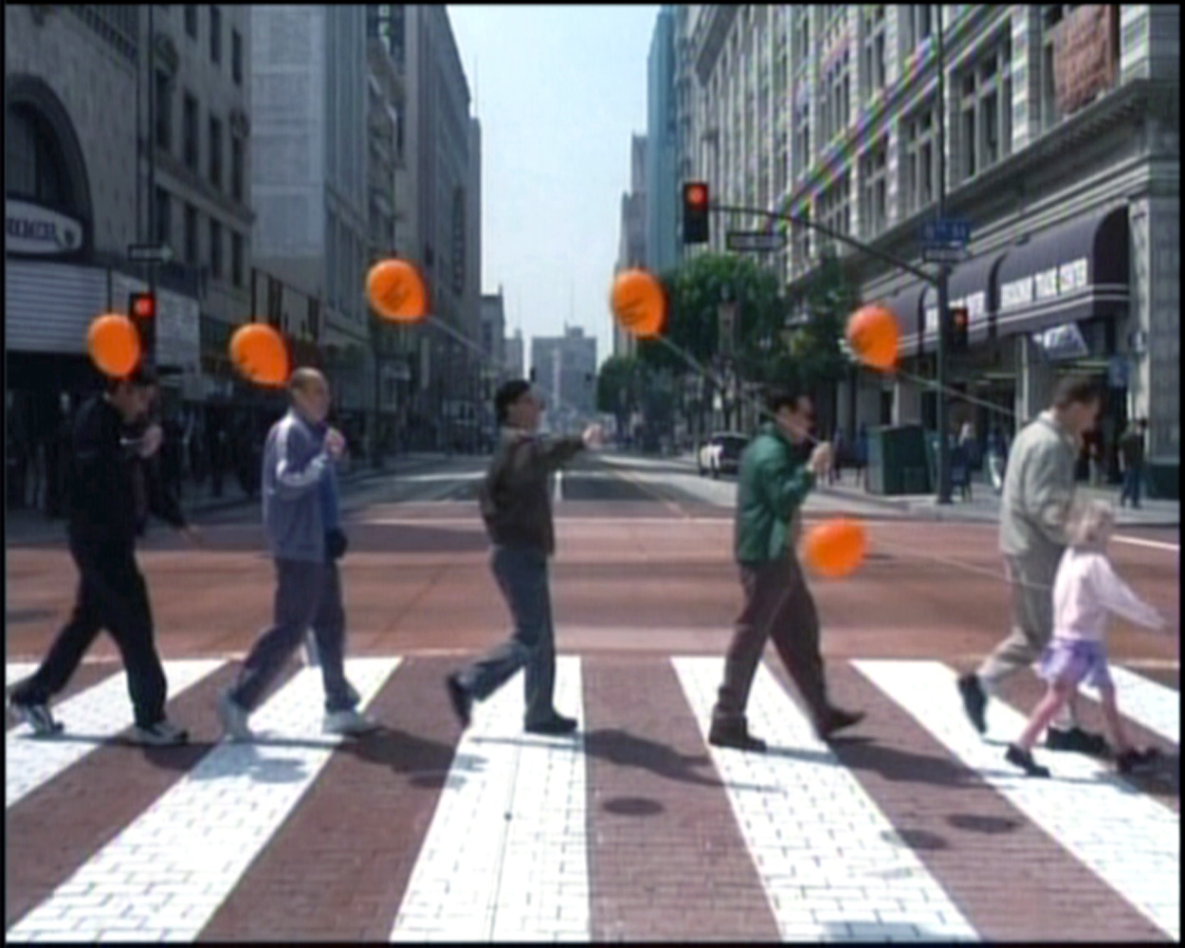
Ecogram: I Am Sam
Student Name
School Name
Date

Slide 2
My Ecogram
Character: Sam Dawson
Book, Movie, TV Show: I Am Sam
Positive
Tenuous
Background
Single parent due to Lucy’s mom being a homeless woman “who needed a room”
Stressful
Arrows = energy flow
Work
Minimal Wage on a Janitor’s salary
Line thickness = intensity
Personal Life
Stressful, with an estranged son; unfaithful husband and fast paced schedule
Psychological
Mentally Handicap with the mental capacity of 6-year old
Friends
Group of developmental disabled supportive group, and agoraphobic neighbor
Sam
Rita
Work
Lawyer
Takes the case pro-bono
Lucy
Randy
Family
Mentally surpassed her father, teased at school, loves her father but he can be a burden
Extended Family
Foster Parent to Lucy, who helps Sam co-parent
Support
Realizes that Sam loves Lucy, but needs help

Slide 3
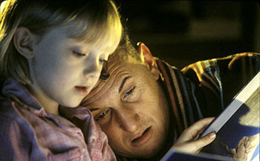
Ecogram: I Am Sam
Based on the main character: Sam Dawson
Mental Capacity of a seven year old and works as a janitor (Background; Work)
Has a support group of friends that are also mentally disabled (Friends)
Has a seven year old daughter that was abandoned by her homeless mother (Family)
Lucy is teased because of her daughter, and taken away by a social worker at her birthday
Sam goes to a high powered lawyer, Rita, who has a stressful personal life; unfaithful husband; difficult relationship with her son
Lucy is sent to Randy her foster parent, but runs away to Sam’s, who takes her back
Through the help of Rita and Randy, Sam is able to raise Lucy. (Extended Family)

