Slide 1
Legal Environment , Intellectual Property, and Ethics in Ecuador
Student Name
School Name
Date

Slide 2
Doing Business in Ecuador- Executive Summary
Since the widespread of globalization, Ecuador has provided a great place for business and outside financial specialists.
The real organizations to be considered are information transfers, mining, vitality programs, interstates, oil, angling, tourism and in addition eco/ethnic tourism, pharmaceuticals and budgetary administrations.
Ecuador is a decent nation to do business in light of the fact that it additionally has a Democratic Government and four real attributes of the focal point for worldwide business in Ecuador:
International Free/Trade Zone
Trading with Andean Neighbors
Financial Benefits
Labor Benefits
Notes:
The way of universal business today requests organizations send workers over the world for gatherings, presentations and arrangements. Accomplishment on the global stage obliges various qualities, one of them being diverse relational abilities. Understanding and acknowledging how to work together in a remote nation helps one make a decent impression, manufacture stronger connections and eventually get to be more successful. The positive aspects of doing business in Ecuador include improving the quality of life, education and medicine discoveries, European interest, and world trade. An a opportunity to import and export goods in the global market, it promotes free competition and competitive markets, which makes it attractive for foreign investment. The country of Ecuador is steadily improving the way in which it handles foreign business. However it is coupled with a complicated legal environment, as well as ethical issues with their oil industry, and a lack of corporate responsibility that impacts the surrounding communities. In comparing their country to the United States, while they share similar approaches to government and rights, there is still much to be improved to create an efficient business environment.

Slide 3
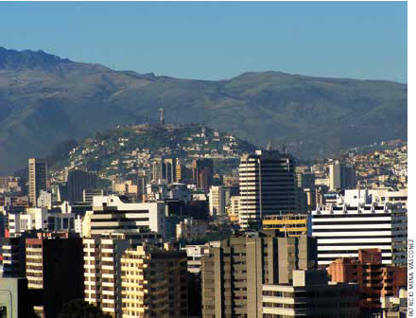
Doing Business in Ecuador
Language:
In order to do business in Ecuador you must learn Spanish, or invest in translation services.
Meeting & Greeting:
Handshakes are customary when meeting and departing.
Body Language:
There is no such thing as “personal space” People work/converse closely with each other.
Business Meetings:
Expect foreigners to be on time
Always be professional
Establish mutual respect and trust
(Kwintessential, 2014), (Doing Business, 2014)
Notes:
The country of Ecuador provides a medium-sized market that has great potential for the US economy. This includes the high export of oil prices, and other benefits that make the market attractive to foreign investments. In order to do business in Ecuador, there are few pointers that should be taken into consideration. Although the American customs are widespread to countries that have been evolved due to globalization, each country has their own set of customs that should be respected. This includes the way in which you communicate, the way in which you greet other business people, your body language, and the way you conduct yourself in meetings. (Kwintessential, 2014) What is really important is when conducting in business relationships, the legal aspects to remember.

Slide 4
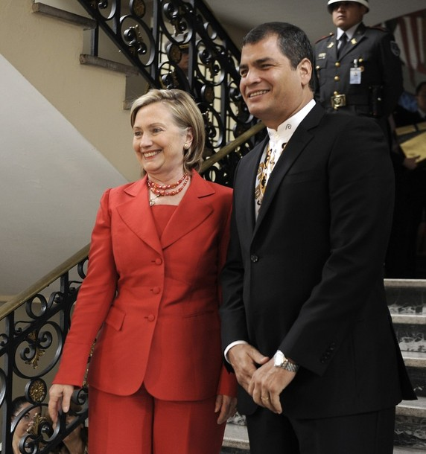
Legal Environment of Ecuador
The country has recently implemented a new legal framework for international and national firms:
Code of Production:
Investment contracts with stabilized incentives and deduction on income tax for 15 years.
Legal security of international companies.
Income tax exemption and advanced payments of taxes.
Freedom to invest without limits.
High level of protection, non-arbitrary or discrimination treatment, and fair and equitable treatment.
However, there are no clear law in place for governing over certain business aspects including franchises and license agreements.
(Embassy of the United States, n.d); (Doing Business, 2014)
Notes:
Ecuador has an active Democratic Government Body in which is ruled by the presidency and three governmental powers like the US. They have a legal system based on their Constitution, international agreements regulations, resolution, laws, and agreements. Ecuador provides great governmental benefits to foreign companies which includes incentives for investments, legal protection, and clear incentives and rules for international and national companies. The legality for foreign business companies are that the they are free to convert their foreign currency for their net returns with no limits, liens, or taxes. They have free access to stock market and national finance systems to obtain credit. More importantly are able to set prices in the market with little to no government intervention. While Ecuador provides a lax legal framework for foreign companies, according to the US government, the complexity of political constitution which promotes private investment, and liberties to companies that promote free competition and competitive markets. (Embassy of the United States, n.d)

Slide 5
Intellectual Property in Ecuador
Ecuadorian Institute of Intellectual Property, the only public agency of Ecuador to oversee the intellectual property rights of organizations and individuals.
Established primarily from law and treaties with the Universal Declaration of Human Rights adopted by the UN.
It protects all property rights of individuals based on the Copyright Act.
Industrial property:
Inventions
Patents
Trademarks
Industrial designs
Geographical Indications (literary and artistic creations)
(Wipo, n.d),
(Bureau of Economic Affairs, nd
Notes:
Ecuadorian Institute of Intellectual Property, the only public agency of Ecuador to oversee the intellectual property rights of organizations and individuals. The constitution of Ecuador mandates that all franchise and license agreements must be registered with the Ecuadorian Intellectual Property Institute . Much like the Copyright Act established in the United States, the intellectual property rights frameworks in Ecuador, follows the same guidelines. The agency that is run through governmental powers, sees to protect all industrial property including, inventions, patents, trademarks, industrial designs, and geographical indications from businesses and individuals. Ecuador seeks to protect the rights and creations of organizations , through education, and enforcements of the legal rules. (Wipo, n.d)

Slide 6
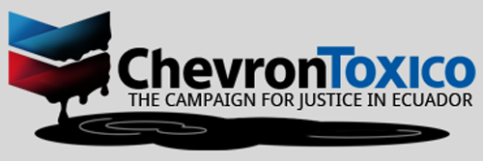
Ethics of Doing Business in Ecuador
Government officials and private Ecuadorian businesses have used regulatory schemes and questionable legal maneuvers to affect foreign company operations in the country.
According to the US report, there has been an increased in Corporate Social Responsibility among organizations navigating in the Ecuador market. They have took the initiative in promoting:
CSR principles
Sustainability
Clean environmental practices
Promoting education.
(
Ecuador - U.S. Department of State.,n.d.)
Notes:
“Government officials and private Ecuadorian businesses have used regulatory schemes and questionable legal maneuvers to affect foreign company operations in the country. One of the largest sectors in which plays into lack of ethics in business relations is the oil industry.” (Bureau of Economic and Business Affairs, 2013) In which has resulted in several businesses and ethical cases against the country and businesses such as Chevron. Much has been reported on the lack of ethical commitment from the government involving the oil industry in which the government, has failed to do its part to improve the infrastructure. The ethics of doing business in Ecuador involve the responsibility of environmental safety, as well as the impact on the surrounding communities which are dependent on jobs and labor, and other social challenges. There is much more to be done by the Ecuadorian government, but for international organizations in conducting business they must commit to the corporate responsibility principles in promoting an ethical business relationship.

Slide 7
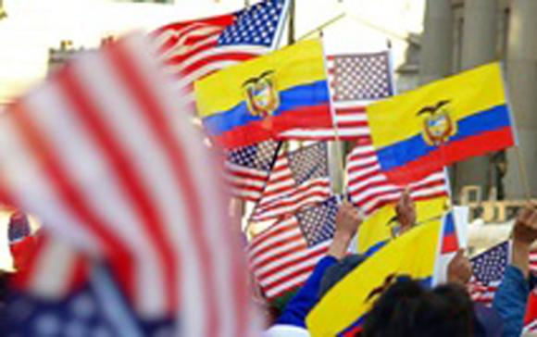
Ecuador Versus The US
Ecuador
United States
Political Instability
Lax Business Laws and Regulations
Anti-Monopoly Laws
Modernize Economy
Increased freedom for State-Owned Enterprises
Insufficient business ethics
Financial Benefits for Foreign Businesses
Political Frustration
Lax Business Laws (Big Businesses)
Laws in place to protect consumers
Economy that is improving due to imports and exports
Emphasis placed on Business Ethics and Corporate Social Responsibility
Financial and Industry Benefits
(Ecuador - U.S. Department of State, n.d.).
(Embassy of the United States, nd.)
Notes:
Ecuador takes a similar approach to business elements, as does the United States. Their legal system works similar to the United States in being a democratic system in which is governed by three legislative bodies. It also promotes free trade and provides lax tax incentives to big businesses. Unlike the United States, it does not have a clear cut policy on business regulations to control their franchise and license agreements. As well as a stable political environment, unlike Ecuador that has seen an increase in political instability with coups, and violent protects against the government. However, they are trying to improve their regulatory system against businesses that try to form monopolies, as well as trying to improve their complicated business regulations and tax laws. The United States also promote free enterprise and trade, and has placed a greater emphasis on business ethics and corporate responsibility. Ecuador is going in the right steps to improve corporate responsibility and business ethics in international and national organizations. Ecuador is continually moving up in the international market for foreign investments, and is trying more ways to attract international business with their lax tax benefits, and attractive industries.

Slide 8
Things To Consider about Business In Ecuador
Improving economy through attracting international business
Consider the legal environment, as well as the commitment to good business ethics
Good protection for intellectual property, and financial incentives for international businesses.
Keep in mind the country’s customs and laws.
Remains an attractive market for international investment
Production Code that includes a variety of measures such as import substitution, enforcement of standards and sanitary and phytosanitary requirements, and investment incentives.
Notes:
For conducting business in Ecuador, an organization or individual must consider the legal, ethical, and intellectual property rights of the country. Ecuador is moderately open to international business n many parts, including general assembling, retail and other service sectors. Notwithstanding, its general investment environment stays indeterminate as its financial, business and speculation strategies keep on evolving. While a few laws and regulations have been sanctioned to encourage expanded national and international private speculation. Other lawful changes have diminished private area support in "supposed" key areas, most quite extractive businesses, and contrarily influenced media and banking sectors. However it does implement and enforce the Production code meant to provide protection and regulation for international business, and improving their economy.

Slide 9
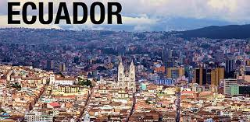
References
2013 Investment Climate Statement – Ecuador. (2013). Bureau of Economic and Business Affairs. Retrieved from http://www.state.gov/e/eb/rls/othr/ics/2013/204634.htm
Doing Business-Ecuador. (2014). Doing Business. Retrieved from http://www.doingbusiness.org/~/media/giawb/doing%20business/documents/profiles/country/ECU.pdf
Doing Business in Ecuador. (n.d). Embassy of The United States. Retrieved from http://ecuador.usembassy.gov/doing-business-local.html
Doing Business in Ecuador. (n.d). Kwinessential. Retrieved from http://www.kwintessential.co.uk/etiquette/doing-business-ecuador.html
Intellectual Property Law. (n.d). World Intellectual Property Organization. Retrieved from http://www.wipo.int/wipolex/en/details.jsp?id=5512

