Slide 1
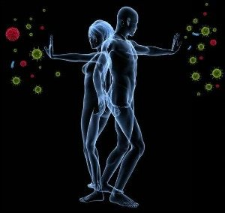
Antibodies and the Immune System

Slide 2
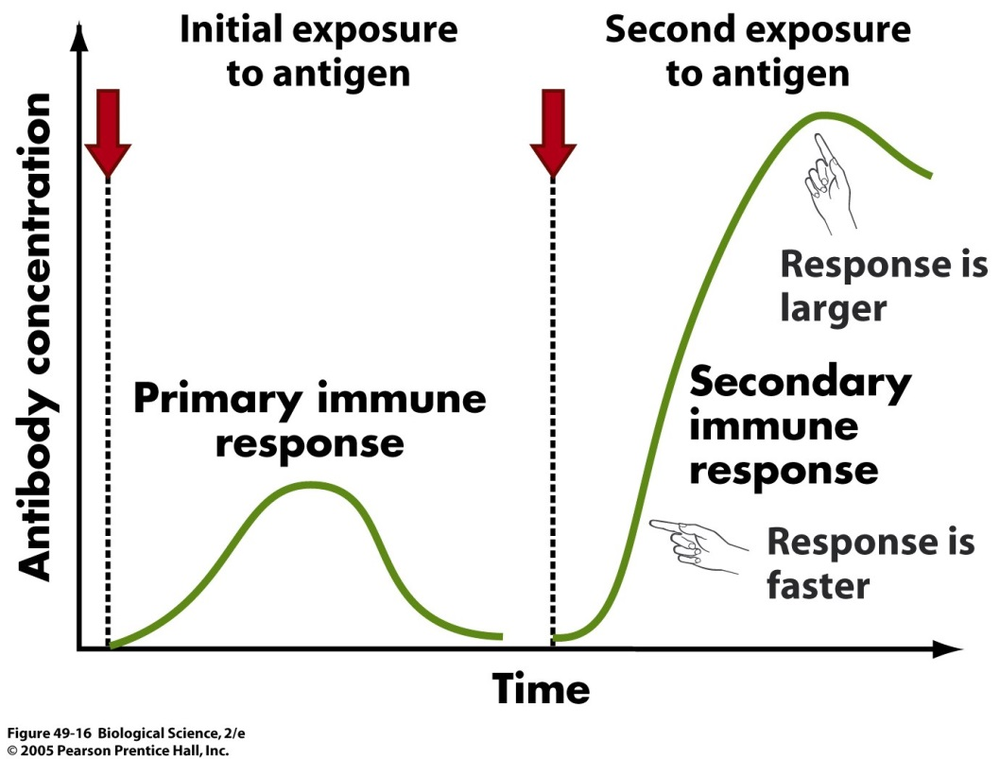
Immune System
Protects your body from microorganisms.
Illicits a response when pathogen enters body to fight infection.
Memory cells: allows a faster immune response during second exposure to same pathogen or antigen.
https://www.google.com/search?q=memory+response+immune+system&espv=2&biw=1366&bih=667&source=lnms&tbm=isch&sa=X&ei=K1FtVJe5HMqwogTUj4GQDA&ved=0CAYQ_AUoAQ#facrc=_&imgdii=_&imgrc=6a16ZCWPCh29WM%253A%3BStSr3PpKuiigaM%3Bhttp%253A%252F%252Fwww.uic.edu%252Fclasses%252Fbios%252Fbios100%252Flectures%252Fmemory.jpg%3Bhttp%253A%252F%252Fwww.uic.edu%252Fclasses%252Fbios%252Fbios100%252Flectures%252Fimmune.htm%3B1380%3B1048
Notes:
The immune system protects your body from microorganisms. Every time you are exposed to or infected by a pathogen, the immune system’s antibodies come to the rescue. And if a pathogen infects you again, the response will be even faster due to the presence of memory cells.

Slide 3
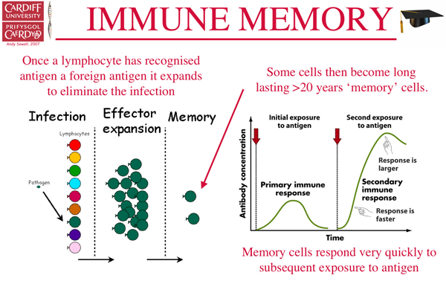
Memory Cells
Recognize a previously-encountered pathogen and neutralize it.
Reduce the need to re-learn the pathogen.
Reduce the development of autoimmune disease (attack of own cells).
http://www.tcells.org/scientific/memory/

Slide 4
Hypothesis
How does the immune system defend the body from a pathogen and how do memory cell’s take part?
The more times of exposure to a pathogen, the greater the number of antibodies present in the human body, resulting in a better immune response.

Slide 5
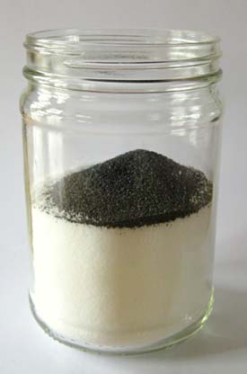
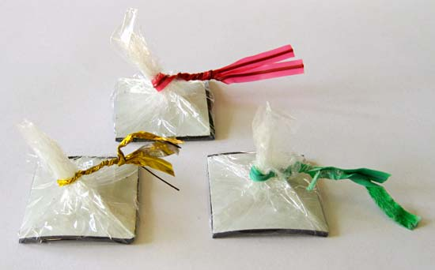
Material and Methods
To illicit an immune system response, an immune system was created:
Materials:
-Glass Jar (body) filled with Salt (human cells)
-Metal Shavings (pathogens)
-Magnetic Tape (antibodies)
- Plastic wrap (1 sq. in.

Slide 6
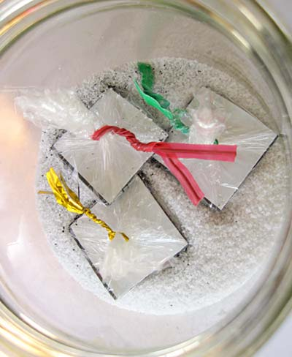
Procedure
Jar was inverted 10 times to mix cells and pathogens
One magnet added, lid closed and inverted jar 10 times
Antibodies removed and placed on a piece of paper folded into ¼ths
Observed results of material on paper
Repeated, added two, then three antibodies
Observed changes and recorded results.

Slide 7
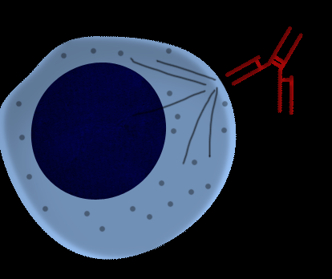
Results
Greater # of metal shavings (pathogen) attached to the antibodies (magnet) after each exposure (addition of another magnet).
Small amount of on magnet.
Antigen
Antibody
http://www.intechopen.com/books/current-concepts-in-kidney-transplantation/modern-immunosuppression-regimens-in-kidney-transplantation

Slide 8
Conclusion
Additional exposures of the same pathogen decreases the response time of the immune system.
Memory Cells very important in immunity of the human body.
Some antibodies attack the body cell in an autoimmune response (as seen in small amount of salt on magnet)
Memory Cells important for reduction of autoimmune response

