Slide 1
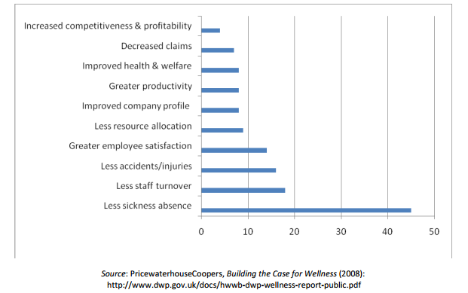
Implications of Lifestyle Interventions in the Workplace of Governmental Employees
Your Name, BS?¹; Your Mentor (if any), Degree¹
¹West Virginia Wesleyan College
ABSTRACT
INTRODUCTION
RESULTS
DISCUSSION
Obesity and other chronic diseases prevalent in the country today are marked as avoidable health concerns that are caused by poor diet choices and sedentary lifestyles. These illnesses contribute to a higher mortality rate of the overall population and increase the incidence of obesity related illnesses such as diabetes and coronary heart disease. Many health initiatives have been put in place to reduce the impact of the obesity epidemic, focusing on health behavior change through the implementation of educational programs. Active duty members within military treatment facilities are commonly overlooked, as they are government employees who do not receive the same level of medical care as their fellow government workers. This project is related to epidemiological health because it helps researchers gain a greater understanding of the distribution of health problems among active duty members. In addition, an improvement in lifestyle choices is an environmental concern because individuals are currently not living in a manner for which their bodies were evolutionarily adapted. This study allows for the implementation of employment-based health promotion and prevention policies. To determine how the health of the target population can be improved, a BlueH Questionnaire was administered. The cost of obesity was calculated to demonstrate the need to improve health status. The OPTAR system will be utilized to calculate military expenses and determine how healthcare can be budgeted. A score of 80% on all sections of the BlueH questionnaire indicated that healthy lifestyles are being promoted. It was found that military personnel are receptive to an implementation of lifestyle changes to reduce the risk of obesity and obesity related disease. In the future, a similar education plan will be implemented to target the removal of tobacco in the compound. This research demonstrates that education provides people with the resources they need to achieve their health goals.
Obesity and unhealthy lifestyle are the major issues in the United States. Recent studies have shown that the percentage of men and women over 20 years of age in the United State has been rising since 1998. Of particular concern, individuals with grade 2 or higher obesity experience a great risk for experiencing mortality. In addition to this health concern, obesity is expensive. The CDC Lean report indicated that the treatment of diet-associated heart conditions cost a total of $70.9 billion in 1995.
This study aimed to determine whether individual choices in addition to the community environment could influence lifestyle-related diseases. While unhealthy lifestyle and diet are the main causes of obesity epidemics, it is also stated that prevention and control of these illnesses requires a systematic, long-term approach. It is therefore reasonable to predict that implementation of a lifestyle intervention at the Naval Medical Center in Portsmouth would be successful.
Epidemiological Issues
The main causes of chronic diseases in the United States are inadequate screening, lack of health literacy, and unhealthy lifestyle
Chronic disease epidemics have a long duration, and take decades to become fully developed
Environmental Health Issues
Environmental interventions that have been found to be effective for the workplace include fitness and gym membership discounts, executive screening, developing a health website, and on-site classes on health
The Naval Medical Center in Portsmouth is working towards many of these goals
Health Policy Implications
Executive Order 13058 provides federal employees with protection from tobacco smoke in federal workspace
The Naval Medical Center in Portsmouth implemented a tobacco-free policy, and created health education programs that are related to smoking cessation and support
Naval Medical Center Policy of the Surgeon General of the Navy is developing guidelines for creating workplace policies that will eliminate the use of tobacco products on site
Socio-Behavioral Perspectives
In order to change health-related attitudes and behaviors, Naval Medical Portsmouth should develop a program that helps workers:
a. Increase physical activity
b. Reduce obesity
c. Help employees with smoking cessation
This would benefit employers by reducing the incidence of sick leave, payments related to disability management, and health care expenses
This research demonstrates that it is important for employers to implement health initiatives for their workers. Since employees spend a majority of their day at their place of work, many lifestyle choices made during this period of time could be positively influenced if these health initiatives are put in place. Ultimately, it is important for employers to understand the benefits that these programs can bring to both the organization and their workers. If these interventions are implemented on a broad scale, it is likely that the obesity epidemic will begin to decline.
CONCLUSIONS
This research has revealed that community-based and work-based health promotion programs can have a positive economic and health outcome on large populations. The analysis of the Naval Medical Portsmouth intervention project has found that government agencies and organizations implementing health promotion, screening, and education programs can reduce absence rates, sick leave payments, and increase the organization's compliance with current workplace regulations. Future funding to support the growth of the services provided at the hospital to the government worker should focus on programs geared toward weight management and tobacco cessation. For this to be successful, additional funding and personnel change will be necessary.
REFERENCES
1) Archer, W.R., Batan, M.C., Buchanan, L.R., Soler, R. E., Ramsey, D.C., Kirchhofer, A., & Reyes, M. (2011). Promising practices for the prevention and control of obesity in the worksite. American Journal of Health Promotion, 25 (3), e12-e26.
2) Bronnum, A. (2013) Public health financing & governance. Retrieved from http://www.mphpublichealthpractice.uw.edu/pdfs/bronnum.pdf
3) Centers for Disease Control and Prevention. (2010). CDC LEAN works! A Workplace Obesity Prevention Program. Retrieved October 31, 2014, from http://www.cdc.gov/leanworks/costcalculator/index.html
4) CDC (U.S. Department of Health and Human Services Centers for Disease Control and Prevention) (2013) Health, United States, 2013. Retrieved from http://www.cdc.gov/nchs/data/hus/hus13.pdf
5) CDC (U.S. Department of Health and Human Services Centers for Disease Control and Prevention) (n.d.) Workplace Health Model. Retrieved from http://www.cdc.gov/workplacehealthpromotion/model/
6) C3 Collaborating for Health. (2011) Workplace health initiatives: evidence of effectiveness. Retrieved from http://www.c3health.org/wp-content/uploads/2009/09/Workplace-health-initiatives-review-of-the-evidence-v-1-20111205.pdf
ACKNOWLEDGEMENTS
Misty Scheel
Dr. Brian Martin
Figure 1. Naval Medical Center in Portsmouth
METHODS AND MATERIALS
Naval Medical Center patients were recruited for study
A BlueH Questionnaire was administered to determine the health of the target population
The cost of obesity was calculated to demonstrate the need to improve health status.
The OPTAR system was utilized to calculate military expenses and determine how healthcare can be budgeted
Data was used to determine how lifestyle changes could be implemented in this patient population in order to decrease the risk of obesity related disease
CONTACT
Figure 2. A summary of benefits related to workplace health initiatives

