Slide 1
Engineering Economics and Effective Decision Making
Engineering Economics Tools

Slide 2
Engineering Economics Tools
Engineering economics tools are essential in ensuring efficient decision making guaranteeing maximum profits possible and mitigating costs to the least possible. There are a number of economics engineering tools that can be applied to realize desired financial goals and objectives. Two of the most commonly used tools are the cash flows and the NPV.
Capital budgeting commonly employs Discounted Cash Flows to obtain and ascertain the potential or actual value of any given investment.
This is achieved through the use of the present value in the form of NPV. The discounted cash flows uses the expected cash inflows and outflows to ascertain the investment option that generates the least cost.
A salient example would be the option to either buy or rent a villa. An investor may be faced with these two options, each with its own merits and demerits.
As such, it is important to consider the cash flows that would be realized by each option, and as a result generate the Net Present Value (NPV) of both alternatives.

Slide 3
Example
If the individual would have to incur an annual cost of 250,000 Dhs to rent it out or purchase it with the help of ADIB at 3.39% bank profit with 60% financing for a duration of 10 years, they would employ the cash flows and the NPV to generate an optimal decision.
Given that the total value of the house is 4,200,000 Dhs, the individual would incur equal monthly instalments of 26,105. This would translate to yearly instalments of 313,260.
The net present value is crucial in helping determine the net worth of the project. This aids in determining the capital needs of each project. The internal rate of return is a measure of the rate at which a given project breaks even.

Slide 4
Cash Flows
Year | Cash flow |  | Principal
 | Bank Loan (60% financing) | Rent | Bank Loan (60% financing)
0 | 2,520,000 | 0 | 2,520,000
1 | -313,260 | -250,000 | 2,206,740
2 | -313,260 | -250,000 | 1,893,480
3 | -313,260 | -250,000 | 1,580,220
4 | -313,260 | -250,000 | 1,266,960
5 | -313,260 | -250,000 | 953,700
6 | -313,260 | -250,000 | 640,440
7 | -313,260 | -250,000 | 327,180
8 | -313,260 | -250,000 | 13,920
9 | -313,260 | -250,000 | -299,340
10 | -313,260 | -250,000 | -612,600

Slide 5
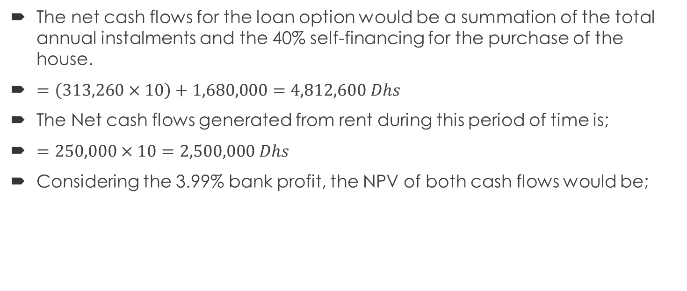
Cash Flows and NPV
The net cash flows for the loan option would be a summation of the total annual instalments and the 40% self-financing for the purchase of the house.
$=\left(313,260×10\right)+1,680,000=4,812,600 Dhs$
The Net cash flows generated from rent during this period of time is;
$=250,000×10=2,500,000 Dhs$
Considering the 3.99% bank profit, the NPV of both cash flows would be;

Slide 6
NPV
Year | Cash flow
 | Bank Loan (60% financing) | Factor | Present Value | Rent | Factor | Present Value
1 | 313,260 | (1+0.399) | 223,917.08 | 250,000 | (1+0.399) | 178,699.07
2 | 313,260 | (1+0.399)² | 160,055.10 | 250,000 | (1+0.399)² | 127,733.43
3 | 313,260 | (1+0.399) ³ | 114,406.79 | 250,000 | (1+0.399) ³ | 91,303.38
4 | 313,260 | (1+0.399) ⁴ | 81,777.55 | 250,000 | (1+0.399) ⁴ | 65,263.32
5 | 313,260 | (1+0.399) ⁵ | 58,454.29 | 250,000 | (1+0.399) ⁵ | 46,649.98
6 | 313,260 | (1+0.399) ⁶ | 41,782.91 | 250,000 | (1+0.399) ⁶ | 33,345.23
7 | 313,260 | (1+0.399) ⁷ | 29,866.27 | 250,000 | (1+0.399) ⁷ | 23,835.05
8 | 313,260 | (1+0.399) ⁸ | 21,348.30 | 250,000 | (1+0.399) ⁸ | 17,037.20
9 | 313,260 | (1+0.399) ⁹ | 15,259.68 | 250,000 | (1+0.399) ⁹ | 12,178.13
10 | 313,260 | (1+0.399) ¹⁰ | 10,907.56 | 250,000 | (1+0.399) ¹⁰ | 8,704.88
 |  | NPV | 757,775.53 |  | NPV | 604,749.67

Slide 7
Summary
Assuming the individual would like to stay in the house for the next 10 years only, the cheapest alternative would be renting the villa. However, it is important to consider that after the 10-year period, if one owns the property, they can sell it at a higher price and realize profits.
As depicted in the example, by applying a number of engineering economics tools, an individual can make a more informed decision on which alternative best suits his/her needs, relative to the amount of money they are willing to commit into the house.

Slide 8
References
Garrett, S. J., & McCutcheon, J. J. (2013). An introduction to the mathematics of finance : a deterministic approach. Kidlington: Butterworth.
Groppelli, A. A., & Nikbakht, E. (2012). Finance. Hauppauge: Barron's.
Jordan, B. D. (2011). Fundamentals of investments. [S.I.]: Mcgraw Hill Higher Educ.
Panneerselvam, R. (2013). Engineering Economics. Delhi: PHI Learning.
Whitman, D., & Terry, R. (2012). Fundamentals of Engineering Economics and Decision Analysis. New York: Morgan & Claypool.

