Slide 1
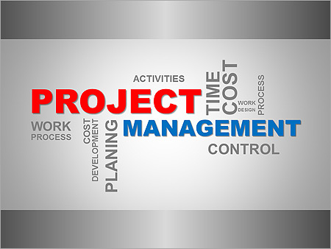
Market Entry Plan
Name Class Date

Slide 2
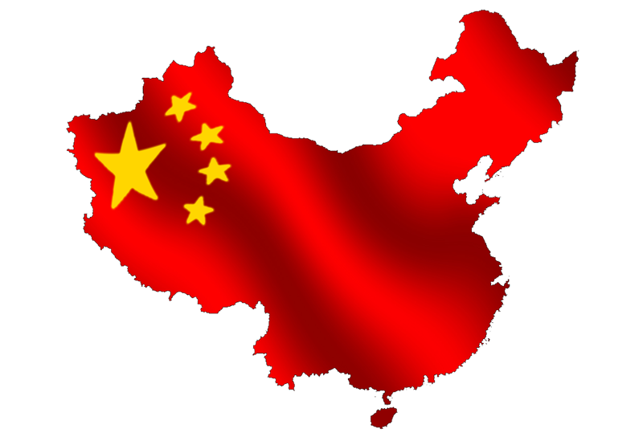
Project Overview
Purpose
Problem
Solution
Notes:
When managing a product through the product lifecycle there comes a time when certain decisions must be made as whether or not certain aspects of the plan will need to be completed or not. There are other times when a solution to the problems the product launch is facing does not exactly fit into what the expectations held by the key stakeholders. In these cases there must be an analysis completed to fully understand what trade-offs are worth compromising over and what other actions could be taken to mitigate the risks and still deliver the requirements to the end user. With any plan there comes a time to make revisions and continually improve the plan to remain agile in the implementation. Through the product launch of the products in China there were specific scenarios in which the initial plan had to be modified in order to fully realize the opportunities available to the organization. An important area of concern is the timing of the operations. The plan is to move at a relatively quick rate in which the organization establishes a hub of operations in China in the first period and then expand every third and fifth period. This timeline will ultimately vary depending on how fact the operations can be established in China.

Slide 3
Challenges in China
Main Challenges
Growing Globalized Market
Notes:
There are two main challenges entering the Chinese market. The first is the competition that is already established and the governmental implications for a foreign business to enter. The goal was to enter markets that did not have a high level of market ownership by other commodity providers. The problem with this is that there is already an established set of large organizations spanning the key geographical areas in which our organization is planning on launching. Larger countries such as China may be attractive due to its large population. Although on average, China is still relatively poor, there are still large pockets of affluent potential customers. The launch of the product will require specific competitive advantages to be created in order to be successful. Each area will need these key benefits to be communicated and exposed to the consumer so that the consumer will choose the product over the already established commodities. Each market entry will need to have an established plan specific to the entry and sustainment of the product within each country.
In the changing globalized environment, supply chain managers and logistics experts need to look ahead to spot challenges in time and prepare the organization for upcoming challenges. The recent government regulations worldwide to increase companies' sustainability and regulate the market, rewarding firms that are “greener” have already started. However, as companies are dealing with developing countries where regulations are just being formed, it is important to deal with the changes and be flexible as an organization. Developing supply chains that are easy to adapt to new requirements is essential to succeed in the competitive landscape of international logistics.

Slide 4
Regulatory Challenges
International Logistics
Supply Chain Leverage
Notes:
Hollweg & Wong (2009) categorized the regulatory challenges of the international logistics industry as: customs documentation (export-import regulations and fees), customs broker license regulations, and restrictions in the hours of operation, cargo-handling licenses, and the change in cargo reservation laws. Further, the authors also state that future government monopoly changes can affect the profitability of international shipment. Examining six ASEAN countries' regulations regarding shipment of goods, the study found that in every individual country, international cargo regulations were significantly higher than those that applied to domestic shipment. Many of the countries examined, such as China, Vietnam, and India are active international trading countries, therefore, their restrictiveness should be considered when planning logistics operation. As an example, the authors mention that “in China trucks are not allowed daytime access in almost all major Chinese cities” (Hollweg & Wong, 2009, p. 21). This could have an impact on supply chain management, logistics efficiency, and profitability.
Dey, LaGuardia & Srinivasan (2011) state “the increasing sustainability within supply chains is just as important as reducing the costs and improving the sales”. The authors conclude that “Unsustainable practices hidden in the supply chain has the potential to become public information extremely quickly, leaving a company’s brand value damaged and shareholders displeased” (p. 1238). However, maintaining the company's reputation is only one of the reasons why companies should consider introducing sustainable practices. Being prepared for government intervention is likewise important.
many Asian and developing countries have developed or are in the process of creating policy guidelines to reduce pollution, waste, and are exercising more control over the industry than ever before. Several new and improved international standards of regulations exist regarding logistics and transport. While many of these frameworks and protocols are not yet compulsory for international companies, the authors suggest that governments – due to public pressure – are going to turn them into industry standards and regulations. One of these frameworks mentioned by the authors (Dey, LaGuardia & Srinivasan, 2011, p. 1242) is the United Nations Framework Convention on Climate Change (1992). Further protocols, such as the Kyoto Protocol of 1997, the recommendations of the Copenhagen Summit (2009), and “cap and trade” guidelines are likely to result in related restrictive regulations. The introduction of “cap and trade” agreements would affect logistics companies in particular. According to the approach, every company would have an emission allowance, and this would be recorded on their permits. If the company wishes to extend their allowances, they would need to “buy” further units at a price set by the regulator. As the authors summarize: “If a new cap and trade system is implemented internationally, the US Chamber of Commerce estimates that diesel fuel could increase by as much as 88 cents per gallon. For the freight industry, which the cost of fuel purchased today to make deliveries may not be recouped for 30, 60, or 90 days; such fuel cost increases would potentially have a devastating impact” (Dey, LaGuardia & Srinivasan, 2011, p. 1243). This would create a great regulatory challenge for logistics companies. It is important that companies consider the risk of new regulations in order to maintain their competitiveness and profitability.

Slide 5
International Transportation
Solution
Create a Competitive Advantage
Drive Behavior based on regulatory compliance
Notes:
Examining maritime international transport, Widdowson & Halloway (2009), research has found that security of transport services has been tightened continuously since September 11, 2001. The authors find that in many cases governments and regulators are not effective enough in communicating compliance requirements with international companies. While the OECD recommends that governments and international regulatory bodies shift from the “from a culture of control to a culture of client service” (Quoted in: Widdowson & Halloway, 2009, p. 19), compliance assessments could be introduced by individual governments without consultation with industry representatives. The study recommends that organizations introduce measures to make their supply chain more visible. This would allow governments to engage in collaborative policy-making consultation, provide recommendation for improvements, and help international logistics companies create internal guidelines, measures, and standards. Aligning self-regulation with government policies is the best approach towards full compliance and regulatory risk reduction, according to the findings of the research (Widdowson & Halloway, 2009, p. 26).

Slide 6
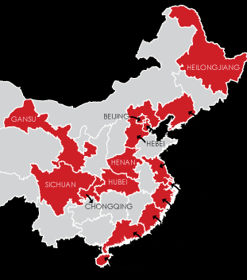
Challenges of Transportation Logistics
Drive Standards to comply with Chinese regulations
Risk of Over-Regulation
Notes:
A recent OECD report (2002) highlighted international challenges of transport logistics. The paper, prepared for regulators, governments, and international organizations provides important details about the future of the industry's global regulatory environment. One of the areas that were not covered by previous articles reviewed was training requirements and qualifications. The study recommends that this is one of the areas OECD is focusing in the future when making policy recommendations. As the document states: “It is important that both policy makers and company executives pay attention to logistics studies and practice, and make training of personnel a top priority” (OECD, 2002, p. 45). The above statement indicates that new training and qualification standard requirements are going to be introduced in the international field of logistics on a global and national level. Regarding policy-making, the report's recommendation states that “Governments need to develop the framework to encourage private sector involvement in the financing and operation of infrastructure, while recognizing the negative effects of infrastructure use by applying “correct” pricing policy” (OECD, 2012. p. 39).
Another forum held about the global logistics and supply chain industry (World Economic Forum, 2013) found that the main vulnerability of the industry lies in over-regulation and the vulnerability of trade agreements. The analysts of the forum state that many international companies have to meet various requirements and norms set by different governments. The lack of harmonization between countries' standards and measures would increase “trade costs more for foreign than domestic suppliers” (World Economic Forum, 2013, p. 11). “Building risk resilience” (World Economic Forum, 2013, p. 20) is also mentioned as one of the activities companies should be focusing on in order to maintain their competitive advantage. The authors, mentioning the 2011 earthquake in Tokyo state that companies should be prepared to changes and challenges, by making their supply chain flexible and creating risk assessments and contingency plans.

Slide 7
Strategic Approach
Optimization Opportunities
Change in Business Process
Change in IT tools
Why do we need it
Increased efficiency
Information on demand in real time
How we succeed in implementation
Planning
Scope Management
Notes:
This optimization is an approach to alleviate unnecessary business processes by reducing the amount of waste within the systems and transform the legacy processes into a wing-to-wing operating model which allows multi-directional data and information flow that is not available within the current configurations. The span of impact is enterprise wide encompassing finance/accounting, manufacturing, sales, service, customer relationship management, supplier management, and human resources. Implementation of this optimization project includes not only a change in IT systems but also adaptation, integration and modification of current business processes. Optimizing projects will allow for reduced cost in Chinese facilities and allow for increased growth within the industry.
Efficiency goes hand in hand with the ability to have and retrieve usable information from a single source.

Slide 8
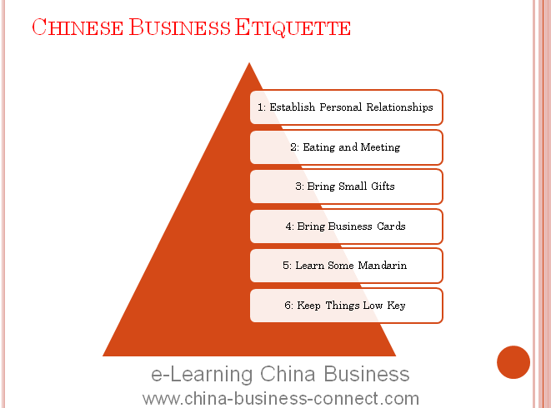
Focus on Effectiveness and Efficiencies
Project Objectives
Implement Optimization
Execute Clear Objectives
Manage Cost
Ensure Quality
Notes:
The optimization project has key criteria that will make sure it is successful. The leadership team understands that the optimization is necessary and wants the project team to take the reins and drive the change within the organization. These changes will require rigor and structure in order to successfully meet launch the project.
Launching the project means meeting the operational objectives defined by the requirements of the project. There are also other key areas within the project management lifecycle that needs to have a definitive set of guidelines. These will be outlined within the best practices framework that will be a critical component in the project manager’s toolkit.
The project’s success is reliant upon the meticulous execution of the project’s deliverables. This is accomplished through following the proper processes and procedures outline in the Project Management Book of Knowledge and using corrallary tools such as the Earned Value Management Tool. These provide the structure and insight into the project’s variables that allow for the project team to make appropriate decisions to manage and execute the scope, cost and schedule of the project.

Slide 9
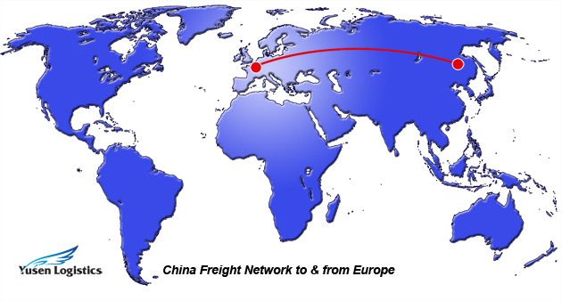
Research to Create the Best Advantage
Research Best Practices in Project Management
Focus on Project Management Institute Members
Design research to understand
Techniques
Tools
Notes:
Within the project the focal point is to optimize the current processes. One of the major factors in not implementing projects is the cost associated with implementing the project. If the cost is greater than the perceived benefits, leadership will not necessarily implement the project unless extraneous outside factors are pushing the decision. These outside impacts could be rules, regulations or new governance that mandates the changes. With this project, the goal is optimization to gain less cost, greater capability and increased effectiveness. The focus of the research is to better understand what needs to happen within the project team to utilize the best resources to achieve project success within budget, meeting the expectations of the stakeholders and launching on schedule. There are multiple ways to research for the project and with each there are inherent risks, challenges and limitations.

Slide 10
Conceptual vision of Scope
Level of Effort
Scope Developed
Project Charter
Planning
Execution
Monitor/Control
Start
Time
End
Business Need
Vision
Initial Planning
Project Development
Closure
Defining
Planning
Execution
Delivery
Lines=Effort needed in that area
Notes:
The conceptual vision of the scope planning event includes first the business identifying a need or a change. Normally a business does not change unless it sees an area of opportunity, there is current problem or it is forced by an outside entity. The business need feeds into a leadership group that devises a vision or direction in which the company needs to go. This could be a special project that needs a project manager or it could be an entire section that needs to be stood up to address the issue. Once this is established a person or group of people are charged with solving the issue and a project management team is born. The initial planning requires developing a charter that will include: project purpose, objectives and success criteria, high-level requirements, high-level project description, high-level risks, a summary milestone schedule and the approval criteria. This document also assigns the project manager to the project as well as the sponsor of the project. From the charter the scope documentation is developed. The scope is developed by interviewing members that have accomplished this task and creative workshops to determine what the project needs to entail. The output will be a scope statement that defines what the scope of the project is, it will be measurable, attainable and will ultimately be accepted by the stakeholders. The scope document reigns in all the current information to provide a concise and direct set of information answering what the project is, the goals and objectives, what needs are being addressed and constraints.
This page also shows how the level of effort and timing increase and decrease among the different phases of each project. This will be explained when reviewing the conceptual project plan. This is just to illustrate the integral piece the scope statement plays in the overall project.

Slide 11
Conceptual vision of Project
Level of Effort
Execution
Project Initiation
Monitor/Control
Planning
Start
Time
End
Business Development
Requirements
Awareness to Leadership
Training
System Development
Transition Strategy
System Preparedness
User Acceptance Testing
Defining
Planning
Execution
Delivery
Lines=Effort needed in that area
Notes:
The project plan has multiple different areas that need to be addressed that would not be addressed in the conceptual view of how the role of the scope plays into the entire project. The project is built upon milestones derived from the charter, scope document and requirements. The concept is to have a time phased implementation of the project and ensure all aspects of the project are covered prior to going live.
The top of the chart denotes the length of time that will be spend in each area. The curves represent the level of effort and time each activity will occur. There will be overlap between functions and responsibilities. The milestones are also annotated on what is on the critical path to accomplish the project plan. These milestones have tasks and objectives associated to them but only the milestones are presented on the conceptual view.
What is not shown is the month and quarterly review, budget, risk analysis, and other daily project management work. As a project manager knowing the scope, schedule and constraints help determine if a project is successful or not. The next chart will visually describe the analysis of the stakeholders.

Slide 12
Implementation of the Project
Test/Validate/Fix System
System Build to Requirements
Transition Actions
Communications
Start
Time
End
Requirements
Quotes
Conference Room Pilot
UAT
Make or Buy
Sourcing Vendor Selection
Conference Room Pilot
Notes:
The project life cycle varies from project to project but the overall them remains consistent. There is a distinct end point in which the project manager is driving toward.
This project plan denotes the implementation milestones that are required to go live at a give point of time in the future. Each milestone represents a multitude of different actions underneath each area. In order to complete the project the system must be created, tested, tuned, validated, adopted and utilized after implementation date.
The project starts with the requirements and from there the determination on whether the company can or wants to create the software internally. Due to the scope and complexity of the system the option to purchase a commercial off the shelf (COTS) option seemed feasible. The requirements were then transferred to the vendor and it will be managed by the project manager to ensure the right things are accomplished during the right times. Some areas to note are the conference room pilots. Since this implementation is changing more than just the IT system but also the business processes it is imperative to bring in the impacted individuals to show the new system, perform actions, play out scenarios and receive feedback from the end users. Communication to not only leadership but to suppliers and the plants impacted will help with informing the end users but also could facilitate the adoption process.

Slide 13
Managing Projects
Opportunities for Improvement
Lean Flow Process
Notes:
When crossing the borders of other countries to conduct business, there are positives and negatives associated with the implementation of those business efforts. Some of the most common and visible differences include cultural differences, language barriers and time zone disparities. While there are some large hurdles to overcome when conducting business that are known risks there are also other difficulties that are not easily identifiable and as easy to quantify into a risk measurement tool. These unknown or misunderstood risks will also need to be mitigated and incorporated into the project plan. Some examples of areas of risk that could potentially be harmful to a project’s successful completion include geographic disparities, climate or weather impacts, logistical infrastructure, information technology integration or other hazards that will need to be addressed when they occur during the project’s life cycle. The laws and regulations of the foreign country as well as the treaties and policies between countries play key operational and strategic planning points for the project manager. The project manager will need to manage the relationships between the project teams at home and abroad as well as understand and abide by the policies and treaties between countries. This is an additional effort on the entire project team and should be considered in the cost/benefit analysis.
The key point for the project manager to act upon is to ensure the requirements for the project are aligned with the scope of the project and that each requirement can be met on time, on budget and within the scope of the project. Managing the external forces and variables will take deft knowledge of the project management process but an understanding and awareness of the benefits and potential roadblocks that would face the project. By understanding these factors the project manager can take the necessary actions to mitigate the risks and successfully implement the project.

Slide 14
China Benefits and Obstacles
Opportunities
Hazards
Notes:
To fully understand the risks and rewards choosing to either move business to other countries or establish project to utilize foreign countries resources it is necessary to look at two different countries. China is in a unique position in which they are creating an environment to be conducive for foreign investors to come into their country and enhance their global economic model. China offers tremendous opportunities for foreign investors to conduct business in their location. The prerequisite for the business or conglomeration of investors is to have a steady and ample capital backing. The benefits of doing business in China include tax benefits offered to startups and large investment companies, free trade zones and distinct markets that cater to varying business types such as financial districts, manufacturing zones and other areas tailored to business growth. The country provides the vessel to conduct business and the project manager’s role is to understand exactly what is required and the cost associate with meeting those requirements. The benefits of project management would come from the general culture of the area including the established business culture for change and grow regarding business ideas and implementations as well as the focus on driving success. China wants the companies to become successful in order to increase the benefits experience by their citizens and economic prosperity.
China has a clear focus on growth and building opportunities for new ventures but they also seek to build upon their foundation to develop a sustainable and profitable economic business model for the entire country. These objectives are a balance between riskier new ventures and the less risky focus on established businesses looking to increase their market visibility globally or looking to take advantage of logistical or skill based benefits.
The disadvantages mostly reside in the same core areas that would be experienced by doing business in any other country that has a difference language, beliefs system, laws, business models or geographic separation from the other country looking to conduct business activities. Language, customs, politics and religion all play a role in project execution but there are some other areas that also are limitation to project management in China. The hyper-competitive process of resource allocation for the project must be accounted for as a risk to the project. Since the area of China is conducive to new ventures there are limited resources available for new countries looking for a part of the market share. The project manager must ensure that the resources required are readily available based on the needs of the project timing and implementation project schedule.
China provides resources that are technological savvy, industrious, intelligent, and highly educated. When projects are implemented in China it is the people and logistical placement within the globe that make the attractiveness so great. China is limited in size but is strategically located in the East and provides the democratic governance that is advantageous to free trade and business growth. Key benefits of expanding opportunities to China include the established business partnership between the United States and China as well as the forged path of success that has been blazed by other companies over the past few decades. There are lessons learned and knowledge available for the project team to learn and understand about China’s cultural differences and other high impact low probability risks. Mitigating the risks of outlined above is fairly simple and China is somewhat welcoming of businesses as long as they adhere to the rules, processes and regulations which are outlined for the business transaction. The formidable and highly capable workforce in China allows the project team’s efforts to be centrally controlled and decentralized executed which is tremendous benefit to the project manager considering the full utilization of the project team for key action to complete the project (Gray & Larson, 2011)
The downside to China includes more than limited physical resources and their availability. China’s culture is risk averse when it comes to new business ventures or non-established business models. This risk is mitigated through thorough and copious documentation on the specifications, quality, quantity, purpose, project schedules and a plethora of other documentation. This level of bureaucracy, while surmountable, can place a strain on resource allocations on the perceived non-value add project tasks. This could become an issue that limits the ability to meet the scope, cost or schedule of the project. This same risk aversion stance by China plays a critical role in the process of implementing new technology or goods into the market. The requirements are more stringent for implementing new items into the market and require a high degree of testing, evaluation, regulatory compliance and other country specific requirements to successfully launch. Understanding the needs and requirements of the Chinese counterparts and allow for appropriate budgeting of resource and all the cost of the project to be fully understood prior to moving business effort to the foreign country.

Slide 15
Building the Plan
S.M.A.R.T
Specific
Measurable
Acheiveable
Resonable
Time-based
Notes:
Building the plan includes garnering the feedback from all those members of the project team including the stakeholders. Each person will have a role and an assigned level of effort assigned whether it is responsible for the completion of certain tasks, accountable for multiple sections of the project work, consulted to gather intelligence on the project or obstacle or informed on situations occurring or project health overall.
Building the plan includes working backwards from what needs to be accomplished and determine what critical milestones are necessary to achieve the desired end state. For the ERP program the plan was established that the first plant to move was on a base line unit with little perceived complexity. This was chosen because the of the level of complexity and that efforts were needed to build the foundation of the entire ERP program. Each section of the procurement to payment sections would need to be established built on software ability and user needs. With limited resources a benefit/risk assessment was completed and the first plant was chosen. Building back from the milestones such as, Go-Live, training, awareness for both internal and external users, User Acceptance testing, System integration, small scale pilots, system build and test, requirements gathering, stakeholder buying and project kickoff as we work backwards from the implementation date.
While building the plan each goal and objective must be S.M.A.R.T. Specific-It must be clearly defined and understandable. Measurable-It must be able to be measured so that the team can understand if it is complete or not. Achievable-The goals and objectives must be able to be accomplished by the project team. Reasonable-This goes hand in hand with achievable in some aspects. The goal and objective must be reasonable meaning it must pertain to the project and the scope of the project but also

Slide 16
Implementation
Driving from Scope to Closer
Solid Scope Statement
SMART objectives
Milestones aligned with Scope
Assigned Accountability
Notes:
Managing a project takes leadership and management skills to ensure success. Implementing a project as large as transition legacy and antiquated systems that are vital to running a business into a new system that drives technological and business process change is a daunting task. For implementation to work the foundation must have a sold scope of work or scope statement. This is the reference document to understand and facilitate decisions in the future. The scope statement is the backbone of the project and when a program manager is in question on whether certain aspects of a project can be accomplished during the project the manager can look back and make an informed decision if the extraneous effort is in scope or out of scope and needs to be put into a parking lot for future iterations. The goals and objectives need to be understood and follow the SMART logic. This provides objectives that the team can hit will also falling into line with the scope statement.
The development of milestones provides landmarks for big item completions on the way to the project completion. These are high visibility items that will be briefed to leadership to provide the window into the project’s life. This will be brief at the quarterly reviews to show what has been accomplished. Milestones achieved and the path ahead.
Throughout the process each member will have a certain responsibility and assignment on the team. This ranges from Responsible, Accountable, Consulted and Informed and each of these represent the functions I described earlier in the presentation. The one caveat is that for this project only one person can be accountable for a specific task. If there is a question or concern regarding that action, milestone or other aspect the accountable member is the point of contact. This clears the communication issues and reduces noise among communicating members.
In order to show how the management of the scope will be implemented the next areas covered will included maps of the conceptual and implementation plans regarding scope management and project plan

Slide 17
Scope Definition
Scope Development
Risks
Scope Creep
Notes:
Scope management is a key success factor in completing any project. If scope is not managed correctly, the requirements and deliverables may fluctuate so much that the original intention of the project may never be met and could result in a fail project attempt. As any project progresses through the phases, the intricacies and details of the project gain clarity. This is where the art of project management dances with the scientific project management methodology to build and execute a project.
The scope is initially established at a high and definitive level at the forefront of a project. The challenge of developing a scope statement is to dance on the line between being too vague in deciding what the scope of the project is and on the other side restraining the scope or setting un-attainable milestones or objectives for the project closure. If the scope is not properly established in the beginning of the project the success of the project would be in jeopardy because what the stakeholders expect could vary greatly from what is going to be delivered.
The term scope creep refers to allowing varying requirement increases into the project. Some scope creep does occur due to the fact that certain aspects of the project that were unknown come to light during different aspects of the project lifecycle that must be addressed. These could revolve around unknown business processes, technological difficulties or unknown risks associated with changing other aspects of the business that were unknown prior to conducting interviews, building business cases and completing walkthroughs.

Slide 18
Lean Management
Solution Implementation
Finding the Problem
Notes:
The solution does not come packaged nicely with a bow on top. Lean management requires hard work and perseverance to implement successfully. Leadership became of a significant manufacturing and quality issue when the amount of returns were significantly impacting their revenue. Just as the ocean recedes at low tide reveling all that is left on the shore from the day’s high tide, as the inventory and sales recede, areas of much needed improvement began to reveal themselves. This required a quick assessment on the leadership’s part to determine what actions needed to occur to address the root cause of the problem and facilitate a change in the business.
The leadership decided to support the lean manufacturing process to build a sustainable solution to a potentially devastating problem. The first step by the leadership team was to bring in subject matter experts to implement the solution. The team was given the task to eliminate the biggest issues that was causing the loss in revenue. This lead the team to the areas requiring re-work which was enhanced by the amount of inventory being held to help disguise the waste in the process. The team identified the wasteful process utilizing gemba walks and holding process flow workshops to understand the entire production process flow from beginning to end. By visiting the work areas and understanding the process maps the team could determine where the problems were occurring that lead to quality issues.

Slide 19
Lean Management
Driving the Solution
Limitations
Notes:
After the problems were addressed the real work involving the sustainment of the overall project began. There are two sides to maintaining a lean culture. The first part involves leadership support in holding and continually striving to uphold new processes and enforcing the standard operating procedures derived from the lean management project implementations. The second and sometimes the most important, is the continual support and advancement of the lean culture in the organization. Lean is in need of constant attention and perfection is never achieved in the lean process.
In this process the problem perceived by leadership was a loss of revenue which was a problem to the shareholders but not a root cause of the issues. Instead of throwing more inventory or other wasteful operations at the issue leadership decided to take action and use lean. Through lean management multiple areas of opportunities were established and process flow improvements and lean projects resulted.
There are limitations to this implementation. The initial decision of the leadership was based upon the results of a core issue and not that of a thorough discovery process. Leadership understood that their manufacturing processes were not sustainable and as a result their operating margins were dwindling. As a reaction they chose lean management implementation to fix the problem. The limitation would fall under the fortitude of leadership to stick with the solution they determined and allow lean management as a cultural change.

Slide 20
Lean Management
Solutions to completing a competitive advantage in foreign markets
Notes:
Lean management is a toolbox in which to choose the right tools to help provide a solution of driving waste from a process. In this project, Pill Box Incorporated understood that they needed a change to their current manufacturing model due to their unsustainable business practices which were only compounded by the decreasing demand and increasing returns for rework. This perfect storm required drastic and immediate attention. The leadership team wanted a solution that was more than their immediate response solutions they were already implementing throughout their business. Lean manufacturing was how they were going take their business out of impending failure and strive to build better business manufacturing models.
This is perfect example of how certain business activities can overshadow underlying issues in the manufacturing processes until a potentially catastrophic event such as major recalls on products or inventory controls that tie up too much capital in the business. These issues do not solve underlying issues but drive the problems to other areas of the business which hinders the ability to implement the correct solutions to the problems.
The entire purpose of this project is to demonstrate the opportunities for a company to utilize the tools of lean management to promote a manufacturing process that is built around eliminating wasteful actions and drive results. Lean management is a cultural endeavor that requires commitment throughout the organization and can be highly successful if utilized and supported.

Slide 21
Works Cited
Dey, A., LaGuardia , P. & Srinivasan, M. Building sustainability in logistics
operations: a research agenda. Management Research Review. Vol. 34 No. 11, 2011
pp. 1237-1259. Print.
Gray, C. F., & Larson, E. W. Project management: The managerial process (5th ed.). New York, NY: McGraw-Hill/Irwin. 2011. Print.
Hollweg, C. & Wong, M. Measuring regulatory restrictions in logistics services. Working Paper. ERIA Research Project Working Group. 2009. Print.
OECD. Transport logistics. Shared solutions to common challenges. 2002. Web.
http://www.internationaltransportforum.org/pub/pdf/02LogisticsE.pdf
Project Management Institute. A guide to the project management body of knowledge. 4th. Newtown Square, PA: Project Management Institute, 2008. Print.
Widdowson, D. & Halloway, S. Maritime transport security regulation: Policies, probabilities and practicalities. World Customs Journal. Volume 3, Number 2. 2009. Print.
World Economic Forum. Outlook on the logistics & supply chain industry. Global Agenda Council on Logistics & Supply Chain Systems 2012-2014. 2013.

