Slide 1
Increasing Personal Energy and Wellness
Name
Class
Professor
February 16, 2015

Slide 2
Factors that Improve Energy and Wellness
Achieving an adequate amount of sleep
Following a well balanced diet
Engaging in regular exercise

Slide 3
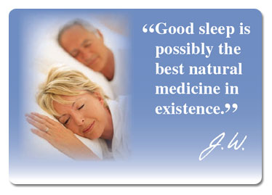
Consequences of Good Sleep Habits
The results of good sleep habits include:
Anti-inflammatory function
Reduction of anxiety and depression
Ability to remain energetic throughout the work day
Restorative functions that help mend the body
Good sleep habits can be established by:
Establishing and sticking to a sleep schedule
Allowing oneself to sleep for the amount of hours necessary to feel well-rested
This is typically a minimum of 8 hours a night

Slide 4
Consequences of a Well-Balanced Diet
The benefits of a well-balanced diet include:
A heightened metabolism
Reduced risk of age-related mental disorders
Nutritional levels that help support natural body processes
To achieve a well-balanced diet:
Vitamins could be consumed or injected to compensate for foods not eaten
A wider variety of foods should be consumed
A health care professional could be visited to provide recommendations

Slide 5
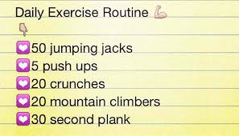
Consequences of Regular Exercise
The benefits of regular exercise include:
A reduced risk of depression and related symptoms
A reduced risk of obesity, diabetes, and cardiovascular
Higher energy and improvement metabolism
Improved cognitive function
To achieve exercise goals:
Stick to a weekly exercise schedule
Create exercise routines that are quick, but effective

Slide 6
Conclusions
A combination of a good night’s sleep, diet, and exercise is needed to achieve high energy and improved health
Individuals who are interested in following a healthier lifestyle should analyze these categories to determine how improvements in each could play into their daily lives
Modern living makes it difficult to live healthily, but we must recognize and counter this phenomenon in order to improve our quality of life

Slide 7
References
Bakalar N. (2014). Vitamin D Tied to Alzheimer’s Risk. Well. Retrieved from http://well.blogs.nytimes.com/2014/08/14/vitamin-d-tied-to-alzheimers-risk/?_r=0
Cleveland Clinic. (n.d.). Sleep and Psychiatric Disorders. Retrieved from http://my.clevelandclinic.org/services/neurological_institute/sleep-disorders- center/disorders-conditions/hic-sleep-and-psychiatric-disorders
National Sleep Foundation. (n.d.). How Much Sleep Do We Really Need? Retrieved from http://sleepfoundation.org/how-sleep-works/how-much-sleep-do-we-really-need
Sharma A, Madaan V, Petty FD. (2006). Exercise for Mental Health. Prim Care Companion J Clin Psychiatry, 8(2): 106.

