Slide 1
Oxford Brookes University welcomes Oxfordshire Rugby

Slide 2
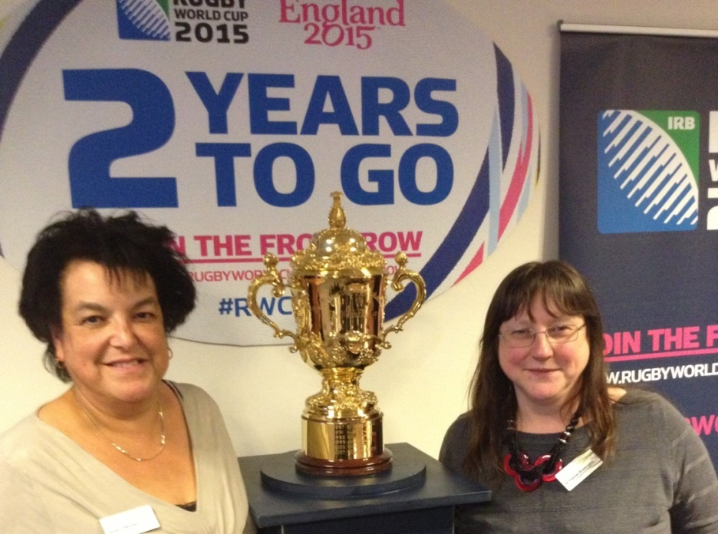
The Project
Jacqui O’Rourke Fran Brassington

Slide 3
Year 1 Marketing Audit
Year 2 Marketing Plans
Year 3 Evaluation of Implementation
What Next

Slide 4
Marketing Audit Results
Overview
Club members are loyal and supportive
Growing Interest in Rugby but poor press on injuries
Work done by a small minority
Not enough opportunities for women
Need more younger members

Slide 5
Chipping Norton RFC

Slide 6
Chipping Norton RFC
☺ family environment of this club makes it unique and inviting high ‘quality of coaching On average Chipping Norton gain 60 more kids per season parents and supporters are very keen to engage with more social activities Membership is value for money Strong word of mouth advertising RFU Seal of Approval Facilities available for hire | ☹ Lack of social events Poor internal communication Weak Financial Base Hard to find Better facilities elsewhere Limited development of coaches and volunteers Facilities not full utilised

Slide 7
Chipping Norton RFC
Recommendations
Efficiently use the club’s current digital platforms, and explore new digital platforms to improve administration, communication and promotion
Hold more social events
Attract and develop community based participation
Hold regular meetings for parents and volunteers

Slide 8
Banbury RFC

Slide 9
Banbury RFC
☺
Best playing facilities in the area
Sponsorship of senior players
U17 &18 teams
Junior coaching on Sundays
Strong volunteer base
Good community spirit
High number of non-playing members
Links with Banbury Guardian
Active Twitter account
Fitness group for parents
Good links with local business
☹
☺
Poor clubhouse facilities
Drop out of teenage players
Transition to competitive sport for minis
No girls’ or women’s teams
Poor member database

Slide 10
Banbury RFC
Recommendations
Set up major fundraising campaign to raise funds for new clubhouse
Develop stronger links with local schools to improve recruitment of juniors , especially girls
Improve use of Social media such as Facebook to maintain links with members going to university – organise events, matches for them in the holidays

Slide 11
Chinnor RFC

Slide 12
Chinnor RFC
☺
High standard of senior first team provides motivation for juniors,
1st team encouraged to coach juniors
Club coaching and facilities of very high standard
Secure financial base
1000 members
Social climate within the club is healthy, a sense of community and togetherness is clear
Chinnor RFC pays for level 1 coaching courses for volunteers
The club facilities that are already in place are capable of holding large events
☹
☹
Power is centralised, with management higher up making decisions and giving orders
There are only a handful of in-house events and usually there is not a great turn out
Poor internal communication
Volunteers contribution not recognised by management
Poorly designed website
Lack of U16-U21 transition academy
There is a lack of integration between the senior and junior sections

Slide 13
Chinnor RFC
Recommendations
Increase the number of social events to increase the level of outreach with the local community, increase the level of integration between the members of the club and to raise further funds for the club
Publicly recognise contributions of volunteers and reward them, in aim to increase retention of volunteers and to increase the level of awareness of the volunteers with the general public.
Develop website and increase use of social media to improve communcation with and between members

Slide 14
Littlemore RFC

Slide 15
Littlemore RFC
☺ Social side warm, welcoming atmosphere low membership fees Low drinks prices events such as Oktober Fest Publicity via JackFM Good level of sponsorship Links to London Welsh Plans to develop junior and women’s teams Loyal members | ☹ Very limited marketing Only 180 members No strategies to recruit more members Club house and events geared towards men Little integration with local community London Welsh potentially moving Hard to find Very limited financial resources

Slide 16
Littlemore RFC
Recommendations
Develop current word of mouth advertising with the use of social media
Develop links with local schools to recruit junior players
Run more social events such as darts competitions to better use facilties and increase income

Slide 17
Wallingford RFC
Expand its current word of mouth marketing strategy with the use of social media.

Slide 18
Wallingford RFC
☺ The club has a wide range of teams and ages involved Membership benefits including gym Good use social media including Twitter and Facebook Range of social events including Rugfest Those who play are prepared to help in other areas of the club Club motto, “Do it for the club” Annual sports tours Professional physiotherapists on site Flood lights Committed sponsors Wallingford Maidens | ☹ Facilities need updating Revenue from bar decreasing Number of volunteers decreasing Player retention Poor internal communication especially between levels

Slide 19
Wallingford RFC
Recommendations
Develop website and use of social media
Harness success of RugFest
Work more closely with sponsors to increase awareness
Upgrade facilities

Slide 20
Gosford All Blacks RFC

Slide 21
Gosford All Blacks RFC
☺ Good playing and socila facilities Good attendance at social events Number of sponsors | ☹ no marketing budget There is a lack of volunteer support The club’s sponsors do not advertise Poor use of social media

Slide 22
Gosford All Blacks RFC
Advertise
Use social meida to imprive internal communication
Work with sponsors to improve publicity
More open day and taster sessions
Coaching schemes in school holidays
Hire out facilities

Slide 23
Wheatley RFC

Slide 24
Wheatley RFC
☺ Wheatley RFC welcomes all abilities of players 3 specific volunteers to run the social media channels, Facilities at the club are modern and in an accessible location. Part of the NatWest RugbyForce Good support from sponsor Ben Kelsey | ☹ Limited financial resources Small club Social media not always updated Poor internal communication Limited advertising Facilities not fully utilised Lack of women

Slide 25
Wheatley RFC
Recommendations
Improve internal communication
Advertise- improve publicity
Develop links with local schools
Hold open days /Taster sessions
Encourage local groupsto use facilities

Slide 26
Witney RFC

Slide 27
Witney RFC
☺ Welcoming club Good facilities Loyal members Wolves team Competitive female teams Good range of sponsors Active use of social media Profitable Committee with clear objectives and goals | ☹ No planned marketing Poor food choice in clubhouse Limited links with local community Shortage of volunteers Weak control of finances –sponsors don’t always pay Outdated IT Poor parking facilities

Slide 28
Witney RFC
Recommendations
Sons/daughters and parents events
Revamp clubhouse menus
More fundraising events
More local publicity

Slide 29
What next

