Slide 1
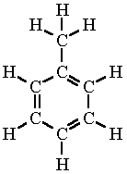
Toluene (C7H8)
By:

Slide 2
Background
Hazardous carcinogen
Also known as: Methyl benzene, Methyl benzol, Phenyl methane, Toluol
Colorless Liquid; mild odor
Exposure limits: TWA 100 ppm ST 150 ppm (CDC, 2014)
Ingredient in degreasers, crude oil, paint thinners, brush cleaners, nail polish, glues, inks, and stain removers, car exhaust, and smoke from cigarettes.
Utilized in:
Oil Refining
Manufacturing of paints, TNT explosives, glues
(Wisconsin Department of Health Services, 2014)
Notes:
Toluene is a hazardous carcinogen. Trade names are commonly known as Methyl benzene, methyl benzol, Phenyl methane, and Toluol. Toluene is a colorless liquid with a mild odor. The total weighted average is 100 parts per million and ST of 150 parts per million. Toluene is commonly used as an ingredient in many different products, such as degreasers, crude oil, paint thinners, brush cleaners, nail polish, glues, inks, stain removers, car exhaust, and smoke from cigarettes. The product is mostly used in industries such as oil refineries, manufacturers that develop paints, explosives and glues.

Slide 3
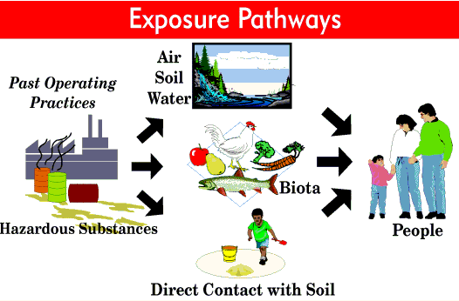
Exposure
Routes of Exposure:
Inhalation of vapor gas
Open container
Soaked rag
Spill
Ingestion
Skin Contact
Chemical can also be released into the environment.
(Drugs and Human Performance Fact Sheets)
Notes:
The most common route of exposure to Toluene in humans occurs through the inhalation of vapor gas. This can occur by sniffing from an open container or from a rag that is soaked in the chemical. It can also occur it is contained in a bag in which the vapors accumulate before the bag is opened. The exposure can also occur by ingesting the liquid chemical or from exposure of skin contact. The chemical can also be released into the environment and stay within the soil, air, or water. The chemical can accumulate and cause exposure through bioaccumulation resulting in contact with humans. In addition, there can be direct contact with the exposed soil. See exposure pathway diagram.

Slide 4
Absorption of Toluene
Readily absorbed via respiratory and gastrointestinal tracts, decreased extent via the skin
Detected in blood within 10 seconds of exposure via inhalation.
Distributed throughout the body.
Accumulates in fat and vascular tissues
Metabolism:
Side-chain hydroxylation to benzyl alcohol by P-450 enzymes in the liver tissue
Oxidation to benzaldehyde by alcholol dehydrogenase→benzoic acid by aldehyde dehydrogenase.
Benzoic acid + glycine → hippuric acid (urinary metolite)
(Faust, 1994)
Notes:
Tolene is readilty absorbed through the respiratory and gastrointestinal tracts, and to a lesser extent through the skin exposure. In human, toluene has been detected within the blood within 10 seconds after initial inhalation exposure. Distribution occurs throughout the body, with accumulation in fat tissue and vascular tissues. The initial step in toluene metabolism is side-chain hydroxylation to benzyl alcohol by P-450 enzymes
in the liver, followed by oxidation to benzaldehyde by alcohol dehydrogenase, and subsequently to benzoic
acid by aldehyde dehydrogenase. Benzoic acid is then conjugated with glycine to form hippuric acid, the
major urinary metabolite.

Slide 5
Excretion
Dose-Dependant
Clearance rapid
Excreted as metabolite in urine, as hippuric acid (60-70% of absorbed)
Complete within 24 hours after exposure
Elimination of toluene by lungs and skin (10-20%)
(Faust, 1994)
Notes:
Toluene excretion in humans and animals is dose-dependent and clearance from the body is rapid.
Toluene is primarily excreted in the urine as the metabolite, hippuric acid, which accounts for 60-70% of
absorbed toluene. Excretion of hippuric acid is usually complete within 24 hours after exposure. The
glucuronide conjugate of benzoic acid excreted in the urine represents
10-20% of absorbed toluene. Elimination of unchanged toluene by the lungs and possibly by the skin may
also account for 10-20% of the absorbed dose

Slide 6
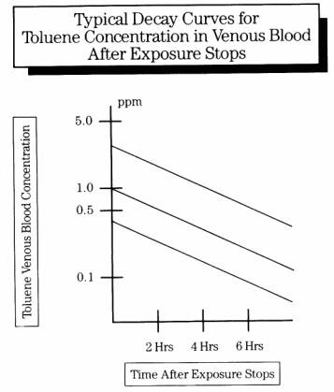
Kinetics
10 sec of inhalation exposure
Highly lipid solube
Highest concentrations in liver, kidney, brain and blood
Half-life in whole blood averages 4.5 hrs (range 3-6 hrs)
Terminal phase half-life 72 hours.
Half-life in fat tissue is 0.5-2.7 days
80% metabolized in liver
Absorption through the skin is slow: ranging from 14-23 mg/cm2/hr
(Drugs and Human Performance Fact Sheets)
Notes:
10 seconds of inhalation exposure. It is highly lipid soluble and accumulates in adipose tissue, tissues with high fat content, and highly vascularized tissues. Highest concentrations are found in the liver, kidney, brain and blood. The initial half-life in whole blood averages 4.5 hours, (range of 3-6 hours), with a terminal phase half-life of 72 hours. The half-life in adipose tissue ranges from 0.5-2.7 days, increasing with amounts of body fat. Approximately 80% of a dose is metabolized in the liver. Absorption through the skin is slow: ranging from 14-23 mg/cm2/hr. The diagram illustrates the decay curve for blood concentration of toluene vs time. As observed there is a decrease in the concentration within the blood with increasing time.

Slide 7
Measurements
In humans can be measured as follows:
Oral absorption: monitored by exhaled air
Urine analysis: toluene metabolites
Blood analysis: levels of toluene (within 12 hours)
Notes:
Measurements of toluene can be conducted through oral exposure through monitoring exhaled air or through urine for a urine analysis for toluene metabolites. In addition, blood analysis can be checked within 12 hours of exposure in order to detect toluene.

Slide 8
Injury Mechanism
CNS primary target organ for acute and chronic exposure
Development of fatigue, tiredness, impaired cognitive ability, irritation of the eyes and throat.
Increased exposure concentration: nausea, staggering gait, nervousness, muscular fatigue, confusion, insomnia.
Research has shown that it is related to induction or repression of genes in pathways associated with synaptic plasticity, GABA receptor signaling and mitochrondrial functioning in the CNS (Hester, 2011)
Kidneys, Liver, Respiratory System, and Reproductive system affected.
Constriction and necrosis of myocardial fibers, swollen liver, congestion
Symptoms include headaches, dizziness, intoxication
Increased exposure at high concentrations can also lead to death.
Heart failure, asphyxiation or aspiration
Mucosal irritant effect from exothermic reaction with water.
(Drugs and Human Performance Fact Sheets)
Notes:
.The primary target organ is the Central Nervous System. Symptoms include fatigue tiredness, impaired cognitive ability, irritation of the eyes and throat. In addition, with increased exposure, there are also symptoms of nausea, staggering gait, nervousness, muscular fatigue, confusion and insomnia. Induction or repression of genes in pathways associated with synaptic plasticity, including long-term depression, GABA receptor signaling and mitochondrial function. Death can result from heart failure, asphyxiation or aspiration. Toluene also owes its pharmacology to a mucosal irritant effect from an exothermic reaction with water. This results in vomiting, lacrimation and ocular burning, cough, chest pain, wheezing and possible interstitial edema, and kidney toxicity with tubular acidosis. Toluene exposure is also associated with a transient liver injury.

Slide 9
References
CDC. (2015). Toluene. NIOSH Pocket Guide to Chemical Hazards. Retrieved from: http://www.cdc.gov/niosh/npg/npgd0619.html
Wisconsin Department of Health Services. (2014). Toleune. Retrieved from: https://www.dhs.wisconsin.gov/chemical/toluene.htm
Drugs and Human Performance Fact Sheets. Retrieved from: http://www.nhtsa.gov/People/injury/research/job185drugs/toluene.htm
Faust, R. (1994). Toxicity Summary for Toluene. Retrieved from: http://vanilla47.com/PDFs/Toluene/TOXICITY%20SUMMARY%20FOR%20TOLUENE%20%20OAK%20RIDGE%20RESERVATION%20ENVIRONMENTAL%20RESTORATION%20PROGRAM.pdf
Hester, S. (2011). Acute toluene exposure alters expression of genes in the central nervous system associated with synaptic structure and function. Neurotoxicology and Teratology. 33(5):522-9

