Slide 1
By Student Name
Leadership Theories
Notes:
Hello class: I will be discuss leadership theories based on the movie "Good Will Hunting. The movie is an excellent example of the application of leadership theories.

Slide 2
Agenda-Leadership Characteristics
Three Leadership Theories
Relationship Leadership Theory
Behavioral Leadership Theory
Trait Leadership Theory
Intelligence
Self-Confidence
Honesty
Notes:
Read from screen these are the areas I will cover today.

Slide 3
Three Leadership Theories
Behavioral Leadership Theories
Relationship Leadership Theories
Trait Leadership Theories
Notes:
Relationship Leadership Theories are also know as transformational theories. This theory is based on a relationship between the leader and the follower.
Sean was determine to motivate everyone Will. As a leader in the movie, Sean(psychologist) strived to help Will to reach his potential. In the end, it was the established relationship
that changed Wills life. Sean found a common ground with the relationship leadership theory that allow Will and Sean to connect in a comfortable place for the both of them.
Behavioral Leadership Theories
Behavioral theories looked at how leaders behaved which developed into different leadership styles. In essence, they define leadership as learned, not something you're born with
Four Styles-Good Will Hunting
Sean focused on needs of Will
Sean acknowledge but not accepted Wills bad behavior
Sean directed Will on what direction he should consider
Sean was prepared for Will
Trait Relationship Theories
Trait theories are based on qualities of an individual person. Sean Maguire had these traits. It is believed that people are born with certain traits or characteristics that will allow them to lead.
Some of the traits or characteristics that Sean Maguire exhibited in the movie
Intelligence Accepts responsibility easily Understands the needs of followers Able to motivate people Trustworthy Good decision maker Self confident Assertive Flexible

Slide 4
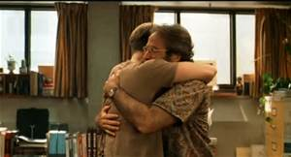
Relationship Leadership Theory
Sean Maguire-Established Trust
Sean Maguire-Found common ground
Sean Maguire-Define relationship parameters
Sean Maguire-Mentoring
Seam Maguire-Positive Attitude
Sean Maguire-Positive Outcomes
Notes:
In the scene when Will was first introduced to Sean Maguire, the psychologist, Sean immediately established he was the leader of the sessions. He used is attitude such as not shaking Will’s
hand during the introduction by putting his hands in his pocket. Sean's posture was erect and very confident. Sean immediately gave Will the eye contact to show he was not afraid of Will’s
Intelligence.
Relationship-oriented leadership theory describes a (Sean Maguire)who is primarily concerned with motivating Will Hunting and attempted to develop a trusting relationship. Sean was a
Relationship Leader providing direction and support for Will Hunting. A part of developing the relationship Sean set parameters from the start to ensure that they were building a productive
And positive counseling sessions.

Slide 5
Behavioral Leadership Theory
Sean Maguire-Positive Attitude
Sean Maguire-Calm
Sean Maguire-Confident
Sean Maguire-Direct Eye Contact
Seam Maguire-Assertive
Sean Maguire-Inviting Feedback
Notes:
In the scene when Will was first introduced to Sean Maguire, the psychologist, Sean immediately established he was the leader of the sessions. He used is attitude such as not shaking Will’s
hand during the introduction by putting his hands in his pocket. Sean's posture was erect and very confident. Sean immediately gave Will the eye contact to show he was not afraid of Will’s
Intelligence.
The best deliver is read from the screen each bullet point and comment on each one with your own words and why it applies. All these are types of behavior

Slide 6
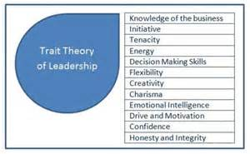
Trait Leadership Theory
Sean Maguire-Intelligence
Sean Maguire-Honesty and Integrity
Sean Maguire-Competent
Sean Maguire-Flexibility
Seam Maguire-Energy
Sean Maguire-Confidence
Notes:
In the scene when Will was first introduced to Sean Maguire, the psychologist, Sean immediately established he was the leader of the sessions. He used is attitude such as not shaking Will’s
hand during the introduction by putting his hands in his pocket. Sean's posture was erect and very confident. Sean immediately gave Will the eye contact to show he was not afraid of Will’s
Intelligence. Sean ream

Slide 7
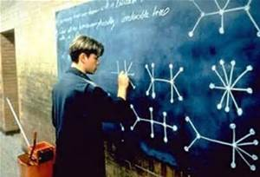
Intelligence
Sean Maguire-Common Ground
Sean Maguire-Books
Sean Maguire-Self-Awareness
Sean Maguire-Reasoning
Seam Maguire-Abstract Thought
Sean Maguire-Mental Activity
Notes:
Sean Maguire used intelligence as a trait to get his point across to the Will Hunting. The movie was a perfect example of how the psychologies utilize intelligence and common knowledge
To reach Will Hunting. The common ground was both were from Southy. The both spent a lot of time reading books, which he used to find a connection. Another leadership tool Sean used was
Using intelligence as a self-awareness session to find what motivates Will Hunting. It was obvious that Will Hunting thought in abstracts. Sean learned leadership taught him to use mental and
Abstract thought to reach Will Hunting.

Slide 8
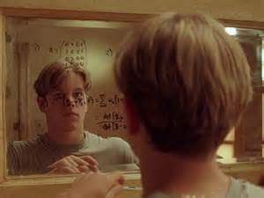
Self-Confidence
Sean Maguire-Leading Sessions
Sean Maguire-Attitude
Sean Maguire-Posture
Sean Maguire-Eye Confidence
Seam Maguire-Assertive
Sean Maguire-Belief in Self
Notes:
In the scene when Will was first introduced to Sean Maguire, the psychologist, Sean immediately established he was the leader of the sessions. He used is attitude such as not shaking Will’s hand during the introduction by putting his hands in his pocket. Sean's posture was erect and very confident. Sean immediately gave Will the eye contact to show he was not afraid of Will’s
Intelligence. Sean ream

Slide 9
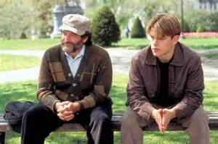
Honesty
Will Hunting-About College
Sean Maguire-People
Sean Maguire-Posture
Sean Maguire-Eye Confidence
Seam Maguire-Assertive
Sean Maguire-Belief in Self
Notes:
People want to follow an honest leader. Years ago, many employees started out by assuming that their leadership was honest simply because the authority of their position. With modern
scandals, this is no longer true. When you start a leadership position, you need to assume that people will think you are a little dishonest. In order to be seen as an honest individual, you will
have to go out of your way to display honesty. People will not assume you are honest.
Sean Maguire honest about his wife
Sean Maguire honest about be fascinated about Will Hunting mind
Sean Maguire honest about his feelings with his wife's death

