Slide 1
English Tenses
By Student
Perfect Tenses

Slide 2
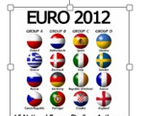
World of Flags
Moroccan Flag Spain
Brazil Flag
France Flag Japan
Egypt

Slide 3
National Anthems
United States
France
Spain
Notes:
Just click on the Speaker to play the National Anthem for each one

Slide 4
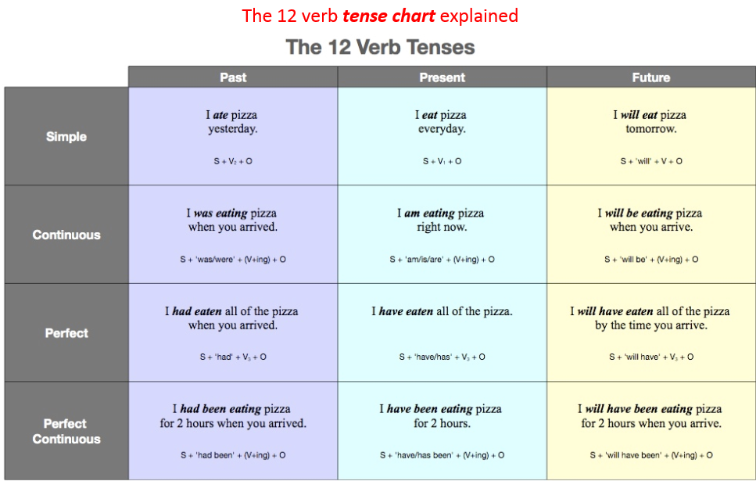
Introduction Tenses

Slide 5
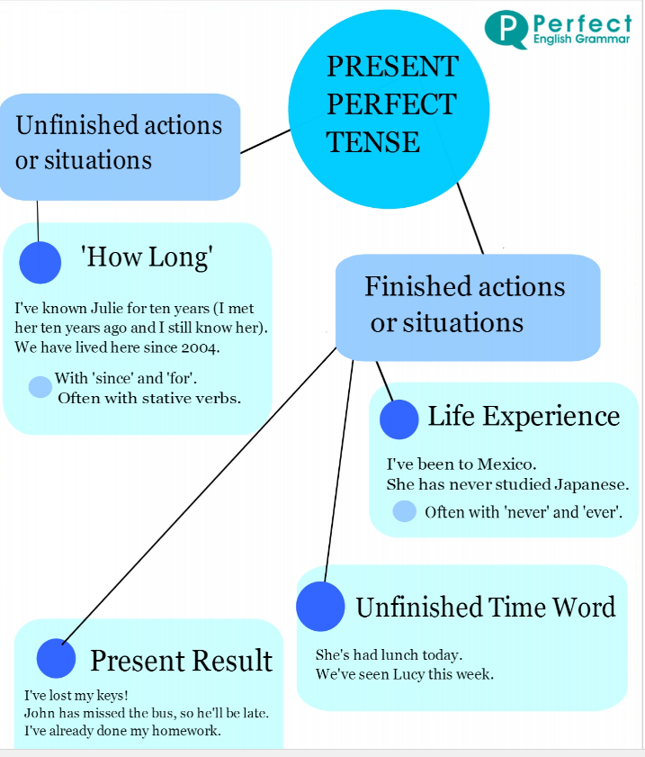
Perfect Tense

Slide 6
Verb Tenses Three Uses
Use 1 Experience
I think I have seen that movie before.
Use 2 Change Over Time
You have grown since the last time I saw you.
Use 3 Accomplishments
Doctors have cured many deadly diseases.

Slide 7
Verb Tenses
Past Took had taken had been taking
Present Takes has taken have been taken
Future Will will be taking will have been taking

Slide 8
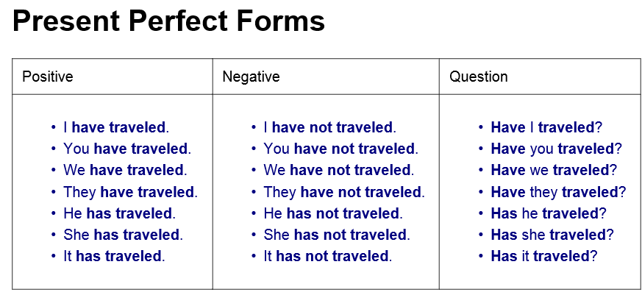
Present Perfect Forms
Past Took had taken had been taking
Present Takes has taken have been taken
Future Will will be taking will have been taking

Slide 9
Present Perfect for Repeated Actions
Past Took had taken had been taking
Present Takes has taken have been taken
Future Will will be taking will have been taking

Slide 10
Three Uses for Present Perfect
Past Took had taken had been taking
Present Takes has taken have been taken
Future Will will be taking will have been taking

Slide 11
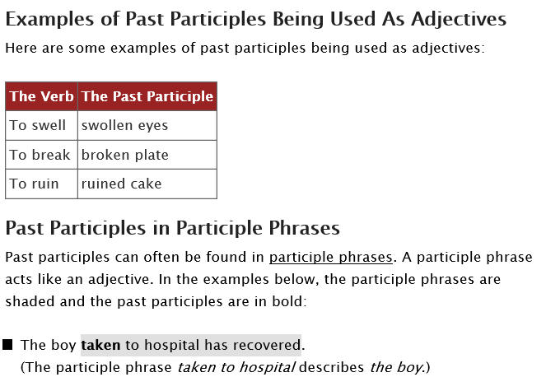
What is Past Participles?

Slide 12
The End Thank you

