Slide 1
Ethical Relativism
By Student

Slide 2
Agenda
Ethical Relativism
Real Example: Sweatshops
Issue-Sweatshops
Description of Issue
Why Ethical Issue?
Opinion on Issue
References
Video-Sweatshops-Try not to Cry

Slide 3
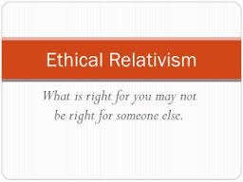
Ethical Relativism
Relative to ones culture
Right or wrong culturally
Moral norms
Different beliefs
Different perceptions of ethics
Ethical relativism is the theory that holds that morality is relative to the norms of one's culture
Velasquez M.,Andre,C.,Shanks,S.J. & Myer,M.(2014). Retrieved May 17,2015 http://www.scu.edu/ethics/practicing/decision/ethicalrelativism.html#sthash.HJMrnEWP.dpuf
Notes:
Ethical relativism is based on what is moral right in one culture may be wrong in another culture. The different beliefs such as the United States indicating that the Sweatshops are unethical
Because people are working children and families for pennies on the dollar. However, in a poor country those pennies allow them to take care and feed their families. It may be unethical in
The United States but it make be morally acceptable in India or Africa. The argument is that a company like NIKE spends pennies to make the tennis shoes in India and the labor is cents on the dollar
Therefore, NIKE is making a thousands percent profit on every tennis shoe sold. However, how many thousands of families eat because of the pay and how much money is helping the India economy
Making tennis shoes. Ethical Customs may be a crime in one region and not a crime in another. In the Untied States to marry only one person is legal but another country legal

Slide 4
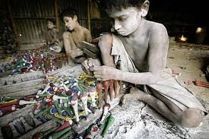
Real Examples-Sweatshop
The Gap-Bangladesh
Nike-Asia
Walmart-Bangladesh
Victoria Secrets-Burkina Faso
Sears-Vietnam
H&M-Philippines
Le Senza-Thailand
Macintyre,D.(2014).10 Major clothing brands caught in shocking sweatshop scandals. Retrieved May 17, 2015 fromhttp://www.therichest.com/rich-list/most-shocking/10-major-clothing-brands-caught-in-shocking-sweatshop-scandals/?view=all
Notes:
Sweatshops have real issues today with big corporations that are making billions resorting to Sweatshops such as Report exposes firing and overwork of pregnant workers, routine beatings and deep poverty wages in sweatshop backed by US mega-retailers such as the GAP, Nike, Walmart, Victoria Secrets, Sears to name a few. The families and women that work for pennies help entire families eat and survive it s the poor treatment, long grueling hours, children working, rape, beatings, blackmail to keep the jobs etc…. That is allowed by the big retailers because all they care about is the end result. As long as they do not see the treatment they ignore and do not take responsibility. However, what needs to change is
Making it illegal for the some of the Sweatshops that are owned by groups that have as many as 30,000 people working for them making pennies. However, all of these are real examples of

Slide 5
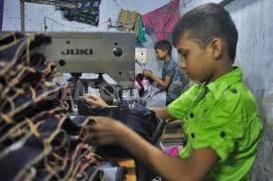
Issues: Sweatshop
Children Labor Laws
Wrong or right culture
Major businesses
Working conditions
Minimum Wage Act
Low Wages
Employments Laws
Ambar,W.(2015).Sweatshops and Child Labor. Retrieved May 17, 2015 from http://www.veganpeace.com/sweatshops/sweatshops_and_child_labor.htm
Notes:
The primary is issue concerning the Sweatshops is the Child Labor Laws that are non-existent in 3rd world countries. In Bangladesh the people that are working in a jobless country or district
Will think of the opportunity to make any money is a blessing but the ones that are running the sweatshops are the abusers. The government needs to make the big retailers bring their own
Management into these countries to ensure they are paid a decent wage and work in acceptable working conditions. The Minimum wage act should be enacted and regulated around the
Globe because no child should be working under slave like conditions.

Slide 6
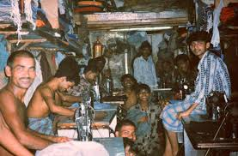
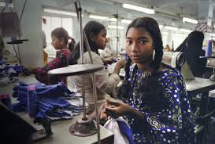
Description of Issue
Children working hard labor
Globally poor communities low salaries
Major Store Brands slave labor
Ethically and Morally right or wrong
Unethical Sweatshops like NIKE
Poor working conditions
Notes:
Nike is the best example of the description of the poor working conditions. The media has awakened the public to this fact that NIKE is one the leaders in the world using cheap labor in Asia
Even though they are recognized globally. Nike is a major store brand that is under scrutiny by the world. They are the number one corporation who has been criticized for the sweatshop
Culture of Nike. It was illustrated that conditions were so horrible that many people including women and children lost their lives. Nike is the best example of the exploited workers in Asia
For financial profits.

Slide 7
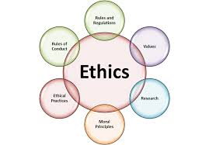
Why Ethical Issue
Wage Laws
Children Labor
Horrible working conditions
Physical Abuse
Forced to Work overtime no pay
Unsafe hazardous working environments
Notes:
The ethical issue is the treatment of children that are working overtime and long hours. In addition, the unethical way the women are physically abused because they live in a 3rd world country.
The next unethical issue is the Child Labor Laws that are not being implemented or followed. It is also unethical to allow an human being to live and work in such horrific working conditions. Its
An ethical issues because people are forced to work overtime and blackmailed into accepting bad treatment so they can feed their families.

Slide 8
Opinion on Issues
In Bangladesh, sweatshops are not considered unethical because they provide better job options for families in third world countries. The Chinese have sweatshops that force people to work for no wages or pennies which is slavery. In Bangladesh the are working as a choice for a better life. The people that should be held accountable is the big corporations that should be paying them higher wages at least minimum wages.
Notes:
This is my own personal opinion that sweatshops are not considered unethical to a family that is starving or children that are starving. In 3rd world countries it’s the conditions that are unethical
But the work is ethical so they can survive in a undeveloped country that has few jobs. It truly believe that the people that should be held accountable is the big corporations that should be paying
them higher wages at least minimum wages

Slide 9
References
Ambar,W.(2015).Sweatshops and Child Labor. Retrieved May 17, 2015 from http://www.veganpeace.com/sweatshops/sweatshops_and_child_labor.htm
Velasquez M.,Andre,C.,Shanks,S.J. & Myer,M.(2014).Ethical Relativism. Retrieved May 17,2015 http://www.scu.edu/ethics/practicing/decision/ethicalrelativism.html#sthash.HJMrnEWP.dpuf
Macintyre,D.(2014).10 Major clothing brands caught in shocking sweatshop scandals. Retrieved May 17, 2015 fromhttp://www.therichest.com/rich-list/most-shocking/10-major-clothing-brands-caught-in-shocking-sweatshop-scand

Slide 10
Thank you Watch Video
Nike Sweatshops-Try not to cry

