Slide 1
Family Involvement in Education

Slide 2
Introduction
How does understanding a child’s life enable teachers to gather enough information to help them effectively communicate with their student’s?
The main aim of the education system is to develop, educate and release the most competent individuals into the workforces as well as the society.
However, the modern-day education system has been plagued with numerous scandals that have highlighted the generally poor standards within society today.
Notes:
The barriers that do exist in the home, school and communal collaboration make the satisfaction of all stake holders very complicated and difficult.

Slide 3
Our Research Objectives
This research aims at finding the root cause of this problem by drawing a relationship between parent-teacher involvement and teacher reported student grades.
This will employ statistical research from existing studies while integrating recent opinions on parent-teacher engagement techniques.

Slide 4
Literature Review
There are two major facets that encompass the education of any and all children, namely; family and school.
This crucial role of the teacher aims at being a cooperator as opposed to being an instructor.
Being a cooperator with someone essentially means familiarizing one’s self with the other’s background, needs, abilities, ambitions and any other facet that is related to the collective well-being of the said collaboration or partnership.
Notes:
Each of these two parts have to work hand-in-hand as they are intertwined to achieving the success of the child.
Parents looking for a good school for their child inquire and carryout extensive research on a school’s success and failures, staff, location, curriculum, meals and factors that affect the well-being and success of its students.
It is the mandate of the school to carry out similar research finding out relevant information on its students to ensure the overall success of the school and its students.
Fortunately, these kind of programs are extensively supported by many institutions and organizations in the United States.

Slide 5
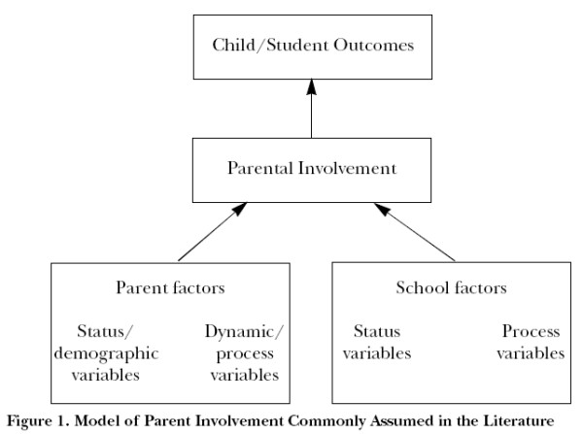
Lit. Review (cont.)

Slide 6
Lit. Review (cont.)
Upon adulthood (18 years of age) most children would have spent a minimal amount (13%) of their time at school, engaging in academic activities.
It is vital to a child’s academic success that the remaining 87% of their time be put to constructive and scholastic oriented activities (Child Trends Data Bank).
Stevenson and Baker reported that increased parent-teacher involvement in a sample population of 179 children depicted improved average performance of these students.
Notes:
A study of three hundred 11-14 years olds depicted this characteristic as well as Stevenson and Baker report.
There is a strong association between reports of parental participation in school activities and tutor reported grades

Slide 7
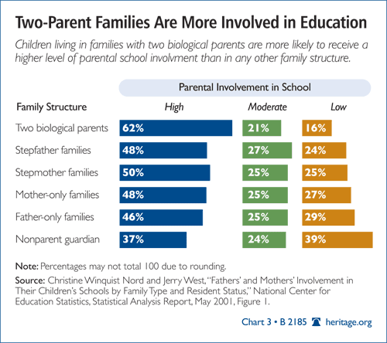
Lit. Review (cont.)

Slide 8
Lit. Review (cont.)
Notes:
A child greatly profits from the involvement of their instructor, teacher or tutor in the child’s own life in one way or another (Harvard Family Research Project).
However, there exist numerous barriers that may hinder the involvement of the teachers in the child’s life.
Some of them include the degree of parent education, the socio-economic status of the family, the family structure and the numerous possibilities of the child’s background that is unique and different from all other student.

Slide 10
Rationale
The increasing evidence of poor academic performance with every passing decade necessitates the need for new techniques designed to improve overall performance, in academics and in the society.
This is crucial in developing effective strategies which will ensure increased student performance and an overall awareness of their roles and responsibilities in society.
Notes:
This research helps find the relationship between parental involvement and the performance of their child.

Slide 11
Research Objectives
The research will aim to answer following questions:
Is there evidence of a relationship between parental involvement in school and student grades?
How do parents and communities get involved in their children’s education?
What form of parental engagement in education are most effective?

Slide 12
Research Method and Design
Research design model
The research design model being used is quantitative research design.
Research design
The research design employed in this study is the correlation design.
This design is used to test the statistical relationships between variables.
Notes:
This design model is suitable for this study as it enables me to aptly analyze the sources of the information used in the study through use of a combination of statistical deduction and empirical evidence that is got through extensive study of the secondary material.
This design is suitable as it tests for strength in the relationship between parent-teacher engagement and the performance of students.

Slide 13
Sample Design and Data Collection
Data Collection the data is to be collected from both primary and secondary sources.
The qualitative data will be collected from a number of local schools with vibrant and active parent-teacher engagement programs.
Quantitative data will be collected from secondary sources online where previous research has been conducted.
Notes:
This information will mainly entail interviews with parents and teachers as well as opinions from students.
This provides the fundamental framework for identifying existing relationships and trends.

Slide 14
Conclusions
In order for there to be a realization of the full support and promotion of family involvement in children education, there has to be a clear understanding of the complex processes within family and how each and every process has its own unique outcome.
This will ultimately lead to the realization that family involvement initiatives ought to be directed towards enhancing existing strengths within the
Notes:
This aids in understanding all the factors that influence and affect the depth and scope of the family’s involvement in the education of children.

Slide 15
References

Slide 16
References (cont.)

Slide 17
References (cont.)

Slide 18
Thank You

