Slide 1
The Determination of College Football Coach Wages
.

Slide 2
Literature Review
- "Are Baseball Players Paid Their Marginal Products?" - Macdonald, Don N., and Morgan O. Reynolds.
- “Salary Vs. Marginal Revenue Product Under Monoposony and Competition: The Case for Professional Basketball”. Scott, Frank, Long, James and Somppi, Ken.
- “Racial Differences in Professional Basketball Players' Compensation”. Lawrence M. Kahn and Peter D. Sherer
- "The Sports Business as a Labor Market Laboratory." Kahn, Lawrence M.

Slide 3
Question
Our group is investigating college football coach salary determination among the SEC and the Pac-12. We specifically chose to select these two conferences because they are about equally competitive, yet there are significant pay discrepancies among coaches in those leagues.
Question: How are college football coaches in equally competitive conferences able to make more than each other? (football coaches in the Pac12, SEC conferences)

Slide 4
Facts
League | Total Pay | 2014 win % | Games televised
Pac-12 | $30,099,004 | 0.582 | 102
SEC | $50,995,769 | 0.612 | 98

Slide 5
Hypothesis
Hypothesis: Coaches of football teams in the SEC are likely to make more money than those in the equally competitive Pac-12 division.
Equation:
In our equation, the dependent variable (Y) is the salary of the football coaches.
Our main independent variables (X) are (2014) win %, total years coached, TV revenue, and our dummy variable is if the team is in the SEC or not.
Total Pay = B₁win%+B₂totalyearscoached+B₃gamestelevised+B₄SEC

Slide 6
Variables
Dependent variable (Y):
total pay of the football coach
Independent variables:
(2014) win %, total years coached,
TV revenue (for the team)
Our dummy variable is if the team is in the SEC or not (1=SEC, 0 = not in SEC)

Slide 7
Sum of Variables

Slide 8
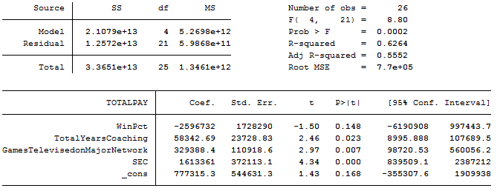
STATA

Slide 9
Hypothesis Tests
Fail to Reject H_{o}
H_{o} : β WinPct = 0
H_{a}: β WinPct =/= 0
t= -1.5 p-value= 0.148
H_{o} : β Years= 0
H_{a}: β Years =/= 0
t= 2.46 p-value= 0.023
H_{o} : β Televised = 0
H_{a}: β Televised =/= 0
t= .2.97 p-value= 0..007
H_{o} : β SEC = 0
H_{a}: β SEC =/= 0
t= .4.34 p-value= 0..000
Reject H_{o}
Reject H_{o}
Reject H_{o}

Slide 10
Regression Model
Total Pay = 777315.3 - 2596732(WinPct) + 58342.69(Years) + 329388.4(Televised) + 1613361(SEC) R² = .6264
Significant variables:
Years
Televised
SEC

Slide 11
Analysis of Significant Variables
Years: A 1 year increase in coaching experience leads to a $58,342 increase in total pay
Televised: An increase of 1 televised game leads to a $329,388 increase in total pay
SEC: If a coach is in the SEC, then they will make $1,613,361 more than a coach in the Pac-12

Slide 12
Room for Improvement
More observations
Compare other college football leagues
Compare other sports
Observe leagues that have equal amount of teams

Slide 13
Conclusion
Hypothesis: Coaches of football teams in the SEC are likely to make more money than those in the equally competitive Pac-12 division.
Based on the analysis of televised games and years of experience for coaches between the two football leagues,yes, coaches in the SEC earn more than coaches in the Pac-12. This hypothesis is accepted.
Notes:
This hypothesis is accepted based on the $329,388 increase in every extra televised game for SEC, and the conclusion that a coach in the SEC will make $1,613,361 more than coaches in the Pac-12. In conclusion, coaches in the SEC will earn more than their counterparts in the Pac-12. However, this analysis is only confined to two leagues, the SEC league and Pac-12. There is room for improvement and there needs to be more observations other than the ones presented. A comparison of other college football leagues in conjunction with the comparisons of the SEC and Pac-12 would make for better improvement regarding these observations. Perhaps an assessment of the NCAA league would provide better accuracy in this area. A comparison of other sports such as basketball may be considered as well. Furthermore, an observation of leagues that have an equal amount of teams can advance improvements in the observation.

