Slide 1
Free Trade
Name

Slide 2
Principles of Free Trade
Trade liberalization can be used in stimulating and promoting economic growth and efficiency
This usually creates comparative advantage and economic growth in the country
Free trade promotes economic development in various global countries by:
reducing costs
increasing the labor and finance used to produce goods
services in the country
Free trade policies usually involve international trade systems and practices including the exchange of exports and imports in various countries globally in a manner that promotes GDP

Slide 3
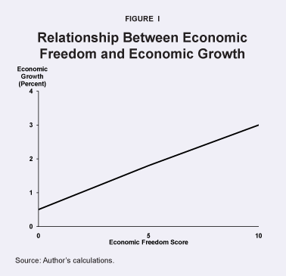
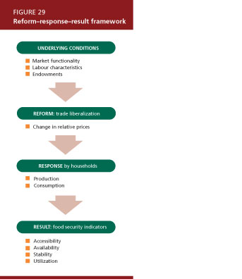
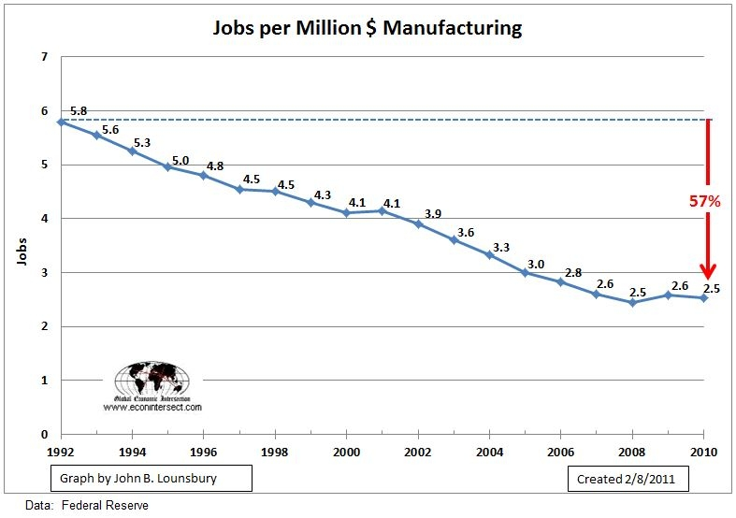
Illustration of Free Trade
Economic Freedom Trade Liberalization Free Trade & Jobs

