Slide 1
Perspectives on Gender In The Contemporary Society
Student
Course
Date
Notes:
Good day to everyone! The aim of today’s presentation is to overview diverse perspectives of gender in the contemporary society, paying specific attention to the reflection of the theme of gender in psychoanalytical and behavioral aspects.

Slide 2
Gender and behaviors
Gender – “the attitudes, feelings, and behaviors that a given culture associates with a person’s biological sex.”
“Behavior that is compatible with cultural expectations is referred to as gender-normative; behaviors that are viewed as incompatible with these expectations constitute gender non-conformity”
Notes:
Before starting the discussion of the role of gender in the contemporary society, the definition has to be made what is meant by gender and consequently expected behaviors. As it is seen from these definitions, gender is social construct based on cultural norms and consequent behavioral expectations
Source: http://www.apa.org/pi/lgbt/resources/sexuality-definitions.pdf

Slide 3
Gender theme in the contemporary society
Commercial sector targets women and men differently
Women are the primary house workers and responsible for childcare in contrast to their husbands
Although at school girls demonstrate better academic achievements than boys, women are more likely to be unemployed, underpaid and have fewer career advancement opportunities
Notes:
Although contemporary society can be praised for its achievements in the deconstruction of gender, the theoretical concepts and academic justification of the deconstruction of gender is far from the real life trends. In this regard, gender still continues to manifest itself in the everyday life. The few examples are:
The retail industry continues to diversify and apply market strategies based on gender differences and encouragement of socially-expected behaviors. This is manifested in diverse ads, gender-oriented colors selection, etc.
Women continue to be the main caregivers of children, and they continue to be responsible for the housework, while they are studying and working. Thus, the opportunity to work and study as men did not take off the gender role of looking after children from women.
Finally, the best example of gendered roles prevalence is the fact that although, at school, girls demonstrate better academic achievements than boys, in the future, they are more likely to be unemployed, underpaid and have fewer career advancement opportunities. Women remain underrepresented in the workforce and leading positions

Slide 4
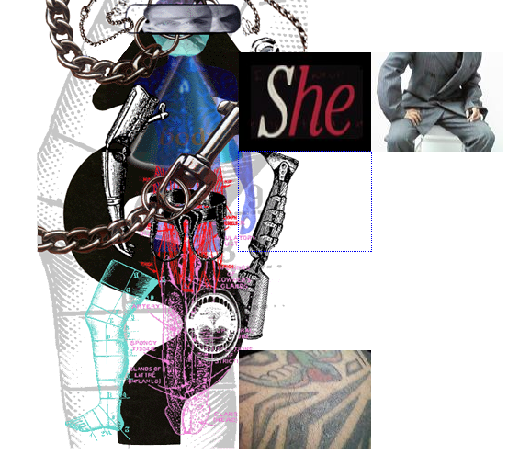
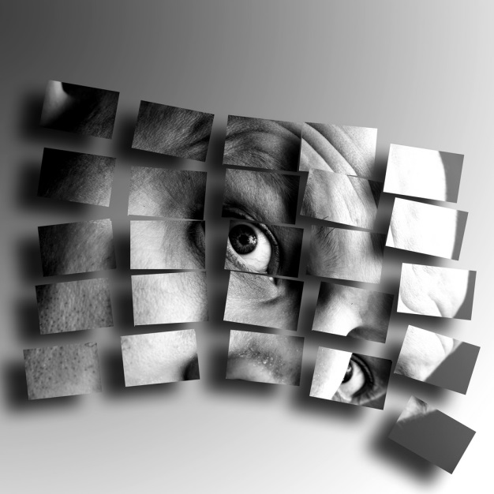
Art Perspectives on Gender
Notes:
While the reality of the contemporary society still demonstrates the prevalence of gendered roles and socially impose conformity to these roles, the art is one aspect of the contemporary culture that tries to deconstruct gendered perception of reality and human lives. This is conducted with the attempt to deconstruct the biological essence of gender as a precondition for the social and consequent psychological deconstruction of gender. One of the prominent examples of such art is Jamie McCartney’s project “The Great Wall of Vagina” that demonstrated diverse sculptural reflections of female genitals. The aim of the project was to encourage social and individual acceptance of diversity of female body and eliminate gendered anxiety regarding it.

Slide 5
Gendered products emphasis
Notes:
The best example of the aforementioned reflection of gender theme in the commercial sector is the representation is female-targeted tools with handles colored in pink. This is the most classic perception of gender through the color preferences and association of femininity with pink color.
The source: http://www.open.edu/openlearn/body-mind/proper-men-proper-women-gender-roles-contemporary-uk-society

Slide 6
Gender in Popular culture
A housewife stereotype into a business woman
( Sex and the City, The Desperate Housewives )
Male masculinity of a bread bringer into a macho man or a metrosexual
( Two and a Half Men, White Collars, Marvel Series, etc)
Makeover TV shows as a stigmatization of a human body
Notes:
From one perspective, it can be argued that the popular culture reflects the social change in the gender deconstruction and elimination of traditional gender stereotypes of housewives and male bread bringers, in fact, the situation is more complex. The contemporary media and popular culture as a reflection of social trends demonstrates the new wave of gender stereotypes. In this regard, the new model of a business woman is perceived as a tough, ruthless, sexy, lady-like mannered but cynical and consumptive in all aspects of life. In other words, she is the female version of a male businessman of the previous century and any deviations from that do not fit the profile.
The same is the case with masculinity. It is given to modes of development: a macho man or a metrosexual. While the first one is expected to be a pure embodiment of a sexual predator, the second is often associated with a gay sexual orientation. Consequently, the public opinion reflected in the popular culture does not give variations for expressing one’s individuality both physical and socio-psychological. The best example of body stigmatization and socially-constructed perception of rights and wrong body features is the popularity of various Makeover TV shows.

Slide 7
Gender impact on social Psychoanalytic Side
Individualism as a reflection of gender burden
The complexity of self-identification and self-realization
Social construction of gender in the context of sexuality
The prevalence of sexism in the contemporary society
Gender typing on early stages of children’s development
Notes:
Among a few psychoanalytical aspects of the discussed subjects are the following:
Individualism as a reflection of gender burden
The complexity of self-identification and self-realization
Social construction of gender in the context of sexuality
The prevalence of sexism in the contemporary society
Gender typing on early stages of children’s development

Slide 8
Individualism as a reflection of gender burden
Female career-makers often view their struggles and hardships as their own mistakes or the lack of efforts
Perception of career, class, workplace barriers to one’s advancement and failures as personal mistake and underachievement rather than a socially-constructed bias
Self-doubt, anxiety, workaholic behavior and moral exhaustion
Notes:
Although individualism is often viewed as the reflection of free self-estimation, it can also serve as means of personal alienation from society and carrying a gendered burden. In this regard, the new socially-constructed model of successful individual that achieves anything on her/his own makes young adults to consider existing class, gender and career conditioned barriers of their success to be their own fault and the lack of efforts applied towards the achievement of their goal. This is particularly stressful fro young women whom gender-oriented society requires to show that they can not only fulfill male positions but also have to look attractive, confident, control their emotions and follow the recent fashion trends together with the news of the Wall Street. Consequently, the perfectionism of individualization results in the increased anxiety about one’s appearance, career performance and the necessity of crafting one’s personality to the socially-imposed criteria of a successful woman. Furthermore, the crises of self-identification can be developed by following popular culture stereotypes rather than making one’s distinctive way of career and personal growth.

Slide 9
The complexity of self-identification and self-realization
Substitution of old gender roles with the new ones eliminated the room for self-expression
The lack of ways for one’s personal and creative self-realization
The contemporary family as a smallest social cell lacks tolerance and understanding
The two-round fight fro one’s identity: parental and social gender stereotypes
Notes:
The new gender stereotypes create the same psychological issues as the previous ones – the conflict between personal id and socially-constructed expectations of the superego. In this regard, an individual has to suppress one’s personal creativity and perception of the world and fit it into the gender-prescribed mode of behavior. For instance, a business women appearing in public without makeup and a proper hairstyle is socially unacceptable. It simply would not fit the pattern, just as a macho man crying does not fit the socially-constructed profile. The lack of promised tolerance to individual self-expression and gendered perception of reality is best shown in the contemporary families where the ideas of the previous gendered roles prevail and teenagers had to go through double pressure of gender stereotypes: the old ones of their parents and the new ones of the contemporary society.

Slide 10
The problems of transgender and gender-variant people
The problem of self-identification, correspondence of body to one’s gender identity is often accompanied by depression and anxiety
The expression of one’s gender and fitting into society, where they face harassment, violence and abuse.
Manifestation of id and ego- overruling of social norms of behavior
The dominance of superego results in accepting the biological gender or self-harm and self-hate
Notes:
The best demonstration that the contemporary society remained gendered and driven by gender differing stereotypes is the case of transgender people. The main psychological problems of transgender people are related to the understanding of one’s psychosexual gender and its consequent correspondence or the lack of such to the biological gender. For such people, the very process of self-realization of a complex gender id is already a challenge since gender dysphoria includes such psychological conditions as various forms of depression and anxiety, isolation, and even suicidal inclinations. But even if an individual manages to come with terms of one’s gender and its further modification sin body and behavior, society has very little tolerance to such individuals which demonstrates the biased gender culture of the contemporary society. From the psychoanalytical perspective, in order to achieve a full self-expression and satisfaction with one’s life a transgender id has to overcome superego. Due to the lack of societal understanding the dominance of id and ego might result in complete challenging of social norms of behavior both gendered and not. On the other hand if id and ego are suppressed by strong superego, transgenders can spend their life in denying their nature or can inflict self-harm or develop destructive psychological disorders

Slide 11
Social construction of gender in the context of sexuality
Feminists were considered to be lesbians; metrosexuals gays and macho men expressed their masculinity to suppress hidden gay desires
The result is the psychological burden of following gender rules (old or new) in order to prove one’s sexuality and gender in the eyes of the society.
Notes:
Another socially inflicted conflict that influences human behavior is missing of different aspects of gender and common societal misperception of distinctions between each of them and sexuality. Thus, it is often perceived that deviation from the gender roles results in the change of sexual orientation. For instance, feminist women were often considered to be lesbians since they challenged the traditional gender roles. Metrosexuals are considered to be gay due to their ability to express attention to their looks, while macho men are considered to express their masculinity in order to suppress hidden gay desires. Consequently, such biased stereotyping places extra pressure on individuals who have to keep proving the society which gender they belong and what their true sexuality is, not to mention gay and lesbian individuals who find it hard to come out due to the social bias and potential implications on their private and social lives. Under these circumstances of sexualisation of gender, superego suppresses both the freedom of sexuality expression and also personal traits if self-realization as male or female since one’s sexuality is constantly under question.

Slide 12
Early Childhood Gender Stereotyping
On the phallic stage of psycho-sexual development, when children accept the gender models of the opposite sex parents begin to panic and often forbid them from playing the opposite and inappropriate gender roles.
This approach can result in the inability of resolving Oedipus and Electra complexes at this stage, the lack of self-confidence and further sexual disorders. Moreover, the inability to relate to parents and society could develop
Notes:
From the psychoanalytical stages of sexual development, the first part of human life is of crucial importance of sexuality structuring. In terms of gender realization, starting from the phallic stage (3-6 years) the distinction between genders develops and children begin to imitate their same-sex parent’s behavior. While children act according to their gender modes, parents are quite encouraging, but when boys begin to wear dresses, or little girls prefer boy’s outfits and games, parents begin to panic and often forbid their children from playing the opposite and inappropriate gender roles. From the psychological perspective, the harsh punishments and not allowing child’s self-exploration can result in the inability of resolving Oedipus and Electra complexes at this stage, the lack of self-confidence and further sexual disorders. Moreover, the inability to relate to parents and society could develop.

Slide 13
Gender typing from behavioral perspective
Child gender distinctive behavior develops at the age 15 to 36 months
Boys are more conformed to the distinctiveness of gender differences than girls due to the extra parental pressure on the development of masculinity and consequent roles
Girls tend to imitate boys behavior due to the preferential status of boys in the contemporary culture
Notes:
From the behavioristic perspective, children develop gender distinctive behavior at the age of 15 to 36 month. A particular feature is that the patterns are learned from parents and are directly related to parental prescription of gender distinctiveness. However, boys are more conformed to gender differences than girls because parents tend to be more preoccupied with the development masculinity and consequent realization of gender roles.
Girls tend to imitate boys behavior due to the preferential status of boys in the contemporary culture just as through the entire history. Irrespective of the improvement of gender statuses in the society, the tendency of parents, particularly fathers, having a first-born son prevails.

Slide 14
The prevalence of sexism in the contemporary society
Women are expected to look sexy (preserve their femininity and gender) and act like men at work, yet they are not respected but viewed as subject of desire or envy
the reverse phenomenon occurs among conservative female activists who begin to segregate women that demonstrate their sexuality through clothes or expected business-style – dual sexism.
Notes:
No matter in which field women work today, they have to correspond to the ideal profile of managing everything and still looking good. They are not allowed to have mood swings during their periods because showing emotions is a sign of weakness in the male business world. Thus, women are to look sexy (preserve their femininity and gender) and act like men at work. Irrespective of the seemingly open career paths, freedom of choosing sexual partners, women end up being stigmatized in a new gender role leaves no room for variations. As a result of such stigmatization the reverse phenomenon occurs among conservative female activists who begin to segregate women that demonstrate their sexuality through clothes or expected business-style and successful women begin to be alienated among other categories of females of the contemporary society. Thus, the double alienation takes place and women who approach business or leadership career path have to fight double sexism both from men and other categories of women.

Slide 15
Gender and Sexual behavior
Crossing gender boundaries regarding sexuality remains controversial.
Although the rights of LGBT begin to be protected more, the social acceptance of them is far from being satisfactory.
The sexual behavioral aspect of gender roles remains the most dogmatic due to the socio-psychological perception of the nuclear family still dominating the contemporary gender discourse.
Notes:
While gender roles in terms of jobs and personal mode of behavior became more diverse, the attitude towards crossing gender boundaries regarding sexuality still remain controversial in the contemporary society, which is often prescribed by religion and political views rather than inter-personal relations. Although, from the legal perspective, the rights of Lesbian, Gay, Bisexual and Transgender (LGBT) community begin to be protected more, the social acceptance of them is far from being satisfactory. Still people are afraid to come out, because they can lose their families, career and sometimes even their health. Consequently, the sexual behavioral aspect of gender roles remains the most dogmatic of all issues. This is largely due to the socio-psychological perception of the nuclear family of a man and a woman that still dominates the contemporary gender discourse

Slide 16
Gay Marriages’ Legalization
The legalization of gay marriages across the US is a step towards acceptance of the gender tolerance
From the politico-social perspective individual’s rights to create same-sex families are protected and recognized on the governmental level
Helps people to gain strength in self-estimation and self-realization in the contemporary society.
Notes:
With recent ruling for the legalization of gay marriages across the US, a step towards acceptance of the ongoing elimination of gender dogmatism took place. From a psychological perspective, individuals see positive signs from within the politico-social perspective suggesting that their rights to create same-sex families are protected and recognized on the governmental level. Except for the legal aspect, gay individuals were given a confirmation of their socio-political recognition and acceptance. Although, the socio-cultural narrative remains quite complex, the official recognition of gay marriages assists people in gaining strength in self-estimation and self-realization in the contemporary society.

Slide 17
Psychological Implications of Gay Marriages’ Legalization
Improved confidence and self-esteem and sexual orientation
Elimination of psychological effects of social stigmatization of same-sex marriages
Reduction of anxiety, stress and depression among same-sex couples
Improvement of dialogue with families of the same-sex partners
Notes:
Moreover, the legalization of gay marriages has tremendous positive implications for individual’s psychology. By being legal recognized, gay and lesbian couples improve their own self-esteem and gain a chance to fit into society on the equal basis. The lack of necessity of hiding and pretending according to prescribed gender roles eliminates psychological effects of social stigmatization of same-sex marriages, meaning anxiety, stress and depression among same-sex couples. Since socio-political tolerance of the same-sex marriages improves through this legalization, parents of the same-sex partners can feel less social pressure and become more perceptive of their children and their choices. Consequently, intergenerational dialogue regarding gender roles can be improved.

Slide 18
Behavioral Implications of Gay Marriages’ Legalization
Couples no longer have to hide their relations from society; they can easily show each other’s affection
More marriages will result in more options for the creation of families with children either adopted or born to surrogate mothers
Gay individuals are encouraged to build families instead of having numerous casual partners, which can improve one’s biological and social aspects of life
Notes:
From the behavioral perspective, couples no longer have to hide their relations from society; they can easily show each other’s affection by hugging each other and holding hands, which in its turn stimulates hormones of happiness and contributes to the physical health and satisfaction with life. In terms of demographic perspective, more marriages will result in more families with children, either adopted or born to surrogate mothers. Consequently, new gender neutral or ambiguous families will develop with mutual responsibility for what previously was a gendered family distribution of responsibilities among partners. Moreover, the mode of gay sexuality expression can change. Instead of having numerous casual sexual partners and preserving one’s official straight status, individuals could come out and build fully functional families of their own, improving their biological and social aspects of life

Slide 19
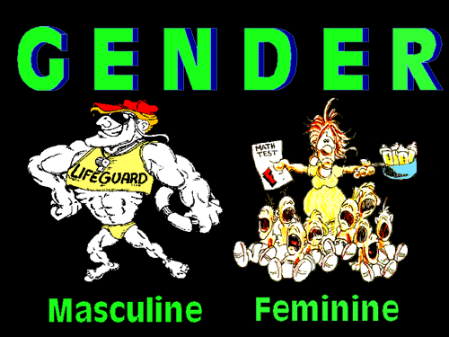
Long-term implications of gay marriages for the gender perception
The dissolution of gender roles
Building of a gender-tolerant society
Notes:
From the long-term perspective, the legalization of gay marriages can result in the dissolution of gender roles at all. In this regard, by raising children in the tolerant and gender ambiguous environment, interpersonal relations and individual self-estimation become the primary values rather than gender roles and gender stigmatization. This view is based on the findings that children raised in same-sex families are characterized by the higher level of tolerance to differences and are more empathic to other people than children raised in strict gender prescribing families.

Slide 20
Conclusion 1
Gender remains a dominant factor in socio-psychological interactions
Gender roles changed but did not lose their dogmatic and stigmatizing nature
Media and popular culture reflect societal trends, but seldom are capable to deconstruct gender roles like the art does
Thus, the process of self-estimation and self-realization remains a difficult one
Notes:
Overall, from all mentioned above it can be concluded, that irrespective of certain positive changes in gender roles changes, gender remains a dominant factor in socio-psychological interactions. In this regard, although a certain diversification of gender roles took place, the current state of their sociological perception remain dogmatic and stigmatizing. Media and popular culture reflect societal trends, but they do not deconstruct gender roles like the art.
In other words, the process of self-estimation and self-realization in the contemporary gendered society remains challenging both psychologically and behaviorally.

Slide 21
Conclusion 2
Gender roles are prescribed in the early childhood and are constantly under direct social pressure through parents and family
Inconsistency of one’s self-determination with gender prescribed roles results in tremendous psychological implications including depression, anxiety, stress and even suicidal inclinations
The way to building a gender tolerant society is through acceptance of differences and the right of people fro self-expression outside gender bias, like it is achieved in the case of the legalization of the same sex marriages
Notes:
Since gender roles are prescribed in the early childhood and are under direct social pressure through parents and family, individuals experience double pressure: gender roles prescribed by their parents and those prescribed by the society. In this regard, one’s id is being suppressed by incredibly strong superego, leaving very little space for self-expression. Thus, the inconsistency of one’s self-determination with gender prescribed roles results in tremendous psychological implications including depression, anxiety, stress and even suicidal inclinations. One of the ways of building gender tolerant society is through acceptance of differences and the right of people fro self-expression outside gender bias, like it is achieved in the case of the legalization of the same sex marriages.

Slide 22
The Final Comments
The issue of gender is complex phenomenon of the contemporary society and it combines interest of individuals, families and society as a whole.
Thus, the elimination of gender typing is possible only if parents teach their children tolerance and give the support their self-identification.
From the psychoanalytical perspective, when one’s id and ego are encouraged in certain aspects by the superego, a more harmonious coexistence and personal integrity can be achieved.
Notes:
In terms of the final comments, I would like to add the following considerations.
Secondly, the elimination of gender typing is possible only if parents teach their children tolerance and give the support their self-identification
Finally, from the psychoanalytical perspective, when one’s id and ego are encouraged in certain aspects by the superego, a more harmonious coexistence and personal integrity can be achieved. In other words, one’s personal integrity is largely conditioned by the support an individual can get from the constructed super-ego.

