Slide 1
The Importance of Hand Washing
Name
Date

Slide 2
Why is Hand Washing important?
Hand washing protects hands against different types of germs
It allows children to share toys and other items without the risk of infection
Children will have clean hands
Children will be safe from different types of diseases
Children will be healthier

Slide 3
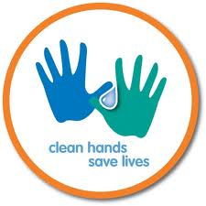
Hand Washing and Health
Hand washing protects children’s health
Children will reduce their risk of becoming sick from infection
Hand washing will prevent the spread of germs from one child to another
This activity will improve health on a daily basis
Hand washing prevents diseases such as colds and the flu in many children
Hand washing will save many lives

Slide 4
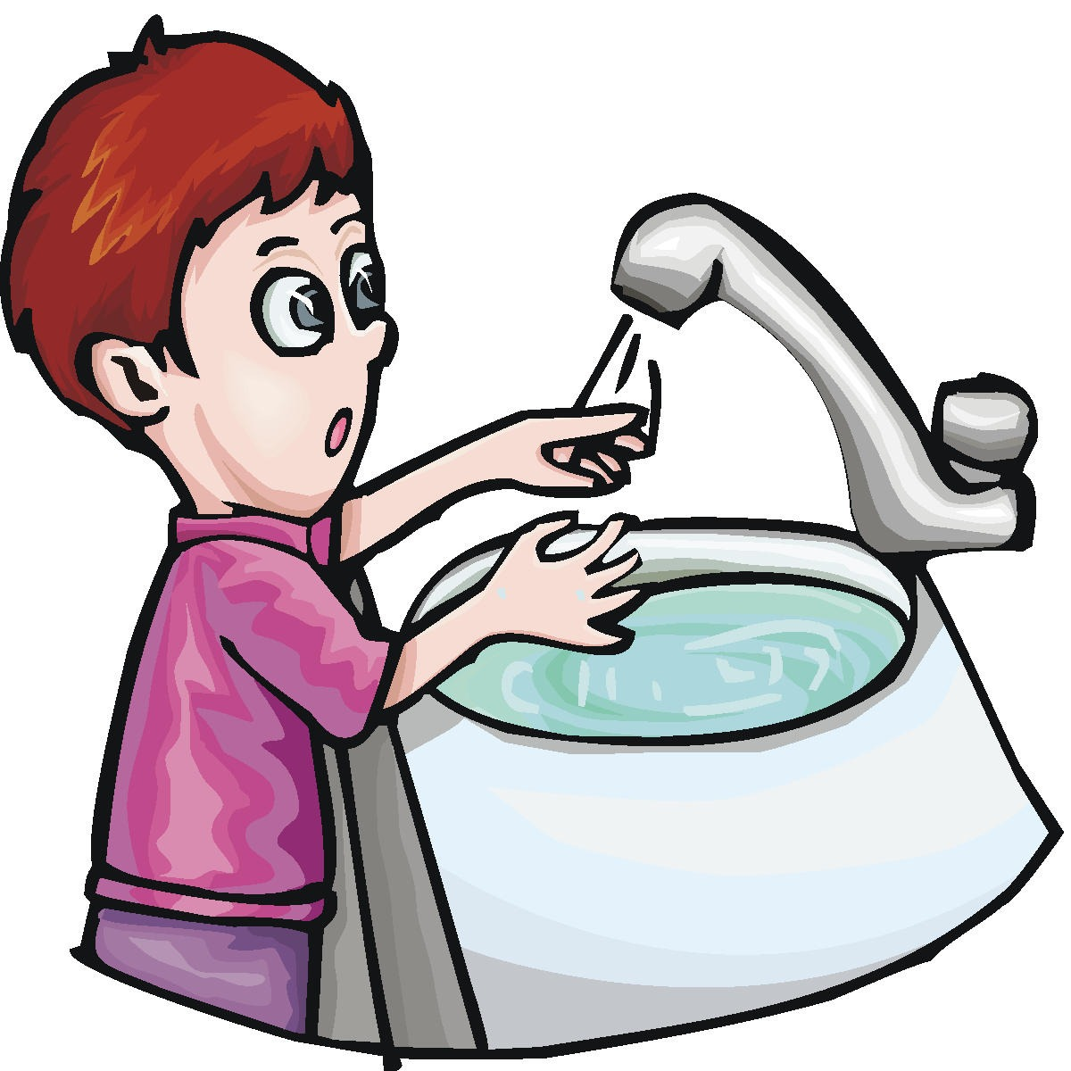
Hand Washing Behavior
Children will learn how to make hand washing a part of their daily routine
Hand washing is a positive and rewarding behavior
Children should be provided with encouragement when they wash their hands on a regular basis
They should also be taught how to properly wash their hands
Adults must set a positive example for children to reduce the
risk of illness and infection

Slide 5
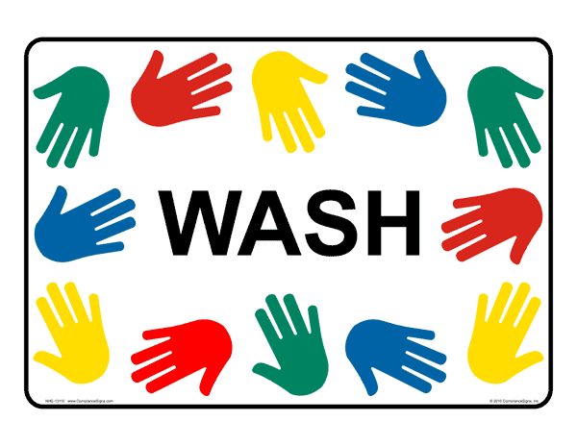
Examples of Hand Washing
Adults must teach children who to properly wash their hands
They must provide lessons to children so that they may duplicate these behaviors
Children must be able to wash their hands on their own without difficulty
They must be able to share their knowledge with other children
Children must learn how to wash their hands under
different circumstances throughout their lives

Slide 6
Rewards for Hand Washing
Children who wash their hands regularly should be supported and/or rewarded for this behavior
A rewards system may generate greater enthusiasm, particularly in younger children
This activity will eventually transform into a daily habit
Children will learn the importance of hand washing in their lives
There must be a system in place to support children who wash
their hands on a regular basis

