Slide 1
Lupus
An informative analysis of the disease.
[FIRST NAME LAST NAME]
[PROFESSOR]
[CLASS]
[DATE]

Slide 2
General Overview
a. Lupus is a multisystem autoimmune disease that is characterized by the production of antibodies to various components of cell nucleus. Additionally the most common form is a chronic inflammatory disease with protean manifestations. This results in a number of clinical manifestations.
b. In 20% of cases, lupus begins in childhood but is very rare in children below the age of 5. The disease is most common in females with a female to male ration of 5:1 in teenagers and 10:1 in adults.

Slide 3
Demographics
a. Lupus has three times the number of incidences in African Americans as it does in Caucasians and is far more common in Hispanics, Asians, and Native Americans as well.
b. The Lupus Foundation of America has estimated that five million people in the world have lupus.
c. The annual mortality rate for Lupus is of 28 for Native Americans, 24 for African Americans, 20 for Caucasians, 15 for Hispanics, and 13 for Asians in a population of 1,000 people.
d. Although the incidence of Lupus has almost tripled, it should be noted that this is partially due to the fact that the diagnosis has increased significantly and lupus is being diagnosed earlier.

Slide 4
Signs and Symptoms
During a physical exam, the following signs may present if the patient has lupus: rash which may be malar, discoid, or vasculitic, oral or nasal ulcers often painless and unnoticed, arthritis of large and small joints, pericardial friction, edema, and CNS.
The most common symptoms that a patient may experience are: fatigue and fever, joint pain, butterfly-shaped rash on face, skin lesions, Raynaud’s phenomenon, shortness of breath, chest pain, dry eyes, and headaches.

Slide 5
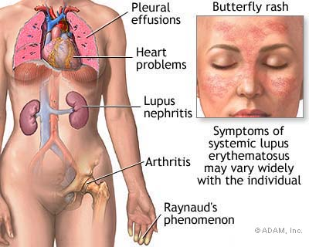

Slide 6
Body Systems Affected
The body systems that are most commonly affected by lupus are: cardiovascular system, immune system, renal system specifically the kidneys, respiratory system specifically the lungs, nervous system, and the skin.

Slide 7
Pathology
Lupus is an autoimmune disease and is therefore not spread through any means.
Pathogens do not cause lupus but there is a known genetic predisposition to the disease. The environmental factors that have most commonly been associated with the disease are: infections, extreme stress, some drugs, and hormones.

Slide 8
Cause of Disease
Lupus does not have a single specific cause although it is very much observed in certain families which has led scientists to conclude that genetic predisposition combined with some specific environmental factors may cause the disease. Some of these specific factors include: UV rays, sulfa drugs, tetracycline drugs, antibiotics, infections, cold or a viral illness, exhaustion, injury, emotional extreme stress, and hormone imbalance during pregnancy, childbirth, and menstrual periods.

Slide 9
Diagnosis
The American College of Rheumatology has instructed that four of the following eleven must be met to classify a patient as having lupus.
Malar rash.
Discoid rash.
Photosensitivity.
Oral or nasal ulcers.
Arthritis.
Cytopenia: Anemia, leukopenia, lymphomenia, or thrombocytopenia.
Neurologic diseases such as seizures or psychosis.
Nephritis.
Serositis: pleuritis or pericarditis.
Positive immunoserology.
Positive ANA.

Slide 10
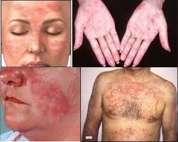
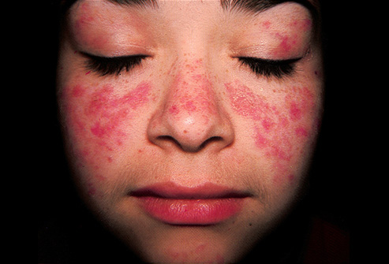

Slide 11
Treatment
NSAIDs may be used for musculoskeletal and mild systemic complaints.
Hydroxychloroquine can be used to help control cutaneous manifestations and help minimize flares.
Steroids may be needed for renal and systemic manifestations.
Immunosuppressive agents may be used for patients with renal diseases.
Methotrexate may be used weekly for patients with arthritic symptoms.
Patients with antiphospholipid anitbodies may be treated with a daily baby aspirin or stronger anticoagulation.
Renal damage may also be treated with ACE inhibitors.
Statin may be used for patients with abnormal lipid profiles.
Rituximab causes B-cell depletion and is most often used for thrombocytopenia.
Plasmapherisis and IVIG has been used as well.
For sever lupus bone marrow transplant may be an option.

Slide 12
Prevention
Since there is no known factual cause of lupus there is no accurate way of preventing the disease from occurring. Avoiding excessive sun exposure and excessive stress may be advocated for.

Slide 13
Interesting Facts
Lupus is very difficult to diagnose because symptoms are intermittent, mimic those of other diseases, have no single laboratory test that can effectively diagnose.
More than 90% of lupus sufferers are women, mostly young women between the ages of 15 to 44.
Lupus is a leading cause of premature cardiovascular disease, kidney disease and stroke among young women.
The three different variations of lupus are: systemic lupus erythematosus (SLE), cutaneous affecting only the skin and drug-induced lupus triggered by a few medications.

Slide 14
Works Cited
"Handout on Health: Systemic Lupus Erythematosus." Arthritis, Musculoskeletal and Skin Diseases Home Page. N.p., n.d. Web. 11 Apr. 2015.
"Lupus - Mayo Clinic." Mayo Clinic. Mayo Clinic, n.d. Web. 11 Apr. 2015.
"Lupus: MedlinePlus." National Library of Medicine - National Institutes of Health. N.p., n.d. Web. 11 Apr. 2015.
"What is Lupus?" Lupus Foundation of America. N.p., n.d. Web. 11 Apr. 2015.

Slide 15


