Slide 1
Pharmacology
Presented by Student

Slide 2
Agenda
Define Pharmacology
Drug names
Legal Classification of Drugs
Pharmacology Definition(1)
Pharmacology Definition (2)
Routes of Drugs Administration
Method of Drugs Administration
References
Notes:
Good morning ladies and gentlemen: Today I am going to discuss and list each one:
Pharmacology Define by Industry
Define Pharmacology
Drug names
Three Types of Drugs
Legal Classification of Drugs
Pharmacology Definition
Method of Drugs Administration
References

Slide 3
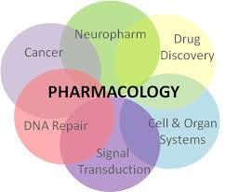
Define Pharmacology
Pharmacology is the branch of medicine and biology concerned with the study and knowledge of drugs
Man-made
Natural
Endogenous(With in the body)
Pharmacology is both clinical and applied science
Pharmacology is knowledge of drugs
The science of drugs including their origin, composition, pharmacokinetics, therapeutic use, and toxicology
Merriam-Webster.(2015).Medical dictionary: Pharmacology. Retrieved April 20, 2015 from http://www.merriam-webster.com/medical/pharmacology
Notes:
Just read from screen it will flow better
Define Pharmacology
Pharmacology is the branch of medicine and biology concerned with the study and knowledge of drugs
Man-made
Natural
Endogenous(With in the body)
Pharmacology is both clinical and applied science
Pharmacology is knowledge of drugs
The science of drugs including their origin, composition, pharmacokinetics, therapeutic use, and toxicology

Slide 4
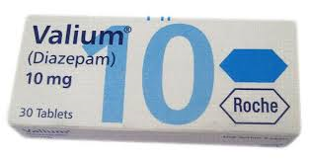
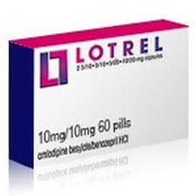
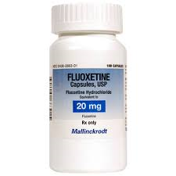
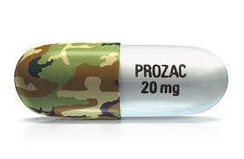
Drug Names
Chemical versus Generic
Generic-the generic name of a drug is an internationally recognized name for that particular chemical, it is created to be unique, fairly simple, and often to link that drug with other drugs in the same class. (Valium is generic name) Lotrel is generic name
Chemical-the chemical name that describes the drugs molecular structure Diazepam is the chemical structure for Valium. Amlodipine is the chemical structure for Lotrel
Non-Proprietary versus Brand/Proprietary
Non Proprietary-the chemical or generic name of a drug or device, as distinguished from a brand name or trademark. A nonproprietary name may be indicated by the letters USAN The Non Proprietary Brand of Prozac would be Fluoxetine
Brand Proprietary-Proprietary brand is a given brand name that is developed and marketed exclusive to the brand of the retailer that can be targeted to specific customers-Prozac is Proprietary brand
Notes:
Example 1 Lotrel Generic
Chemical name for Lotrel is Amlodipine
Example 2 Valium Generic
Chemical name for Valium Diazepam
Example 3 Prozac is Brand and Fluoxetine is the non-proprietary name

Slide 5
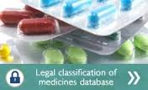
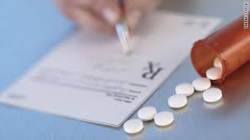
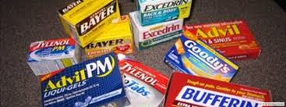
Legal Classification of Drugs
Define Prescription Drugs- A drug that can only be obtained by means of a physicians prescription
Prescription Drug-
Bought at pharmacy
Prescribed by a physician
Prescribed and intended for the use of one person
Regulated by FDA through New Drug Application(NDA)
Over the counter drug-
Purchase over the counter
Drugs that do not require prescription
Regulated by FDA
Merriam-Webster.(2015).Medical dictionary: Pharmacology. Retrieved April 20, 2015 from http://www.merriam-webster.com/medical/pharmacology
Notes:
These are the legal classification of Drugs but also you have “Drug classification system”. The Drug Classification system is (This lets your teacher know you did your research
• Class A drugs include: heroin (diamorphine), cocaine (including crack), methadone, ecstasy (MDMA), LSD, and magic mushrooms.
• Class B includes: amphetamines, barbiturates, codeine, cannabis, cathinones (including mephedrone) and synthetic cannabinoids.
• Class C includes: benzodiazepines (tranquilisers), GHB/GBL, ketamine, anabolic steroids and benzylpiperazines (BZP

Slide 6
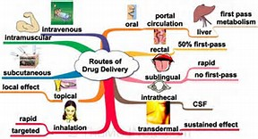
Routes of Drug Administration
Parental Route a drug to be injected by parental route must be sterile.
Intradermal-hypodermic needle into dermis
Intravenous-hypodermic needle into veins
Subcutaneous-Injection into the skin
Intramuscular-injection into muscle
Transdermal: Transdermal is a route of administration wherein active ingredients are delivered across the skin for systemic distribution
Oral-Oral administration (per os) is a route of administration where a substance is taken through the mouth
Inhalation-topical local anesthesia Inhalational, e.g. asthma medications
Pharmacorama.(2015).Routes of drug administration. Retrieved April 20, 2015 from http://www.pharmacorama.com/en/Sections/Pharmacokinetics-5.php
Notes:
Just read from screen it will flow better

Slide 7
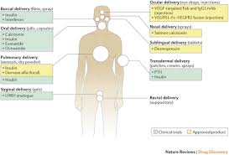
Methods of Drug Administration
Topical-Usually for a local effect, a substance is applied directly where its action is desired. Epicutaneous (application onto the skin), e.g. allergy testing,
Eye drops-Eye drops (onto the conjunctiva), e.g. antibiotics for conjunctivitis
Ear drops-such as antibiotics and corticosteroids for otitis externa
Transdermal-Transdermal (diffusion through the intact skin), e.g. transdermal opioid patches in pain therapy
Notes:
Just read from screen it will flow better

Slide 8
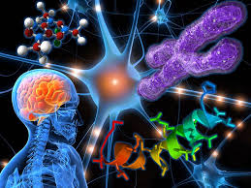
Pharmacology Definition
Addiction-Compulsive use of drugs
Antidote-medicine to counter act poison
Drug Interaction-A drug chemical that may increase or decrease the effectiveness of a drug
Drug Tolerance-A persons response to a drug that lessen or increase the intensity that the drug works
Merriam-Webster.(2015).Medical dictionary: Pharmacology. Retrieved April 20, 2015 from http://www.merriam-webster.com/medical/pharmacology
Notes:
Just read the descriptions from the screen and comment on one that you know. When you get to Placebo you can say”This a pill that makes you feel better but has no chemicals in the pill, it has been proven to be effective
It was better not to split up because it looks sloppy when you have continued on the presentation. This way its clean.

Slide 9
Pharmacology Definition (cont)
Placebo-Harmless pill prescribed for the physiological benefit of the patient
Prophylaxis-The preventing of a disease
Side effects-physical or mental affects of a drug
Toxicity- is a degree to which substance can damage an organism
Merriam-Webster.(2015).Medical dictionary: Pharmacology. Retrieved April 20, 2015 from http://www.merriam-webster.com/medical/pharmacology
Notes:
Just read the descriptions from the screen and comment on one that you know. When you get to Placebo you can say”This a pill that makes you feel better but has no chemicals in the pill, it has been proven to be effective
It was better not to split up because it looks sloppy when you have continued on the presentation. This way its clean.

Slide 10
Thank you
Thank you for listening to my presentation today!

Slide 11
References
Drugs.com(2015).Definition of Drugs. Retrieved April 20, 2015 from http://www.drugs.com
Merriam-Webster.(2015).Medical dictionary: Pharmacology. Retrieved April 20, 2015 from http://www.merriam-webster.com/medical/pharmacology
Pharmacorama.(2015).Routes of drug administration. Retrieved April 20, 2015 from http://www.pharmacorama.com/en/Sections/Pharmacokinetics-5.php

