Slide 1
Phrenology and the Chernobyl Accident.
[FIRST NAME LAST NAME]
[INSITUTIONAL AFFILIATION]

Slide 2
Part 1: The Evolution of Phrenology
In the 18th century, “Phrenology is a defunct field of study, once considered a science,” (Stanford Medicine, 2015, para. 1). A. Franz Joseph Gall based himself on the fact that the brains of humans are very different from those of other mammals.
“Phrenology enjoyed great popular appeal well into the 20th century but has been wholly discredited by scientific research,” (Encycolpaedia Britannica, n.d., para. 1).
A. Ablation was used to disprove localization suggested by phrenology, (Goodwind, 23)

Slide 3
The Methodology of Phrenology
Phrenology is based on a process in which an individual’s skull is felt by hand so as to identify the individuals psychological attributes.
This method seeks to analyse the indentations and/or enlargements on an individual’s skull.
They also extensively employed a craniometer to make the intricate measurements.

Slide 4
Example 1: Before Ablation Was Used.
Phrenology divided the brain into 37 different areas each responsible for and attributed for a certain task, (Wells, n.d.)
The size of each determined the capabilities you had in that area.
(Wells, n.d.)

Slide 5
Example 2 Pivotal Change: The Use of Ablation
Flourens removed parts of the brain and tested how the human subject responded, (Goodwind, 23).
The brain parts removed did not concur with the projected model of phrenology.

Slide 6
Example 3 Modern Concept: Conceptual Understanding of the Brain
“Your brain contains billions of nerve cells arranged in patterns that coordinate thought, emotion, behavior, movement and sensation,” (Mayo Clinic, 2015).
The understanding of the human brain has considerably changed since the inception of phrenology.
Current theories such as Catell’s human personality model effectively define people’s personalities

Slide 7
Part 2 Historical Event: The Chernobyl Accident
Happened in April 26, 1986 in Ukraine.
Released radioactive elements into the atmosphere of much of Europe.

Slide 8
Social and Historical Context
The event happened as an accident and was not caused by any historical or social factors.
Previous awareness of the great destructive potential and extensiveness of radioactive materials was not known.

Slide 9
Impacts of Historical Event
The Chernobyl Disaster considerably helped in understanding the pseudoscience of phrenology.
Phrenology held that the shape of the contours of one’s head can be used to decode their personality and character.
The disaster’s victims experienced considerable psychological trauma that could not be attributed to the shape and contours on their heads
The effects of the Chernobyl disaster includes deformed foetuses and babies. The shapes and contours of these victims cannot be used to decode their personality.

Slide 10
Supporting Example 1
Nuclear plants now require voter approval, contamination guidelines to be met, and economic feasibility, (Hendrick, 2015, para. 1).
These implementations for all power plant began around the time of the accident.
“The authorities of the Soviet Union and, later, of the Commonwealth of Independent States (CIS) spent huge resources to deal with the consequences of the accident. Efforts were made to clean up contaminated areas and to reduce the amount of radioactivity in food and drink with varying degrees of success,” (GreenFacts, 2006, para. 4).

Slide 11
Supporting Example 2
The Chernobyl accident has considerably shaped human understanding of the world through the understanding of the psychological effects of radio active energy.
The inherent risks associated with radioactive power production has led to extensive research on the effects of radioactive material on the human brain and body.

Slide 12
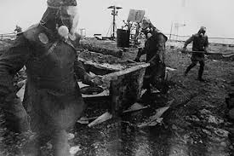
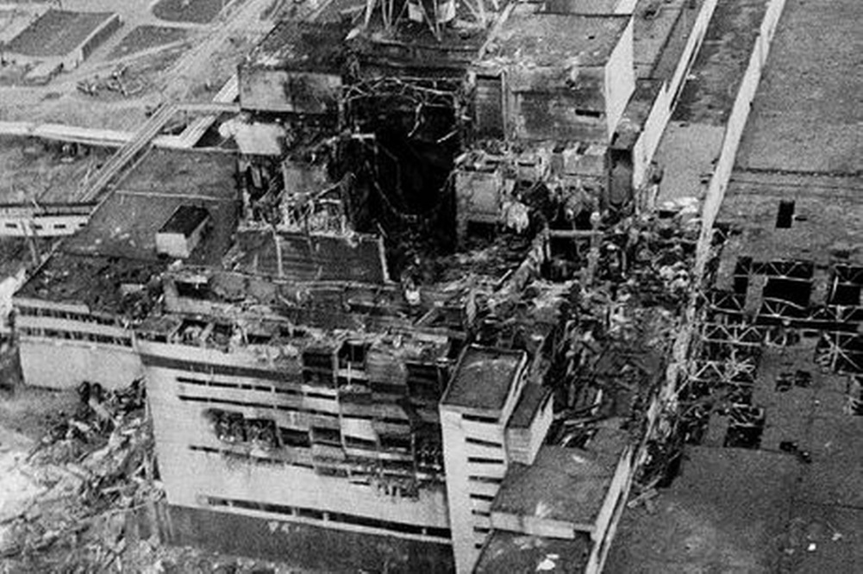
Images

Slide 13
References
Encyclopaedia Britannica. (n.d.). phrenology | pseudoscientific practice | Encyclopedia Britannica. Retrieved from http://www.britannica.com/EBchecked/topic/458369/phrenology
Goodwin, C. J. (2010). Research in psychology: Methods and design. Hoboken, NJ: Wiley.
GreenFacts. (2006). Chernobyl Nuclear Accident. Retrieved from www.greenfacts.org/en/chernobyl/
Hendrick, S. (2015, March). STATE RESTRICTIONS ON NEW NUCLEAR POWER FACILITY CONSTRUCTION. Retrieved from www.ncsl.org/research/environment-and-natural-resources/states- restrictions-on-new-nuclear-power-facility.aspx
Mayo Clinic. (2015). Slide show: How your brain works - Mayo Clinic. Retrieved from http://www.mayoclinic.org/brain/sls-20077047
Stanford Medicine. (2015). Phrenology Lab - Treatment Options - Student 5 Class Practice Site - Stanford Medicine. Retrieved from http://med.stanford.edu/medwebtraining/shc- class/student5/treatments/phrenology-lab.html
Wells, S. R. (n.d.). Phrenology. Retrieved from http://www.bc.edu/bc_org/avp/cas/fnart/phrenology/phrenology_frames.html

