Slide 1
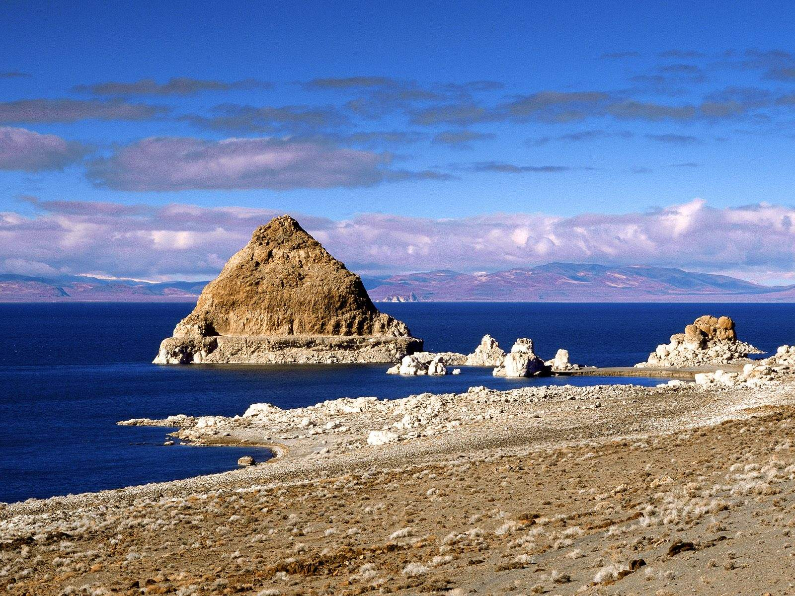
Pyramid Lake,
Nevada: A Valuable Resource
For the Northern Piaute Indian Tribe and the World

Slide 2
This presentation will cover:
Geography/Area Map
Biotic and Abiotic Statistics
Recent History and Human Impact
Traditional Use of Fish
More Human Impact – Some Positives
The 1970s and Beyond
Future Human Impact/Conclusion
References

Slide 3
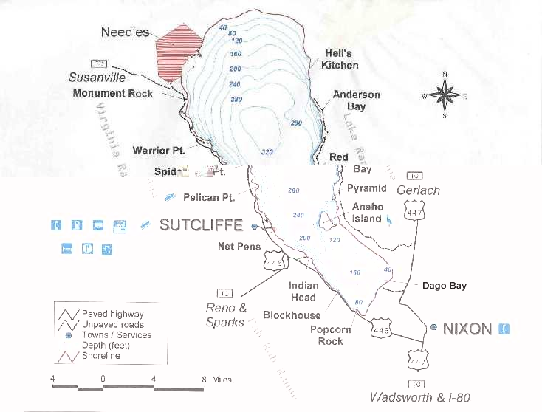
Pyramid Lake Area Map
Location: approximately 65 miles north of Carson City, Nevada

Slide 4
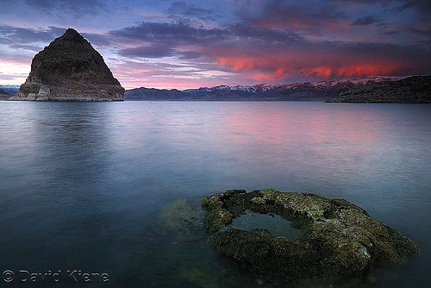
Biotic and Abiotic Statistics
Elevation: 3,817 feet
Acreage: 112,000
Length 15 miles
Width: 11 miles
Deepest Point: 350 feet
Salinity content: 17%
Permanent surface inflow:
Truckee River (from Lake
Tahoe)
Rainfall level: 7.5 in/yr.
Sunset on Pyramid Lake

Slide 5
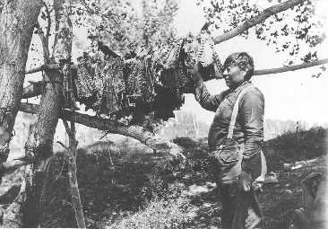
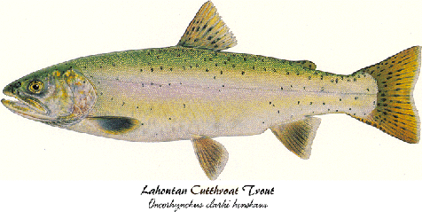
Traditional use of fish: A Valuable Resource
Cui-ui fillets drying in a tree (Paiute - Herbert Pancho, 1930)
Lahontan Cutthroat Trout

Slide 6
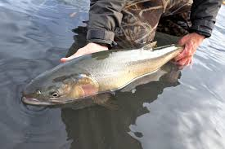
Recent History and Human Impact
1950s and 1960s
Truckee River was used to grow and support Reno and Sparks, Nevada
A number of erected dams created a delta at the mouth of Pyramid Lake - fish couldn’t get upstream to spawn
The river was in a state of degradation from the dumping of waste from companies upstream
Lahontan Cutthroat Trout

Slide 7
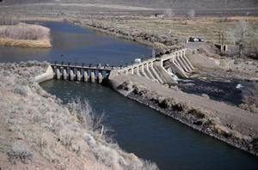
Derby Damn
Location: On the Truckee River approximately 20 east of Reno, Nevada - constructed in 1905
Derby damn provides irrigation water for about 73,000 acres of cropland - reducing water needed to support marine (and other) life

Slide 8
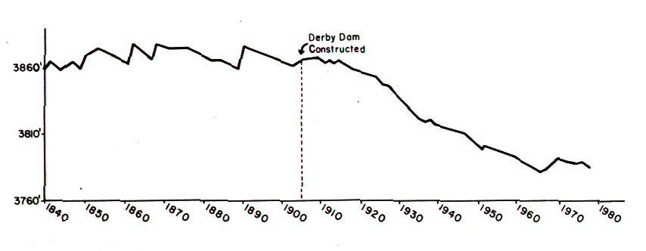
Pyramid Lake water levels from 1840 to 1980
Building the Derby Damn caused the near extinction of the Lahontan Cutthroat Trout

Slide 9
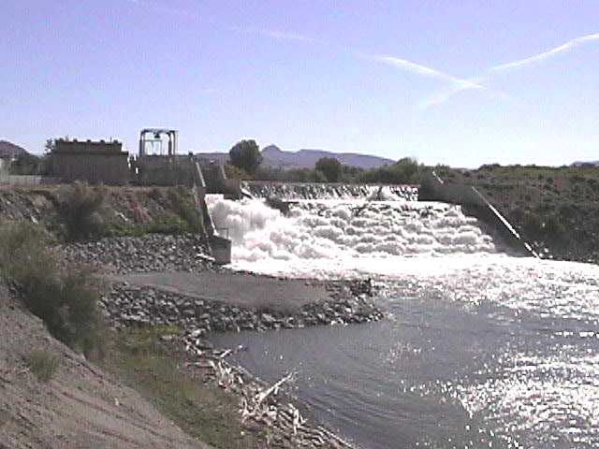
Marble Bluff Damn
Location: On the Truckee River approximately 2.3 miles upriver from Pyramid Lake
Constructed in 1975, by the Bureau of Reclamation
Poses a barrier to the efficient passage of the cui-ui

Slide 10
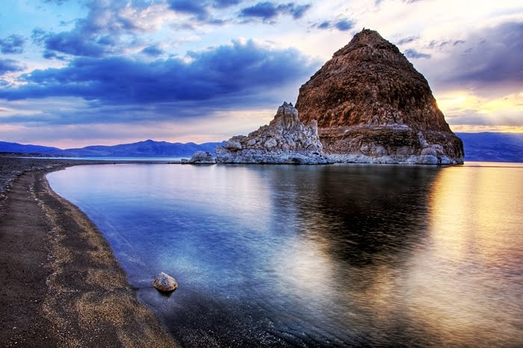
More Human Impact – Some Positives
1960’s
The U.S. fish and Wildlife, the Bureau of Land Management (BIA), and the tribe stepped in to help with the environmental problems
1970’s
Endangered Species Act listed the Cui-ui as an endangered species
The Marble Bluff damn was modified to allow safe passage of the fish

Slide 11
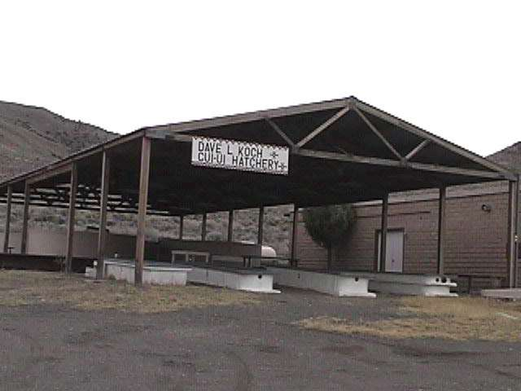
The 1970s and Beyond
Clean Water Act and creating the Environmental Protection Agency (EPA) = better water quality
1990 - the tribe was awarded water rights
The tribe set up hatcheries to protect the Cui-ui and the Lahontan Cutthroat Trout
Koch Cui-ui Hatchery
David Dunn Hatchery

Slide 12
Future Human Impact/Conclusion
Pyramid Lake is a valuable natural resource, especially for the Northern Piautes......steps have been taken, but more can always be done!!

Slide 13
References
NPS. (n.d.). Derby Diversion Dam Nevada. Bureau of Reclamation
Historic Dams, Irrigation Projects, and Powerplants: Managing
Water in the West. Retrieved from
http://www.nps.gov/nr/travel/ReclamationDamsIrrigationProject
ndPowerplants/Derby_Diversion_Dam.html
Pyramid Lake Fisheries. (n.d.). Welcome to Pyramid Lake Fisheries!
Retrieved from http://www.pyramidlakefisheries.org/
Smith, D. H. (2000). Modern tribal development: Paths to self-sufficiency
and cultural integrity in Indian country. Walnut Creek, CA: AltaMira
Press.

