Slide 1
Racial and Ethnic Disparities in Healthcare
Student’s Name
Institutional Affiliation
Date

Slide 2
Disparities in Access to Healthcare
The main points highlighted in this presentation focus on the disparities in access to healthcare.
Essential elements like access to health insurance and the socioeconomic status of an individual however, do not enlighten all of the racial and ethnic disparities in access to care.
The minority Americans are more likely to have a high probability of experiencing problems accessing high-quality healthcare as compared whites.

Slide 3
Factors deterring access to healthcare
Geographical isolation – this makes finding and locating healthcare very difficult.
Language and cultural barrier – limits non-English speakers from pursuing healthcare
Availability of support services such as transportation and childcare is scarce.
Notes:
The disparity in access is particularly challenging since people without a stable, ongoing relationship with a primary doctor are less likely to get specialty and preventive services, therefore are less likely to experience better health outcomes.

Slide 4
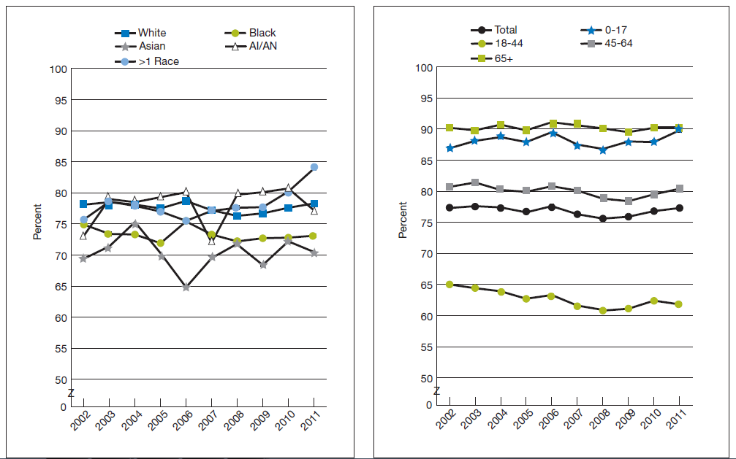
Graphical Representation
Notes:
In overall, about 77.3% of the individuals had a frequent principal doctor or care provider, in year 2011.
Between the year 2002 to 2011, the Asians and Blacks were less likely compared to Whites to have a frequent or usual main care doctor in all years except 2004.

Slide 5
Interpretation
The graph represented above gives factual figures of the people who have frequent primary care provider (doctor), arranged by race and age, from the years of 2002-2011
Note: A regular primary doctor is defined as the source of health care that an individual often goes to for professional medical advice, for example, preventive health care, referrals to other health professionals and new health problems.
Notes:
In all years, individuals between the ages 1of 8-44 were least likely to have a regular chief doctor, while folks of the age 65 and above were highly probable to have a regular doctor (in the year 2011, 61.8% and 90.2%, respectively).
In all years, the proportion of individuals with a regular doctor was higher for individuals with basic activity limits and complex activity limitations compared to individuals with neither limitation.

Slide 6
Recommendations
The observed disparities can be addressed using highly targeted involvement entailing the implementation of enhanced interpreter services or culturally competent educational materials.
This would prompt the population to seek appropriate medical intervention in due time.

Slide 7
Limitations to this Study
Access to healthcare is largely determined by expectations regarding the etiology of a particular disparity or the assumed nature of the difference.
Certain disparities may be determined, for instance, by gaps in access to healthcare and insurance coverage.
These disparities can be difficult to directly address using an appropriate strategy.

Slide 8
Summary
Given the rapidly growing diversity in the demographics of America there is an increasing number of minority Americans.
This means that the amount of people at risk of disease and not getting the care they need is also increasing.
The information presents gives a snapshot of the number of diversified individuals and how they respectively have access to regular doctors.

Slide 9
References
Agency for Healthcare Research and Quality. National Healthcare Disparities Report. 2014.
Agency for Healthcare Research and Quality. User Comparative Database Report. 2014.
Friis R. H. Epidemiology 101. Sudbury, Mass: Jones and Bartlett Publishers. 2010.

