Slide 1
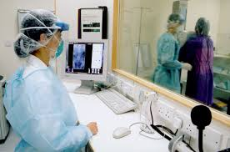
Reducing Errors in Radiology

Slide 2
Introduction
Errors occur in all professions including in medicine
As much as most of these errors are small, their consequences are huge
These consequences arise from several situations such as worker’s laxity, technological problems, and even the management discrepancies.
The veracity of these errors implies that mitigation strategies are needed to reduce the occurrence of these errors.
These errors always occur during radiology mainly because of the use of technology.
Notes:
The health sector needs a lot of care in mainly because any mistake can cost the lives of the patients and even that of the health workers. These errors have always existed for a long time in the industry. However, the entrance of the use of technology in the industry has increased the chances of errors occurring. Most of these errors occur mainly because of the laxity of the health workers. The nature of the industry requires that the workers are properly qualified for their respective jobs. However, this is not the case as some educational institutions. Moreover, the workers need to be very careful when dealing with radiological practices.

Slide 3
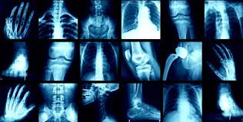
What are medical Errors?
The definition of medical errors is different from any other definition of errors
This is because the definition is dependent on the situation of the error.
Mismanagement is always the main cause underlying these errors
However, these errors are not intentional but occur due to laxity.
Therefore, this definition depends on the adversity of the events underlying an error rather than the initial medical condition on the patient.
In essence, medical errors are in several forms including omission, planning, deviation from standard care and execution
Notes:
The definition of medical terms is different from a nonprofessional’s definition in that it needs knowledge of the events in the industry. Indeed, medical errors have different definition from regular errors because it needs an analysis of the nature of the problem. The events prior and after the error should be studied to ascertain the underlying cause of the error. This should be done obtain the real cause of the error. In essence, prior medical condition of the patient does not affect the occurrence of an error. Hence, the consequences that occur because of the patient’s condition cannot be termed as errors

Slide 4
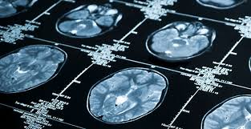
Causes of Medical Errors Patient Handovers
This implies the transfer of a patient from one health care giver, which may be a physician or an institution, to another.
These events need to be handled well since the next care giver relies from the data presented by the previous caregiver.
The departments in the hospital usually carry out patient handovers because of specialization in these departments.
Since radiology department is complementary to other departments, handovers are always frequent.
The solution to this challenge is the improvement of cooperation and communication between the health workers in every institution.
Notes:
The fact that one department cannot possess all the requirements for the treatment process implies that every health care institution has to be segmented into various segments. this also implies that patients have to move from one department to the next during their diagnosis and treatment. The Radiology department is very important aspect for other departments and the treatment of malignant growths. This implies that patients are passed from other departments to the radiology department for diagnosis or treatment. Bad communication and lack of teamwork lead to errors during these handovers. This becomes one of the causes of errors in radiology. The solution to this problem is enhancement of communication between one healthcare worker and the next. The institution should also find ways of creating unity and cooperation between members of different departments.

Slide 5
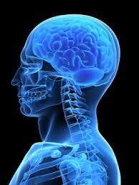
Worker Fatigue
Sleep is a very important component in human life
It is also one of the elements that cause fatigue especially when one lacks it.
The notion that hardworking and motivated people have little sleeping time has affected the industry.
A constant lack of enough sleep leads to chronic fatigue
This fatigue has a positive correlation with medical errors especially in the radiology department
The solution should come from the government since a small number of health professionals in service causes the fatigue.
This will allow the health workers enough resting time
Notes:
Fatigue is one of the causes of errors in many fields. These errors are frequent in busy professions such as those in the health care industry. Indeed, the health care industry requires the workers presence at all times. This fact is aggravated by the fact that there are few healthcare professionals working in these hospitals. Moreover, radiology departments have few professionals implying that fatigue affects these individuals all the time.

Slide 6
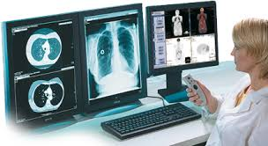
Mitigation Strategies Safety Culture
The nature of the causes of errors in radiology indicates that solutions should emanate from both the management and the workforce.
The hospital should establish certain rules that govern the safety of the operations in any hospital
All these rules and regulations should span all the departments in the hospital including the radiology department.
Thus, radiologic professionals are required to operate according to some safety standards related to the nature of their work.
They are also required to maintain cultural safety during the imaging operations
Notes:
Every health care facility should understand the importance of safety in all medical operations because of the value of human life. Radiology department and its operations utilizes devices that are sometimes dangerous to use. This implies that the technologists in this department should possess certain attributes such as carefulness in the sector. However, the most effective tool is the establishment of a safety culture in the department that rhymes with the safety culture of the whole institution. This will eliminate the chances of having errors in radiology.

Slide 7
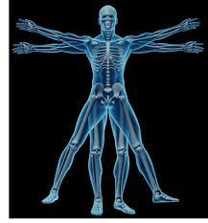
Checklists
The first step in getting rid of medical errors is identifying their root cause then working to eliminate the cause.
Errors in radiology department are similar for various institutions
This implies that reported errors can be documented and then used to create solutions
Checklists are then created to help in checking the progress of reducing the challenges in the industry.
Notes:
Checklists are very important components in the process of finding a solution to a given problem. It allows the individuals concerned to check the progress of the process of finding a solution. Additionally, checklists are appropriate for the learning process because they contain all the details about a particular case. These checklists will be appropriate in making sure that the health care workers know where to anticipate particular problems and how to deal with such problems when they occur. Moreover, they are helpful in designing a safety culture for a particular institution since it notes the areas that need to be addressed.

Slide 8
Conclusion
Just as life is, errors are unavoidable in medical practice especially in radiology where most activities depend on machines and other technological devices. This presents a need for carefulness and competency especially in this field because of the veracity of the consequences related to the errors. As much as most of these errors can be avoided, they cannot be eliminated completely. However, several strategies can help in minimizing the occurrence of these errors. The process of identifying a solution requires that the causes of these errors are identified and then used to create the needed solution. In essence, the mitigation strategies depend on the causes of the errors in radiology. The process needs cooperation and a good communication between all the employees and the management. Moreover, the government should employ more health care workers to reduce the chances of fatigue.

