Slide 1
Group Five Theories Presentation
Roy/Kolcaba

Slide 2
Historical Period - Sister Callista Roy
Sister Callista Roy was born in October 14, 1939 in Los Angeles, California.
1974- Roy’s Adaptation Model was formed, stating individuals seeking equilibrium through the process of adaptation; identified six physiological needs:
(exercise and rest; nutrition; elimination; fluid and electrolytes; oxygenation and circulation; and regulation and temperature, sense and endocrine system) (Zerwekh, & Claborn, 2009, p. 165).
While many nursing theories are related to the historical context in which they were derived, Sister Roy’s theory primarily focuses on nursing needs in modern society and therefore are highly applicable to current nursing practices.

Slide 3
Historical Period - Katherine Kolcaba
Comfort Theory was first presented in 1991 and continued to developed through 2001 (“Katherine Kolcaba,” n.d.).
After years of refinement, Comfort Theory was applied to institutional integrity. In order to expedite and assist organizations, institutional outcomes were included to explicitly identify practical applications in the healthcare environment (Kolcaba, 2001, p. 88).
Most influencing theories include:
Ida Jean Orlando-1961/1990 Nursing Process Theory (Relief)
Virginia Avernal Henderson 1978 Need Theory (Ease)
Josephine Patterson and Loretta Zderad 1976/1988 Humanistic Nursing Theory (transcendence) (“Katherine Kolcaba,” n.d.).

Slide 4
Educational Background
Roy
1963 Graduated with a Bachelor of Arts with a major in nursing from Mount St. Mary's College, Los Angeles (Vera, 2014).
1966 Master's degree in pediatric nursing - University of California (Vera, 2014).
1973 and 1977 Master’s and PhD in Sociology (Vera, 2014).
She is a sister of St. Joseph of Carondelet (Vera, 2014)
Kolcaba
1965 Graduated with diploma of nursing from St. Luke’s Hospital School of Nursing (“Katherine Kolcaba,” n.d.).
1987 Graduated with Registered Nurse (RN) and her Masters in Nursing (MSN) from Frances Payne Bolton School of Nursing, Case Western Reserve University (CWRU) (“Katherine Kolcaba,” n.d.).
1997 Graduated with PhD Nursing from Case Western Reserve University (“Katherine Kolcaba,” n.d.).

Slide 5
Experiential Background - Roy
The Roy Adaptation Model for Nursing had its beginning when Sister Callista Roy entered the University of California’s masters program in pediatric nursing. Roy was influence by her advisor and seminar faculty, Dorothy E. Johnson (Boston College Connell School of Nursing, 2013).
Roy learned about the concept of adaptation and was impressed with the resiliency of children. At the first seminar in her masters program, she proposed that the goal of nursing was promoting patient adaptation. After that Johnson encouraged her to develop this concept of adaptation as a framework for nursing. The view of the person as an adaptive system took shape from this early work (Boston College Connell School of Nursing, 2013).
The model’s second phase was developed over 17 years of work with faculty at Mount St. Mary's College. In 1970, the model became the framework for a nursing-based curriculum (Boston College Connell School of Nursing, 2013).

Slide 6
Experiential Background - Roy (cont.)
The first three textbooks about the adaptation model came about in 1976, 1984 and 1991 (Boston College Connell School of Nursing, 2013).
By 1987 at least 100,000 nurses had been educated in programs using the Roy Adaptation Model (Boston College Connell School of Nursing, 2013).
By the late 1990s Roy felt an urgency to re-define adaptation. She looked at spirituality and science and their relation to adaptation (Boston College Connell School of Nursing, 2013).
A content analysis was done on 500 samples of patient behavior from all clinical areas. The nursing students collected the data for physiologic, self-concept, role function and interdependence categories. The four adaptive modes were added as the ways in which adaptation is manifested. These modes became the basis for nursing assessment (Boston College Connell School of Nursing, 2013).

Slide 7
Experiential Background - Kolcaba
During the development of the comfort theory, Kolcaba conducted a concept analysis of comfort that examined literature from several disciplines including nursing, medicine, psychology, psychiatry, ergonomics, and English. This review confirmed that comfort is a positive concept and is associated with activities that nurture and strengthen patients (March & McCormack, 2009, p.76).
1991 Published article: An analysis of the concept of comfort. Journal of Advanced Nursing (“Katherine Kolcaba,” n.d.).
1991 Published article: A taxonomic structure for the concept of nursing. Journal of Nursing Scholarship (“Katherine Kolcaba,” n.d.).
1994 Published article: A theory of holistic comfort in nursing. Journal of Advanced Nursing (“Katherine Kolcaba,” n.d.).
Began developing a diagram of the aspects of comfort. Article also includes six defining factors that examine why comfort is a significant middle range theory (“Katherine Kolcaba,” n.d.).

Slide 8
Experiential Background - Kolcaba (cont.)
1995 Published article: The art of comfort care. Journal of Nursing Scholarship (“Katherine Kolcaba,” n.d.).
2000 Published article: Empirical evidence for the nature of holistic comfort. Journal of Holistic Nursing (“Katherine Kolcaba,” n.d.).
2001 Published article: Evolution of the mid-range theory of comfort for outcomes research. (Kolcaba, 2001).
2003 Published book Comfort Theory and Practice: A Vision for Holistic Health Care and Research (“Katherine Kolcaba,” n.d.).
2005 Published article: Comfort Theory and its application to pediatric nursing. Pediatric Nursing (“Katherine Kolcaba,” n.d.).
Article applies Comfort Theory to pediatrics, while explaining the current approach to pediatrics as attempting to relieve discomfort (“Katherine Kolcaba,” n.d.).

Slide 9
Philosophical Foundations - Roy
Persons have mutual relationships with the world and God
Human meaning is rooted in an omega point convergence of the universe
God is intimately revealed in the diversity of creation and is the common destiny of creation
Persons use human creative abilities of awareness, enlightenment, and faith
Persons are accountable for the processes of deriving, sustaining, and transforming the universe
(Boston College, Connell School of Nursing, 2013)

Slide 10
Philosophical Foundations - Kolcaba
Nurse scientists are beginning to explore the effectiveness of broadly targeted interventions such as progressive muscle relaxation, imagery, and therapeutic touch. These interventions and others are intended to elicit positive whole person responses and thus would be measured most accurately by whole person outcomes. Whole person responses have been difficult to operationalize because of their complicated content domains, possible carry-over effects between components of the outcome, and the theoretical difficulties of interpreting a total score. However, comfort is a holistic outcome that accounts for whole person responses and it has been previously operationalized (Kolcaba, 1992).
The basic assumptions of the theory of comfort are that:
human beings have holistic responses to complex stimuli
comfort is a desirable holistic outcome that is germane to the discipline of nursing
human beings strive to meet, or to have met, their basic comfort needs. (Kolcaba, 1992).

Slide 11
Main Theoretical Components for the Roy Adaptation Theory
Level of Abstraction
Primary Focus
Roy’s Adaptation Theory is used by most professionals in areas of human science and humanities. The system is vital in the field of nursing simply because it helps in development of structural framework used for practice and aids to further nursing knowledge providing an understanding of nursing scientific process and in the nursing role for setting health standards (Polit & Beck, 2012).
Roy’s model helps the nursing profession with a framework to aid further model-based research. The Theory of Adaptation model has helped shape the profession and nursing practice at length (Polit & Beck, 2012).
Her nursing theory is important to the modern treatment of patients. Her definitions of metaparadigms are; “Person: biopsychosocial being seeking equilibrium; Nursing: manipulates the stimuli to promote coping; Health: successful coping with stressors” (Zerwekh, & Claborn, 2009, p. 167).
The primary focus includes the evaluation of whether nurses within healthcare institutions currently use the adaptation model and how they believe this has changed their practice (Andrews & Roy, 1991).
It will be necessary to determine the impact that implementing this model has as an intervention to enhance nursing best practices (Andrews & Roy, 1991).
This question will be explored by providing nurses with surveys that will assess the aforementioned questions in addition to providing nurses with information about the adaptation model that will facilitate its use in the healthcare setting (Andrews & Roy, 1991).

Slide 12
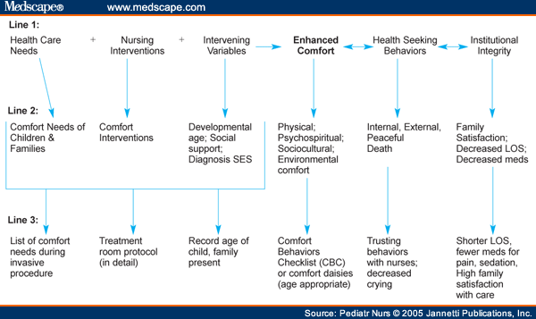
Main Theoretical Components for Kolcaba’s Comfort Theory
Level of Abstraction
Primary Focus
The Theory of Comfort is a mid-range theory for nursing practice and research. It is a mid-range theory because of the limited number of concepts and propositions, low level of abstraction, and ease of application to actual practice.
In order to use the theory, three steps are required:
(a) understanding the technical definition of comfort and its origins
(b) understanding the relationships (propositions) between the general concepts entailed in the theory
(c) relating the general concepts to specific pediatric problems/settings in order to enlighten practice and generate research questions (Kolcaba & DiMarco, 2005).
Comfort is a positive outcome that has been linked empirically to successful engagement in seeking behaviors and theoretically to positive institutional outcomes such as higher patient satisfaction (Kolcaba & DiMarco, 2005).

Slide 13
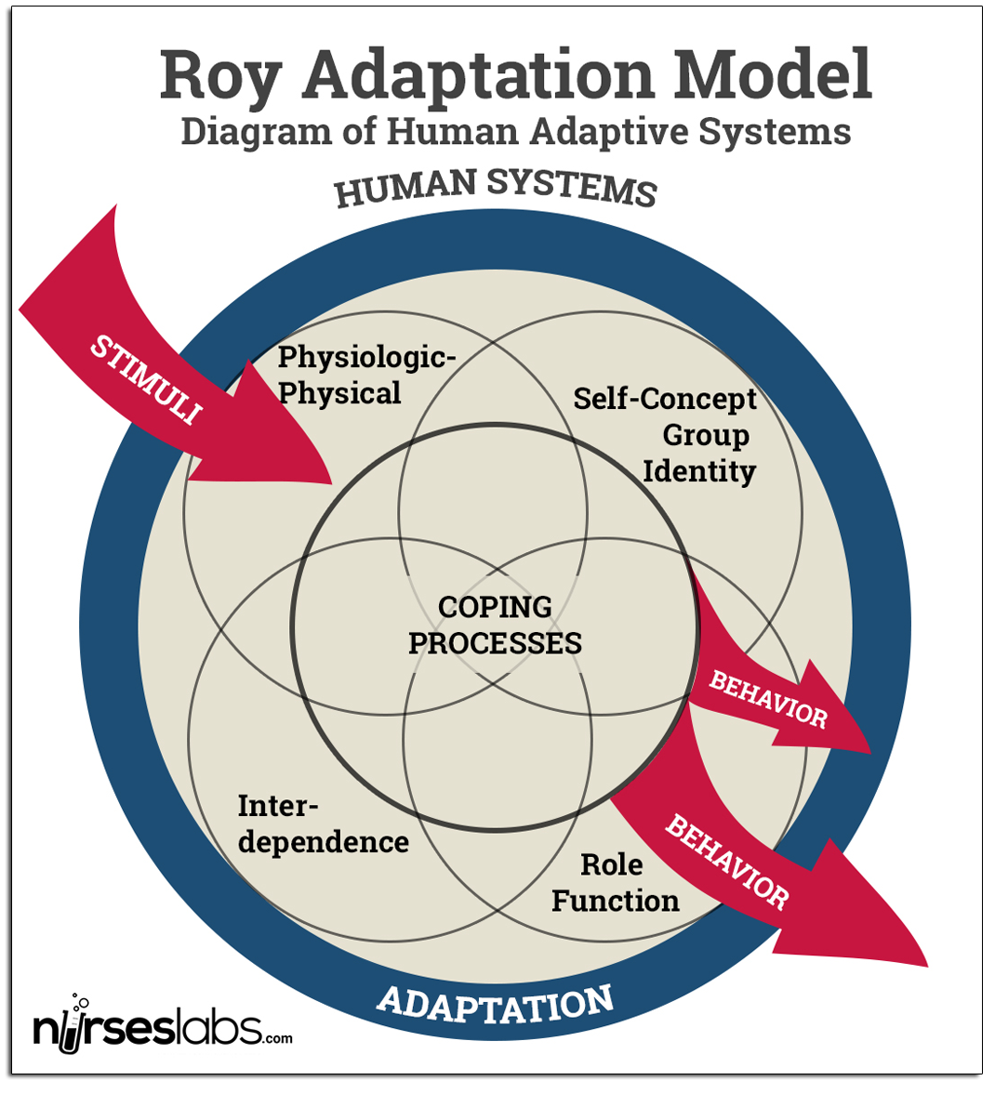
Applying Roy’s Adaptation Model in Practice
To ensure that the adaptation model of nursing can be adequately used to promote human health, nurses must follow a six-step process that includes:
an assessment of behavior
assessment of stimuli
nursing diagnosis
goal setting
intervention
evaluation (Rambo, 1984).
This understanding of the recovery process can be used to enhance patient health. It is therefore to train nurses to use this model and assess whether they believe that its implementation would be valuable to their practice (Rambo, 1984).

Slide 14
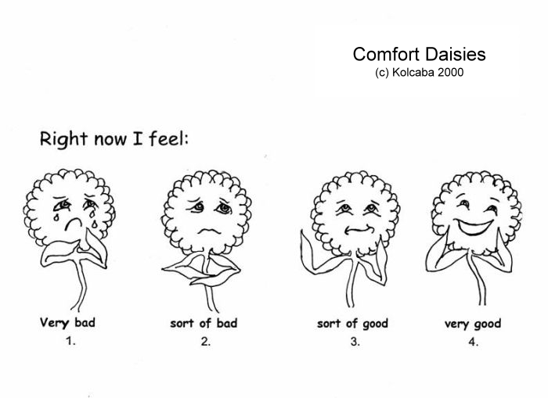
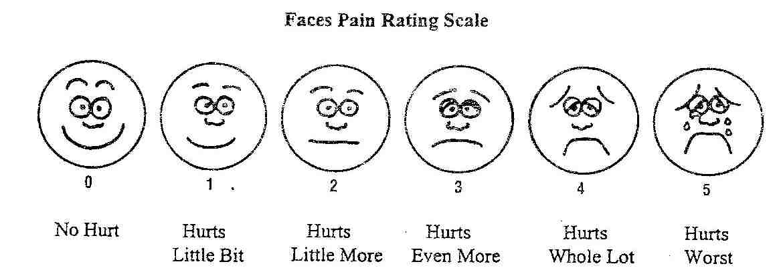
Applying Kolcaba’s Comfort Theory in Practice
The Comfort Daisies were developed by Katharine Kolcaba and the Faces Pain Rating Scale is used in pediatric hospitals all over the United States. “Patients with pain may have problems completing long questionnaires. The important aspects of selecting a pain scale for patients with stroke are that it should be short and easily understandable, place a low burden on patients, and be reliable when replicated” (Li-Ling, Ching-Yi, Keh-Chung, & Ching-Ju. 2014. pp. 135-136).

Slide 15
Christian Worldview
Roy
Kolcaba
God is intimately revealed in the diversity of creation and is the common destiny of creation (Shelly & Miller, 2006, p. 47).
Persons have mutual relationships with the world and God (Boston College Connell School of Nursing, 2013).
“The theories of … Sr. Callista Roy represent[s] the influential of General Systems Theory (GST) and the comprehensive sense of holism. …Roy acknowledge[s] God in some way… we can see the strong influence of biblical views in the concept of person, health, environment and nursing” (Shelly & Miller, 2006, p. 50).
Christian nursing is a ministry of compassionate care for the whole person in response to God’s grace towards a sinful world, which aims to foster optimal health (shalom) and bring comfort in suffering and death for anyone in need (Shelly & Miller, 2006, p. 244).
Comfort is related to a Christian Worldview because comfort is a common practice as a Christian nurse. Christian nursing is holistic and caring for the whole person as Kolcaba’s theory is related to comfort and caring for the whole person. Christian nursing also means providing comfort hope and compassionate care for those who are suffering (Shelly & Miller, 2006, p. 254).

Slide 16
References
Andrews, H. A., & Roy, C. (1991). The adaptation model. Norwalk, CT: Appleton & Lange.
Boston College Connell School of Nursing (2013). The Roy adaptation model. Retrieved from https://www.bc.edu/schools/son/faculty/featured/theorist/Roy_Adaptation_Model.html
Katherine Kolcaba: Middle range nursing theorist. (n.d.). Retrieved from https://sites.google.com/a/northgeorgia.edu/middle-range-nursing-theorist-presentation/background-of-theory-development
Kolcaba, K. (1994). A theory of holistic comfort for nursing. Journal of Advanced Nursing, 19(6), 1178-1184. http://dx.doi.org/10.1111/j.1365-2648.1994.tb01202.x
Kolcaba, K. (2001). Evolution of the mid-range theory of comfort for outcomes research. Nursing Outlook, 49(2), 86-92. Retrieved from http://www.ncbi.nlm.nih.gov/pubmed/11309563

Slide 17
References
Kolcaba, K., & DiMarco, M. (2005). Comfort theory and its application to pediatric nursing. Pediatric Nursing, 31(3), 187-194. Retrieved from http://www.medscape.com/viewarticle/507387
Kolcaba, K., & Kolcaba, R. J. (1991). An analysis of the concept of comfort. Journal of Advance Nursing, 16(11). 1301-1310. http://dx.doi.org/10.1111/j.1365-2648.1991.tb01558.x
Li-Ling, C., Ching-Yi, W., Keh-Chung, L., & Ching-Ju, H. (2014). Relative and absolute reliability of a vertical numerical pain rating scale supplemented with a faces pain scale after stroke. Physical Therapy, 94(1), 129-138. http://dx.doi.org/10.2522/ptj.20120422
March, A., & McCormack, D. (2009). Nursing theory: Directed healthcare: Modifying Kolcaba’s comfort theory as an institution-wide approach. Holistic Nursing Practice 23(2), 75-80. Retrieved from http://www.sonoma.edu/users/k/koshar/n300/Kolcaba_2.pdf

Slide 18
References
Meleis, A. I. (2012). Theoretical nursing: Development & progress (5th ed.). Philadelphia, PA: Lippincott, Williams, & Wilkins.
Nursing Theory (2013). Sister Callista Roy, Nursing theorist. Retrieved from http://nurseslabs.com/sister-callista-roy/
Polit, D., & Beck, C. (2012). Nursing research: Generating and assessing evidence for nursing practice (9th ed.). Philadelphia, PA: Lippincott Williams & Wilkins.
Rambo, B. (1984). Adaptive nursing. Assessment and intervention. Philadelphia, PA: W.B. Saunders.
Shelly, J. A. & Miller, A. B. (2006). Called to care: A Christian theology of nursing (2nd ed.). Downers Grove, IL:Intervarsity Press.
Zerwekh, J., & Claborn, J. C. (2009). Nursing today: Transition and trends (6th ed.). St Louis, MO: Saunders Elsevier.

