Slide 1
SPSS PROJECT
[Writer’s Name]
[Institutional Affiliation]

Slide 2
Objectives
This project is based on the recognition and description of the SPSS software which is used for analysis of data. This paper shows how to use SPSS in doing research by using SPSS tutorial and the screenshots are attached how the SPSS program is used
The project involves the research question based on clinical research for the analysis of data and the data will be analyzed with the help of SPSS
An alternative and null hypothesis will be developed for the research question
An appropriate test of statistics using SPSS software will be done i.e. inferential and descriptive analysis for the hypothesis
The test of inference statistics will meet all the significance level and assumptions
The significance level will also be set for the hypothesis to accept or reject
The decision to accept of reject will be done with the SPSS data and the values lying within the confidence interval

Slide 3
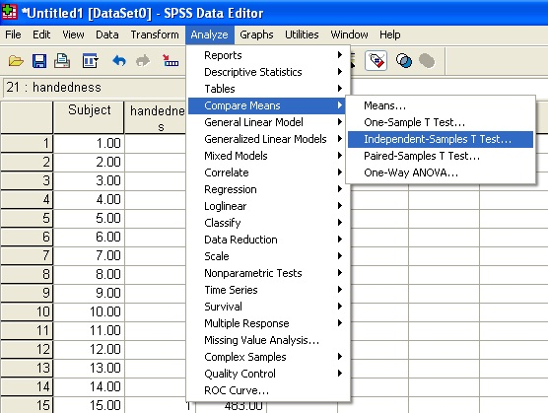
Step 1:Null and Alternative Hypothesis
The research question is that is there any relationship between quiet time (hours) and the length of stay (in days) in surgical intensive care unit?
Null Hypothesis (HO): The quiet time (hours) and the length (in days) of medical surgical setting of pediatric acute care are directly proportional to each other
Alternative Hypothesis (HA): The quiet time (hours) and the length (in days) of medical surgical setting of pediatric acute care are not directly proportional to each other

Slide 4
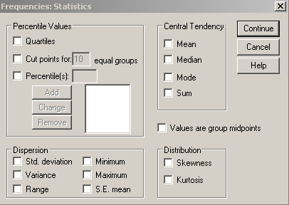
Step 2A: Descriptive Statistics
The purpose of the descriptive statistics is to show the mean, range, standard deviation and variance of the data
The dependent variable is Length (in days) whereas quiet time (hours) is the independent variable (George, 2013)
The descriptive statistics is done by going in the Analyze tab the SPSS software
Once the analyze tab is selected, go to the descriptive statistics then select it. The box of descriptive statistics will be opened which has options to select range, mean, standard deviation, error etc. (George, 2013)
The mean helps to identify the average of the data set (Fiddler et al., 2013)
The range shows the maximum and the minimum values
Standard deviation shows the dispersion of the data (Fiddler et al., 2013)

Slide 5
Steps Showing SPSS Program Descriptive Statistics
The first step is to go to the analyze tab in the SPSS program. In the analyze tab select the descriptive statistics option as seen in the screen shot
Once the descriptive stats option is selected, a new window of descriptive stats will be shown. In that window, there are various options like mean, range, standard deviation, standard error, kurtosis and skewness
Clicking on these option and then selecting OK will generate the descriptive statistics as seen in the screenshots below

Slide 6
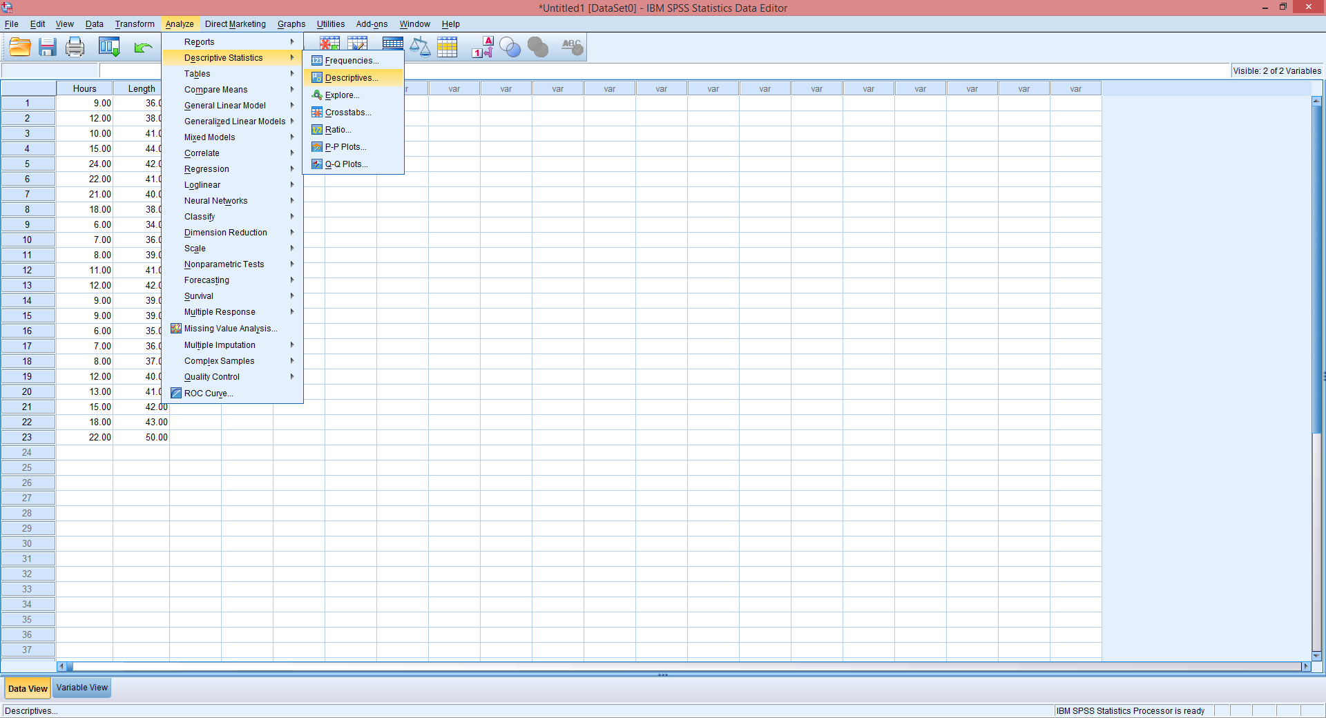
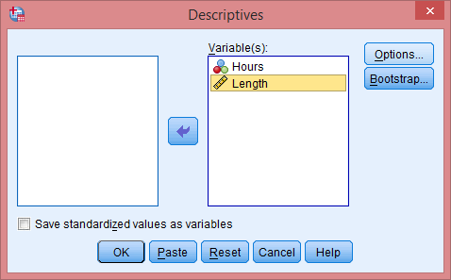
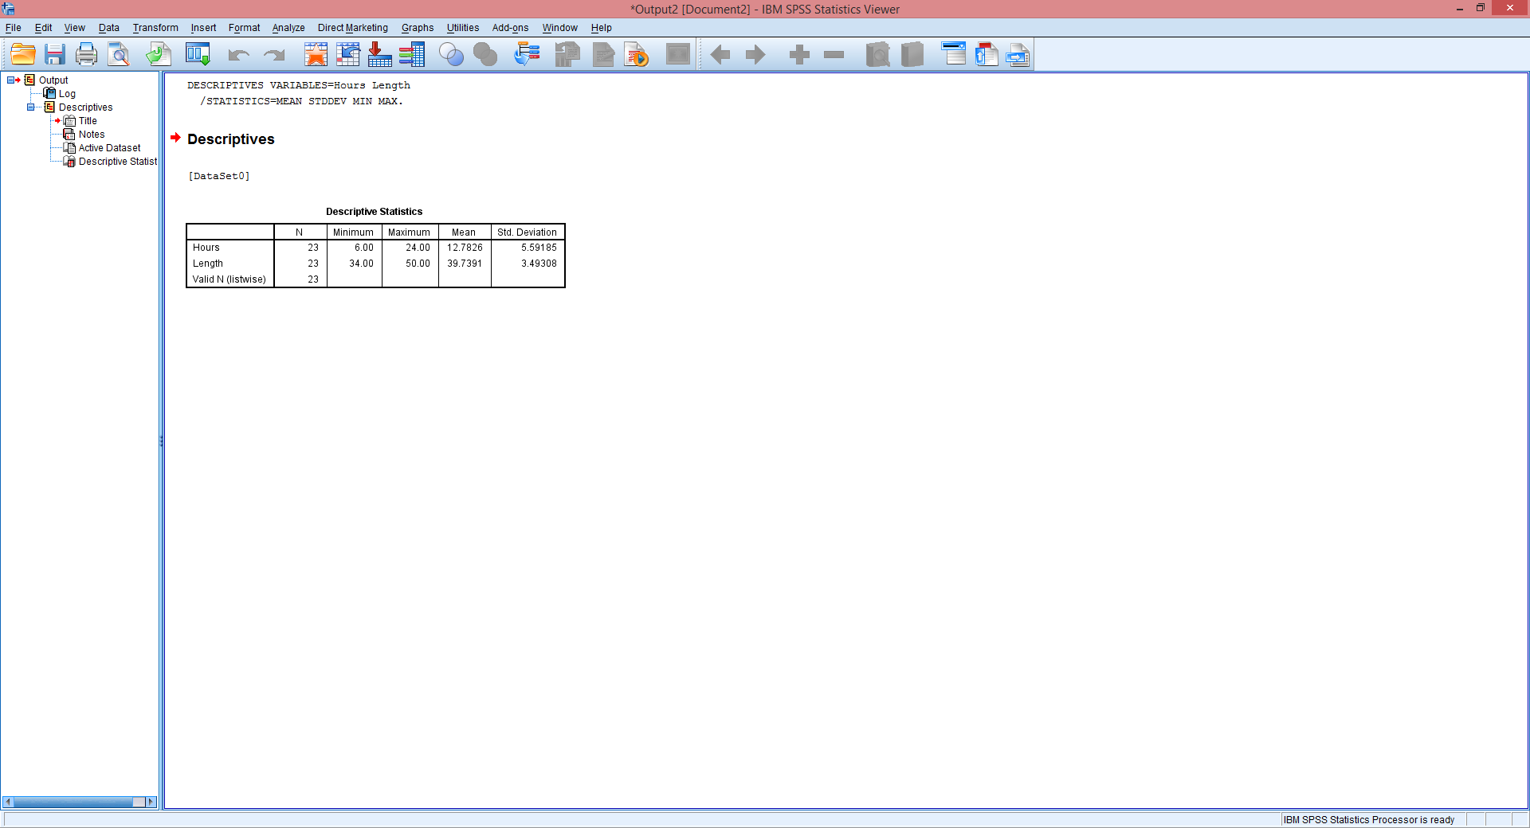
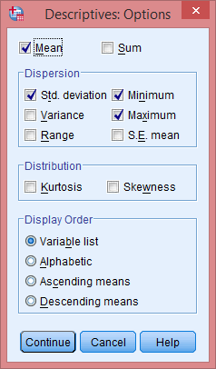

Slide 7
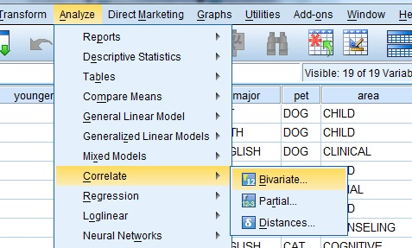
Step 2B: Inferential Statistics
The inferential statistics and data analysis statistics test used is the Correlation study using Pearson’s.
As we can see from the inferential statistics at 95% confidence intervals using correlation test, the hypothesis is accepted
The Purpose of the test is to find out that the values lies within the confidence interval to accept the hypothesis
The significance level selected is 5% and it is two tailed
Pearson’s tests shows the direction of linkage and association that exists between the 2 variables
The Pearson Correlation is used commonly for determining the linear relationship strength and the direction of the relationship of the variables

Slide 8
Step 3:Assumptions of Using Pearson’s R
Pearson’s R is used and founded on four assumptions;
The variables being measured are continuous
There’s an existing linear relationship between the variables
There should be no significant outliers
The variables should be normally distributed in approximation
These assumptions can be checked using SPSS in the following way:
The first step is to go to the analyze tab in SPSS program and then selecting the correlation study and then selecting the option of Bivariate
In the Bivariate window, the Pearson study is selected. Once the Pearson box is checked select the independent and dependent variables and then click the two tailed test
By clicking OK the SPSS program will do the correlation study between the two variables and then will show the results as seen in the screenshots

Slide 9
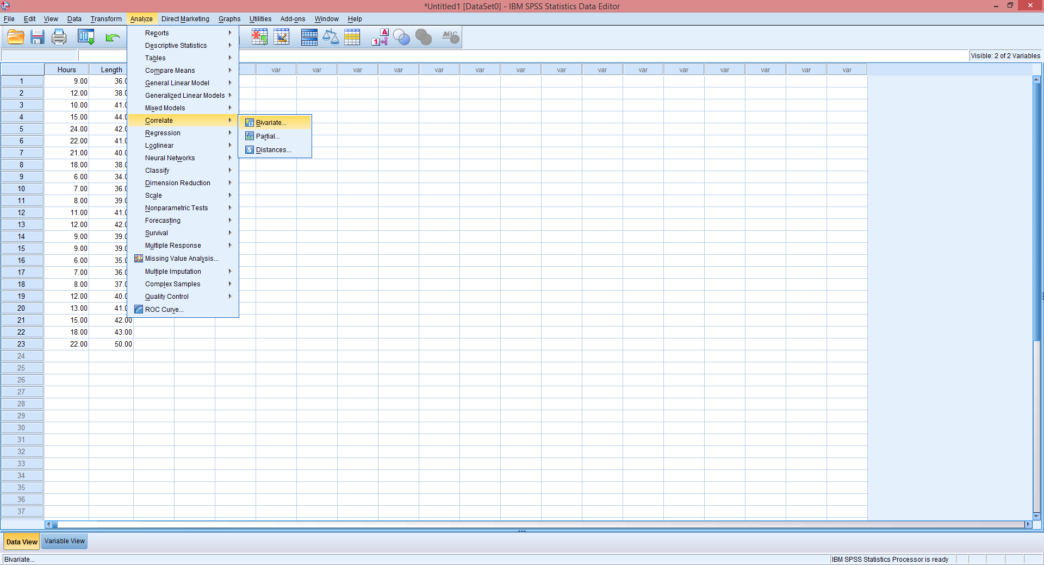
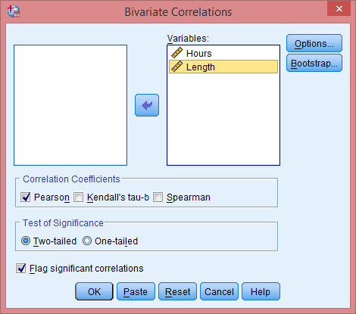
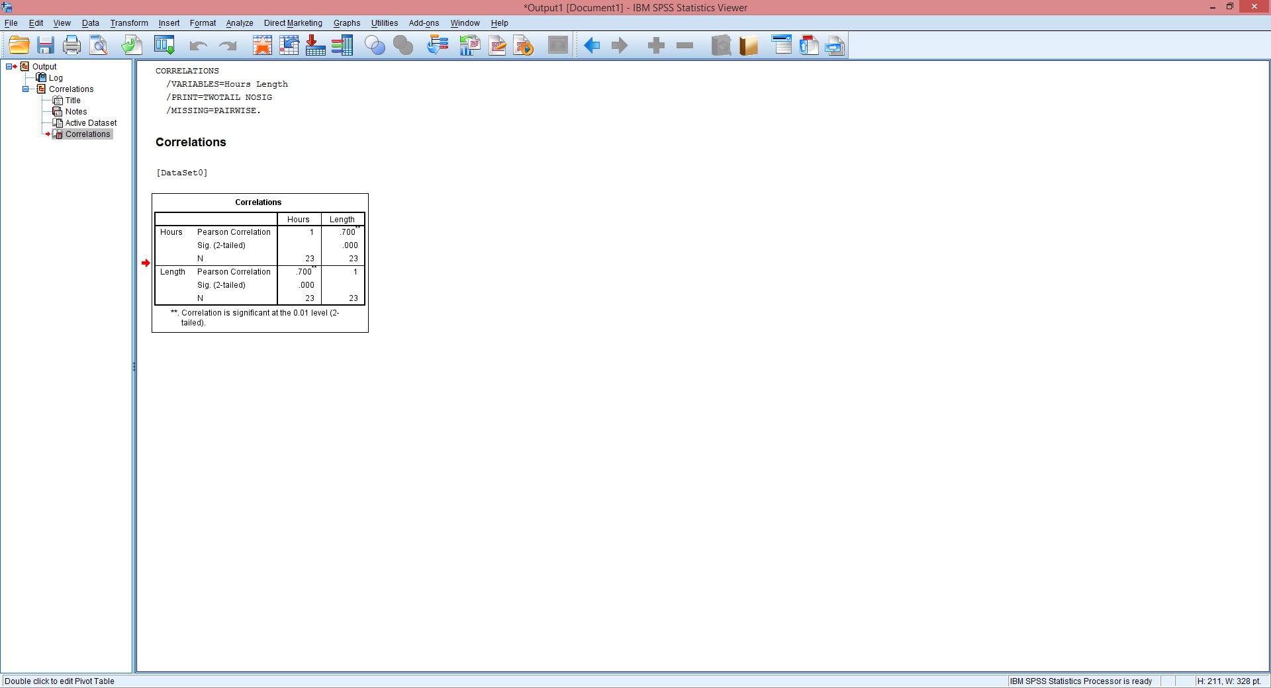

Slide 10
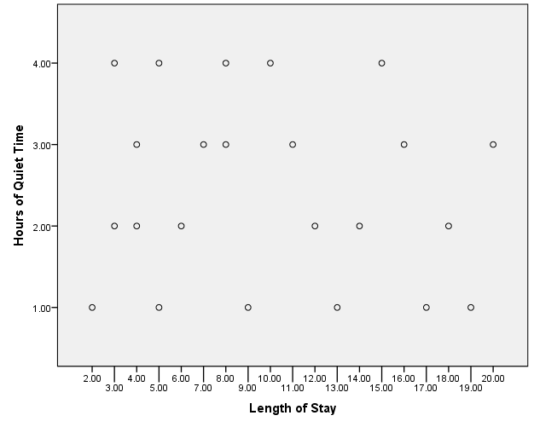
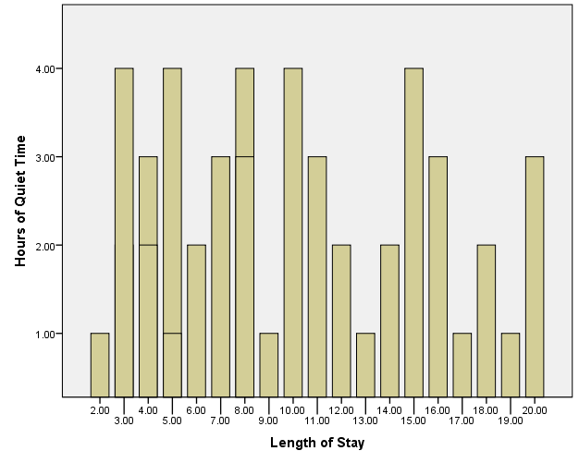
Data for Descriptive Statistics and Pearson Correlation Using SPSS
Descriptive Statistics
 | N | Range | Minimum | Maximum | Mean | Std. Deviation | Variance
Hours of Quiet Time | 23 | 18.00 | 6.00 | 24.00 | 12.7826 | 5.59185 | 31.269
Length (in days) | 23 | 16.00 | 34.00 | 50.00 | 39.7391 | 3.49308 | 12.202
Valid N (listwise) | 23
Correlations
 |  | Hours | Length
Hours of Quiet Time | Pearson Correlation | 1 | .700**
 | Sig. (2-tailed) |  | .000
 | N | 23 | 23
Length (in days) | Pearson Correlation | .700** | 1
 | Sig. (2-tailed) | .000
 | N | 23 | 23
**. Correlation is significant at the 0.05 level (2-tailed).

Slide 11
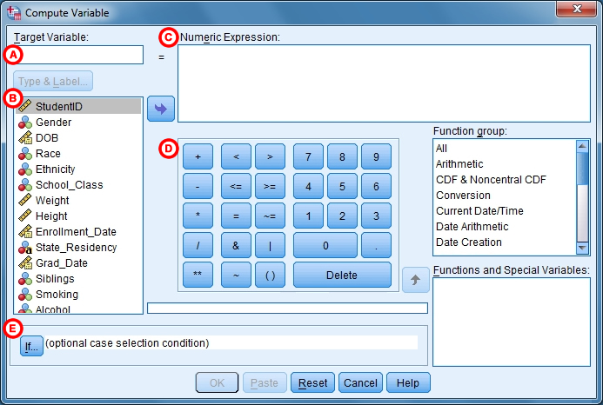
Step 4: Computed Values (Variables)
New variables can be generated by using he compute command.
This command is embedded in a number of functions such as arithmetic, statistical, random number, string and date/time functions.
Technically, compute is a transformation
Computing a new variable can be executed by clicking transform tab.

Slide 12
Step 5: Comparing R Value and Critical Value t
According to the data, the hypothesis is accepted as the values lies within the curve of the confidence interval which is at 5%. The Pearson coefficient ‘r’ is 0.7 which lies between -1 and +1. This shows a positive relationship with the variables. Since the value of r is more than the critical value the hypothesis is accepted
The type of error to be committed in this case are the type 1 as the significance level is 5%.
Type 1 error occurs when there is a rejection in the null hypothesis which is true actually
Type II error occurs when the null hypothesis is not rejected when it is false.
The rationale for accepting the hypothesis is that the Pearson correlation shows that there exists a relation between quiet time (in hours) and the length (in days) of surgical intensive care setting

Slide 13
Conclusion
The applications of SPSS statistical software considerably enhances data manipulation, analysis and presentation.
The statistical software would help to determine te successes and feasibility of research by highlighting subtle elements that show the relationships between the statistical data used in the research.
This is significant in validating any given hypothesis or claim made by research

