Slide 1
School Safety Proposal
Student Name
Professor Name
Course Title
Date

Slide 2
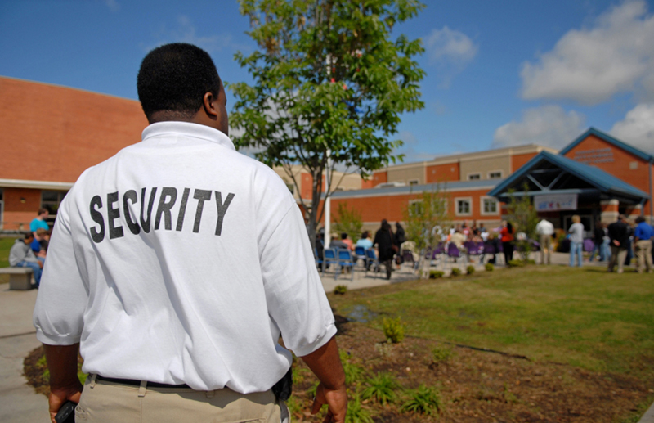
Simple Proposals Which Will Make Schools Safer
Schools must be made safer.
There has been some progress made, though not nearly enough
The increased safety in schools must come in the form of physical security :
security measures
Guards
police presence
As well as creating an environment free from
harassment and/or
threatening speech,
In order that students may enjoy an inclusive environment which is conducive to learning (Strauss, 2013).
Bullying and school shootings have increased in past decades.
It is apparent that a safety campaign for schools nationwide are needed for the benefit of:
Student
Faculty
School
Community
Notes:
Schools must be made safer. This has been a fact for some time now, and there has been some progress made, though not nearly enough. The increased safety in schools must come in the form of physical security (security measures/guards/police presence), as well as creating an environment free from harassment and/or threatening speech, in order that students may enjoy an inclusive environment which is conducive to learning (Strauss, 2013). For the last several years, culminating in the most recent school shootings and cases of bullying, it has become apparent that a safety campaign for schools, nationwide, is needed. In response to that, this proposal is targeting the most basic elements of school safety. Yet, the most basic also may prove to be the most productive in terms of added benefit to the student, faculty, school, and community. This proposal has been formed after consultation with numerous government publications, and has at least two noted.

Slide 3
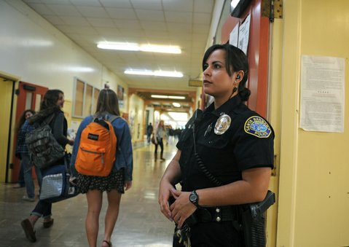
Simple And Sustainable Solutions
Solution:
Hiring Highly Trained Personnel
Range from School Resource Officers (Armed Police Officers) to Mental Health Professionals
Effective Line of Communication
Information Sharing that goes hand and hand with:
Collaboration and Communications
Crucial Element that is at times Challenging.
Collaboration with:
Police
Fire
Mental Health
Teachers
Students
Parents
Notes:
One such solution, which is relatively easy to implement, is the addition of additional and highly trained personnel. These professionals may range from School Resource Officers (Armed Police Officers), to Mental Health Professionals, who will be able to not only comfort in times of grief, but also to take a proactive stance in identifying and possibly helping to resolve troubled behavior(s), before a manifestation occurs. Indeed, to add Resource Officers and Mental Health Specialists to campuses will become an investment in safety, and in the overall success of the school, and its students (MODZELESKI, 2014) Time and time again, it has been shown through study that in order for any type of safety response to become effective, an effective line of communication and working together must first be evident.
Secondly, the idea of information sharing, which goes hand in hand with collaboration and communications, is an idea that has been a long time in coming to fruition. This is a crucial element, although it is admittedly difficult at times, because different agencies (police, fire, mental health, teachers, students and parents), are all being asked to work together. In reality, each of these groups has a different set of defined parameters for communications and record keeping. As such, to openly share and/or decipher those, in real time, is at times cumbersome and extremely difficult (Gay, 2014).

Slide 4
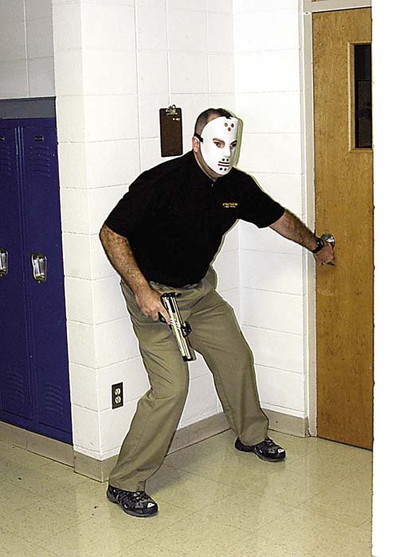
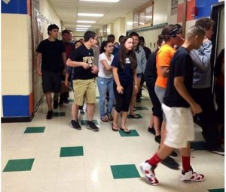
Training and Education
There needs to day to day and week to week training and education in the event of emergency for:
Administrators
Students
Training and Practice is crucial!!!
Local police and fire departments will be happy to host training for schools and students
Promote future collaboration
With each new threat that emerges, planning must always evolve, and change with the threat
TIn order to defeat that threat, and to keep all involved safe from harm.
Notes:
If everything is going to plan, there still remains the active day to day and week to week plan of training and educating administrators and students, in the event of emergency. Any good plan is only a good plan until an extraordinary plan of action has been rehearsed and placed alongside of it. Therefore, training is crucial and just cannot be overstated enough. School officials will often find that their local police and fire departments will most likely be happy to host training with the school and its students, as this will also better prepare those agencies and will also promote the aforementioned notion of collaboration. Alongside of training comes plans and practices. It might seem backwards to put the plan AFTER the training. However, the reasoning for this is that the training, to a certain degree, is static and remains the same from situation to situation. However, with each new threat that emerges, planning must always evolve, and change with the threat, order to defeat that threat, and to keep all involved safe from harm.

Slide 5
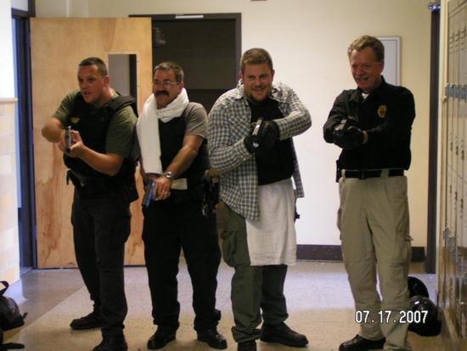
Preparation is Better Than Being Unprepared
To become proactive and not reactive when face with sometimes dire consequences.
This will ultimately save lives, and help to build stronger communities
Practice the plan, until the actions become automatic and nearly second nature is the key to any plan
Therefore, a constant back and forth between communications, planning, and practice must evolve as a basic schedule of events for a local agency or corporation who wishes to have a successful outcome, should a need arise for emergency action (Gay, 2014).
There should not exist a scenario where an otherwise highly trained group of community minded citizens are caught off guard to the point of jeopardizing the safety of students, inside of a school
Notes:
In that same vein of thoughts, to then practice the plan, until the actions become automatic and nearly second nature is the key to any plan. Without practice, the plan will not work, especially under the stress of a real life situation. Therefore, a constant back and forth between communications, planning, and practice must evolve as a basic schedule of events for a local agency or corporation who wishes to have a successful outcome, should a need arise for emergency action (Gay, 2014).
The thinking behind all of this preparation is simple. In this, or any other civilized country, there should not exist a scenario where an otherwise highly trained group of community minded citizens are caught off guard to the point of jeopardizing the safety of students, inside of a schoolhouse. In short, the entire notion of a tragedy, of whatever type, where harm and/or loss of life occurs in school is not only difficult to fathom, it is frankly unacceptable. Therefore, the rationale has been, and will continue to be, to become proactive and not reactive when face with sometimes dire consequences. This will ultimately save lives, and help to build stronger communities.

Slide 6
Putting Plan into Action
The actual plans of actions are available to school and other officials from the Project AWARE (Advancing Wellness and Resilience in Education)
These procedures have been devised by social scientists and proven to be effective, if used properly and with a proper intent.
Those holding these offices are fast becoming the protectors, in many ways, of the nation’s children, and as such, our collective future.
Notes:
The methodology to be utilized has, in part, already been described in a very loose detail. The actual plans of actions are available to school and other officials from the Project AWARE (Advancing Wellness and Resilience in Education), which can be researched or found at whitehouse.gov (Strauss, 2013). These procedures have been devised by social scientists and proven to be effective, if used properly and with a proper intent. As an ending note, it would behoove all who are involved to take the role of administrator or public servant as seriously as one is able to do so. Those holding these offices are fast becoming the protectors, in many ways, of the nation’s children, and as such, our collective future.

Slide 7
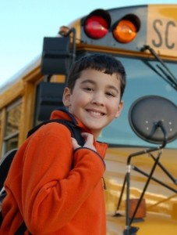
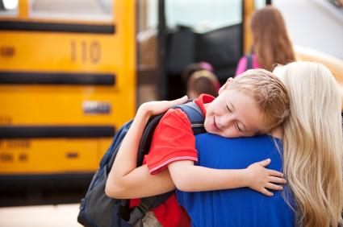
To neglect the current situation at hand, would be a grave injustice to this, and future generations. May all do their part, and do their part well. Thank you.
Notes:
Those holding these offices are fast becoming the protectors, in many ways, of the nation’s children, and as such, our collective future. To neglect the current situation at hand, would be a grave injustice to this, and future generations. May all do their part, and do their part well. Thank you.

Slide 8
Works Cited
Gay, M. (2014). SCHOOL SAFETY: Lessons After Loss. Techniques: Connecting Education & Careers , 89(7), 20-25. Accessed on April 1, 2015. https://ezproxy.indstate.edu/login?url=http://search.ebscohost.com/login.aspx?direct=true&db=f5h&AN=98641783&site=eds-live&scope=site
MODZELESKI, W. e. (2014). Practical Research To Address School Safety: The Secret Service-U.S. Department Of Education Safe Schools Initiative. Translational Criminology, 20-22. Accessed on April 1, 2015. https://ezproxy.indstate.edu/login?url=http://search.ebscohost.com/login.aspx?direct=true&db=i3h&AN=98969335&site=eds-live&scope=site
Strauss, V. (2013, January 16). Obama's proposals on school safety. Accessed on April 1, 2015. washingtonpost.com: http://www.washingtonpost.com/blogs/answer-sheet/wp/2013/01/16/obamas-proposals-on-school-safety/

