Slide 1
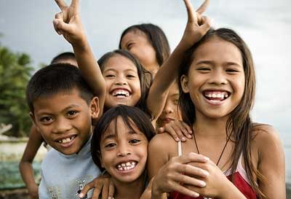
Filipino Culture and Nursing practices
Enter names of group members
Name of the school
Name of the instructor
Date

Slide 2
This presentation will cover:
• Definitions of culture • Cultural trends of Filipinos • Filipino Culture and health • Filipino Cultural competency • Impact of Filipino culture on nursing practice • Barriers to culturally competent nursing care • Considerations for nursing practice • Conclusion
Notes:
This presentation will cover - This presentation is intended to help nurses give the best care possible to patients of every culture, but in this case – more so Filipinos. Here is some background surrounding particular Filipino health issues - One health problem common among Filipinos is that of hypertension (high blood pressure). It has been note that 10% of the population over the age of 15 suffers from this. Another significant healthcare concern in the Philippines is tuberculosis. This particular disease numbers the Filipino population as 4th highest in mortality rates due to this illness. Malaria and dengue fever are also prevalent because of the diminished capacity to control the mosquito population. Although the infant mortality rate is 48.9 and one third of the children are malnourished, everyone is provided basic health care at no cost, and financial assistance is available to those who need it. Thankfully, hospital services are available to all citizens.

Slide 3
Culture – Dynamic Definition 1
Culture has been described as “Ethnic groups that are culturally ascribed identity groups, which are based on the expression of a real or assumed shared culture and common descent” (Jones, 1997).
Notes:
Culture has been described as “Ethnic groups that are culturally ascribed identity groups, which are based on the expression of a real or assumed shared culture and common descent.” We are all who we are based on our countries, traditions, family life, and society as a whole. This quote in particular refers to the group of people that we “belong to.” For example, someone can be Italian, or Irish, or a combination of both. The degree to which the cultural heritage is passed down by our families makes us feel more or less a part of a given ethnicity. Those who are not born in the U.S. or whose parents were not born in the U.S. may have closer ties to one or more particular cultures. However, it is also possible to be from a later generation on to still be imbedded in a particular community. A good example of something like this could be the Chinese who live in China town. Usually the combination of traditions, family life, and society as a whole is what determines who someone is from an ethnological standpoint.

Slide 4
Culture – Dynamic Definition 2
Culture has also been described as that which we know, think, and feel about the world, coming from our own perceptions. It is also what we are taught through other’s interpretations of how things work. (Milton, 1996).
Notes:
Culture has also been described as that which we know, think, and feel about the world, coming from our own perceptions. It is also what we are taught through other’s interpretations of how things work. Given this description, culture seems like it is a bit more individualistic. While this is not necessarily the case, we are all influenced in many different ways. An individual may not be Latino, or even come from a Latino family, but if their friendships are with Latino individuals, then they may be inclined to see themselves as Latino. Or perhaps we were born into a Catholic family and identify more with Buddhism. What does that make us culturally? As such, religion and religious beliefs also play an enormous role in defining who we are culturally. Everything works in tandem to create the complexity of who we are as people.

Slide 5
Introduction
The focus of this presentation is on the Filipino culture.
The Filipino culture holds distinct viewpoints on illness, healthcare, and death based on cultural perceptions.
These cultural influences and perspectives serve to inform nursing practices among the Filipino population.
Notes:
The focus of this presentation is on the Filipino culture. Many of the customs and traditions of Filipinos have been strongly influenced by a colonial history. The Spanish colonization of the Philippines lasted for more than 350 years; therefore there is an important presence of Spanish influence on the Filipino culture. The Filipino language, more commonly known as Tagalog, has borrowed Spanish words as well. Filipinos are religious in nature; most of the present-day traditions are a mix of Christian, Pagan and other local religious affiliations. As an example, every year towns all across the country hold festivals known as “Fiesta,” which celebrate the patron saints of each town, villages, or regional districts. The festival season is celebrated with church ceremonies, street parades in honor of the patron saints, fireworks, and beauty and dance contests for each generation (the young and the old). Southern Filipino beliefs have also been influenced by Islam, and they also celebrate their own unique customs and traditions. Overall, Filipino culture is extremely diverse and colorful.

Slide 6
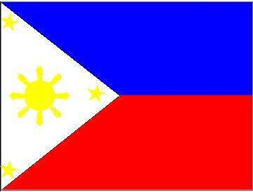
5 Filipino Cultural Trends of Importance
Filipinos use traditional herbal remedies, along with prescribed medicines as a way of life.
Filipinos tend to believe that all objects have a spirit of their own; there is a strong pull towards the supernatural and ritual.
Notes:
Mulder (1994) relates that herbal and homeopathic remedies are often used in conjunction with medically prescribed medications. Traditional herbal remedies are a life way and is taught as part of the school health curriculum. Filipinos have been influenced by western religions, there is no doubt that traditional beliefs continue to exist as well. The one thing that is most certain about the beliefs of this culture is that they are extremely varied, and this has caused some conflict between tribes. Nevertheless, all Filipinos come from a background where it was believed that all objects had some sort of spirit of their own. This was usually most associated with natural objects such as rocks, trees, the wind, etc. Additionally, the belief in one Supreme God existed as well, despite the many different names used for this being. This article strongly suggests that there existed, and still does, a strong pull towards the supernatural and ritual. Although the Spaniards tried to eradicate this aspect of Filipino culture, they were not successful.

Slide 7
5 Filipino Cultural Trends of Importance Continued...
Filipinos have doubt in the human ability to “make things happen” – creating a fatalistic view of sickness, which causes Filipinos to appear lax in their treatment of illness.
Filipinos tend to go along with others to “keep the peace.” This can cause can inauthentic reactions to what is actually taking place.
Filipinos generally look to the eldest family member for medical decision-making.
Notes:
In one study, indigenous beliefs and practices, in relationship to religion, are discussed. In the U.S. we tend to focus on oneself as that which makes decisions and controls our fate, that is not so in Fillipino culture. Instead, there is more uncertainty in the human ability to “make things happen.” This tends to lead to what appears to be a more fatalistic view of sickness, or at the least more acceptance of illness. For example, if a Filipino does not necessarily agree with a particular medical decision, they may agree with a healthcare professional in an attempt to avoid any disagreement. On the other hand, another danger exists when important decisions are to be made. Normally, Filipino tradition dictates consultation with the head of the family or decision maker – often dictated by birth order. It is then vitally important to try and assist this individual in understanding end-of-life issues and advance directives, since the rest of the family and the patient will ultimately look to this person for direction.

Slide 8
The Importance of culture
The importance of culture cannot be stressed enough. Considering unique cultural attitudes allows us to:
Be understanding of other’s viewpoints, feelings, and reactions
Realize that cultural values will inform decision-making
And grants that we will “meet people where they are”
Notes:
In reference to the importance of culture, considering unique cultural cannot be stressed enough. We need to be understanding of other’s viewpoints, feelings, and reactions, and realize that cultural values will inform decision-making, and make certain that we “meet people where they are”
Without cultural awareness, we will not be able to give a patient what is most needed. Those in the nursing field need to be accepting and understanding of other cultures to treat them well- or accept that treatment may not be what the patient (or his or her family) may want. The Filipino culture holds distinct viewpoints on illness, healthcare, and death based on cultural perceptions. These cultural influences and perspectives serve to inform nursing practices among the Filipino population. The Filipino culture is unique. Gaining a full understanding of this culture will greatly help in giving patient care.

Slide 9
Culture and Health – Factors that can influence health care decisions Filipinos often believe that:
Traditional herbal remedies will cure them – they may resist more western medical treatments.
Objects have a spirit of their own – they may trust that the spirits will heal illness.
Notes:
When discussing culture and health, it must be remembered that Filipinos tend to believe that traditional herbal remedies will cure them – and they may resist more western medical treatments. Objects are seen as having a spirit of their own with unique healing properties, and they may trust that the spirits will heal illness. It should also be noted that because most Filipino health workers are exported, and getting workers to service those in rural areas can be difficult, this may serve to support the more traditional beliefs in healing to limited access to Westernized health care. Again, these unique ways in which to view the world can make all the difference when treating patients. Nurses need to realize that treating Filipinos may be challenging. It is important to know where the patient is coming from and to speak to the appropriate individual so as not to offend the family and patient.

Slide 10
Additional Factors that can influence health care decisions Filipinos often believe that:
The human ability to “make things happen” does not exist – they may show a lack of engagement in the treatment of an illness.
One should go along with others to “keep the peace” – they may not really communicate how they feel about a medical treatment.
The eldest family member should be responsible for medical decision-making – they may discount the feelings of other family members
Notes:
10.Additional Factors that can influence health care decisions of Filipinos relates to the common belief that the human ability to “make things happen” does not exist. While in the U.S. an individual will attempt to beat a sickness, one will not find that same attitude in the Philippines. This is actually viewed as a negative approach to healing by Western Standards, and may show a lack of engagement in the treatment of an illness. Another factor of influence is the idea that one should go along with others to “keep the peace.” this can have negatives outcomes when a Filipino person is faced with a decision about advance directives, due to the cultural tendency to go along with others and to create peace and harmony. The article continues that this can grant inauthentic reactions to what is actually taking place. Lastly, as the eldest family member should be responsible for medical decision-making, this could discount the feelings of other family members

Slide 11
Cultural Competency
According to National Institute of Health, cultural competency is “the combination of a body of knowledge, a body of belief and a body of behavior. It involves a number of elements, including personal identification, language, thoughts, communications, actions, customs, beliefs, values, and institutions that are often specific to ethnic, racial, religious, geographic, or social groups” (NIH, 2015).
Notes:
If cultural competency is defined as “the combination of a body of knowledge, a body of belief and a body of behavior. It involves a number of elements, including personal identification, language, thoughts, communications, actions, customs, beliefs, values, and institutions that are often specific to ethnic, racial, religious, geographic, or social groups” (NIH, 2015), then to do a great job in the nursing industry, a nurse must have cultural competence. This is especially important to the Filipino community, who, unlike those in Western culture, has the more collectivist values found in Asian and Pacific Islander cultures. This is vitally important for nursing practice. This way of seeing the world indicated that nurses need to learn a lot about cultural differences between ethnic groups – especially those that the health care giver is working with primarily.

Slide 12
Nursing and Culture: Why it Matters
Having culture competence as a practicing nurse
enables:
The ability to provide service that is respectful and responsive to the patient.
An understanding of how health beliefs and practices may influence patient/nursing relationships.
The realization that patients have linguistic needs that are diverse.
Notes:
Why does it matter? Because having culture competence as a practicing nurse enables the health care professional the ability to provide service that is respectful and responsive to the patient, to understand how health beliefs and practices may influence patient/nursing relationships, as well as realize that patients have linguistic needs that are diverse. Among all things that contribute to operating with near-complete culture competence, is simply belong able to detach when necessary. Even in a medical setting, and no matter what one would like to believe, one individual does not have the power to make decisions for others - we have very little control over others. If those in the nursing community can realize this, it will create a space for exceptional patient care. Nurses will do the best job possible by being culturally competent using these definitions. Without this, misinterpretation, miscommunications, and frustration can occur.

Slide 13
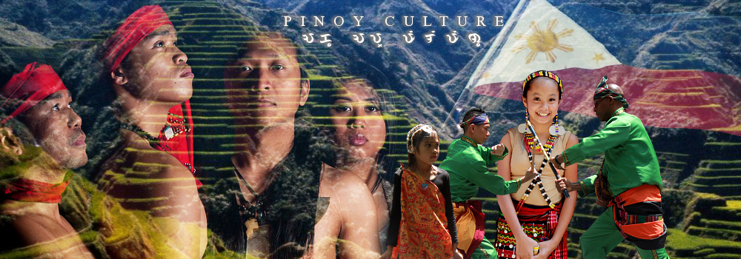
Barriers to culturally competent nursing care can include:
Believing that one’s own way of viewing a medical situation is best.
Holding religious beliefs that do not allow for acceptance of other’s unique cultural beliefs.
Notes:
As health care professionals, we need to be aware that “our way” is not always the “right way.” More often than not, when treating those from another culture, it is important to set aside our own beliefs to provide the best care possible.
In one report from the WHO (2011), it has been noted that the health status of Filipinos has improved over the forty years. Infant mortality has improved, life expectancy) is now 70 years of age and beyond, and the incidence of communicable diseases has fallen. Nevertheless, the WHO (2011) reports that there is still great inequality in wealth and access to resources for this population. What does this have to do with barriers to patient care? Everything! In a population coming from such unequal distribution of wealth, one aspect cultural adaptations is to make do with what one has. This may look very different from what Westerners might expect to see or believe. Given this, health care professionals need always maintain an attitude of acceptance.

Slide 14
Barriers Continued...
Believing that a medical treatment is better than what the family wants and asks for.
Not caring for a patient in a culturally sensitive manner, offending the patient.
Discounting patient wants and needs due to language barriers.
Notes:
Continuing from the last slide, the effects of unequal access to resources may look very different from what Westerners might expect to see or believe. Given this, health care professionals need always maintain an attitude of acceptance. Nurses cannot afford to believe that one medical treatment is better than another, especially in regards to what the family wants and asks for. Not caring for a patient in a culturally sensitive manner, and offending a patient due to ignorance of cultural differences due to privilege only serves to degrade patient care. One of the most vital area in which health care professionals can learn to embrace the wants and needs of other cultures is to learn more about the language – or at least ensue that there is someone close by who can interpret the language effectively. Discounting patient wants and needs due to language barriers.

Slide 15
Considerations for Nursing
Without an active awareness of the cultural differences between patients – from varying backgrounds – nursing care will be limited in what it offers the patient.
This not only tends to cause poor communication, but it can also have dire consequences that could lead to increased illness, and even death.
Notes:
In considerations for nursing, there needs to be a particular emphasis on culture as a community, and the ways in which we choose to practice medicine.
Not having an understanding of another’s culture or language can be damaging to a patient, and may even cause death. Nurses must have some awareness of the population they are serving. For the Filipinos, conversation and views about health expand beyond the individual self to include the family, community, and the natural world as well. This emphasizes the manner in which Filipinos conceptualize health, and consequently how this influences health practices. Certain studies and authors make us aware that “health policy makers need to take into account the role culture plays in the way people conceptualize health to ensure that health policies and programs reflect the particular beliefs and needs of their target populations.” They go on to say that without awareness of the diverse and varying views of patients, those in the healthcare industry will not provide culturally appropriate care.

Slide 16
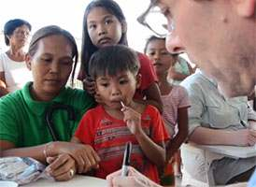
In Conclusion
All within the nursing field should seek to gain cultural awareness of others, and in this case Filipinos specifically.
This will ensure that the correct type of treatment is being given, that patients are being understood, and they will be accommodated.
One of the greatest gifts we can give another is acknowledgment and consideration of who they are as human beings – whatever the culture
Notes:
In conclusion this presentation has hopefully been able to help nurses give the best care possible to patients of every culture, and especially Filipinos in this case. A thorough examination of culture – as seen in different lights has been examined, and the Filipino culture, in all its richness and diversity, has been summarized. Without question, the Filipino community and approach to health care is quite different from that which is found in the United States. Nevertheless, it is only through leaning about other cultures (in this presentation the Filipino culture, of course) that nurses and health care professionals can be best equipped to serve diverse populations. If nurses are truly committed to helping others, and in this case Filipinos – with all their cultural differences -then the best thing one can do is acknowledge Filipino cultural values, make accommodations if necessary, and let the patient know that they are being heard and considered.

Slide 17
References
Jones, S. (1997). Multidemensional Ethnicity: Towards a Contextual Analytical Framework.
The Archaeology of Ethnicity (Chapter 5), 84-105. Routledge, London.
Levesque A., & Li, H.Z. The Relationship Between Culture, Health Conceptions, and Health
Qualitative–Quantitative Practices, A Approach. Journal of Cross-Cultural Psychology, 28(3), 252-265.
McAdam, J.L., Stotts, N.A., Padilla, G., and Puntillo, K. (2005). Attitudes of Critically Ill Filipino Patients and Their Families Toward Advance Directives. American Journal of Critical Care, 14(1), 17-25. Retrieved from http://ajcc.aacnjournals.org/content/14/1/17.full
McLaughlin, L.A. and Braun, K.L. (1998). Asian and Pacific Islander Cultural Values: Considerations for Health Care Decision Making. Retrieved from http://hsw.oxfordjournals.org/content/23/2/116.short

Slide 18
Milton, K. (1996). Environmentalism and Cultural Theory: Exploring the Role of Anthropology in Environmental Discourse. Routledge, New York, NY.
Montejo, J.A. (2015). Indigenous Religious Beliefs and Practices in the Philippines. Philippine Islands. Retrieved from http://www.philippine- islands.ph/
Mulder, N. (1994). Filipino Culture and Social Analysis. Philippine Studies: Historical and Ethnographic Viewpoints, (42)1.
National Institue of Health. (2015). Cultural Competency. Clear Communication. Retrieved from http://www.nih.gov/clearcommunication/culturalcompetency.htm
World Health Organization. (2011). The Philippines health system review. Health Systems in Transition, 1(2).

