Slide 1
The iPhone Market
Presented by:
A Presentation about Market Competition,
Growth and Survival
Notes:
Speaker 1: This presentation aims to create a more recognizable understanding as to how the iPhone market has been established, how it grew and how it became more effective in surviving the different terms of competition that exists in the market today.

Slide 2
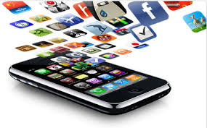
The iPhone Phenomena
The creation of the first iPhone was designed to cater to the communication needs and demands of the public as response to the growing culture of owning handheld devices.
The creation of the first iPhone has set a new standard for modern communication.
Notes:
Speaker 2: leading computer companies such as Apple Inc lead the way towards creating a new set of gadgets that would make it easier for the world to embrace a new culture and a new perception on modern communication.
Speaker 2: this innovation entails putting everything that a person needs within a handheld device that was easy to navigate and carry elsewhere.

Slide 3
The iPhone Culture
To set the market ready, companies such as Apple Inc. provided the market with an overview of what it would be like to have everything in one’s fingertips. iPhones and other brands of smartphones basically promoted the following concepts:
Freedom
Convenience
Fashion Trend
Notes:
Speaker 1: What was very strategic about the process of market setup that Apple Inc. established is that the company first tried to target the behavior and perception of the people with regards communication making them realize the importance of owning a handheld device that would let them do almost everything they need and everything they want.
Speaker 2: this made it easier for them create a sense of ‘want’ among the people hence making their product rather highly acceptable upon release

Slide 4
The Birth of a Trend
From the birth of one product
comes the birth of other markets:
iPhone app markets
Accessories and add-ons
to the basic iPhone
Network companies offering
Special communication
bundles in
support of iPhone release
Notes:
Speaker 3: Along with the release of the new iPhone product, the creation of new markets spur along with it
Speaker 2: Apple Inc was smart enough to create alliances with top companies providing particular add-ons and product support to the product they have released in the market to assure their company of proper market share

Slide 5
The Creation of Competition
Branded Smartphones
Branded smartphones come from known brands such as Samsung and LG featuring almost the same functions as the iPhone but offers a much wider source of market add-ons
Android phones are more general in form. They are noticeably produced by both branded and non-branded companies which makes these choices easier on the budget.
Android Phones
Imitation Phones
China, India and other countries have created imitation phones that almost look and feel like that of the original smartphones and android phones following the iPhone trend
Notes:
Speaker 1: recognizing the point of competition in the industry that has been created by the introduction of iPhone provides a clear vision as to how and why modern communication trends were given birth and why it thrives at such a successful pattern of growth at present.

Slide 6
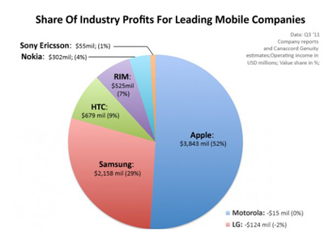
The Rate of Competition
Notes:
Speaker 2: As seen from the image herein, it could be understood that Apple and Samsung are among the top contenders in the field of providing smartphones and iPhone choices to the market.
Speaker 2: the market’s recognition of the reputation of these companies is what makes them more effective in creating a more distinct sense of development that the mobile companies primarily embrace especially for the sake of establishing a more evident sense of improvement in the products they offer

Slide 7
Furthering the Market’s Desire
iPhone innovation never stops
iPhone innovators never stop finding ways to improve their sense of advancement. Creating more features that they think would be amicable to the market they serve, these creators never stop surprising the public with what they have to offer.
Smartphones and android phones follow the trend
There seems to be no end to the creation of these options of communication devices; every turn of time, there is something new that they have to offer the market with
Notes:
Speaker 3: true, the creation of the iPhone market, the smartphone market and other android phone products all support the unending demands of the market especially when it comes to improving communication options and imposing a more defined mobile-culture among members of the modern society.

Slide 8
References
Lewis, Peter (January 12, 2007). "How Apple kept its iPhone secrets". CNN.
Vogelstein, Fred (January 9, 2008). "The Untold Story: How the iPhone Blew Up the Wireless Industry". Wired.
Cheng, Jacqui (June 9, 2008). "AT&T remains sole iPhone carrier in US, revenue sharing axed (Updated)". Ars Technica.

