Slide 1
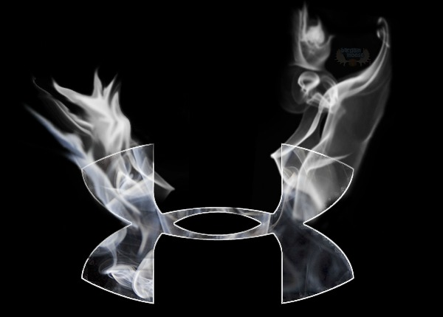
Under Armour : Strategic Environment
Student Name
Professor Name
Course Title
Date

Slide 2
Under Armour: Current Situation
Past Corporate Performance Indexes
Poor financial performance in footwear, small market share,
Strategic Posture:
Currently behind Nike, in the overall industry. But hold over 75% of the performance apparel market share. (Germano)
Current Mission
“To make all athletes better through passion, science and the relentless pursuit of innovation.” (Subramaanian and Gopalakrishna 347)
Objectives
-”To be the athletic brand of this generation, and next.”
Be the go to sports brand for athletes
Be the Official Outfitter for Schools (High School & Collegiate)
Strategies
Target influencers to market their products. Target print, digital, and television advertising.
Policies
Full Retail Pricing that would add to the Up-market appeal and position different from other brands.
Notes:
In looking at the current situation of Under Armour, we can look at the current situation. Based on the remarks by the CEO and founder of UA, the recent performance showed a continued decline in the financial performance, in which sales for their footwear declined by 16.6% in 2010. (Subramaanian and Gopalakrishna 347) However, in their prime category, apparel, they saw an increase. The increase has helped to put them as one of the few small companies that have been able to compete with the market leader Nike. Their past performance indexes indicate poor financial performance in other categories besides apparel, with a small market share in the overall sports apparel market. However, the performance apparel market in which UA created, also currently dominates with over 75% market share. Their current mission is to appeal to athletes through their products, while trying to be the go to brand for athletic people. Their strategies is to get the biggest influencers in high school, college, and beyond to market their products. Their policy had previously concentrated on applying their full retail pricing, in order to appeal their individuality against other brands, as they focus on their three main categories of innerwear and outerwear apparel, footwear, and accessories.

Slide 3
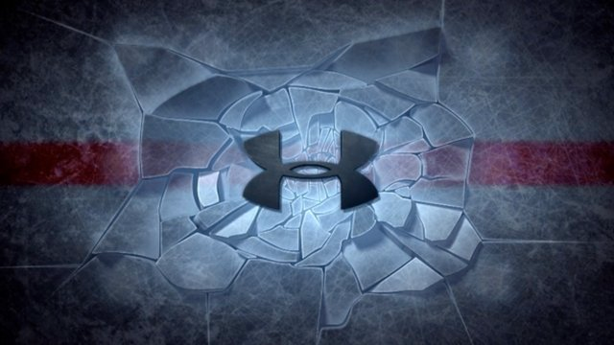
UA Internal Environment : Corporate Structure
UA provides a corporate structure that is comprised of
Simple structure
That is centralized
Only consist of the upper echelon
Provides direct supervision
The top management with 8 executives including:
CEO: Kevin Plank followed
Board of Directors that are responsible for much of the decision making of UA.
They are evaluated by a small committee each year.
Lead Director that is in change of holding Board meetings.
Notes:
Under Armour’s corporate structure consists of a simple structure that makes it easier for better leadership and communication between members of upper management. The corporate structure also involves a centralized structure that makes it easier for each member of the 8 executive team to voice their opinion, and working towards a common goal. The corporate structure only consist of the upper echelon of Under Armour, while employees are able together to come up with innovative ideals. The corporate structure flows from the founder and CEO, to the Board of Directors in which consists of members of the board, that is evaluated annually each year by a small committee (corporate governance). The corporate structure serves as a way to keep the ideals and the goals focus without putting too much “noise” around the brand.

Slide 4
UA Internal Performance: Corporate Culture
UA Culture revolves around the aspects of football.
Everyday they have “team huddle” where they huddle up with out team (department) and talk about their daily goals or what is going on new in the Company. The bosses choose not to make the employees feel uncomfortable No one really acts like they are above anybody, as they want to establish teamwork.
UA encourages a culture of
Innovation
Integrity
Reliability
Inspiration
Teamwork
Good Communication
Culture of shared values and ethics that sets the standard for the entire company, from the top-down approach that encourages growth.
Notes:
Under Armour’s corporate culture consists of proliferating and organizational environment that encourages innovation and innovating ideas among employees to be able to compete with larger companies such as Nike. Under Armour, also instills the values and ethics of inspiration, reliability, and integrity. Under Armour holds their employees to a certain standard that allows for the employees to focus on the company’s common goal to be the premier choice for athletes in all sports arenas. The corporate culture revolves around team work, good communication, and the aspects that football plays an integral role in how work is conducted. Many football terms have been added into the company vocabulary.

Slide 5
UA Internal Environment: Resources, Capabilities & Core Competencies
Capabilities
Team driven style
Driven towards the same goal, and allowing for everyone to run on the same wavelength
Make a product that is great
Tell a good story about the product
Service UA
Build a great team
Core Competences:
Managing Marketing Campaign, performance & professionalism, appealing, practical, and athletic
Resources
Marketing strategy involves getting the top influencers throughout each sport and getting them to wear the products
Pay out advertising costs to digital, print, and television; as well as fees to be schools “Official Outfitter”
The key drive is to offer products than what is currently on the market
Charge full price retail in order to appeal to be different from other brands.
Notes:
Under Armour is provided with several resources that helps in positioning the company right behind Nike, and before Adidas. (Geranmo) Under Armour has the capabilities of a team driven style that helps to drive the team in the company towards a common goal that allows each member to run along the same wavelength. All of these capabilities makes the team focus on a product that is great, helps tells a story about the product, services the company, an helps to build a great team. The core competencies of the company is to manage their marketing campaign that focuses on using the “influencers” from each sport to market their products, and volunteer to wear their merchandise. The resources that Under Armour uses involves paying out advertisement to multiple media, and fees to be the “Official Outfitters” for colleges. This is key to helping make their brand appeal different from other teams.

Slide 6
Works Cited
Subramanian, Ram, Gopalakrishna, Pradeep. “Case 20: Under Armour.” in Concepts in Strategic Management and Business Policy: Toward Global Sustainability, 13th Edition Prentice Hall. 2012.
“Mission and Values.” Under Armour. 2015. Web. 30 April 2015. http://www.underarmour.jobs/why-choose-us/mission-values/
Germano, Sara. “Under Armour Overtakes Adidas in U.S. Sportswear Market.” Wall Street Journal. 8 Jan 2015. Web. 29 April 2015. http://www.wsj.com/articles/under-armour-overtakes-adidas-in-u-s-sportswear-market-1420753934

