Slide 1
Caterpillar Inc. Leadership Team
Name of Student
Name of Course
Instructor’s Name
Institutional Affiliation
Date

Slide 2
Introduction
Caterpillar Inc. is among the leading manufacturers of various items around the world.
The company focuses on the manufacturer of natural gas engines, diesel, mining and construction equipment, and industrial gas turbines.
The company has established a niche in the manufacturing sector and is among the most valuable companies in the world. Caterpillar Inc.
has continuously sought to be a market leader by establishing a global presence in the sectors that it serves.
Notes:
Caterpillar Inc. is a Fortune 100 company that has a global dealership network. According to Forbes, Caterpillar Inc. is the largest construction manufacturer in the world. The company was formed in 1925 after the C. L. Best Tractor Company and Holt Manufacturing Company merger. It was originally based in California before other offices were opened throughout the country and across the world. Presently, its headquarter is in Deerfield, Illinois.

Slide 3
Caterpillar Incorporation
Over the course of its operations, Caterpillar Inc. has grown and expanded according to its customers’ needs.
The company has been dynamic and adaptive to the changes in the world.
Over the years, it evolved from being a ‘brick and motor’ organization to providing other services such as innovation, problem-solving, and servicing.
Since its establishment in 1925, Caterpillar Inc. has been assisting its clients to create a better world.
Notes:
The company has been assisting its customer base to make sustainable progress and drive positive change across the globe (Caterpillar, 2019). According to the company’s 2020 statistics, its worldwide revenue and sales were worth $41.7 billion. The figures made the company the leading manufacturer of the items it produces. Even though the company operates in various sectors, its operations focus on the following three primary segments; energy and transportation, resource industries, and construction industries.

Slide 4
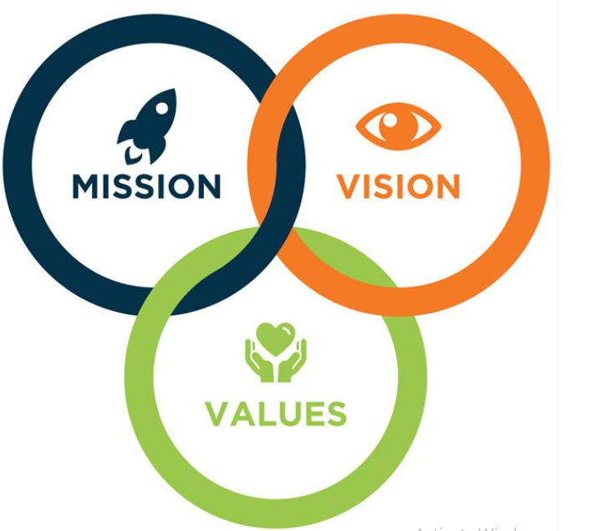
Mission, Vision and Core Values
Caterpillar Inc.’s mission, vision, and core values are associated with its objectives and goals.
The company’s mission, vision, and core values focus on answering questions such as what defines the organization, what values are associated with it, and its long-term goals.
These aspects of the organization make a company know its goals and the steps it needs to take to reach such goals.
Notes:
Mission, vision, and core values underlie the company’s strategies and the steps that should be taken to address the challenges that the organization faces. As an organizational dimension, the mission statement focuses on how the company aims to serve its stakeholders. The mission also focuses on addressing its employees' and customers' current and future needs. The vision statement focuses on how the organization envisions its future to look. It is concerned with the company’s desires and aims. The last dimension, core values, focuses on how the organization shapes its cultures and business strategies. The four dimensions assist the organization to aspire for more, thereby creating an environment of dedication and improving team cohesion.

Slide 5
Caterpillar’s mission is to have a sustained dedication to customers’ needs and continue to provide improved products to its customers.
The organization’s mission also entails meeting the societies' needs in its operating environment.
The company has an execution and operation model that ensures all its customers have a common perspective of the business activities.
Notes:
The company’s mission also entails focusing on economic growth that can be achieved through the energy and infrastructural development. Throughout its operations, the company seeks to protect the planet by ensuring its activities are not harmful to the environment.

Slide 6
Caterpillar’s vision is to create a world in which all people have proper access to basic needs such as sanitation, food, reliable power, and clean water.
The company’s vision is to provide all the basic needs using environmentally sustainable ways.
Besides, the company’s vision is also to enhance the environment’s quality and improve the standard of the communities where people work and live.
The company seeks to advance sustainable methods in its production methodology and create a better world by reducing the rates it emits greenhouse gases.
Notes:
Caterpillar’s vision is to offer its customers a range of finance solutions to facilitate product acquisitions. The company offers customers cat dealers for machines, cat parts, and engines. The products are intended to provide customers with unique values to assist them in achieving basic communal needs.

Slide 7
Caterpillar’s core values include sustainability and belief in future profitable developments.
The company developed its beliefs in 1974 to ensure it adheres to the reasons it was established.
Throughout the course of its operation, caterpillar’s core values have always been concentrated on sustainability as the organization seeks to protect the environment from harmful emissions.
Other values that define the organization entail; excellence, principles, and dedication.
Notes:
The company’s value creation of innovating solutions to its customers. As a result, it has created a communication channel where customers can communicate their opinion of the company’s products and services. Throughout its operations, the core values have shaped Caterpillar Inc.’s business strategy and purpose. They have helped the organization have a sense of commitment to its goals and become responsive to its customer's demands.

Slide 8
Caterpillar’s Leadership Team
Caterpillar’s leadership team governs the company and ensures it achieves its strategic objectives.
The company’s corporate governance ensures it serves its shareholders with high levels of integrity and responsibility.
The company’s governance program also ensures it complies with all corporate and civil laws. The company’s leadership team has established a governance system that oversees the company’s performance and actions.
The company’s commitment to its governance system has made it have a leadership team that steers it to better performance and profitability levels.
The company has an executive management team that oversees daily operations.
Notes:
The executive team is led by Jim Umpleby, who is the company’s chief executive officer and Board of Directors Chairman. Jim is a reputable business leader who is conversant with Caterpillar Inc.’s culture as he joined the company in the 1980S. Jim has earned his position in the company as he has risen the ranks from an associate engineer to the company’s head. He holds over forty years of experience in the company’s operations and has gained international experience in the various leadership roles he has occupied. Other positions that Jim has served in the organization include being the group president between 2013 and 2016.

Slide 9
Caterpillar’s Leadership Team
Notes:
The company has a Chief Financial Officer who oversees all the organization’s financial services. Andrew Bonfield is Caterpillar Inc.’s Chief Financial Officer and is responsible for managing the company’s global information services and financial products. Andrew Bonfield became part of Caterpillar Inc. in 2008 and held over thirty years of experience in financial expertise. Other companies which he has served include the gas utility company, National Grid Plc. Bonfield's expertise as a chartered accountant makes him a highly valued business leader.
Another important member of Caterpillar Inc.’s executive team is Bob De Lange, who is the Group President. Bob oversees operations in the digital, distribution, and service segments of the business. He heads the Asia Pacifica Distribution, Americas Distribution, and the European distribution. In the course of his career, Bob has held various leadership roles such as marketing representative and field sales representative. Bob’s expertise in operations management has made the company have one of the most efficient distribution channels in the world. He has managed to make the organization adopt efficient production and distribution models.

Slide 10
Organizational Structure
Caterpillar Inc. changed its organization in December 2015 as a way of creating an unmatched competitive position.
Through the restructuring, the company created new divisions to help in conducting organizational functions.
The divisions created through the restructuring entailed Global Aftermarket Solutions and Distribution Service.
The restructuring also resulted in the creation of three other divisions to guide the organization’s functions.
Notes:
. From 2015, the company adopted a vertical-type divisional structure. Through the structure, the employees are divided according to their output and performance. Each division is headed by a vice-president who directly reports to the president. The structure has accorded Caterpillar Inc.’s flexibility in all its divisions core competencies. Besides, vertical decision-making ensures faster decision-making as lower levels can make autonomous decisions.

Slide 11
Organizational Structure
A holacracy structure is characterized by a permanent managerial position.
Caterpillar Inc. does not have such an organizational structure as it has a team that undertakes particular functions (Pratap, 2021). The functions undertaken by the teams are product-related or managerial in nature.
Caterpillar Inc. has functional teams that ensure all the organizational projects are executed according to its cultures and standards.
Notes:
The functional groups have a limited period because they are always dismantled once their objectives have been achieved. However, the divisions established in 2015 have been permanent as the company seeks to adapt to a structured organizational management system.

Slide 12
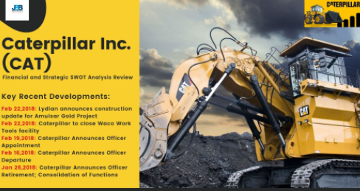
SWOT Analysis
Caterpillar’s leadership team often conducts a SWOT analysis to know its market position and whether external factors may threaten its marketplace presence.
The first aspect of SWOT analysis is a strength that explains the features that distinguish Caterpillar Inc. from its competitors.
The first strength is that the organization is a leading brand in the manufacturing industry.
The company enjoys a good market reputation in the mining and construction sector, attracting high-value customers.
The company’s reputation can earn it high revenue sources without incurring additional marketing expenses.
Notes:
A second organizational strength for Caterpillar Inc. is its vast product portfolio. The company has a diversified portfolio that reduces the unsystematic risks associated with concentrating in a particular industry. For example, market shifts in the mining industry may not have substantial effects on the company’s operations as it will derive revenue from other profitable industries such as construction.
A company’s weaknesses depict regions that may offset its capacity to generate high revenue amounts. One weakness facing the organization is its overdependence on the United States market. Even though Caterpillar Inc. derives most of its profits from the US market, its failure to undertake market diversification possess a greater risk to its operations and revenues. The company can increase its revenue base through expanding operations in Asia and European countries. The second weakness facing the company is its low innovation rates. The company has not introduced a new product or manufacturing line for almost a decade. The failure to innovate means that the company has remained stagnant and has lost possible revenue sources.

Slide 13
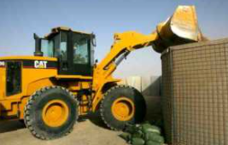
SWOT Analysis
Opportunities are the factors that can accord the organization a competitive advantage if they are well utilized.
One opportunity that Caterpillar Inc. can utilize is the presence of new technology.
Advancements in technology have presented new ways through which companies can interact with their customers and deliver products to them.
The organization can utilize the new technology to increase its market presence and revenues.
A second opportunity for Caterpillar Inc. is the current logistic situation that has resulted in to decline in transportation costs.
Notes:
The current infrastructural developments have product transportation across the world to be easier and cheaper. The third opportunity is the rapid urbanization in the world, especially in developing countries. The high urbanization rates have created a high demand for the company's products, resulting in high revenues and a customer base.
Threats are external factors that can negatively impact the company’s reputation or revenues. One threat that Caterpillar Inc. faces is product imitation. Presently, the market is filled with companies that provide services similar to Caterpillar Inc.’s. Since the companies do not have a high market reputation as Caterpillar, they can imitate its products to gain a market presence. Market imitation threatens the company’s revenues and reputation as the imitating companies may not match its quality. A second threat facing the company is strong competition. The construction and mining industry is characterized by big organizations such as Bechtel, which have huge market capitalization and can finance several projects. These companies threaten Caterpillar Inc’s market share and revenue source.

Slide 14
Recommendations
Caterpillar Inc.’s mission, vision, core values, SWOT analysis, and leadership team provide the basis for the recommendations that intend to increase its market presence, product portfolio, and customer base.
One recommendation for the company is that its strategies should focus on market development and market penetration.
The company should utilize intensive growth strategies to have a significant market presence.
For example, it should focus on increasing its sales from the current base and create a new market base.
According to market statistics data, Caterpillar Inc. has focused on the American market. Even though the market has the highest revenue potential, the company should increase its prospects in markets such as Europe and Asia that also have high potential.
Notes:
. The company should scale its operations in these markets as a market development and market penetrations strategy. The company can use its current distributors to scale operations in these underutilized markets.
The company should also emphasize diversification in its operational strategy. Even though the company has a diversified portfolio, the diversification can be regarded to be moderate. The company operates in industries such as power equipment, mining, and construction. The current market realities show that the company can gain additional income by venturing into solar power generation and supply industries. The company can use an intensive growth strategy to enter into new industries. High diversification levels will also make the company spread business risks across different sectors.

Slide 15
Recommendations
Caterpillar Inc. has an opportunity of enhancing performance by emphasizing differentiation in its business model.
For a differentiation strategy to be successful, the company needs to enhance its investment in development and research to make its products attractive to customers (Bruijl, 2018).
Presently, the company’s products such as engines, financial services, and equipment are not different from the ones sold by competitors.
Product differentiation will enable the company to increase its competitiveness and maintain its market reputation.
Notes:
The company can enhance its financial performance by widening its distribution network. Caterpillar Inc. should focus on growing its markets because of the positivity that is characterizing the economic markers. The company can increase its distributors in Asian and African countries where its operations have been limited. Countries like China present a huge potential for the company.

Slide 16
References
Bruijl, G. H. T. (2018). The relevance of Porter's five forces in today's innovative and changing business environment. Available at SSRN 3192207.
Caterpillar, I. N. C. (2019). Caterpillar 2019 annual report. Peoria, Illinois.
Pratap, A. (2021). Caterpillar SWOT Analysis. Retrieved 15 August 2021, from https://notesmatic.com/caterpillar-swot-analysis/. (2021). Retrieved from https://www.caterpillar.com/.

