Slide 1
Child Abuse in America
Donald Rogers
SOC 210 RA01
Notes:
Good morning everyone my name is Donald and I am her today to share my research on child abuse in America. Please wait to the end to ask questions but if the question is really important feel free to ask during the presentation. Lets begin

Slide 2
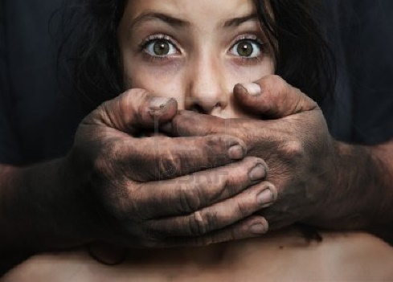
Introduction
Child abuse in the United States has become a serious social problem. There are thousands of children being abused and traumatized in the United States every year. This presentation will review the history of child abuse, different forms of child abuse, social effects of child abuse and possible solutions to the prevention of child abuse.
Notes:
There are thousands of children being abused and traumatized in the United States every year. The Centers for Disease Control and Prevention (CDC) “found that 678,932 victims of child abuse and neglect reported by Child Protective Services (CPS) in 2003”.(CDC,2015. The acts of child abuse is one of the most harmful social problems the United States today. There are far too many acts of maltreatment of children resulting in a life time of physical and mental scars. Parents can be charged with child abuse neglect when they intentionally and deliberately hurt a child physically, sexually or psychological abuse.

Slide 3
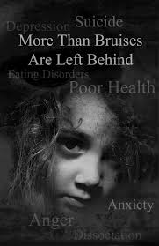
History
The social ills of child abuse plagues the United States historically showing little evidence that this child abuse social problem has been resolved.
The American public and social services agencies have been fighting child abuse issues as early as 1888, during the Women’s Rights Movements led by Ladies Federal Labor Union
In the middle of the 1960s, the government realized that the urgency for programs and legislation such as the Child Abuse Reporting Law that was set-up by the U.S. Children's Bureau.
Notes:
The history of Child abuse has existed and flourished in all cultures and ethnic backgrounds, in all its forms. Throughout history, children were considered property. Parents had the unrestricted authority to do to a child whatever was deemed necessary. Usually the father made all the disciplinary decisions. However, children are being killed or hurt by family members going back several decades.

Slide 4
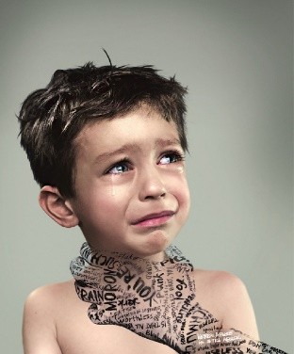
Present Day
There is a catastrophic number of children that are injured or dying because of child abuse. In the United States today we have more than 3 million reports of child abuse and 4 or 5 children are killed by child abuse or neglect (Findlaw,2015).
The United States is not doing very well with the prevention of child abuse. This is evident in the United States because of the number of children in overloaded foster care system, homelessness and poverty
The United States is losing the battle of protecting children from predators and their own family members. The child abuse epidemic has reached catastrophic proportions that is a direction reflection of our society.
Notes:
In present day we have a catastrophic number of children that are injured or dying because of child abuse. Abuse is a growing problem in today’s society. Although abuse of adolescents occurs at a rate lower than that of younger children, it is still very important to help keep it from continuing its harmful cycle. In our day and times we have more causes of neglect that has become an epidemic. Neglect is the most prevalent form of child abuse in the U.S. today.

Slide 5
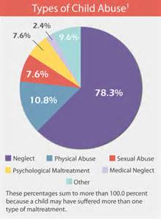
Social Institution
The United States is losing the battle of protecting children from predators and their own family members. The child abuse epidemic has reached catastrophic proportions that is a direction reflection of our society.
The abuse child may be admitted by the schools, social services, government agencies and simple referrals for several reasons neglect, sexual abuse and maltreatment
The mental institution have certain protocol when children are not submitted by their parents. The healing process for this child does not start until the social or mental institution intervenes address the year’s maltreatment.
Notes:
The social institutions have their own problems because the history of the abuse child does not always make to the people that are trying
To help the abuse children move forward. In addition, there are many different reasons the children are being admitted from schools, government
Agencies and government social agencies. They combine all the medical reasons together without separating the truly mental damage children from child abuse. Its is important that the mental health social institutions are given all the medical information and background to help that child to heal.

Slide 6
Socio-Demographic Variables
The gathering of the Socio-Demographic variable information on child abuse has many barriers to the reporting of the child abuse. The factors of location, family size, male, females, and medical agencies reporting child abuse.
The child abuse incidents are reported from different avenues such as children affairs, juvenile, foster homes, social agencies and police department all have different ways to report child abuse.
The medical providers have a difficult time understanding which child is truly sick from the flu and which ones are being neglected. In addition, the emergency room have difficult time determining the illness or child abuse (Evans & Rosch, 2015).
Notes:
The gathering of the Socio-Demographic variable information on child abuse has many barriers to the reporting of the child abuse. The factors of location, family size, male, females, and medical agencies reporting child abuse. In order to track and record the child abuse statistics to find trends to prevent the child abuse is a difficult task. The child abuse incidents are reported from different avenues such as children affairs, juvenile, foster homes, social agencies and police department all have different ways to report child abuse. However, these avenues are not interconnected to prevent child abusers from slipping through the system undetected as habitual child abusers. The medical providers have a difficult time understanding which child is truly sick from the flu and which ones are being neglected. In addition, the emergency room have difficult time determining the illness or child abuse (Evans & Rosch, 2015).

Slide 7
Sociological Theory
Child abuse is considered a sociological occurrence that is not a normal behavior patterns for human beings because the child abuse is learned from the abusing parents.
The sociological traditions and learned behaviors derived from years of verbal and physical abuse. This makes it true that child abuse is a sociological child abuse is considered a sociological phenomenon
The social impact of the child abuse is passed on to future generations while society still looks for new and innovative ways to prevent untimely injuries.
Notes:
The sociological theory is that the children from abusive families continue that tradition into the future. The learn these habits which are passed down from generation to generation. The behaviors of the child and parents are not normal in society. They do not have any other way to learn about violence of child abuse through experience.

Slide 8
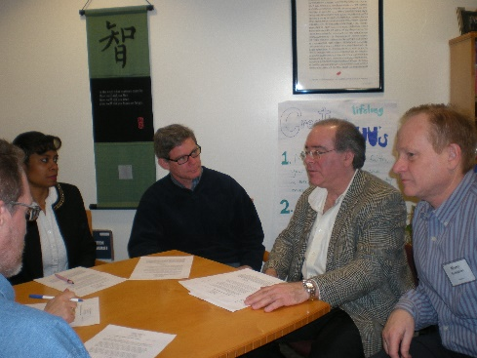
Social Action
Social advocates and social agencies working together
Community based social actions to address child abuse
Community hotlines to report abuse in timely manner confidentially
Notes:
Social actions is an important part of any push to change the trends of abused children.

Slide 9
Conclusion
Child abuse has a long history dating back to 1800s
Child abuse demographics are difficult because of different agencies report systems
Child abuse is an social issue that is not getting better
Notes:
It is the parents responsibility and duty to ensure their child is not abused. The abusive Parents greatly affect their children’s behavior. Children are like sponges--they model everything a parent does and incorporate what they see into their own lives. It is important that parents set the right examples for their children. Negative examples can be detrimental to a child’s development and can lead to bad behavior. There are social factors that are clearly one of the reasons for some many children being abused. The government has many different legislations to protect children but more governmental resources needed to be committed to this social problem.

Slide 10
References
Centers for Disease Control and Prevention (CDC).(2015).Child maltreatment prevention. Retrieved from www.cdc.gov/violenceprevention/childmaltreatement
Evans, K.,& Rosch,J.(2015).Barriers to reporting child maltreatment: Do emergency medical services professional fully understand their role as mandatory reports. North Carolina
Medical Journal.Vol. 76, no. 1,pgs. 13-18

