Slide 1
E-Cigarettes
Student
Course
Date

Slide 2
Introduction
Stress is an inevitable part of the contemporary lifestyle
People continue to find different ways of coping with stress, yet try to conduct a healthy lifestyle
It is very unlikely that smoking is going to disappear from the common practice
The solution of desire for healthy lifestyle yet smoking is found – E-cigarettes
Notes:
The contemporary lifestyle is characterized by high levels of stress. In order to preserve high level of productivity and manage stress, various coping strategies and addictions prevail. Although cigarettes is one of the most addictive legal substances, it is far from being eliminated from the common practice anytime soon. Irrespective of the widespread knowledge of the harmful impact of smoking to one’s health, smoking is still a common phenomenon (Gleam, 2014). The solution of the problem between a healthy lifestyle and the necessity of nicotine for stress relief is found – E-cigarettes.

Slide 3
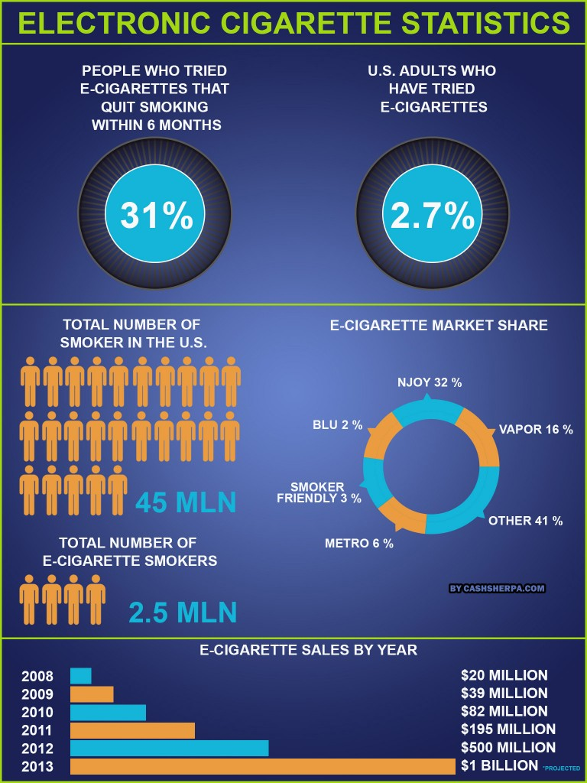
Notes:
The recent statistics demonstrate that people who tried e-cigarettes and quit smoking estimate 31%, 2.7 % of American adults already tried e-cigarettes.
The overall number of smokers in the US is 45 million, while the number of e-cigarettes smokers is 2.5 million, suggesting that there a great potential for this product. Moreover, e-cigarettes sales are increasing each year with the number of sales doubling in 2013 compared to 2012, estimating the total of $1 billion sales in 2013.
The source of image: http://blog.theeciggy.com/2013/06/electronic-cigarette-statistics.html

Slide 4
Recommendations
Benefits of the product and its difference from the regular smoking should be used marketing communications strategy
The emphasis should be placed on the healthy nature of the product for one’s health and environmental benefits
It worth aiming at wider customers with further diversification of target groups after the results of initial sales
Notes:
As the previous slide demonstrated the number of sales of e-cigarettes increases, thus, the product is perspective for our company to sell (Bagley, 2015). In terms of marketing strategy it is worth to emphasize the healthy nature of e-cigarettes and that the US has not banned the use of e-cigarettes because the Food and Drugs Administration has not been able to prove any significant harm from them to humans. The US should not ban e-cigarettes as scientific studies have shown so far that they pose no significant threat to human health and are even a safer alternative to traditional cigarettes.
In terms of the target customers segment, it is worth to start with a wider audience and based on the results of initial sales reorient towards the most functional audience (Bagley, 2015).

Slide 5
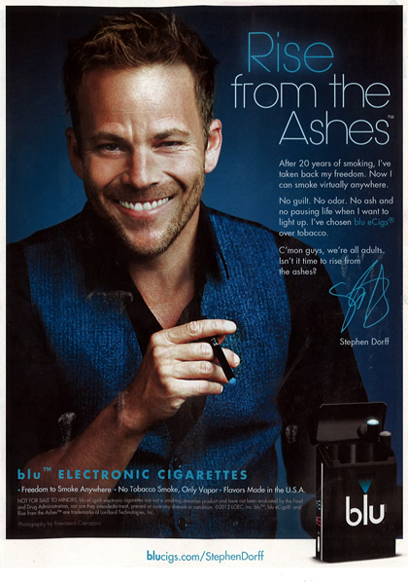
Advertisement strategy
Notes:
The channel for delivering our marketing message to our consumer audience will be through commercial advertisements. We can not only advertise our product, but we can also list facts about e-cigarettes to make the audience feel excited about quitting the filthy habit of smoking and purchasing e-cigarettes from our company. This is an appropriate channel because it reaches out to the mass consumer audience. (Senter, 2015)
The source of image: https://popbabble.wordpress.com/2014/11/17/stephen-dorff-sells-e-cigarettes/

Slide 6
Benefits of E-cigarettes
E-cigarettes are safer than traditional cigarettes because they do not emit smoke
The thousands of harmful chemicals found in cigarette smoke are not found in e-cigarettes.
Some researchers suggest that nicotine is not the threat, but rather the smoke.
Nicotine is a chemical stimulant not much different from caffeine found in coffee and energy drinks.
Notes:
Contemporary evidence suggests that e-cigarettes are safer than traditional cigarettes because they do not emit smoke. Without smoke, there can be no second-hand smoke (Etter, 2013). The danger that burning tobacco imposes comes from the smoke. Furthermore, the thousands of harmful chemicals found in cigarette smoke are not found in e-cigarettes. Some researchers suggest that nicotine is not the threat, but rather the smoke. Nicotine is a chemical stimulant not much different from caffeine found in coffee and energy drinks (Gleam, 2014). Prolonged users of any type of cigarettes become addicted to the nicotine. Traditionally, addicts used nicotine patches to constrain their use of smoke. If all the user needs is a hit of nicotine, then they do not need to rely on smoke as they can either rely on nicotine patches or e-cigarettes if they would rather simulate the act of smoking in a safer way (Griffen, 2015).

Slide 7
If product does not sell as well as expected
The necessity to reorient towards the groups that but the product the most
Change of marketing strategy towards younger adults is possible in the case of e-cigarettes
Change of marketing approach towards fashion and popular culture trends, including both health and stylish images
Notes:
If the sales are lower than expected, then the primary implication for the company would be to reorient its marketing strategy towards the groups that are more likely to buy the product which was demonstrated in the initial sales (Etter, 2013). Moreover, most marketers of e-cigarettes are able to target market the youthful generation in many ways that traditional cigarette companies cannot. While ads for cigarettes are banned from public television, e-cigarettes remain free to advertise. This is because e-cigarettes contain no tobacco, which means they are not subject to the same tobacco laws that traditional cigarettes are bound to. The fluids used in e-cigarettes also come in hundreds of flavors, most of them fruity which marketers use to convey the idea to the youth that these forms of e-cigarettes are related to candy. The designs of the e-cigarette devices themselves are manufactured in many designs and colors that conform to a pop culture, which becomes appealing to the youth (Senter, 2015).

Slide 8
Conclusion
E-cigarettes is a fashionable product, and its sales are increasing worldwide
It can resolve the complexity of smoking habit in the contemporary society
There are numerous ways of promoting this product on various segments of the market
The company can lose only if it does not use this opportunity.
Notes:
E-cigarettes is a fashionable product that demonstrates growing sales worldwide. Thus, it is still not late to enter both national and global market.
Since e-cigarettes can resolve the complexity of smoking habit in the contemporary society, this product will remain relevant due to the ongoing, long-term trends towards a healthier and more responsible lifestyle. Consequently, there are numerous ways of promoting this product on various segments of the market. Therefore, the company can lose only if it does not use this opportunity.

Slide 9
References
Bagley, C. (2015). Managers and the Legal Environment: Strategies for the 21st century. Boston: Cengage Learning.
Etter, J. (2013). The Electronic Cigarette: An Alternative to Tobacco? New York: Create Space Publishing.
Gleam, J. (2014). Electronic Cigarette: Beginner’s Guide. New York: Conceptual Kings.
Griffen, M. (2015). E-Cigarettes 101. Retrieved from Web MD:http://www.webmd.com/smoking-cessation/features/electronic-cigarettes
Senter, S. (2015). 6 Low-Cost Marketing Strategies. Retrieved from Business Know How: http://www.businessknowhow.com/marketing/affordmark.htm

