Slide 1
Educating Students with ASD
Concerns to be Addressed

Slide 2
Sources Interviewed
General Education Teacher
Special Education Teacher
Parents
Notes:
The interviewees for this study consisted of a general education teacher in the public school system, a special education teacher of children with learning disabilities in the public school system, and parents of a child with ASD.

Slide 3
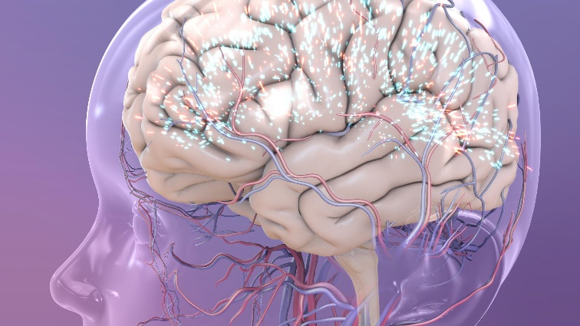
ASD Defined
What is ASD? It is a mental disorder.
Autism Spectrum Disorders
Social communication and interaction deficits
Restricted, repetitive behavior patterns
Notes:
Children with ASD exhibit a broad spectrum of symptoms that affects their ability to function normally, depending on their level of impairment. Some children have only mild impairment and others show severe disabilities.
Two of the hallmark symptoms of ASD are problems with social communication and interaction skills, as well as exhibiting behavior patterns that are on repeat and are restricted.
(NIH, n.d.)
(Costello, 2015) - Image

Slide 4
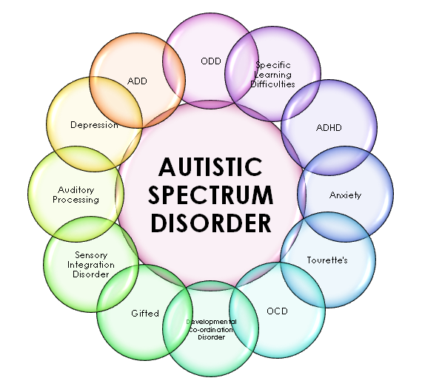
ASD Symptoms
Present in early childhood development
Causes significant functioning impairment
Social impairment
Communication issues
Notes:
ASD symptoms appear within the child’s first two years of life and present significant difficulties with normal functioning. These children do not follow normal or typical patterns of behaviour when developing communication and social skills, as compared to other children in the same age group.
Social impairment includes: problems making eye contact, disassociation with the environment, rarely points or shows things to others, unusual responses to others’ emotions, such as affection or anger.
Communication problems include: slow to respond to their own name or fails to, slow or fails to develop gesture skills, delayed language development, unusual and inappropriate language responses.
The image shows some a spectrum of symptoms and conditions associated with ASD.
(NIH-2, n.d.)
(Costello, 2015) - Image

Slide 5
Interviewee – General Education Teacher
Areas of Concern
Curriculum
Educator Training
Notes:
The interviewee was a general education teacher who voiced possible concerns about how children with ASD would learn, what their curriculum would consist of, and how would they assimilate with the rest of the class.
To address this issue, the teacher was assured that children with ASD are educated in the least restrictive environment as possible, as these children are entitled to be educated in regular classrooms. They are not just restricted to classrooms where every child is disabled. They are given the aids and support that they need to learn in a regular school environment to foster their inclusion.
To address the teacher’s other issues: It was noted that training for teachers is made available whenever they will be assigned to teach a child with ASD, prior to the child entering the classroom. The teacher is also trained on the assistive technologies needed for the child.
(AS, 2012)

Slide 6
Interviewee – Special Education Teacher
Areas of Concern
Curriculum
Teaching Methods
Responsibilities of Special Education Services
Notes:
The interviewee was a special education teacher who, like the general education teacher, voiced concerns about children with ASD’s curriculum.
The issue of curriculum was addressed in the same manner as for the general education teacher.
To address the special education teacher’s other issues: Teaching methods were recommended to the teacher such as floortime (play activities on the floor), picture exchange communication system (helping them communicate using pictures), and verbal behavior (motivating them to learn language with word values). The teacher was also given information on how to find additional teaching methods for children with ASD.
The special education teacher was informed that special education responsibilities are purposed to continue from early intervention services and begin teaching children with ASD from about age 3. They are assessed by experts and interventions and planning processes are developed with the special education teacher’s input.
(AS, 2012)

Slide 7
Interviewee – Parents of a Child with ASD
Areas of Concern
The Child’s Education Rights
Available Therapies
Curriculum
Notes:
The interviewee was the parents of an ASD child who voiced concerns about the child’s rights, therapies available to the child, and the nature of the child’s curriculum in school.
First of all, the curriculum was addressed just as it was for the teachers, and the parents were reassured that the child would be educated in as natural an environment as possible with other children in the child’s peer group that may or may not be disabled.
The parents were reassured that the child’s right to a public education was a top priority, as every child has a right to such. This is mandated by the Individuals with Disabilities Education Act (IDEA) of 1975. The act highlights the school’s responsibility to uphold its mandates. Additionally ADA (Americans with Disabilities Act), enacted in 1990, also has provisions to protect the civil rights of children with ASD so that they have equal access to education.
Available therapies were also discussed and the parents reassured that they can choose from various therapies to assist the child, such as physical therapy, speech and language therapy, and sensory integration therapy.
(AS, 2012)

Slide 8
Who is Affected
All Races
All Ethnicities
All Socioeconomic Groups
Both Genders
Notes:
Part of knowing how to make recommendations about ASD to those concerned is knowing who is affected by the disease. The truth is, the disease does not discriminate, as it affects people of all races, income statuses as well as both girls and boys, although it is most prevalent in boys.
It is important to note that ASD encompasses a broad range of conditions, according to the CDC and the Autism and Development Disabilities Monitoring Network.
(CDC, 2015)
(ASD-News, 2010) - Image

Slide 9
Recommendations
Address each interviewees concerns uniquely
Ensure that they each receive support materials and awareness information
Point them in the direction to access online resources
Notes:
The best thing to do when addressing each interviewees concerns, is to listen attentively and support suggestions with backup information that is tangible.
It is advisable that children with ASD are taught in small class sizes so that they are able to be given close attention so that they can achieve to the best of their ability.
Additionally, it is advisable that the parents of the ASD child understands and receives information on the “No Child Left Behind” program so that the know about the policies mandated by this program.
Interviewees are encouraged to take advantage of training available to them, particularly the parents, to better understand the challenges and necessities of caring for and educating a child with ASD.
(AS, 2012)

Slide 10
Conclusion
The old saying, “It takes a village to raise a child,” certainly applies to a child with ASD. It takes a team of people to ensure that these children have the proper care and education, as appropriate for their rights.
Each student should be treated as an individual
The focus should be on motivating the child to learn.
Notes:
(AS, 2012)

Slide 11
References
AS. (2012). Educating Students with Autism. Retrieved from Autism Speaks: https://www.autismspeaks.org/sites/default/files/sctk_educating_students_with_autism.pdf
ASD-News. (2010, April 26). ASD Class Sizes [Image]. Retrieved from ASD-News: http://hercasd.blogspot.com/2010/04/asd-class-sizes.html
CDC. (2015, February 25). Facts About ASD. Retrieved from Centers for Disease Control and Prevention: http://www.cdc.gov/ncbddd/autism/facts.html
Defying. (n.d.). ASD Spectrum Illustration [Image]. Retrieved from Defying the Spectrum!: http://www.defyingthespectrum.com/new-gene-studies-uncover-why-autism-symptoms-vary-widely-by-kendall-costello-on-january-24-2015/
NIH. (n.d.). What Is Autism Spectrum Disorder? Retrieved from National Institute of Mental Health: http://www.nimh.nih.gov/health/topics/autism-spectrum-disorders-asd/index.shtml
NIH-2. (n.d.). Early Signs & Symptoms. Retrieved from National Institute of Mental Health: http://www.nimh.nih.gov/health/topics/autism-spectrum-disorders-asd/index.shtml#part_145439

