Slide 1
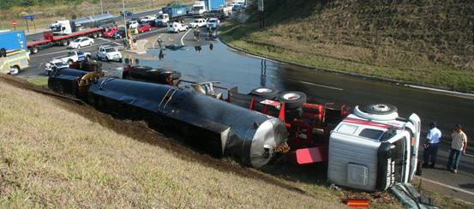
DOT 1403 Hazard Containment

Slide 2
Hazard Containment
Hazardous materials have become crucial elements of the growth and development of industries and crucial sectors of the economy.
In a scenario where a truck with a DOT 1403 placard overturns, there is potential risk for catastrophic effects in the surrounding environment as well as human beings.
Taking into consideration that the control center is 10 miles away, it may take 10 minutes for the earliest chemical emergency response teams to arrive.
Notes:
As such, the safe transportation of these materials from one point to another is critical to the success of the economy. Accidents that occur while in transit or at a fixed station or installation entail;
chemical leakage
chemical spillage
chemical overheating
escape of gas or vapor
fire
explosion (National Environmental Agency, 2015)
Taking into consideration the toxicity of the chemical, there is need for swift action to minimize the effects of any potential leakages. Taking into consideration that the control center is 10 miles away, it may take 10 minutes for the earliest chemical emergency response teams to arrive. However, other response teams, such as the police and paramedics can arrive at the scene much earlier. While these emergency response units will be integral in controlling the accident site, there are not properly equipped to handle spillage.

Slide 3
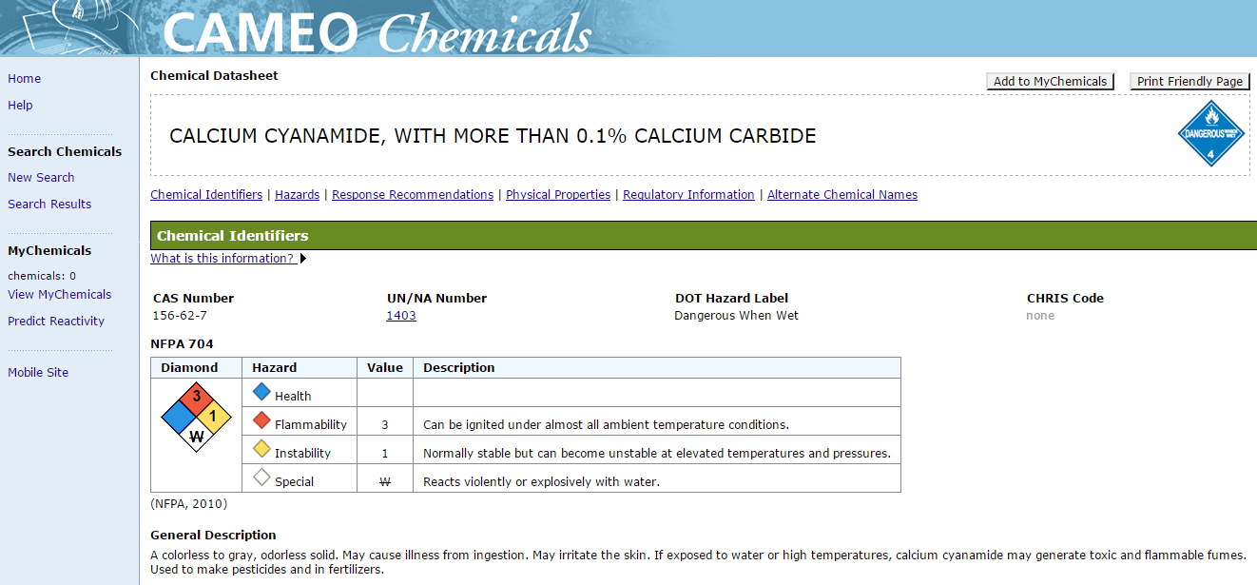
CAMEO Chemicals
Notes:
According to the CAMEO Chemicals Database, Calcium Cyanamide with more than 0.1% calcium carbide is specifically dangerous when wet.

Slide 4
Hazard Identification
The first and most important thing to do is to identify the chemicals and/or substances that are involved in the accident.
The DOT Placard 1403 indicates that this is a Class 4.3 Calcium cyanamide with more than 0.1 percent of calcium carbide.
The second stage is to clear the accident scene of any survivors and/or people.
The driver would be directed to immediately put pout their cigarette and move to beyond half a mile (800 m) from the scene of the accident.
Notes:
This placard is essential in setting in motion the sequence of events that would ensure the safety of the individuals involved in the accident.
Since the driver is still within the vicinity of the accident, it is best that he be moved to a safe distance. During evacuation, the driver should have his face covered to avoid contact or inhalation of the smoke from the truck.
While moving the driver to safety, it is essential that the emergency response telephone number be contacted. This can be done by the driver as they would have access to the shipping paper for the substances within the truck.

Slide 5
Source of Ignition
All sources of ignition have to be eliminated from the scene of the accident.
DOT 1403 placard substances may potentially be ignited by heat, flames or sparks.
The driver posed a potential risk through his cigarette.
The 5 gallon buckets found in the truck also have to be eliminated.
The small fire is an issue of concern and should be quickly put out.
This is because Dot 1403 placard substances can be ignited by flames, sparks or heat.
Notes:
All the necessary response units are to be contacted during this time. All operations beyond this point should be carried out with the required protective clothing. A particulate filter respirator is the most ideal and adapted equipment to the substance’s airborne concentration. This tool should be available with the driver as it is a requirement that vehicles transporting hazardous substances have the necessary clothing and protective wear to effectively and safely handle the substances at any given instance.
Furthermore, these substances react with water to ignite or even explode. As such all sources of fire and water have to be eliminated from close proximity to the truck. By removing him from the scene of the accident this threat is eliminated.
These pose considerable risk owing to the close proximity to the substances. A potential spill close to these buckets can be lead to catastrophic results.

Slide 6
Source of Ignition (cont.)
The fire, if left unchecked would gradually raise the temperatures around the container, eventually igniting the substances into a fire or a potential explosion.
Notes:
The dry sand will be used to put out the fire. The available water will not be employed to put out the fire as it poses too many risks at this stage of the emergency operation.

Slide 7
Isolation of Accident Scene & Spillage Control
Isolation of the accident area is critical.
A buffer zone can be quickly created around the area using the sand from the environment.
Spillage and leakage of the material poses high risks.
Sand is an effective tool in achieving this with minimal risk.
This procedure requires an intricate and extensive quick search throughout the lower side of the track.
Any signs of leakages should be muffled with mound of sand available.
Notes:
The dry sand will be used to put out the fire. The available water will not be employed to put out the fire as it poses too many risks at this stage of the emergency operation.
Owing to the fact that there is a nearby water source or deposit, it is crucial that the substances within the truck do not get into contact with the water. By virtue of having sand, the fire can be muffled by developing a cushioning. This is critical in containing any spillage and/or fire that may spark suddenly.
As such all sources of leakage and spillage have to be identified. The sand would then be used to seal up any points of spillage that may be visible. In the case where there is a spillage or leakage, the point of leakage and the substance have to be kept dry.

Slide 8
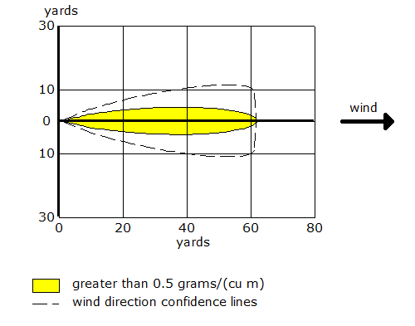
Isolation of Accident Scene & Spillage Control
Notes:
As depicted by the diagram from the Aloha software, a relatively small leak of$0.5 mg/{cm}^{3}$ and taking into consideration wind, the leakage may potentially move 60 yards from the source.
Taking this into consideration, the best plausible course of action is creation of a ridge around the leakage.
This will be supplemented by covering the leakage with the dry sand. However, this has to be done after the fire has been extinguished. The gases emitted from the burning substance is toxic. Taking into consideration the direction of the wind, handling this step before putting out the flame can expose emergency response personnel to exposure to the substance through inhalation.
This procedure also has to be completed using the appropriate protective gear.

Slide 9
Tank/Container Cooling
Cooling of the tanks is integral in maintaining the substance and container temperature at low and acceptable levels.
However, this can only occur well after the fire has been put out.
Water can then be carefully flooded to container the temperature of the container, and in return the temperatures of the substances within the container.
Using the sand, gulley and trenches can be created to control the flow of water around the areas.
Notes:
This is a vital component of the emergency procedure. DOT 1403 placard substances can potentially ignite even after the fire has been extinguished. This is crucial in avoiding backflow of water to areas close to the container.
One important characteristics as depicted by the DOT 1403 placard is that the substances react to water. When in contact with water, there is the potential that the substance may produce flammable gasses or even ignite when in contact with the water or the surrounding moist air. As such water should not come into contact with the substances in the tank.

Slide 10
First Aid
Immediately after the fire has been put under control and the container cooled to reasonable temperature levels, first aid can be administered to the driver.
Firstly, the driver’s eyes are checked for contact lenses. If present, they are removed and the eyes with a normal saline solution.
Any affected areas of the skin are flooded with water while ensuring all contaminated clothing is removed. Once the driver is at a safe distance away from the scene, they would be encouraged to take deep breaths of fresh air.
Notes:
Furthermore, the patient is constantly consulted for any symptoms of any effects on the respiratory system identified by a burning sensation in the chest, throat or mouth.
The occurrence of risks in road and rail transport mostly affect the environment and the population in close proximity to the road and/or rail. The most common areas that are associated with high risks include stopover and service points for vehicles and trains. These include lorry parking sections and railway marshalling yards. At these points it is much easier to obtain emergency response. However, it poses considerable risk to the environment and people as well.

Slide 11
Important Things to Consider
During this whole process there are a number of care tips that have to be observed.
In order for a successful emergency operation, safety standards by those involved in the procedure is paramount.
It is important that the individual involved in the emergency operation stay upwind at all times.
It is also important to note that the Class A fire extinguisher cannot be employed in this scenario.
Notes:
This is a critical in avoiding any inhalation of any substances, vapors or products of decomposition that may cause severe injury.
This class of fire extinguishers is meant for solids such as paper and wood.
As such using this class of extinguisher on a potential exposed leakage may have catastrophic results for the emergency response unit attending to the fire.
Risks in the transportation of hazardous materials lies at the point where there can occur a release, ignition, or any form of event that may catalyze its reaction to the surrounding environment.

Slide 12
References
CAMEO Chemicals. (2015, March). UN/NA 1403. Retrieved from CAMEOChemicals.noaa.gov: http://cameochemicals.noaa.gov/unna/1403
Centers for Disease Control and Prevention. (2007, September). NIOSH Pocket Guide to Chemical Hazards. Retrieved from CDC.gov: http://www.cdc.gov/niosh/docs/2005-149/pdfs/2005-149.pdf
EPA. (2015, February). MARPLOT Software. Retrieved from EPA.gov: http://www2.epa.gov/cameo/marplot-software
National Environmental Agency. (2015, January 20). Hazardous Substances. Retrieved June 18, 2015, from National Environmental Agency: http://www.nea.gov.sg/anti-pollution-radiation-protection/chemical-safety/hazardous-substances
Notes:
This is a critical in avoiding any inhalation of any substances, vapors or products of decomposition that may cause severe injury.
This class of fire extinguishers is meant for solids such as paper and wood.
As such using this class of extinguisher on a potential exposed leakage may have catastrophic results for the emergency response unit attending to the fire.
Risks in the transportation of hazardous materials lies at the point where there can occur a release, ignition, or any form of event that may catalyze its reaction to the surrounding environment.

