Slide 1
Minority subjects
nAME
Notes:
Introduction

Slide 2
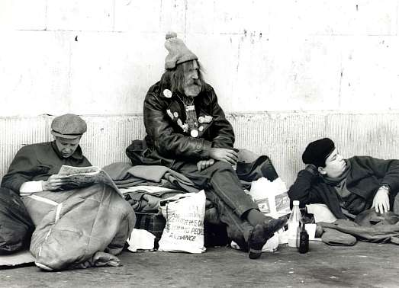
Who experiences homelessness?
Notes:
Every year, minority subjects go through homelessness. In fact, it has been estimated that an average of 3.5 million individuals have to go through some sort of homelessness or another. This has become such a prevalent topic throughout America that government officials have begun discussing whether or not something should be done in order to provide for these individuals.

Slide 3
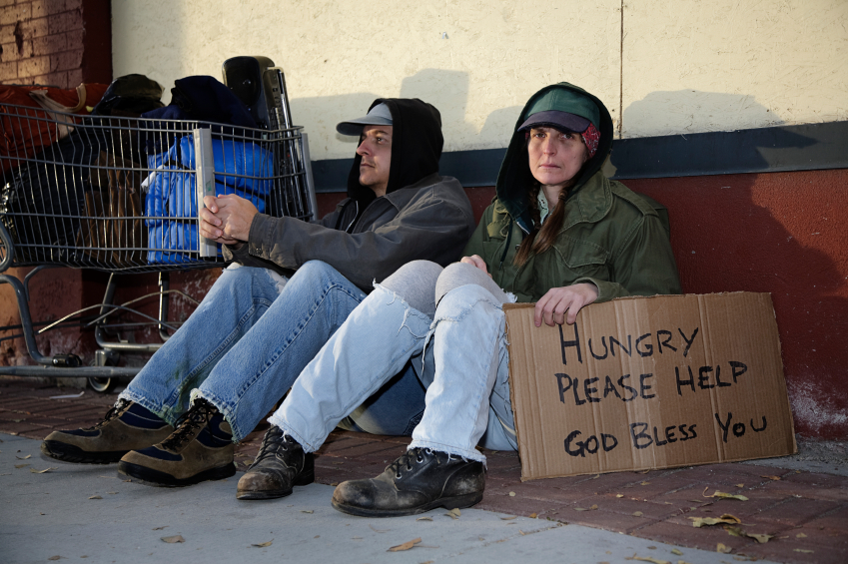
Should the government intervene?
Notes:
Because of the government’s inaction to provide safe, adequate shelters for the homeless, there are numerous individuals who have complained that the homeless should be taken care of. This is especially true because of the manner in which many of the homeless today used to serve in the United States military.

Slide 4
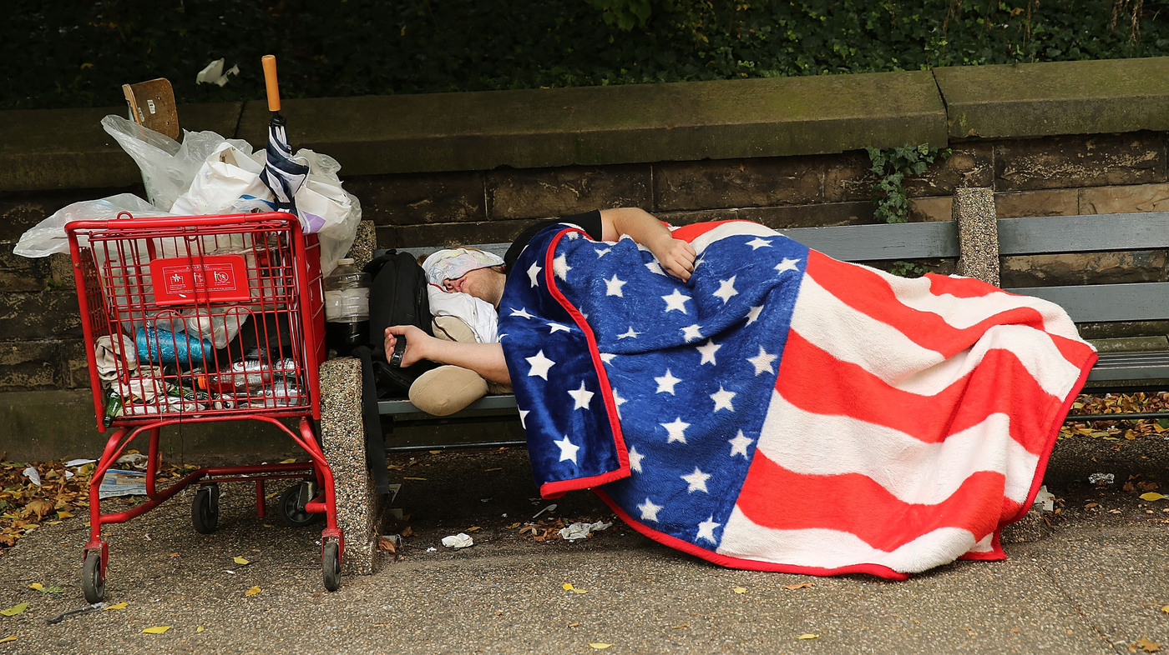
What kind of impact can this have on society?
Notes:
If the government refuses to act at these trialing moments, then it goes without saying that there will be many who will begin to speculate that the government truly does not care about its individuals. This can create a variety of problems throughout society because there will be many who disagree with the majority of the government’s actions.

Slide 5
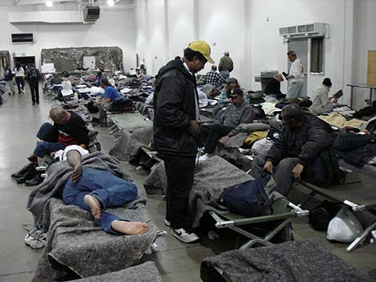
What are the conditions in the homeless shelters like?
Notes:
The bad thing about homeless shelters is that when the government is willing to provide them, they are of bad quality. The government has failed to provide safe and adequate accommodations for many individuals in the past and because of this, there are many homeless people who would rather sleep on the streets than in the shelters.

