Slide 1
Is Domestic Violence Related to Culture
Name
Class
Professor
August 13, 2015

Slide 2
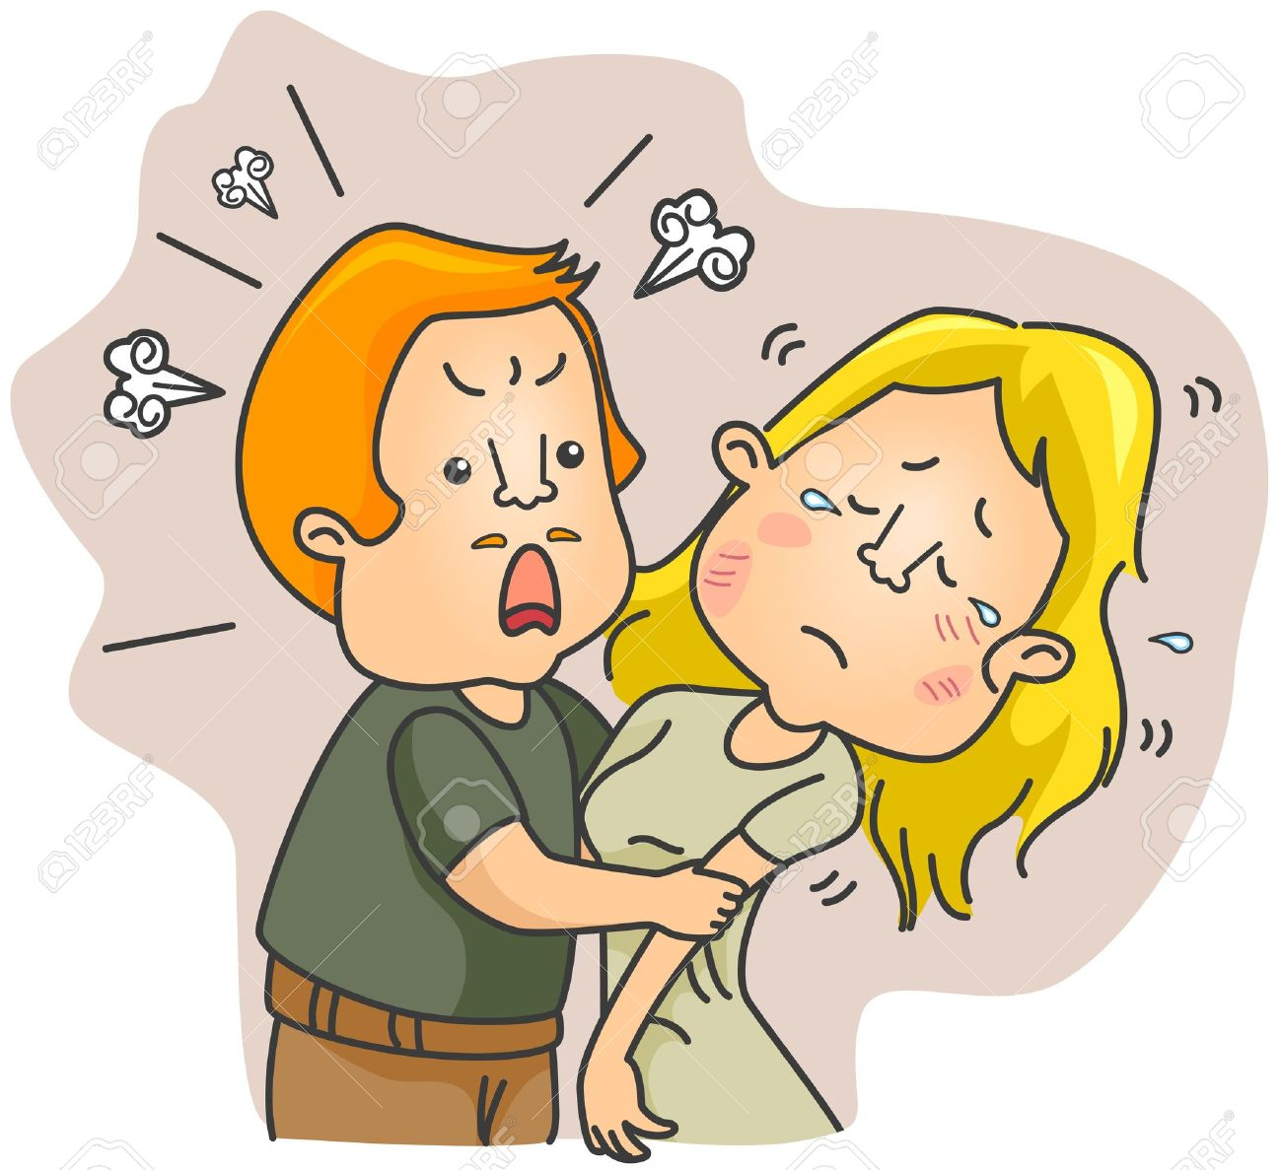
Introduction: What is Domestic Violence?
Domestic violence is defined as physical or verbal abuse that is detrimental to one’s spouse
It is an issue that involves the ethical responsibility that we, as a society, have towards those who are being abuse
Some cultures participate in more crimes of domestic violence than others
Notes:
Domestic violence is defined as physical or verbal abuse that is detrimental to one’s spouse. It is an issue that involves the ethical responsibility that we, as a society, have towards those who are being abuse. Ultimately, we must protect these people. Some cultures participate in more crimes of domestic violence than others, but is this a result of cultural values?

Slide 3
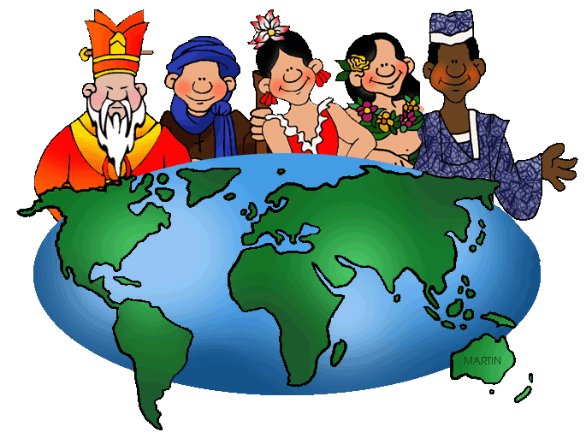
Domestic Violence is a Cultural Issue
Culture is broadly defined as the traditions, religions, languages, and relationships that distinct peoples have
One’s culture plays a dominant role in his/her perception of domestic violence
There are some cultures that believe domestic violence is normal and indicative of a loving relationship
Many actions of domestic violence are marginalized due to cultural influences (Farnsworth, 2005)
Domestic violence used to be considered normal in America
Notes:
Culture is broadly defined as the traditions, religions, languages, and relationships that distinct peoples have. One’s culture plays a dominant role in his/her perception of domestic violence. Consequently, there are both men and women who feel that domestic violence is both necessary and normal. As far back as the 1800s, laws in the United States gave men the legal rights to chastise their wives using whatever means necessary. Therefore, changing cultural normalities could decrease the incidence of domestic violence.

Slide 4
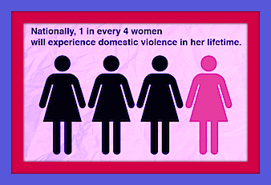
Domestic Violence: The Facts
Domestic violence is high incidence
Children who live in homes where there is domestic violence also suffer abuse or neglect at high rates (30% to 60%).
1 in 3 female homicide victims are murdered by their current or former partner every year.
Notes:
Domestic violence is high incidence; 1 in every 4 women will experience domestic violence in her lifetime. In addition, children who live in homes where there is domestic violence also suffer abuse or neglect at high rates (30% to 60%). Last, 1 in 3 female homicide victims are murdered by their current or former partner every year. It is important to fight against domestic violence to support families.

Slide 5
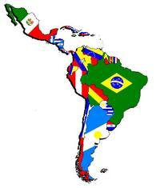
Domestic Violence: Latin Culture
Latino women are taught to be “submissive, docile, self-sacrificing, and stoic” (Agoff, & Castro, 2007)
Men are thought to have power above women
This creates an atmosphere that is conducive to domestic violence
Notes:
Certain cultures are conducive to domestic violence. Because men are thought to be superior and women inferior, abusive behaviors are seen as acceptable. Often, women are too worried to disrupt this power dynamic because they understand that harm could befall them.

Slide 6
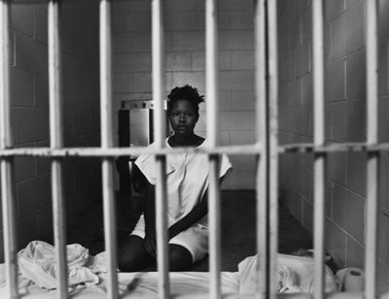
Opposing Opinion: Domestic Violence is Not a Cultural Problem
Many individuals claim that domestic violence is not problematic and is a natural part of the relationship
Some women believe that domestic violence is an indicator that their spouses care for them
Many men and women believe that the place of a woman is in an inferior position
Notes:
Many individuals would argue that domestic violence is not a major issue. These people claim that domestic violence is a natural part of the relationship, that it is an indicator that their spouses care for them, and that the place of a woman is in an inferior position. However, these individuals are convicting themselves to a life of harm. They do not understand that they are not happy because they have never experienced an alternative to their current state.

Slide 7
Solving the Problem: Redefining the Role of Women in Culture
In order to break the cycle of abuse and domestic violence, cultural norms and stereotypes must be broken (Anderson, 2008)
It is important for both members of a relationship to understand that mistakes and problems are not always the fault of the female
Problems can be solved by establishing strong communication skills as a couple
Notes:
It is important for both members of a relationship to understand that mistakes and problems are not always the fault of the female. Problems can be solved by establishing strong communication skills as a couple. In order to break the cycle of abuse and domestic violence, cultural norms and stereotypes must be broken. While this requires a societal change, it is important for everyone to take steps to promote this societal shift. The most important first step is for everyone to become informed of this issue.

Slide 8
Resolving Abusive Relationships
It is important for couples in abusive relationships to seek counseling to control their anger and repair the relationship (Constantine, 2007)
Occasionally, individual counseling is necessary if a woman does not feel safe enough to talk in front of her husband
There are many charity organizations that are willing to support women and help them overcome their abusive relationships
Notes:
It is important for couples in abusive relationships to seek counseling to control their anger and repair the relationship. Occasionally, individual counseling is necessary if a woman does not feel safe enough to talk in front of her husband. There are many charity organizations that are willing to support women and help them overcome their abusive relationships. With this support in place, many women will be able to overcome the cultural normalities that they have adapted to and understand that their own personal liberty is an important aspect of life.

Slide 9
References
Agoff, C., Herrera, C., & Castro, R. (2007). The weakness of family ties and their perpetuating effect on gender violence: A qualitative study in Mexico. Violence against women, 13(11), 1206-1220.
Anderson, K. L. (2008). Gender, status, and domestic violence: An integration of feminist and family violence approaches. Journal of marriage and family, 59(3), 655-669.
Constantine, M. (2007). Racial micro-aggression against African American clients in cross-racial counseling relationships. Journal of Counseling Psychology, 54(1), 1–16.
Farnsworth, I. S. (2005). Battered women's process of leaving: Implications for career counseling. Journal of career assessment, 13(4), 452-475.

