Slide 1
Roots of Organizational Policy
Jackson Memorial Hospital

Slide 2
Introduction
Non- profit health care organization
Tertiary level hospital
Linked to Leonard Miller School of Medicine University of Miami
Contains over 1,550 licensed beds
Notes:
Jackson Memorial Hospital is a non-profit accredited tertiary care level hospital. It is considered a major teaching facility being linked to University of Miami Leonard M. Miller School of Medicine. The facility contains over 1,550 licensed beds being a magnet for medical research, referral center and home to Ryder Trauma Center. This center is the only level 1 adult and pediatric trauma center in Miami-Dade County (University of Miami Health system, 2015)

Slide 3
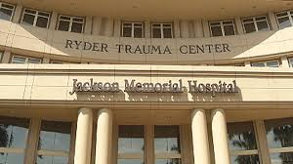
Introduction Cont’d
Magnet Hospital for medical research
Referral center for trauma
Houses Ryder Trauma Center
Ryder Trauma center is the only level 1 adult and pediatric trauma center
Notes:
Jackson Memorial Hospital is a non-profit accredited tertiary care level hospital. It is considered a major teaching facility being linked to University of Miami Leonard M. Miller School of Medicine. The facility contains over 1,550 licensed beds being a magnet for medical research, referral center and home to Ryder Trauma Center. This center is the only level 1 adult and pediatric trauma center in Miami-Dade County (University of Miami Health system, 2015)

Slide 4
Demographics
Located at Civic Center
Situated at North West intersection
Important Medical Centers Included
Notes:
The hospital can be found at the Civic Center, on the Northwest quadrant intersection of I-95 and SR 836. Precisely, this environment contains a huge medical center encompassing University of Miami Hospital formerly known as Cedars of Lebanon Medical Center, Miami VA Medical Center and University of Miami Miller School of Medicine. Numerous research centers along with laboratories share the hospital geographic space. These include the UM/Sylvester Comprehensive Cancer Center and the Cure Paralysis (University of Miami Health system, 2015)

Slide 5
Organizational Policies
Procurement procedures,
Hurricane disaster precautionary measures
Patient safety measures
Health system affiliation policy
Electronic health recording policy
Notes:
There are numerous polices governing the function of Jackson memorial hospital. They are aligned to procurement procedures, hurricane disaster precautionary measures, patient safety measures, the health system affiliation policy and the electronic health recording (EHR) polices. These polices govern functions of the Jackson Memorial Hospital as an organization as well as it affiliates such as VA medical center and district centers, which do not share the same geographic space (University of Miami Health system, 2015)

Slide 6
Procurement
Public trust Miami Dade County Regulation
Applicable to all contracts the organization engages
Includes professional services
Mandatory adherence regardless of funding source
Notes:
This policy relates to the Public trust Miami Dade county regulations. The policy is applicable to every contract the organization engages for public improvements as well as every purchase goods and services. Services include professional ones undertaken by the Trust Corporation to which Jackson Memorial is associated. Adherence to this policy is mandatory regardless of the funding source except when otherwise stipulated by the administrative Federal law policy (Public Health Trust of Miami-Dade County, 2014).
This regulation’s purpose is for governing the procurement services, goods and construction. It serves as an advisory to Trust staff for consistency in the administrative process. Regulation deviations should not initiate for protest or appeal by people who might be affected by this policy implementation. Besides, the policy was intended by the trust to implement transparency the Trust to promote competition and transparency in public procurement. All Trust and Jackson Memorial Hospital employees who are directly or indirectly associated with procurement are asked to promote the policy (Public Health Trust of Miami-Dade County, 2014).

Slide 7
Hurricane disaster precautionary measures
Aligned to National disaster policies
Policy intention is to have its personal hurricane disaster team
Alerts give advance directive to staff
Patients safety is paramount in the operations
Notes:
Jackson Memorial Hospital Hurricane Response Plan is created to offer information needed for ensuring efficient safe response to hurricanes. Often Hospitals are affected by hurricane and Florida is a hurricane targeted region. The policy is aligned to National Hurricane polices as well as those mandated by the Jackson Health system (Hurricane Response plan, 2012).
Jackson Health System Emergency Management Department established a unit for monitoring National and Regional Weather Services. Current weather conditions are circulated through bulletins forecasts. These operations are aligned to the Miami Dade County Emergency Operations Center. The intention is supplying Jackson Health System personnel with advanced data, which will prepare them to take necessary precautions ahead of time. Patients’ safety is at risk as well as staff when a Hurricane strikes. Therefore, aligning polices with state and federal regulations are essential (Hurricane Response plan, 2012).

Slide 8
Patient safety measures
Fall prevention policies construction regulations
Safety in medical practice e.g. medication errors
Elopement prevention and documentation
Policy aligned to Healthcare administration safety rules
Notes:
Jackson Memorial Hospital has a comprehensive patient safety policy, which coincides with national mandatory standards for patient safety. An extensive elopement policy accompanies this safety regulation. It encompasses documentation of patients’ elopement incident on a form designed by the state health care administration. Nurses have special responsibility with reference to elopement, falls, accidents as well as medical errors which, result in serious consequences. Even though elopement mainly targets mental health patients, the fact that any patient could elope strict precautionary measures have been instituted as safety measures in limiting occurrences (Mejia, Wedderburn & Davila, 2012).

Slide 9
Jackson Memorial Hospital affiliation policy
Policy aligned to HIPPA Regulations
Jackson Memorial Hospital has many affiliates
The expectation of affiliates are very high
High standard and integrity is demanded
Notes:
These policies are embodied in the form of a manual being aligned to state regulations regarding the way health care organizations could engage in affiliations with other agencies. Jackson Memorial hospital is affiliated to may other health care agencies including the medical center which share its property. The affiliation polices place a strong demand on healthcare professionals and supporting professions engaged in Jackson health care delivery system (Affiliation Handbook, 2014).
These standards are HIPPA related and include patient safety with reference to ensuring patient privacy and confidentiality; patient care that is not discriminatory irrespective of social status, immigration discrepancies and whether patients can pay or not. Affiliates must function with integrity and honesty. When billing patients measures must be taken to generate accuracy in accounting. Invoices must be processed within the contractual framework and guidelines. Resources must be appropriately distributed among affiliates (Affiliation Handbook, 2014). .
.

Slide 10
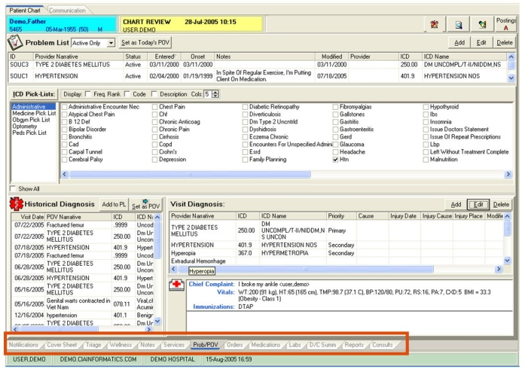
Electronic health recoding policy
Mandated by Affordable care Act
Requirement for securing tax credits
HIPPA regulated implementation
HIPPA software use guidelines
Notes:
Electronic medical records policies at Jackson memorial hospital coincide with HIPPA regulations as it pertains to establishment and interventions by administration as well as staff engaged in the meaningful use of computer based storage of patient data. Since there have been nationwide safety breeches of sensitive patient data HIPPA issued specific regulations for all health care organizations to be inscribed in their policy documents. Software with security devices compatible with the current systems were to be installed across the healthcare system (Comprehensive Amendment, 2012).
They have been mandated to be periodically checked ensuring that systems are functioning according to regulations. Only credible companies are utilized in installing and maintaining the electronic health record system at Jackson Memorial Hospital. Jackson Memorial Hospital electronic health record policies were adopted in compliance with the Affordable care Act mandate for hospitals to receive state and Federal benefits inclusive of tax breaks (Comprehensive Amendment, 2012).

Slide 11
Conclusion
Jackson Health care system offers state of the art care
The services are accessible to all Florida Residents
Contains many medical centers on its property
The Hospital is internationally accredited
Notes:
Jackson Health care system offers state of the art care. The services are accessible to all Florida Residents. The organization contains many medical centers on its property. The Hospital is in internationally accredited.

Slide 12
References
Comprehensive Amendment (2012). Jackson Health care Medical Record System. Retrieved
October 9th, 2015 from http://www.jacksonhealth.org/library/credentialing/medicalstaff-rules-regulations.pdf
Affiliation Handbook (2014).Jackson Health Care system. Retrieved October 9th, 2015
fromhttp://cnhs.fiu.edu/nursing/undergrad/_assets/common-assets/clinical-
education/clinical-placements/Jackson-affiliation.pdf
Hurricane Response plan (2012). Retrieved on October, 8th 2012 from
http://www.jacksonhealth.org/library/plans/hurricane-response-plan-12.pdf
Public Health Trust of Miami-Dade County (2014).Procurement Regulations. Code 248
Retrieved on October 8th, 2015 from
http://www.jacksonhealth.org/library/procurement/procurement-
regulation.pdf
Mejia, B.Wedderburn, B., & Davila, M. (2012). Patient safety; Management of patient
elopement. Retrieved October 9th, 2015 form
http://www.jacksonhealth.org/library/nursing/patient-elopement.pdf
University of Miami Health system (2015) .Jackson Memorial Hospital. Retrieved October 9tth,
2015 from http://uhealthsystem.com/locations/jackson

