Slide 1
Operating Conditioning Presentation
Name
Class
Professor
August 16, 2015

Slide 2
Operant Conditioning
Operant conditioning is the process by which people learn behaviors
Positive and negative reinforcement help increase behaviors (Tucker, 1998)
Positive and negative punishment help reduce behaviors

Slide 3
Pavlov’s Dog: An Operational Conditioning Experiment
Pavlov learned that he could train his dogs to respond to certain stimuli (McLeod, 2013)
By helping them associate the sound of a bell with feeding time, he learned that he could make his dogs salivate even when food is not present
This is an example of positive reinforcement because the dog learned to associate the bell with being rewarded with food

Slide 4
Punishment: How Many Parents Modify Behavior
Many parents will send their child to a “time out” corner when they are misbehaving
These parents are aware that their child will tend to behave to avoid this
This is a form of negative punishment

Slide 5
Case: A Child’s Crayons are Taken Away
A child has his or her crayons taken away for fighting with her sibling
This form of operational conditioning is an example of negative punishment

Slide 6
Why negative punishment?
Negative punishment is when a desired item is removed after undesired behavior occurs
It is meant to reduce the undesired behavior by having the child associate negative behavior with the removal of desired items (Sadowski, 2012)
Focus is on removing the desired behavior

Slide 7
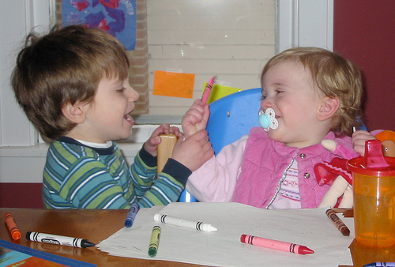
Making the Punishment Meaningful
Often, the context of the situation determines whether or not the punishment will be effective
In this case, if the two siblings were fighting over crayons, the punishment would be significantly effective
If the two siblings were not fighting over the crayons, they may not be able to reconcile with why the crayons were taken away

Slide 8
Application of Operant Conditioning
For this punishment to be successful, it is important for the mother to keep this punishment consistent for this behavior
It is also important for the mother to use similar punishments for her other child to avoid creating a double standard

Slide 9
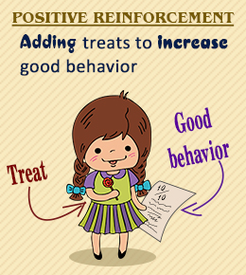
Application of Observational Models
Operant conditioning overlaps with the idea of classical conditioning (Mackintosh, 1975)
To an extent, all of our behaviors are directed by either stimuli or consequences
Through both processes, young children and adults are able to learn

Slide 10
References
Mackintosh NJ. (1975). A theory of attention: Variations in the associability of stimuli with reinforcement. Psychological Review, 82: 276–298
McLeod S. (2013). Pavlov's Dogs. Retrieved from http://www.simplypsychology.org/pavlov.html
Sadowski K. (2012). The Difference Between Positive and Negative Punishment. Retrieved from http://nspt4kids.com/parenting/the-difference-between-positive-and-negative- punishment/
Tucker M, Sigafoos J, Bushell H. (1998). Use of noncontingent reinforcement in the treatment of challenging behavior. Behavior Modification, 22: 529–547

