Slide 1
Quality Improvement Project
Name
Class
Professor
August 9, 2015

Slide 2
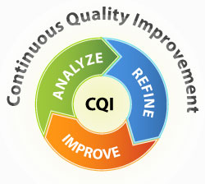
Area Where QI Change Will Occur
Med/surg unit of local acute care facility
This study will occur within one department to efficiently track the progress of communication between staff members and the impact on the quality of care
All nurses within the department will be provided with an iPhone to enhance communication between nurses that are working with the same patient

Slide 3
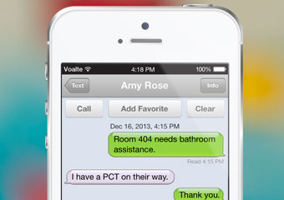
Identification of Desired Outcome
Nurses will have a better understanding of the needs of the patient at the end of each shift
Nurses will be notified of important information regarding a patient more quickly
Communication will be more effective because it will be documented
Requests that occur as a result of communication between nurses will be performed a larger percentage of the time due to the instant nature of the message in addition to the fact that the message has been recorded for reference
Accountability of nurses will increase due to enhanced record keeping

Slide 4
Identification of Units or Personnel or Departments Affected by Change
All nurses in the ward/department will be asked to participate independently of shift

Slide 5
Discussion of How QI Project Will be Implemented
All nurses in the department will be approached with the project idea and be consented if they wish to participate
Participating nurses acknowledge that the iMessages will be tracked for research purposes
The consistency of reports between nursing shifts will be measured in addition to the speed with which the nurses respond to patient needs
Nurses will take a survey that will help researchers understand their opinion of the practicality of the iMessaging system to enhance communication between nurses

Slide 6
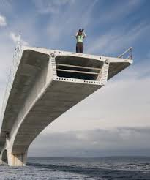
Project Weaknesses/Room for Improvement
All employees need to be on board for the project to be successful
It will be expensive to purchase iPhones for the employees
This project is strong because it requires little training to teach nurses to use the cell phones
Lewin’s theory of change is applicable to this project

