Slide 1
Songkick
Name
Class
Professor
September 26, 2015

Slide 2
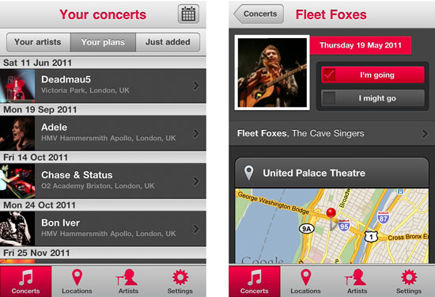
Background
The company was founded by Ian Hogarth, Michelle You, and Pete Smith in 2007 in London
This application allows music fans to track their favorite bands and determine when they will be performing in their area
It also provides other news about live music events
More than 10 million people use this application each month (Bradshaw, 2014)
Notes:
Songkick was founded by Ian Hogarth, Michelle You, and Pete Smith in 2007 in London. To design the application, they relied on funds raised from an internet campaign. This application allows music fans to track their favorite bands and determine when they will be performing in their area. Alerts will sound to let the user know when a band they are interested in will be coming to their town. The application also provides other news about live music events. More than 10 million people use this application each month.

Slide 3
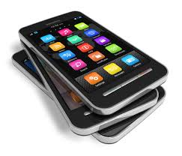
Target Market or Customer Base
This business targets people who primarily use smartphones (Sisaro, 2011)
Both Google and Android versions of Songkick are currently available
Since a wide variety of music is covered on the application, Songkick is meant to appeal to people of all ages and demographics
Songkick now also targets musicians who need help funding their tours
Notes:
Songkick targets primarily individuals that use smartphones because the application is only available on mobile devices. Both Google and Android versions of Songkick are currently available. Since a wide variety of music is covered on the application, from rock to country to jazz, Songkick is meant to appeal to people of all ages and demographics. Songkick now also targets musicians who need help funding their tours. Therefore, this application is ideal for all music lovers and can help them either find concerts they will be interested in or help them fund their own music.

Slide 4
Revenue Stream
Songkick earns its money through referrals
The company puts customers in touch with concerts they may be interested in
When customers buy tickets, Songkick’s partners will provide it with commission for the purchase
Songkick therefore makes more money by optimizing its app for more widespread use
Notes:
Songkick is currently free to download. The company earns its money through referrals. To make revenue, the company puts customers in touch with concerts they may be interested in. When customers buy tickets, Songkick’s partners will provide it with commission for the purchase. Songkick therefore makes more money by optimizing its app for more widespread use. It’s marketing practices focus on attracting more customers that are likely to purchase tickets.

Slide 5
Primary Competitors
Direct competitors include:
GigLovers
Bandsintown
Applauze
Livekick
My Concert Archive
TiBconcerts
These applications and websites allow users to access news and information about upcoming concerts and some allow users to purchase the tickets for these events directly
Notes:
Songkick has many direct and indirect competitors. However, since there are a large number of direct competitors, these businesses are the primary concern. These competitors include: GigLovers, Bandsintown, Applauze, Livekick, My Concert Archive, TiBconcerts, and more. These applications and websites allow users to access news and information about upcoming concerts and some allow users to purchase the tickets for these events directly. It is likely that many more companies will open in the future, entering into direct competition with Songkick. Indirect competitors include ticket vending websites like Ticketmaster and Stubhub are also a concern. Songkick will continue to be successful if it’s able to over its services in a customer friendly manner.

Slide 6
Company News and Evaluation
Songkick was awarded one of Time Magazine’s best Android applications in 2013
In 2015, it merged with CrowdSurge to spread their reach
The use of the application is highly recommended because it is easy to use
However, individuals that prefer to not use applications for buying tickets will not find this service useful
Notes:
Songkick continues to evolve to cater to the needs of its users. As such, Songkick was awarded one of Time Magazine’s best Android applications in 2013. In 2015, it merged with CrowdSurge to spread their reach and to sell tickets to a broader customer base. Overall, the use of the application is highly recommended because it is easy to use. Since the application is only available on Android and iPhone, Samsung and other smartphone users will not be able to access it. In addition, individuals that prefer to not use applications for buying tickets will not find this service useful. Thus, it is a useful app for the specific audience that Songkick targets, but it is not accessible to people that fall outside this target demographic.

Slide 7
References
Bradshaw, T. (2014). Songkick makes a noise with 10m
subscribers. Retrieved from http://www.ft.com/cms/s/0/82635984-e5bc-11e3-aeef- 00144feabdc0.html#axzz330Gghirn
Sisaro, B. (2011). A Go-to Site for Tracking Music Acts. Retrieved from http://www.nytimes.com/2011/05/02/business/media/02 songkick.html

