Slide 1
Synthesis Essay on Homeschooling
Name
Class
Professor
August 30, 2015

Slide 2
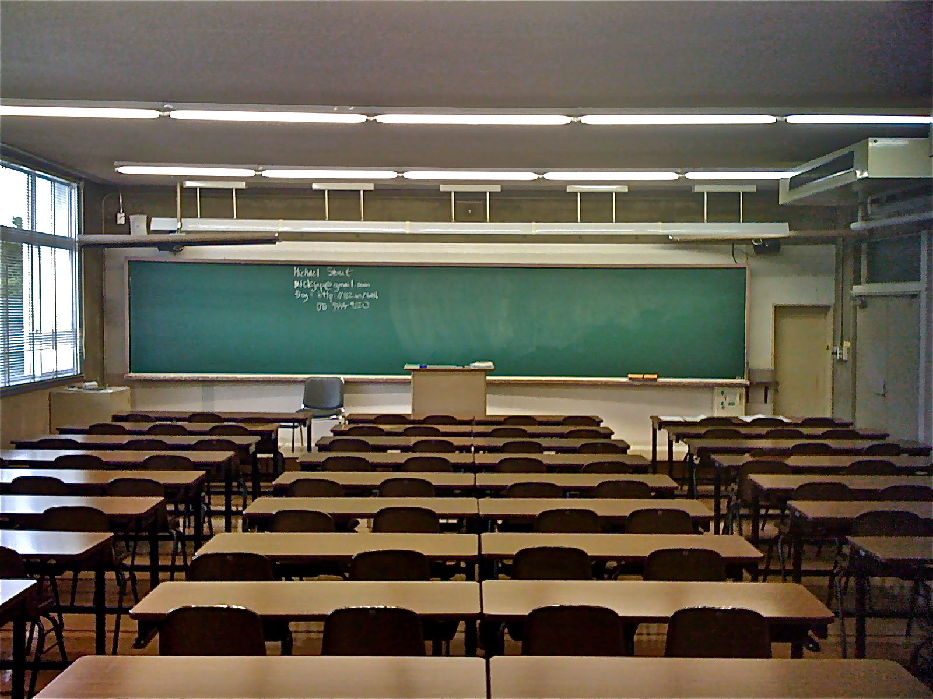
If you could help a child achieve academic success by simply spending more time with them, would you do it?
Notes:
If you could help your child achieve academic success by simply spending more time with them, would you do it? Homeschooling is an option that many parents could use to help their children have accessed to personalized learning to help their grades. It is important for parents to determine if homeschooling is a good option for their child based on the availability and knowledge of the parents in addition to the needs of the children.

Slide 3
Introduction to Homeschooling
Why homeschooling?
Decreases uncertainty about teacher’s knowledge and ability
Provides for a safer classroom environment
Parents feel that they will be better able to meet the needs of their children
Notes:
Many parents are concerned with their child’s academic success. Parents are worried about their teacher’s knowledge and abilities in addition to the classroom learning environment. Some parents argue that homeschooling is the most effective way to ensure that their children are able to succeed. In this manner, parents are able to become involved with various aspects of their child’s abilities and needs for improvement in a manner that is not possible in the traditional classroom.

Slide 4
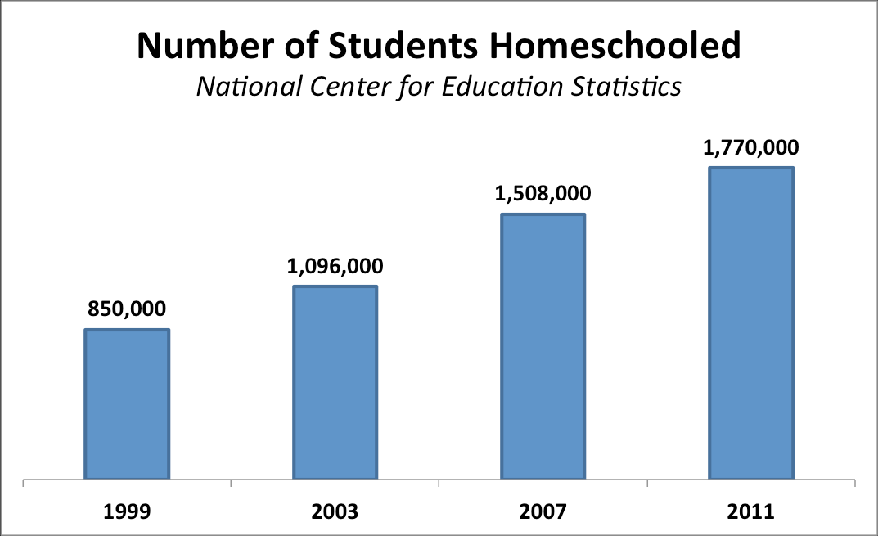
Issue: Who Homeschool’s?
According to the National Center for Education Statistics:
Approximately 3 percent of the school-age population was homeschooled in the 2011–12 school year
Among children who were homeschooled, a higher percentage were White (83 percent) than Black (5 percent), Hispanic (7 percent), or Asian or Pacific Islander (2 percent)
91 percent of homeschooled students had parents who said that a concern about the environment of other schools was an important reason for homeschooling their child
Notes:
There are an increasing amount of students being homeschooled. Some parents believe that home schooling allows children to develop a better understanding of academic material. On the other hand, some parents believe that providing students with a traditional classroom education can more effectively contribute to student learning. Parents from different socioeconomic backgrounds have different opinions and options and it pertains to homeschooling. A majority of children that forgo traditional classroom learning opportunities are white. In addition, parents who chose to homeschool their children are concerned with the school environment.

Slide 5
Issue: Do Homeschooled Kids Perform Better?
Research studies have been conducted to help parents and educators gain a better understanding about the advantages of homeschool
The home-educated typically score 15 to 30 percentile points above public-school students on standardized academic achievement tests (Ray, 2015)
It was found that the education experience of the parent is not relevant to contribute towards this success
Notes:
Individuals who come from low socioeconomic backgrounds were found to perform as well in a homeschooled environment compared to their wealthier peers. Because of their enhanced academic performance, children who are homeschooled are being actively recruited by colleges. These individuals also have a better chance of being accepted into college of their choice because they have higher ACT and SAT scores.

Slide 6
Issue: Critics Don’t Agree About the Merits of Homeschooling
“We simply can’t draw any conclusions about the academic performance of the “average homeschooler,” because none of the studies so often cited employ random samples representing the full range of homeschoolers”
- (Anne, 2013)
Notes:
Critics of the claim that home-schooled students tend to perform better academically state that studies that have attempted to determine whether this phenomenon is truth have been flawed. Many of these studies are biased towards homeschooling and therefore are created in order to support this growing trend. “We simply can’t draw any conclusions about the academic performance of the “average homeschooler,” because none of the studies so often cited employ random samples representing the full range of homeschoolers”. It is therefore important to consider the meaning of the data that is generated and determine what this means for members of the general population.

Slide 7
Analysis: Benefits of Homeschool
Individuals that are homeschooled are provided with individualized attention (Bowen, 2014)
These individuals are in a safe learning environment and students are able to strengthen bonds with their family members as a part of this process (Raise Smart Kid, n.d.)
Homeschooling is particularly advantageous for children with special needs because they will be provided with exclusive focus
Notes:
Individuals that are homeschooled are provided with individualized attention and are therefore able to develop specific skills that are targeted to help them academically (Bowen, 2014). Furthermore, these individuals are in a safe learning environment and students are able to strengthen bonds with their family members as a part of this process (Raise Smart Kid, n.d.). Last, homeschooling is particularly advantageous for children with special needs because they will be provided with exclusive focus.

Slide 8
Analysis: Benefits of Classroom Learning
Traditional classroom learners are able to benefit from the social environment that is inherent of the classroom
These individuals are more likely to develop a social intelligence due to their required interactions with their classmates
Notes:
It is important to consider that the homeschool environment requires a significant time investment on the behalf of the parent and the child will need to become involved in social activities. Traditional classroom learners are able to benefit from the social environment that is inherent of the classroom. These individuals are more likely to develop a social intelligence due to their required interactions with their classmates. However, the literature indicates that the degree of success that parents have in teaching their children social skills is independent of the schooling method and pertains more greatly to their overall opportunities to interact with individuals their age in addition to adults.

Slide 9
Conclusions
The literature has no conclusive statements regarding the value of homeschooling over traditional classroom learning
Statistics claim that homeschooled studies achieve higher academic success
Critics of homeschooling claim that these statistics are not reliable
Many individuals believe that homeschooled students lack the socialization that traditional classroom learners receive
Notes:
The literature has no conclusive statements regarding the value of homeschooling over traditional classroom learning. Based on the broad understanding presented, however, statistics claim that homeschooled studies achieve higher academic success. Critics of homeschooling claim that these statistics are not reliable. Furthermore, many individuals believe that homeschooled students lack the socialization that traditional classroom learners receive.

Slide 10
References
Anne, L. (2013). Stop Saying Homeschoolers Are Brilliant! Retrieved from
http://www.patheos.com/blogs/lovejoyfeminism/2013/06/stop-saying-homeschoolers-are-brilliant.html
Bowen, R. (2014). Why Homeschool Kids Are Smarter Than Kids Who Go to Public School.
Retrieved from http://www.brighthubeducation.com/homeschool-methodologies/126403-why-homeschooled-kids-are-smarter/
MaryEllen. (2012). Homeschool vs. Public School: Who’s Better Socialized? Retrieved from
http://www.offthegridnews.com/how-to-2/homeschool-vs-public-school-whose-better-socialized/
National Center for Education Statistics. (2015). Homeschooling in the United States: 2012
(forthcoming NCES2015-019).
Raise Smart Kid. (n.d.). Benefits of Homeschooling: How It Could Make Kids Smarter.
Retrieved from http://www.raisesmartkid.com/6-to-10-years-old/5-articles/50-benefits-of-homeschooling-how-it-could-make-kids-smarter
Ray, B.D. (2015). Research Facts on Homeschooling. Retrieved from
http://www.nheri.org/research/research-facts-on-homeschooling.html

