Slide 1
Leadership
Name
Class
Professor
August 7, 2015

Slide 2
What is leadership?
A leader is formally defined as an individual “who influences others to attain goals” (Bateman & Snell, 2014)
Managers benefit by gaining leadership skills to help increase efficiency in the workplace
It is essential for managers to learn how to enact leadership principles into their duties in order to ensure that their workers will remain productive

Slide 3
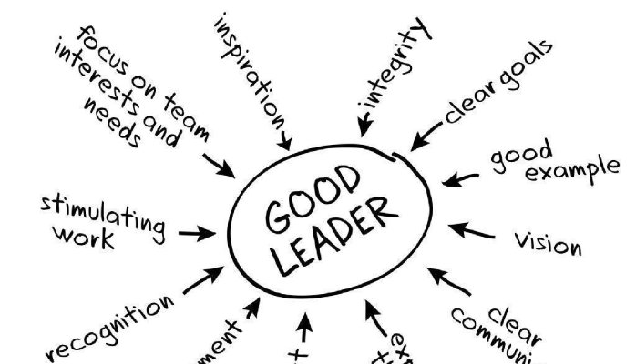
What qualities do good leaders have?
Encourage productivity
Motivate employees
Provide workers with new knowledge and skills
Reward employees when applicable
Provide a supportive environment

Slide 4
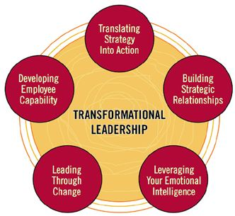
Transformational Leadership
Transformational leadership is the leadership style that is best able to ensure that workers have the resources and desire necessary for them to contribute to organizational success (Bernard, 2000)
It is important to understand the relationship between transformational leadership and employee efficacy because the quality of worker output is tied into profitability

Slide 5
Good Leadership Requires an Understanding of Employee Needs
Transformational leadership requires that the manager or supervisor understand the capabilities of their employees, in addition to their wants and needs (Eagly, 2013)
Employee needs can be defined according to Maslow’s hierarchy of needs
Social
Monetary
Creative

Slide 6
Women as Transformational Leaders
Women are more likely to be transformational leaders
Transformational leadership characteristics can be learned, but they tend to be innate more frequently for women
Overall, female managers like to provide workers with rewards for good work more frequently than male managers in practice

Slide 7
Benefits of Transformational Leadership
Transformational leaders:
Ensure that workers have the resources they need to constantly be motivated and succeed
Their workers are provided with challenges that help to keep them interested in their work
Transformational leaders are more liked by their employees
Even though transformational leaders demonstrate a clear balance of authority, these individuals wish for their workers to understand that they are primarily there to support their needs and to ensure that the work will be completed

Slide 8
Learning to be Transformational: A Research Study
A study was conducted to confirm whether people would be able to participate in a program that would help them learn the skills of transformational leadership and apply them directly into practice
A majority of study participants were able to effectively apply the skills they learned during training
Because leadership style has a meaningful effect on employee performance, it is important for organizations to consider the value of transformational leaders in the workplace

Slide 9
Organizational Culture
When supervisors are generally disliked, a negative organizational culture is created which damages the work ethic
The implementation of transformational leadership could act as a preventative method to ensure that work quality is consistent throughout
Positive organizational culture is a beneficial effect that results from transformational leadership

Slide 10
Transformational vs. Authoritative Leadership
The opposite of transformational leadership is often considered to be authoritarian leadership
With authoritarian leadership, employees are told what to do without given an explanation
The leader appears to be more concerned with ensuring that deadlines are met rather than the ability of the employees to produce quality work
When hard deadlines need to be met, leaders need to be flexible with their tactics in order to ensure organizational success
Authoritative leadership is beneficial for meeting these deadlines

Slide 11
Conclusion
Transformational leaders are:
Good motivators
Willing to understand the needs of employees
Able to help achieve workplace productivity
Concern for the worker is often key, but leaders also need to place an emphasis on productivity and institutional goals. Good leaders understand how to achieve a balance between these two factors.

Slide 12
References
Bateman T, Snell S. (2014). Management. McGraw-Hill Education.
Bernard M. (2000). The Future of Leadership in Learning Organizations. Journal of Leadership & Organizational Studies, 7(3): 19-31.
Dvir T, Eden D, Avolio BJ, Shamir B. (2002). Impact of Transformational Leadership on Follower Development and Performance: A Field Experiment. Academy of Management Journal, 45(4): 735-744.
Eagly, Alice H. (2003). Transformational, Transactional, and Laissez-Faire Leadership Styles: A Meta-Analysis Comparing Women and Men. Psychological Bulletin, 129(4): 569-591.
Kouzes J, Posner B. (n.d.). THE FIVE PRACTICES OF EXEMPLARY LEADERSHIP® MODEL. Retrieved from http://www.leadershipchallenge.com/about-section-our-approach.aspx

