Slide 1
The Story of Christian Dior
Name
Class
Professor
August 21, 2015

Slide 2
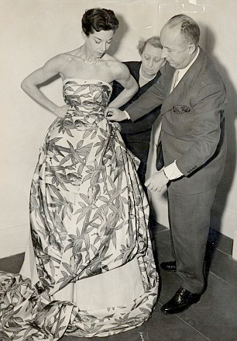
Christian Dior – Personal History
Christian Dior was one of five children of a wealthy fertilizer manufacturer in Normandy, France (Grainger 125)
When his family moved to Paris, he made money selling his artwork for 10 cents a piece
In 1937, Dior gained his first job as a fashion designer working for Robert Piguet, where he was responsible for design (Pochna 5)
After fighting in World War II, Dior began his career anew
In 1946, he officially opened his own fashion store (Sheridan 44)
Notes:
Christian Dior was one of five children of a wealthy fertilizer manufacturer in Normandy, France. His family wanted him to work as a diplomat, but when his family moved to Paris, he made money selling his artwork for 10 cents a piece. In 1937, Dior gained his first job as a fashion designer working for Robert Piguet, where he was responsible for design. There, he started to work on basic designs. Dior’s career took a pause after he was recruited to the war effort in World War II. During the war, he creating clothing for the wives of soldiers. After fighting in World War II, Dior began his career anew. In 1946, he officially opened his own fashion store

Slide 3
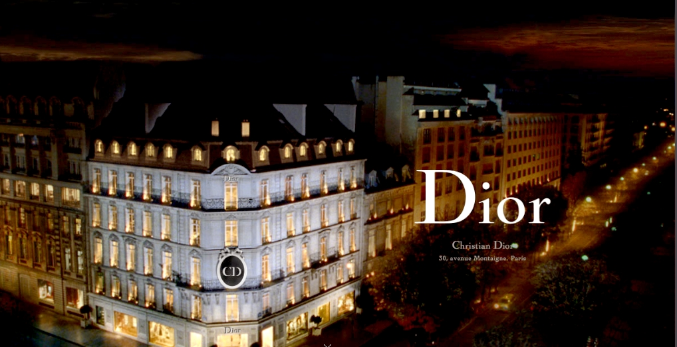
The House of Dior
The “House of Dior” was Christian Dior’s first business establishment
  It was run out of a house
Dior was able to open his doors due to financial backing by wealthy businessman Marcel Boussac
Boussac was technically the primary owner of the company, but Dior managed to make a reasonable amount of profit
The Dior corporation officially began in 1947, one year after the “House of Dior” was established
Notes:
The “House of Dior” was Christian Dior’s first business establishment. It was run out of a house physically located at at 30 Avenue Montaingne Paris B. Dior was able to open his doors due to financial backing by wealthy businessman Marcel Boussac. Boussac was technically the primary owner of the company and established himself in a place of primary profitability as well. However, Dior managed to make a reasonable amount of profit in spite of this. The Dior corporation officially began in 1947, one year after the “House of Dior” was established.

Slide 4
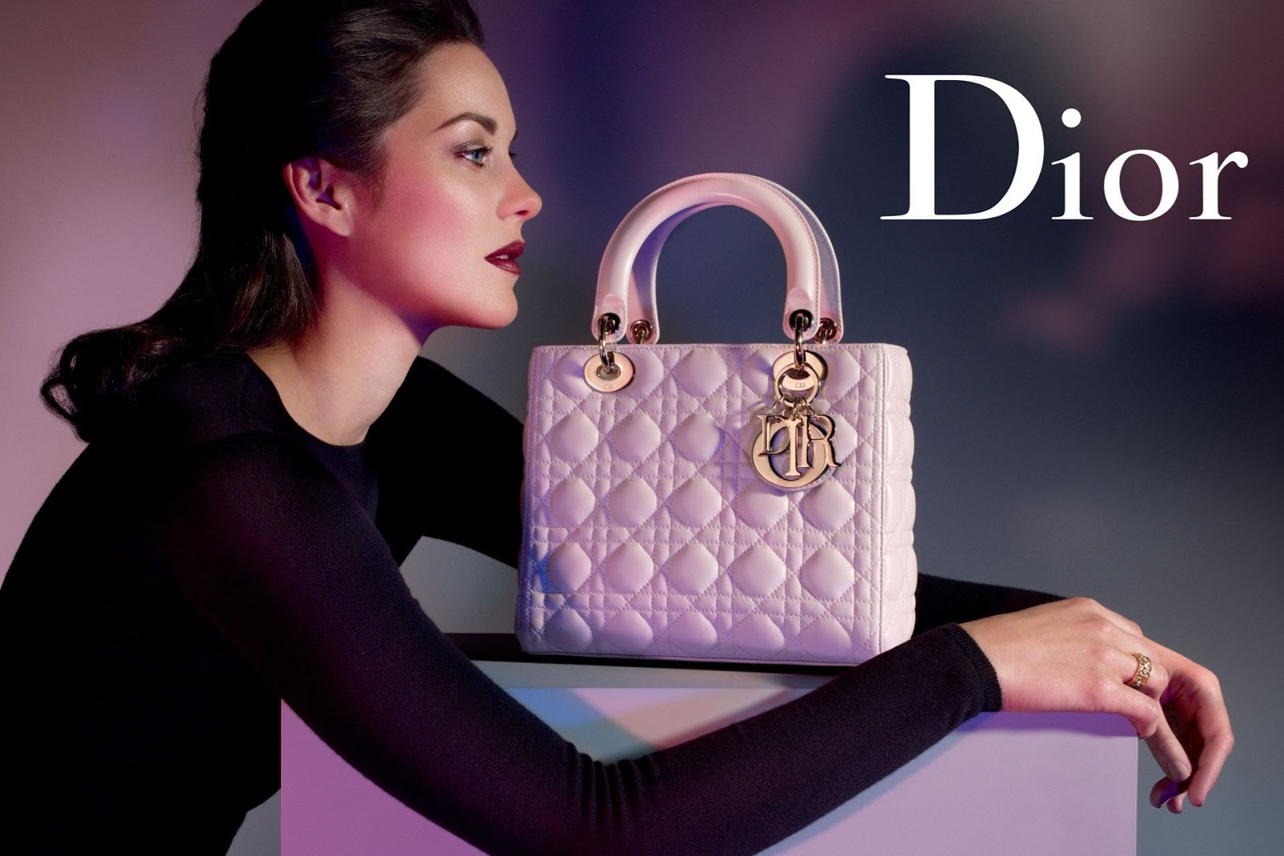
Dior Finances
Revenue for the company was $30,984.0 million as of June (Bloomberg Business)
Year by year, Christian Dior SE has been able to grow revenues from €28.6B EUR to €31.0B EUR
Gross profit for the company is $20,377.0 million as of June
The company has also been able to decrease the amount of money it spends on production and administration from 47.15% to 46.24%
Notes:
Even though Christian Dior passed away in the 1950s, Dior continues to be a popular brand. Furthermore, the company conducts good business which allows it to make a large some of money. The revenue for the company was $30,984.0 million as of June. Year by year, Christian Dior SE has been able to grow revenues from €28.6B EUR to €31.0B EUR. As such, gross profit for the company is $20,377.0 million as of June. Furthermore, it engages in efficient use of money. The company has also been able to decrease the amount of money it spends on production and administration from 47.15% to 46.24%.

Slide 5
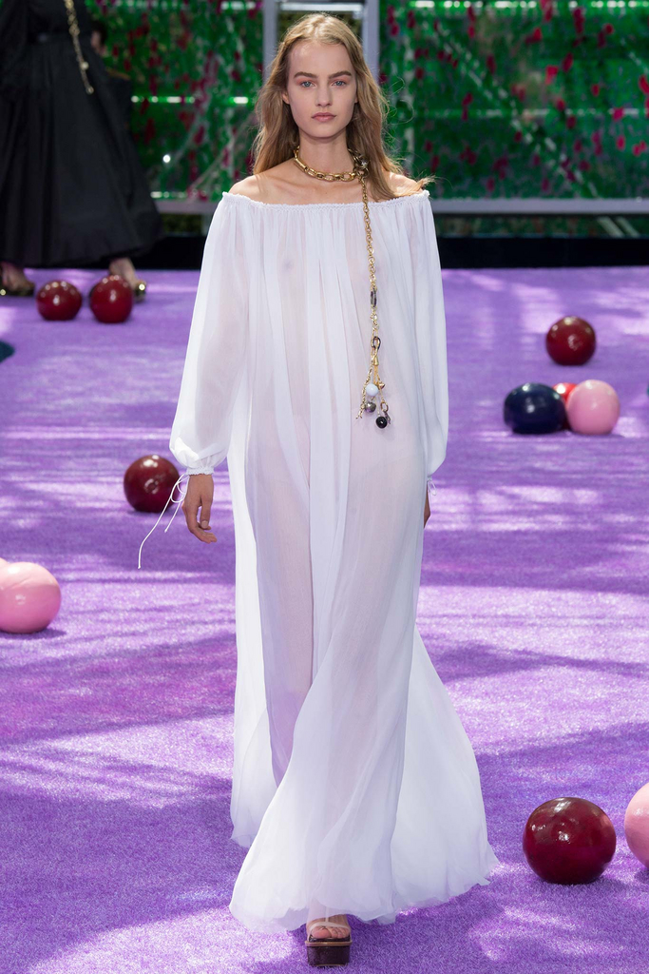
Dior Fashion
Dior products are currently sold all over the world
  This provides the company with a good opportunity to market to diverse audiences
Dior is responsible for creating and maintaining the latest styles, which contributes to profitability (Blanks)
Each decade of style produced by the company has a significantly different look from its previous lines
  New looks come out each season
Notes:
Dior products are currently sold all over the world, but are very popular in first world nations like the United States and Britain. This provides the company with a good opportunity to market to diverse audiences. Dior is responsible for creating and maintaining the latest styles, which contributes to profitability. Each decade of style produced by the company has a significantly different look from its previous lines. New looks come out each season. This contributes to company branding. Fans of Dior’s clothing look forward to these fashion shows each season and enjoy the clothing as both an art form and apparel that can be worn.

Slide 6
Dior Fashion – His Classic Look
The woman on the right is wearing one of Dior’s signature looks
  It’s called “Bar”
This outfit did not sell well but is iconic of Dior’s fashion during the 20th century
This look was considered to be more scandalous than what most women would wear in 1955.
Notes:
The woman on the right is wearing one of Dior’s signature looks called “Bar”. The photoshoot took place in 1955 and this photo is now considered to be one of the hallmarks of Dior’s fashion. Interestingly, this outfit did not sell well during the time period, but has continued to be iconic of Dior’s work. This look was considered to be more scandalous than what most women would wear in 1955 and is representative of the edge fashion that Dior continues to produce.

Slide 7
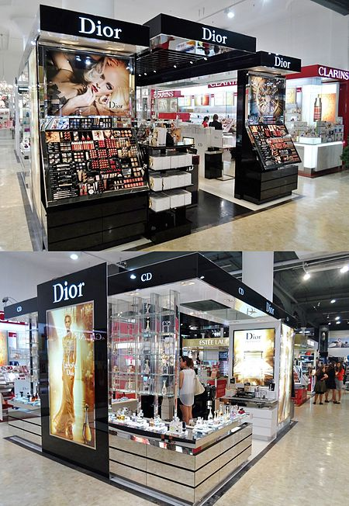
Dior Today
Dior is currently controlled by businessman Bernard Arnault
The company currently sells high end fashion in addition to accessories, footwear, and other items
Dior currently conducts business around the world, although it remains strict to Christian Dior’s original mission to produce new looks
As of 1990, the net income for the company was $22 million; this value continues to rise
Dior continues to be a very popular brand name today
Notes:
Dior is currently controlled by businessman Bernard Arnault and it employs many fashion designers to put forward new looks. The company currently sells high end fashion in addition to accessories, footwear, and other items. Dior currently conducts business around the world, although it remains strict to Christian Dior’s original mission to produce new looks. Recently, it was introduced in China. As of 1990, the net income for the company was $22 million; this value continues to rise. Dior continues to be a very popular brand name today and many individuals interested in the fashion world wish to keep up with the latest trends it puts forth.

Slide 8
Works Cited
Blanks T. Christian Dior. 6 July 2015. Web. 21 August 2015.
Bloomberg Business. Christian Dior Se (CDI:EN Paris). 2015. Web. 21 August 2015.
Grainger, Nathalie. Quintessentially perfume. London: Quintessentially Pub. Ltd., 2010.
Martin, Richard & Koda, Harold. Christian Dior. New York: The Metropolitan Museum of Art,
  1996.
Pochna, MF. Christian Dior: The Man Who Made the World Look New. Arcade Publishing, 1996.
Sheridan J. Fashion, Media, Promotion: The New Black Magic. John Wiley & Sons, 2010.
Waldman, H. Christian Dior. Design Museum, Dental student 58.3(1979): 58–60.

