Slide 1
A Therapeutic Exploration of Nicotine
Name
Class
Professor
October 18, 2015

Slide 2
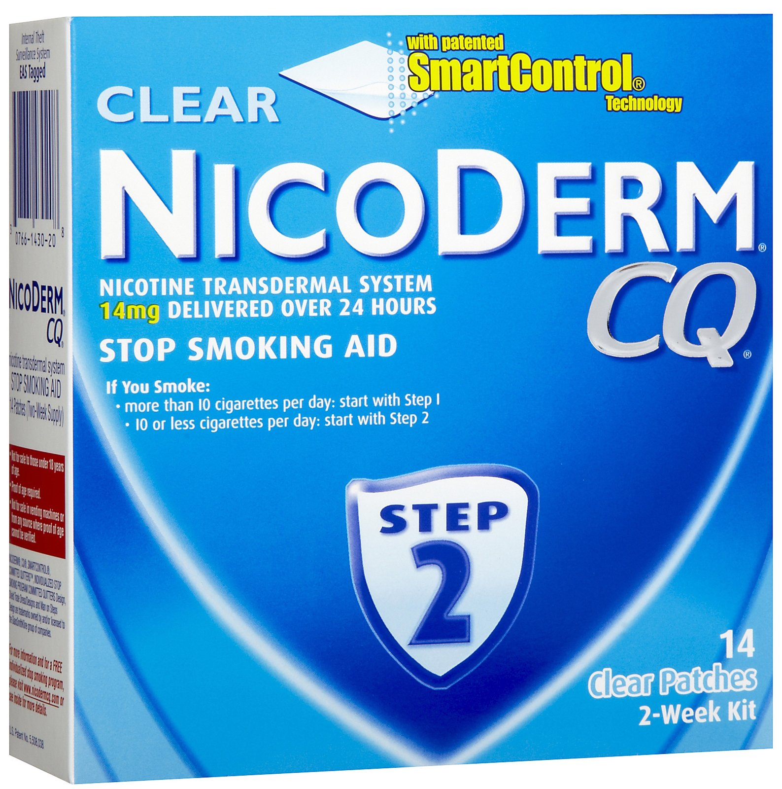
Introduction and Summary
- Nicotine is associated with cigarette addiction
- Nicotine has also been used to reduce disease symptoms
Notes:
Nicotine is most commonly associated with cigarette addiction. However, this addiction is due to nicotine’s interaction with chemical receptors in the brain, indicating that there are biological consequences for this chemical’s use. It is expected that nicotine can be used for many therapeutic purposes. Most commonly, nicotine is used in small doses to help individuals cope with smoking cessation. Nicotine has also been used to reduce symptoms that are characteristic of ADHD, Alzheimer’s disease, schizophrenia, and more. It is therefore important to determine the medical implications of nicotine in the human body. Because the chemical interacts with brain receptors, it can plausibly be used to subside symptoms related to brain disorders. The literature has indicated that nicotine has many medical implications, so it is necessary to further explore the relationship between nicotine use and the decrease in incidence of disease related symptoms.

Slide 3
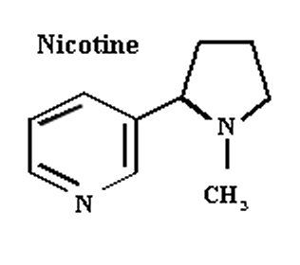
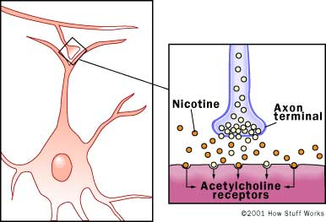
Why study nicotine?
- Nicotine creates addiction by interacting with receptors in the brain
Notes:
Nicotine is the chemical in cigarettes that is responsible for an addictive effect. While many smokers simply enjoy the act of smoking, it is also important to consider that many of them believe that smoking is inconvenient, but are unable to resist their desire to have a cigarette. Nicotine treatment has conventionally been used to prevent smoking cessation, which has been effective in many cases. However, since nicotine engages in complex associations with receptors in the brain, many scientists have hypothesized that nicotine could be used as a treatment to alleviate the symptoms of a variety of diseases, despite the side effects it creates (Dewey et al. 1998). Based on studies of chemical transduction, nicotine could bind to receptors in the brain to either amplify or reduce certain chemical effects (Benowitz et al. 2010). Provided that an illness or disorder is related to the nicotine receptor in some manner, it is plausible for nicotine to be used to create artificial effects in the brain.

Slide 4
Mechanism of Nicotine in Body
- Nicotine releases neurotransmitters when it binds to the neuron
Notes:
Many people around the world suffer from a cigarette addiction. Although members of the population are becoming increasingly aware of the health problems associated with cigarette smoke, such as its carcinogenic effect, it is challenging for many patients to succeed in their smoking cessation plans. Smoking makes people feel good because nicotine releases neurotransmitters when it binds to the neuron. In an attempt to help members of the population reduce their frequency of smoking, many governments have created smoking cessation programs that provide interested individuals with free nicotine patches and additional information about how to quit this habit (Benowitz et al. 2010). As such, many people have been able to quit smoking. Reducing the concentration of nicotine that is taken in during smoking helps reduce the addictive effects of the chemical. This is an important relationship because it demonstrates that nicotine dependence exists and reducing the nicotine exposure can reasonably reduce this dependence.

Slide 5
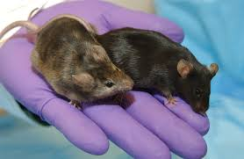
The Treatment of Nicotine Addiction
Notes:
Many people continue using cigarettes due to their physical dependence on this chemical. Nicotine withdrawal symptoms appear when desensitized α4 β2* nicotinic cholinergic receptors become active after periods of cessation (Cohen et al. 2001). This causes anxiety and stress among previous nicotine users. Nicotine operates primarily by binding to the CB1 receptor (Cohen et al. 2001). Knockout mice have been shown to exhibit to the impacts of nicotine (Cohen et al. 2001). Research has identified an interaction between the nicotine and the endocannabinoid system has been reported (Cohen et al. 2001). Administering agonists to both CB1 and the cannabinoid receptor simultaneously provide awarding effects (Cohen et al. 2001). A selective CB1 antagonist, called rimonabant (SR141716) has been designed using this understanding to help counter nicotine addiction. It operates by hyperactivating the endocannabinoid system.

Slide 6
A Broader Impact of Nicotine on Health
- Nicotine may be currently acting as an environmental contaminant
Notes:
As more nicotine products are created it is essential to determine the impact that these pharmaceuticals could have on the environment and therefore impact human health as a whole. A study found that we may be exposed to pharmacological toxins in spite of their habits and individual health maintenance (Waiser et al. 1999). There are somewhat high levels of nicotine detected in the environment in Wascana Creek, Saskatchewan, Canada, and this particular observation is likely a widespread phenomenon (Waiser et al. 1999). Pharmaceutical companies that do not implement best practices for the disposal of their wastes contribute to a chemical contamination of the environment. As a consequence, some of this product enters the drinking water and contributes to the development of health effects in members of the population. It is therefore important to consider the impacts, positive or negative, that nicotine may be having on the human body.

Slide 7
Nicotine as a Treatment for Tourette’s Syndrome
- Tourette’s syndrome is characterized by uncontrolled and sporadic movements and vocalizations
Notes:
Tourette’s syndrome is characterized by uncontrolled and sporadic movements and vocalizations. Nicotine could be used to lessen the severity of the symptoms for Tourette’s syndrome (Sanburg et al. 2001). Traditionally, neuroleptics were used to alleviate these effects. However, there was a major concern that using such drugs would contribute to undesirable side effects. Animal studies have shown that using a conventional smoking cessation method has contributed to the reduction in symptoms of patients with Tourette’s (Sanberg et al. 2001). This observation was then examined once more experimentally (Sanberg et al. 2001). Variants of nicotine gum and patches were used for this purpose. An interesting finding of this study was that a single nicotine patch could be utilized to treat Tourette’s symptoms over several days. Even though nicotine is not commonly used to treat the symptoms of this disorder, it is a plausible and cost effective treatment.

Slide 8
Nicotine as a Treatment for ADHD
- Nicotine patches have been shown to reduce ADHD related symptoms in children
Notes:
A randomized control trial using the nicotine patch demonstrated that patients with ADHD experiences markedly reduced symptoms as a consequence of the patch’s use (Shytle 150). A randomized control trial using the nicotine patch demonstrated that patients with ADHD experiences markedly reduced symptoms as a consequence of the patch’s use. The average age of participants in the study was 10 years old, indicating that that this treatment is applicable for school age children. For all ten participants, the 48-item Conners Parent Rating Scale was used to assess ADHD symptoms both at baseline and after applying the nicotine intervention. While the treatment demonstrated that symptoms related to ADHD were reduced, there were many side effects associated with the treatment, including nausea, stomach ache, itchiness, and dizziness. Therefore, it may not be plausible to use nicotine patch intervention to treat ADHD. It is important for researchers to consider the benefits and harms that are associated with an intervention to be able to ethically allow for its continued use.

Slide 9
Nicotine as a Treatment for Alzheimer’s
- Nicotine improves the ability for Alzheimer’s patients to focus
Notes:
Studies have been conducted that determine that applying nicotine injections to patients with Alzheimer’s disease would improve their ability to focus (White et al. 158). In the past, studies have been conducted that determine that applying nicotine injections to patients with Alzheimer’s disease would improve their ability to focus. A double blind placebo study was implemented to determine the efficacy of nicotine treatment on patients in this population by studying a dose related effect. The Conners’ continuous performance test (CPT) was used to measure the ability for the patients to pay attention. It was found that the use of nicotine allowed members of this patient population to improve their ability to react to given stimuli, although it was found that they were not able to make improvements according to other forms of assessments that were provided.

Slide 10
Physical Health Applications
- It was found that nicotine use can actually intensify physical maladies
Notes:
A 2011 study was conducted to determine whether individuals that are admitted to the emergency department would benefit from involvement in a smoking cessation program (Bertstein et al. 575). In this study, researchers found that many of the individuals admitted to the department smoked more than 10 cigarettes a day and that this was negatively impacting their health and contributing to the severity of some of the symptoms they were experiencing. This demonstrates that nicotine has the potential to make certain health conditions worse. Nicotine patches were used as primary treatment in this experiment. It was hypothesized that providing patients with lower doses of nicotine than they would usually receive would contribute to the reduction of these symptoms. It was found that the use of nicotine patches through the intervention program were not necessary to persuade individuals in the emergency department to reverse their smoking habits. Therefore, while there are demonstrated mental health implications for nicotine use, it may not be reasonable to use nicotine to treat non-mental maladies.

Slide 11
Future Directions: Expanding Trial Size
- The use of larger patient samples are more likely to predict effects seen in the general population
Notes:
It appears that nicotine has many practical uses in situations that are not conventionally considered. It is therefore necessary for scientists to conduct additional research to determine whether it would be reasonable to use nicotine to treat mental disorders. Many of the studies discussed can be classified as phase I trials for use of the drug, so it would be necessary to conduct phase 2 and phase 3 studies to determine proper toxicity reports and dosing information. Furthermore, determining the efficacy of nicotine in treating symptoms for a variety of disorders in larger population samples would be beneficial because this would reveal whether the data retrieved from the preliminary studies were due to chance or whether they can be used as realistic findings. Overall, It is important to determine the symptom alleviating ability of this chemical and compare it to the side effects it produces to determine whether continued treatment of some disorders using this drug are reasonable.

Slide 12
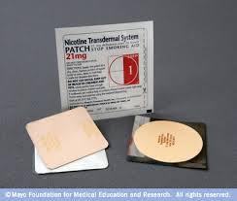
Future Directions: Do the Detriments Outweigh the Benefits?
- The use of nicotine in medical practice is not currently common
Notes:
The use of nicotine in medical treatment is not a common practice and it is therefore challenging to determine whether use should be continued; large scale systematic reviews of this data are not available. Furthermore, there are many environmental applications that should be considered; if nicotine use increases and it enters the water stream, members of the population may suffer from detrimental side effects. In addition, it is important to determine whether the side effects that the drug treats are considered to be more medically useful than the side effects the drug creates.

Slide 13
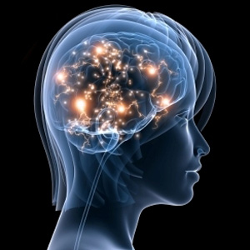
Future Directions: An Understanding of Disease
- There are not currently many studies available that study the relationship between nicotine use and the reduction of mental symptoms
Notes:
It would be beneficial to assess the utility of nicotine use in future clinical studies by determining the incidence of disease and disorders commonly faced by individuals that do and do not smoke cigarettes. There are not currently many studies available that determine the connection between nicotine and symptom alleviation, which is especially true in the context of modern research; it may be helpful to reassess the findings of old studies according to a modern understanding.

Slide 14
Bibliography
Bernstein SL, Bijur P, Cooperman N, Jearld S, Arnsten JH, Moadel A, Gallagher EJ. 2011. A randomized trial of a multicomponent cessation strategy for emergency department smokers. Academy of Emergency Medicined Emerg Med. 18(6):575-83.
Benowitz, N.L. 2010. Nicotine Addiction. N Engl J Med. 362(24): 2295–2303.
Cohen, C., Kodas, E., Griebel G. 2005. B1 receptor antagonists for the treatment of nicotine
addiction”. Pharmacology Biochemistry and Behavior 81(2): 387–395.
Dewey, S.L., Brodie, S.D., Gerasimov, M., Horan, B., Gardner, E.L., Ashby, C.R. 1998. A pharmacologic strategy for the treatment of nicotine addiction. Synapse 31(1).
Powledge TM. 2004. Nicotine as Therapy. PLoS Biol. 2(11): e404.
Sanberg, P.R., Silver, A.A., Shytle, R.D., Philipp, M.K., Cahill, D.W., Fogelson, H.M.,
McConville, B.J. 1997. Nicotine for the treatment of Tourette's syndrome. Pharmacology & Therapeutics 74(1): 21–25.
Schneider NG, Olmstead RE, Franzon MA, Lunell E. 2001. The nicotine inhaler: clinical pharmacokinetics and comparison with other nicotine treatments. Clin Pharmacokinet. 40(9): 661-84.

Slide 15
Bibliography Continued
Sharp, L.K., Lipsky, M.S. 2002. Screening for depression across the lifespan: a review of measures for use in primary care settings. American Family Physician 66(6): 1001–8.
Shytle, R.D., Silverabc, A.A., Wilkinsonabe, B.J., Sanbergabd, P.R. 2002. A Pilot Controlled Trial of Transdermal Nicotine in the Treatment of Attention Deficit Hyperactivity Disorder. The World Journal of Biological Psychiatry 3(3)(2002): 150-155.
Waiser MJ, Humphries D, Tumber V, Holm J. 2011. Effluent-dominated streams. Part 2: Presence and possible effects of pharmaceuticals and personal care products in Wascana Creek, Saskatchewan, Canada. Environ Toxicol Chem. 30(2): 508-19.
White, H.K., Levin, E.D. 1999. Four-week nicotine skin patch treatment effects on cognitive performance in Alzheimer’s disease. Psychopharmacology 143(2): 158-165.

