Slide 1
Assignment 3- Design Thinking Project
Student’s Name:
Institutional Affiliation:
Course:
Professor’s Name:
Due date:

Slide 2
Title of my case study
Case Study #4: Family Interactions in the Home
More and more, each member of a family has one or two screens at their fingertips. This creates custom viewing experiences and constant connections to technology. This, in turn, is leading to a reduction in human interactions in homes. What would you suggest to enhance the interactions in families?

Slide 3
Step 1- Strategies I used to emphasize with the users
Powerful empathy may assist in sustaining societal harmony and collaboration. Humans are able to communicate with each other via this process. I would gained the empathy of my users by making myself vulnerable. I used visual communication emphasis strategies such as video still, video clip and photographs which explained how family interactions at home have been hindered by the technology.

Slide 4
Step 1- Strategies I used to emphasize with the users (continuation)
As a result, I was able to handle more difficult situations with my users using the above visual communication strategies. I would ensure that I shows my users that i have ever been a technology addict to the extent that i was always glued on the screens which in turn reduced my human interactions at home.
I also embraced Overviews and Foreshadowing which acted as signposts for the audience, letting them know where they are in the story.

Slide 5
Step 2- The problem statement that indicates my user need and insight
Technology has made it difficult to establish a healthy relationship amongst the family members because of the widespread usage of personal computers, tablets and smartphones which leaves people glued on their devices. As a result of social media, video conferencing, and replying to emails, you may feel the need to always be "plugged in" online which in turn minimizes the interactions amongst family members. Being disconnected from the internet can make us feel as if we're losing out on important information.

Slide 6
Step 2- The problem statement that indicates my user need and insight (continuation)
The problem, though, is that excessive Internet use can develop to a dependence on technology which in turn makes people to neglect their social lives. Social media, for example, was supposed to bring people together, but in certain circumstances it can instead divide them and minimize their family interactions.
Some people may feel less isolated and get chance to interact with their family members if they find strategies to limit their use of social media, such as setting time limits for social apps.

Slide 7
Step 3- Ideation strategies I used to propose possible solutions to the problem
I used storyboarding and brainstorming ideation strategies to propose possible solutions to the problem of minimized family interactions due to internet addictions. I built my ideas with those of the users which enabled me to come up with new ideas. I kept the dialogue focused by dividing my users into small manageable groups. Participating in a brainstorming session with people from a wide range of experiences and perspectives can led to more creative solutions.

Slide 8
Step 3- Ideation strategies I used to propose possible solutions to the problem (Continuation)
When I was embracing the storyboarding ideation strategy, in order to better understand what works and what needs improvement, users developed a visual tale that displays their ideas and the probable results of those ideas. I observed my user's journey, including the effects of my solutions, throughout the entire process.
The following are the ideas that I developed:
1. Minimizing my users technology addiction by assisting them to Make a list of the things such as family interactions missing out on because of your Internet addiction.

Slide 9
Step 3- Ideation strategies I used to propose possible solutions to the problem (Continuation)
2. Assisted my users to reorganize their day-to-day activities. They spending too much time on the technology, hence they were able to alleviate the situation by scheduling other activities. It was possible to stop the bad habit by interfering with their regular routine in a productive way.
Brainstorming was an effective ideation strategy because it is possible to think without fear of criticism. Storyboarding was also effective because it ensured that all parties were on the same page and I used it to bring the project's overall goal to life.

Slide 10
Step 4- Prototypes
The family and societal norms were that people should interact during family times. However, people have been preferring to use their technology devices instead of interacting. The below prototype will examine all the possible behavioral options and personal values that can bring a behavioral equilibrium between the use of technology and interacting during family times.
The goals of the prototypes was to conserve resources I needed to verify my users` demand and to assess the technical feasibility of my plan before moving forward.

Slide 11
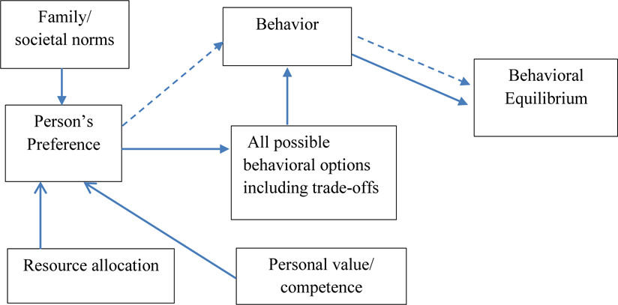
Step 4: Prototypes (continuation)

Slide 12
Step 4- prototypes (continuation)
The prototype below did not result in a favorable solution because previous studies have found that people who think about the future are more likely to be addicted to the Internet and Facebook.

Slide 13
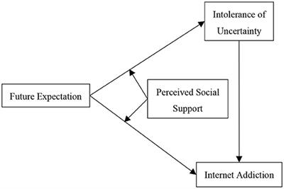
Step 4: Prototypes (continuation)

Slide 14
Step 5- Testing
I will test your prototype on real people by having them accomplish simple tasks. The prototype will be able to perform a variety of essential functions for me. Afterward, I will write down these instructions and see if my beginner tester understands and completes these tasks, or not. Using this method, I will be able to swiftly determine whether or not your prototype is capable of accomplishing the goals that I believe it should accomplish.
I will also make sure my product works in all of the scenarios in which it will be used by your target audience.

Slide 15
Conclusions
Human relationships have been fundamentally transformed by the development of computer systems and the Internet, compared to the development of non-computer technical systems. There are both positive and negative outcomes to the modern-day shift in how people connect with each other through smart applications and the Internet/Wi-Fi. Loved ones may now stay in close touch wherever they are on the planet because to the ubiquitous availability of Internet-capable smart gadgets.
While technology has helped to link individuals across the globe through the digital realm, those who are physically near to one other are sometimes separated by their inability to disconnect from their mobile devices. This is known as Virtual Distance.

