Slide 1
Ethnographic Research Design
Students name:
Affiliation:
Lecturer

Slide 2
Overview
Application of ethnographic research design
Advantages Ethnographic design
Disadvantages of ethnographic design
Classification of ethnographic design
Ethnographic design characteristics
Ethical Guidelines for Ethnographic Research
Assessment and evaluation of ethnographic design
Infographic for ethnography research design
Picturies
Attachment article

Slide 3
Application of Ethnographic Research Design
Ethnographic research design represents a qualitative method that presents a setting where study participants and the researchers interact inclusive of observations in a real life setting and environment.
Application of ethnographic design is crucial and useful especially in a user-centred design project in its early stages. Mainly because ethnography is concerned with the understanding and development of a design problem.
Evaluation of an existing design through various ethnographic methods.
Studying and evaluating specific groups that could mean a cultural representation of a particular population
Cultural studies.

Slide 4
Advantages of Ethnographic Design
Ethnographic design is critical in analysis and identification of issues that may be unexpected
Ethnographic research design’s capacity to deliver quality results of the participants attitudes and behaviors in a detailed and clear manner.

Slide 5
Disadvantages of Ethnographic Design
Ethnographic studies are time consuming, they take place over a prolonged period of time.
The participants involved in the ethnographic studies might not always act naturally, as some alter their behaviors during the study.

Slide 6
Classification of Ethnographic Designs
Critical ethnographies: The researchers make efforts to find solution for populations and groups that are marginalized and in the study.
Case Studies: Each ethnographic design is unique and specific to a case as regarding a population or a group.
Realist Ethnographies: these typical ethnographies advocate for the third person as regarding and ethnographic study

Slide 7
Ethnographic Design Characteristics
Each ethnographic design provides a detailed description and interpretation of the study participants.
Each ethnographic design is unique in its case study and setting.
A study group of an ethnographic design must be culturally linked with similar patterns of life and traditions.
The language, behavior and general way of life are shared by the participants
The evaluation and fieldwork involve interaction and negotiations with the participants to obtain a clear understanding.

Slide 8
Ethical Guidelines for Ethnographic Research
There should be no harm befalling whatsoever in the study
Honesty and openness is essential in ethnographies
Prior to the research the necessary permissions and informed consent should be obtained
The records from the study should be protected and preserved.

Slide 9
Assessment and Evaluation of Ethnographic Design
Informed evaluation regarding ethnographies is critical for the researcher to develop and refine data and knowledge from the study. Assessment and evaluation methods include:
Assessing and understanding the study participants cultural background and concept
Collecting data illustrating cultural sharing, such as the language details, the shared behaviors and beliefs
Assessing the participants and the study’s general theme and drawing conclusions based on the data.
Interpretation of various concepts applied in the study

Slide 10
Infographic for ethnography research Design
Application of Ethnographic Design
-User-Centred design project
-Evaluation of an existing design
-Studying and evaluating specific groups
-Cultural studies
Advantages of Ethnographic Design
-Critical analysis and issues identification
-Capacity to deliver quality results
Disadvantages of Ethnographic Design
-Time Consuming
-Participants might not always act naturally
Classification of Ethnographic Design
-Critical ethnographies
-Case studies
-Realist ethnographies
Ethnographic Design Characteristics
-Detailed description and interpretation
-Unique in the case study and setting
-Study groups are culturally linked
-Shared language, behavior and way of life
-Field work involve interaction and negotiation
Ethical Guidelines for Ethnographic Research
-No harm on the participants
-Honesty and openness is essential
-Acquisition of permissions and informed consent
-Records should be protected and preserved

Slide 11
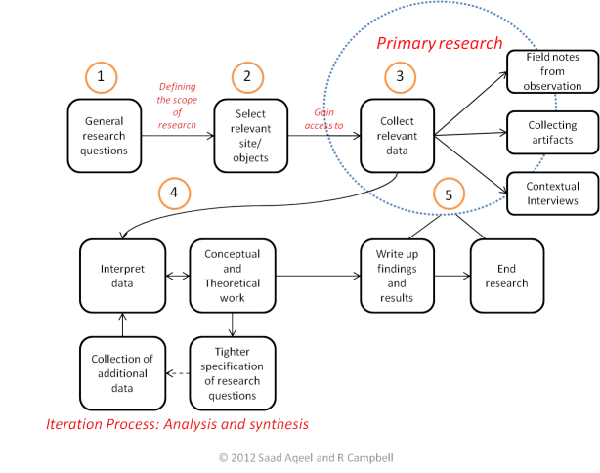
Picturies

Slide 12
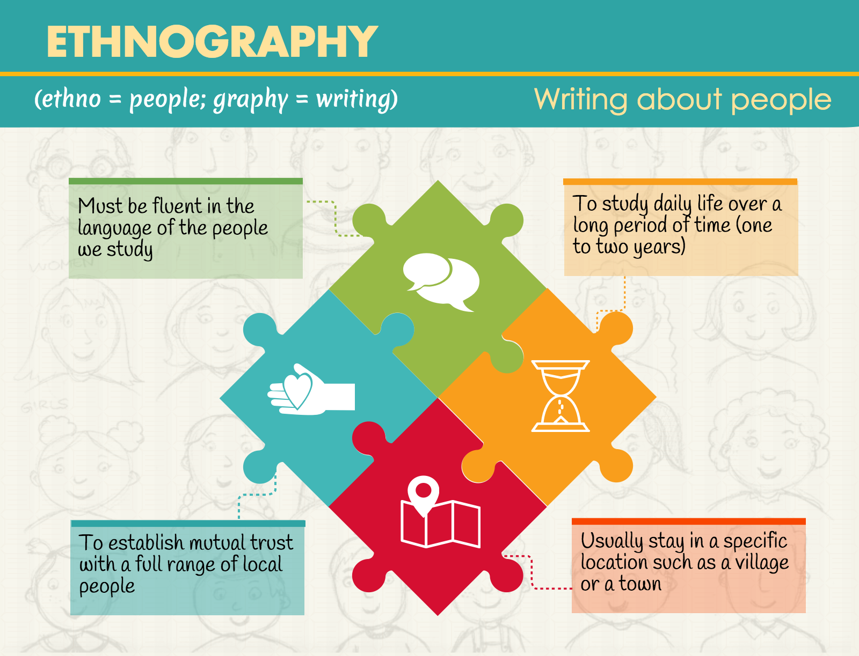
Picturies

Slide 13
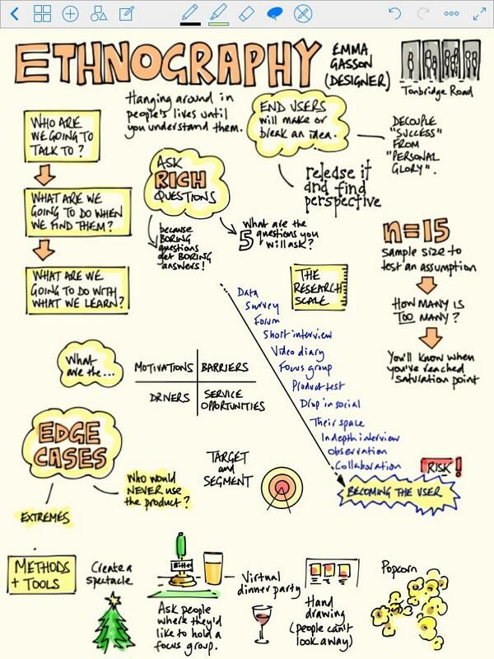
Picturies

Slide 14
References
Creswell, J.W., & Guetterman, T. C. (2019). Chapter 14: Ethnographic Designs. In Educational Research: planning, conducting and evaluating quantitative and qualitative research (6th ed., pp. 473–496). Textbook. Saddle River, New Jersey: Pearson
Finch, T., May, C., Mair, F., Mort, M., & Gask, L. (2003). Integrating service development with evaluation in telehealthcare: an ethnographic study. Bmj, 327(7425), 1205-1209
Wasson, C. (2000). Ethnography in the Field of Design. Human Organization, 59(4), 377–388. http://www.jstor.org/stable/44127235
Wright, C. (1993). School processes: an ethnographic study. Gender and Ethnicity in Schools: Ethnographic Accounts, 191.

Slide 15
Attachment Article
Wasson, C. (2000). Ethnography in the Field of Design. Human Organization, 59(4), 377–388. http://www.jstor.org/stable/44127235
Link: http://www.jstor.org/stable/44127235

