Slide 1
Feminism war imperialism Education
Students’ Name
Instructors’ Name
Course Code
Date

Slide 2
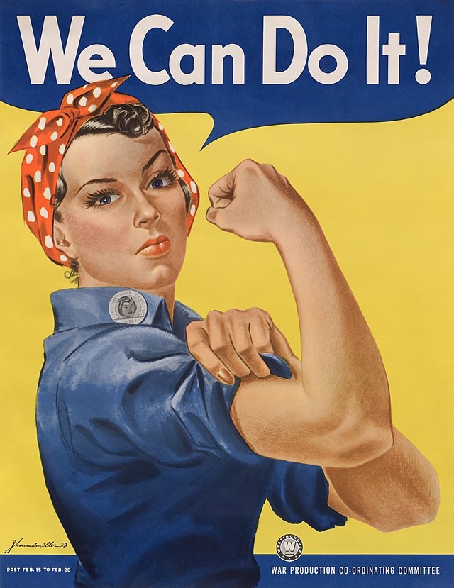
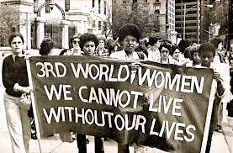
Introduction
Feminism war imperialism education were led by the movements and ideologists.
They had an aim of defining and establishing equal political, cultural and economic rights for all women in the United States.
The imperialism had a great influence on politics of American culture and happened in about four waves.
The education that was being aired had many goals but later on the leaders that were influencing the policies decided to have a focus on the rights of women to vote.
Notes:
The education was started by a small group with an aim of protecting the rights of women and also promoting equality. Feminism war imperialism education were led by the movements and ideologists. They had an aim of defining and establishing equal political, cultural and economic rights for all women in the United States. The imperialism had a great influence on politics of American culture and happened in about four waves. The education that was being aired had many goals but later on the leaders that were influencing the policies decided to have a focus on the rights of women to vote. The presentation will show how the education impacted United States.

Slide 3
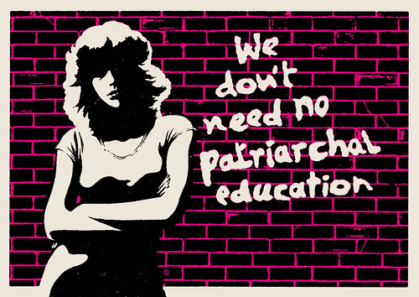
Impact of Feminism war imperialism education to America
The feminist movements helped in bringing a change in the western culture especially for the suffering that women were undergoing in education.
After the education, there was an increase in the pay to women, right to start a divorce processes or even the right to have some property.
The feminists also helped in the understanding that education is a form of socialization that helps in driving patriarchy roles.
The ideas and education focused on males and females but mainly on the females.
Notes:
Feminism education opened the doors to fighting for the rights of the American people. The feminist movements helped in bringing a change in the western culture especially for the suffering that women were undergoing in education. After the education, there was an increase in the pay to women, right to start a divorce processes or even the right to have some property. The feminists also helped in the understanding that education is a form of socialization that helps in driving patriarchy roles. The ideas and education focused on males and females but mainly on the females.

Slide 4
Reaction of Americans to Feminism war imperialism education
There were mixed reactions on the step of imperial education to all people in the society.
There were some negative perceptions in the feminism society where it is believed that there was an increase of promiscuity among all women.
B prinkley says “ Feminism although was underrated helped in forming a basis for the development of rules for people” (Brinkley 39)
Many women were also going against the concept of marriage and also raising some questions on abortion of even the pills they were taking.
The most important bill that was established was that of women such that the society is able to treat all people equally.
Notes:
There were mixed reactions on the step of imperial education to all people in the society. There were some negative perceptions in the feminism society where it is believed that there was an increase of promiscuity among all women. B prinkley says “ Feminism although was underrated helped in forming a basis for the development of rules for people” Many women were also going against the concept of marriage and also raising some questions on abortion of even the pills they were taking. The most important bill that was established was that of women such that the society is able to treat all people equally.

Slide 5
Role of Feminism war imperialism education to America
One of the greatest impacts of imperialism on feminism war was in the right to vote.
The right to vote ensured they had a say in the society and also led to an increase in women that had political offices.
There was also good upholding of the human rights because equality was promoted.
The author says“ America is a nation of almost unparalleled diversity, I think. And as we certainly are aware today, with our present battles on multiculturalism, the task of melding a single nation out of all of the component parts of the American people is a very difficult one and, I would argue, an unfinished one ” (Brinkley 67)
Feminism had some shortcomings because men and women are different in physical beings and ability and thus equality may not be achieved.
Notes:
One of the greatest impacts of imperialism on feminism war was in the right to vote. The right to vote ensured they had a say in the society and also led to an increase in women that had political offices. The author says "America is a nation of almost unparalleled diversity, I think. And as we certainly are aware today, with our present battles on multiculturalism, the task of melding a single nation out of all of the component parts of the American people is a very difficult one and, I would argue, an unfinished one”. There was also good upholding of the human rights because equality was promoted. Feminism had some shortcomings because men and women are different in physical beings and ability and thus equality may not be achieved.
Feminists took everything too far.

Slide 6
Personal effect of Feminism war imperialism education
The education contributed greatly to the equal rights being experienced in the country today.
I have some many empowered women that have had a significant impact on my life and thus it is very important to me.
There is also so much peace because of the respect that genders have for one another and thus living together is easy.
I am happy that women can be helped in roles that were meant for men like having a contribution to the child care or even the domestic labor.
Notes:
I personally believe that feminism war imperialism had a positive impact to my life as I continue to uphold great rights and privileges. The education contributed greatly to the equal rights being experienced in the country today. I have some many empowered women that have had a significant impact on my life and thus it is very important to me. There is also so much peace because of the respect that genders have for one another and thus living together is easy. I am happy that women can be helped in roles that were meant for men like having a contribution to the child care or even the domestic labor.

Slide 7
Work Cited
Brinkley, Alan, John Michael Giggie, and Andrew Huebner. The unfinished nation: A concise history of the American people. McGraw-Hill, 1993.

