Slide 1
Proposed solutions to the U.S. Correctional System Failures in Facilitating Family Values among Incarcerated Parents
Student’s name
Institution affiliation
Course
Instructor
Due date

Slide 2
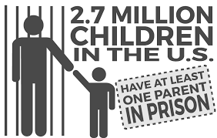
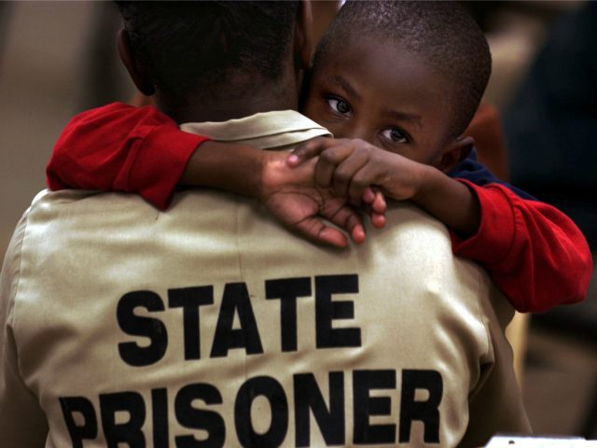
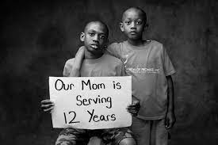
Proposed solutions to the U.S. Correctional System Failures in Facilitating Family Values among Incarcerated Parents
OVERVIEW
Aim
Introduction
Background
Statement of Research Problem
Scope
Method/ A approaches
Proposed Solutions
Conclusion

Slide 3
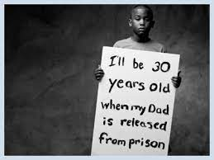
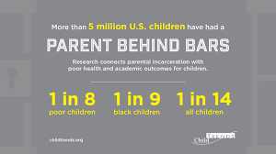
Aim
The aim is to investigate and correct the gaps of the correctional system to provide and maintain family ties and values when parents are incarcerated.
Introduction
The immediate implication of the incarceration of a parent is the social stigma, shame, weakened ties to the parent, poor performance in school, and loss of financial, social, and emotional support from the parent. It is crucial that correctional systems find a method to ensure this gap left by an incarcerated parent is filled and family ties and values and maintained.
Background
Previous research indicates that the U.S. correctional system has implemented social programs for incarcerated parents. The institutions have implemented social programs and initiatives to allow adults sufficient access with their family members.
Notes:
About me
Topic:
Introduction: There is a need to ensure the protection of these children from abuse and neglect.
Background: . It is worth noting that the practice has been crucial in stabilizing the bond between parents close persons. However, the literature does not indicate any initiative for allowing imprisoned persons to interact with their children to enhance critical family values (Kjellstrand et al., 2018).

Slide 4
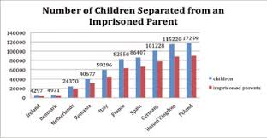
Statement of Research Problem
The U.S. correctional system must ensure that convicted persons serve their sentences as directed by the court. The agency is mandated to ensure that jailed individuals leave the institution as productive community members (Kjellstrand et al., 2019).
Scope
This research will include several key stakeholders of the U.S. correctional system. . It will cover the practical feasibility of implementing social programs that allow convicted persons with children sufficient family time (Charles et al., 2019). The initiatives would contrast with conventional visiting practices that offer limited interaction time between inmates and their visitors.
Methods/approach
In essence, the research methodology will include an integrated approach to data collection for the target population. It will include a qualitative research design that measures the satisfaction levels of incarcerated parents when meeting their loved ones (DeGruy et al., 2012).
Notes:
Statement of Research Problem: Therefore, this statutory institution's role is to ensure that incarcerated parents have sufficient time and resources to accomplish their family duties through improved social programs with loved ones.
Scope: This scope of research will be useful in developing fundamental conclusions and recommendations for improved efficiency of the institution.
Methods/Approach:). In this context, the participants will facilitate information required for reforming existing practices associated with family visits. This approach will be useful in attaining the relevance, applicability, and consistency of practices in the U.S. correctional system.

Slide 5
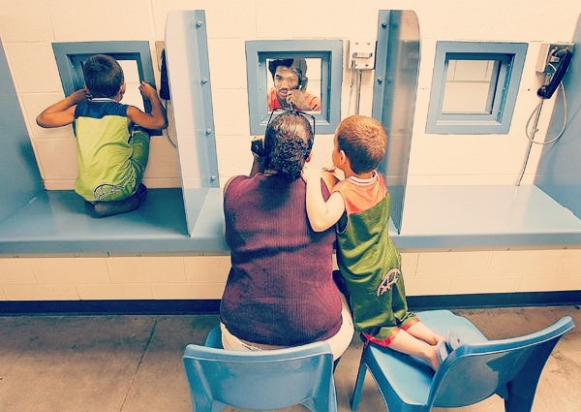
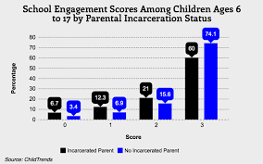
Proposed solution
The institution can develop exchange programs that allow imprisoned persons to engage in parental duties similar to home.
The proposed solution entails allocating more time and resources to implement an initiative that allows incarcerated parents to interact with their children.
Another measure that can be taken is to ensure young children below the age of ten are allocated more time to familiarize themselves and bond with parents.
Conclusion
The gap identified for this research is fundamental in enhancing progressive societies in modern times. Family values enable the peaceful re-integration of imprisoned persons with the public once released.
Notes:
Proposed Solution: This is a critical stage of child-parent bonding and affects the adult relationship. Therefore, these important bonding stages must be maintained.
Conclusion:. The traits also allow convicted persons to focus on vital issues entailing parental roles and responsibilities to children.
Consequently, the U.S. correctional system should be objective in aiding incarcerated parents with sufficient family time in specialized programs.

Slide 6
REferences
Charles, P., Muentner, L., & Kjellstrand, J. (2019). Parenting and incarceration: Perspectives on father-child involvement during reentry from prison. Social Service Review, 93(2), 218-261. https://doi.org/10.1086/703446
DeGruy, J., Kjellstrand, J. M., Briggs, H. E., & Brennan, E. M. (2012). Racial respect and racial socialization as protective factors for African American male youth. Journal of Black Psychology, 38(4), 395-420. https://doi.org/10.1177/0095798411429744
Kjellstrand, J. M., Reinke, W. M., & Eddy, J. M. (2018). Children of incarcerated parents: Development of externalizing behaviors across adolescence. Children and Youth Services Review, 94, 628-635. https://doi.org/10.1016/j.childyouth.2018.09.003
Kjellstrand, J., Yu, G., & Eddy, J. M. (2019). Parental incarceration as a predictor of developmental trajectories of externalizing behaviors across adolescence. Children and Youth Services Review, 103, 10-17. https://doi.org/10.1016/j.childyouth.2019.05.016
Kjellstrand, J., Yu, G., Eddy, J. M., & Clark, M. (2020). Children with incarcerated parents and developmental trajectories of internalizing problems across adolescence. American Journal of Criminal Justice, 45(1), 48-69. https://doi.org/10.1007/s12103-019-09494-4
Notes:
References
Charles, P., Muentner, L., & Kjellstrand, J. (2019). Parenting and incarceration: Perspectives on father-child involvement during reentry from prison. Social Service Review, 93(2), 218-261. https://doi.org/10.1086/703446
DeGruy, J., Kjellstrand, J. M., Briggs, H. E., & Brennan, E. M. (2012). Racial respect and racial socialization as protective factors for African American male youth. Journal of Black Psychology, 38(4), 395-420. https://doi.org/10.1177/0095798411429744
Kjellstrand, J. M., Reinke, W. M., & Eddy, J. M. (2018). Children of incarcerated parents: Development of externalizing behaviors across adolescence. Children and Youth Services Review, 94, 628-635. https://doi.org/10.1016/j.childyouth.2018.09.003
Kjellstrand, J., Yu, G., & Eddy, J. M. (2019). Parental incarceration as a predictor of developmental trajectories of externalizing behaviors across adolescence. Children and Youth Services Review, 103, 10-17. https://doi.org/10.1016/j.childyouth.2019.05.016
Kjellstrand, J., Yu, G., Eddy, J. M., & Clark, M. (2020). Children with incarcerated parents and developmental trajectories of internalizing problems across adolescence. American Journal of Criminal Justice, 45(1), 48-69. https://doi.org/10.1007/s12103-019-09494-4

